Slide 1


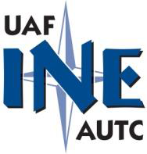

2014 Alaska Concrete Summit
Dena’ina Center - Anchorage, Alaska
November 25, 2014
LEED Update;
& other important happenings…
And the ALASKA CONCRETE ALLIANCE

Slide 2


Slide 3
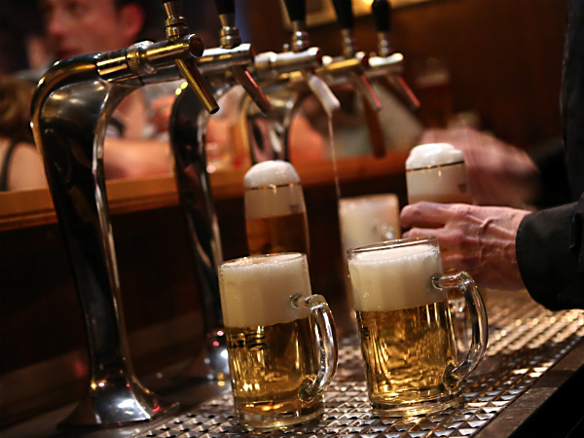
Notes:
The U.S. Green Building Council (USGBC) is the nation’s foremost coalition of leaders from across the building industry.
Industry-led and consensus-driven, the Council is as diverse as the marketplace it serves. Membership includes building owners and end-users, real estate developers, facility managers, architects, designers, engineers, general contractors, subcontractors, product and building system manufacturers, government agencies, and nonprofits. Leaders from within each of these sectors participate in the development of the LEED Rating Systems and the direction of the Council through volunteer service on USGBC’s open committees.

Slide 5
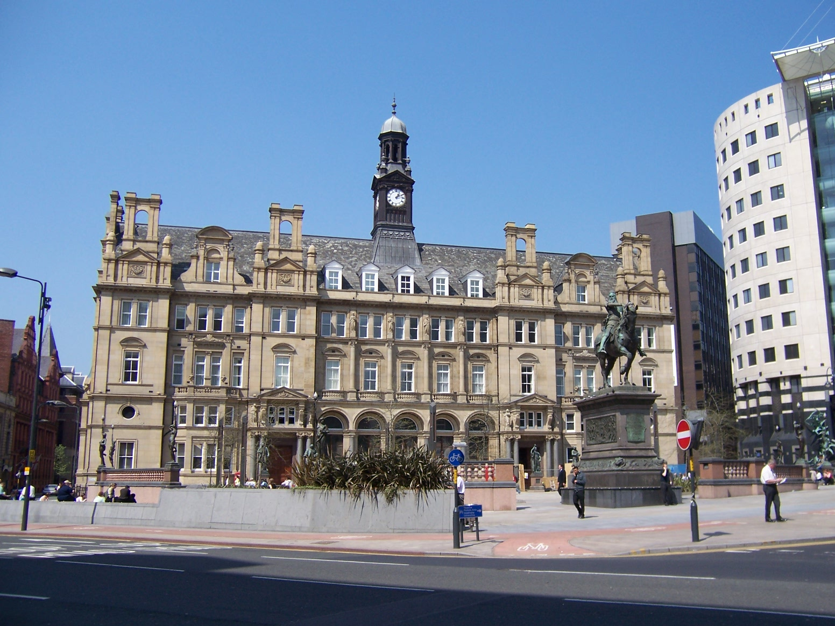
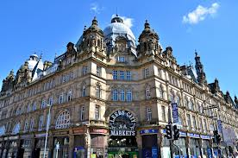
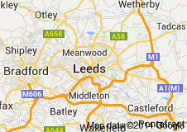
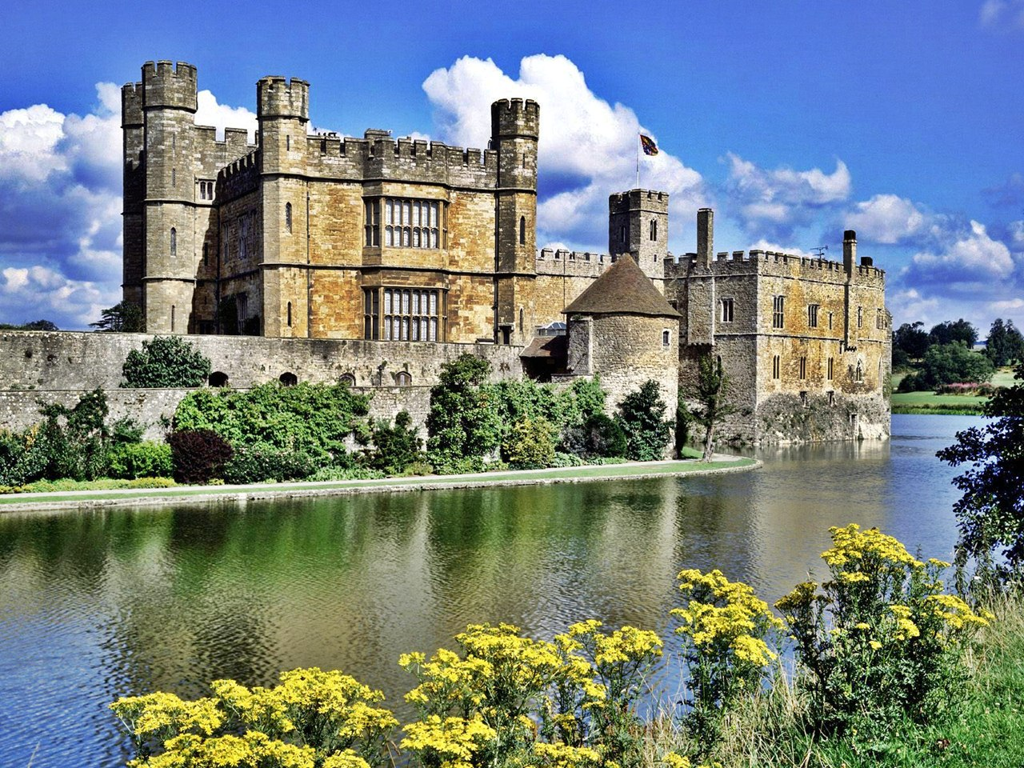
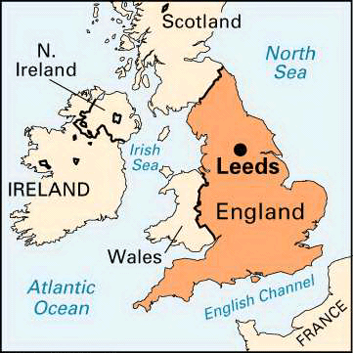
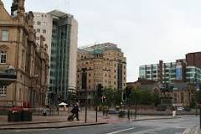
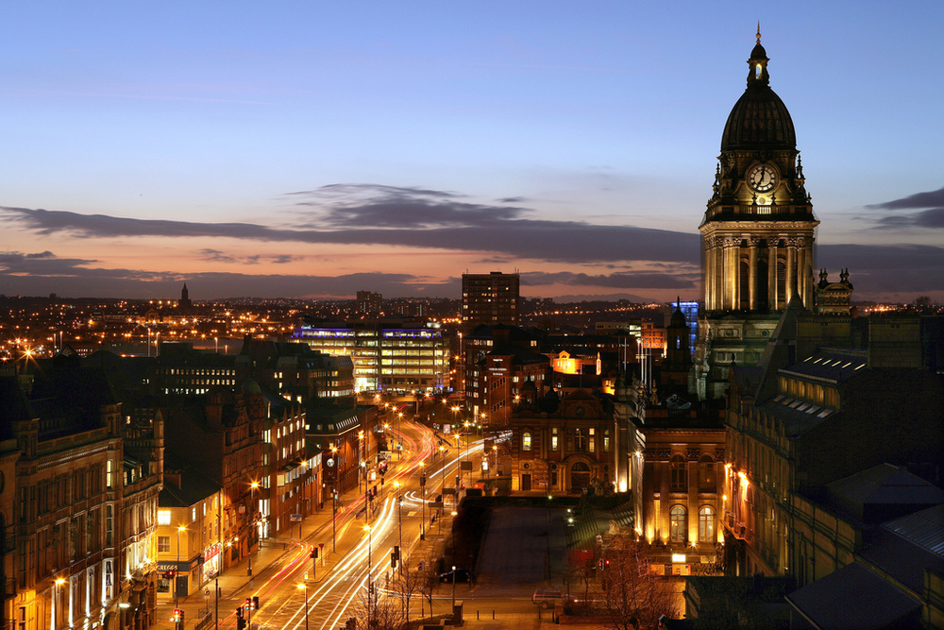
‘LEED’ not Leeds
Leeds is a city in West Yorkshire, England.

Slide 6
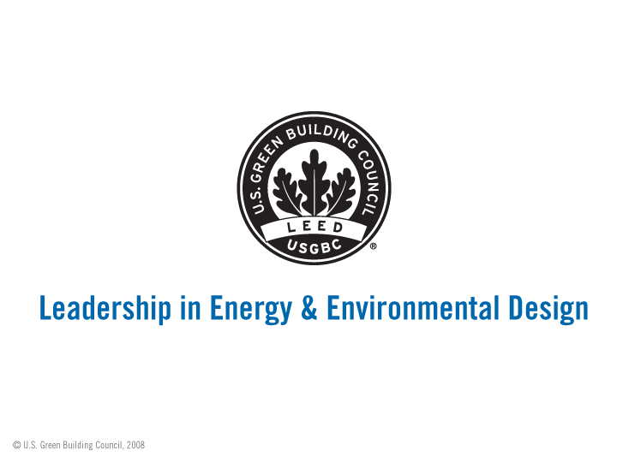

Slide 7
LEED:
building certification program that recognizes best-in-class building strategies and practices.
To receive LEED certification, building projects satisfy prerequisites and earn points to achieve different levels of certification. Prerequisites and credits differ for each rating system, and teams choose the best fit for their project.

Slide 8


Slide 9


Slide 10
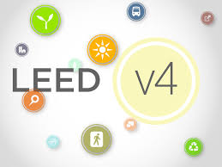

Slide 11
http://www.usgbc.org/leed/v4/

Slide 12
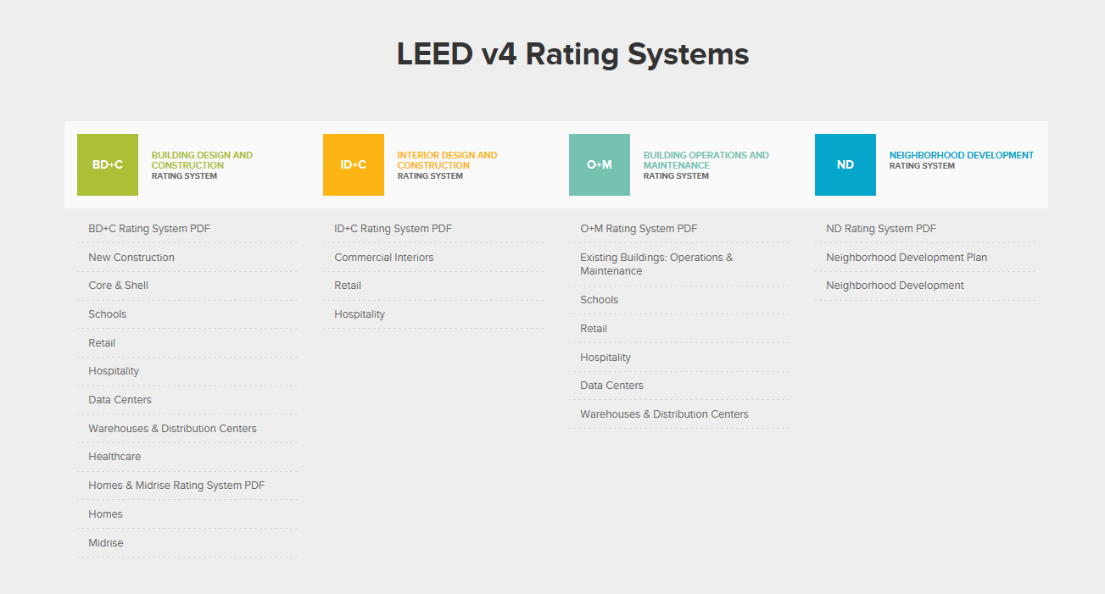

Slide 13

Each rating system is made up of a combination of credit categories.
Within each of the credit categories, there are specific prerequisites projects must satisfy and a variety of credits projects can pursue to earn points. The number of points the project earns determines its level of LEED certification.

Slide 14
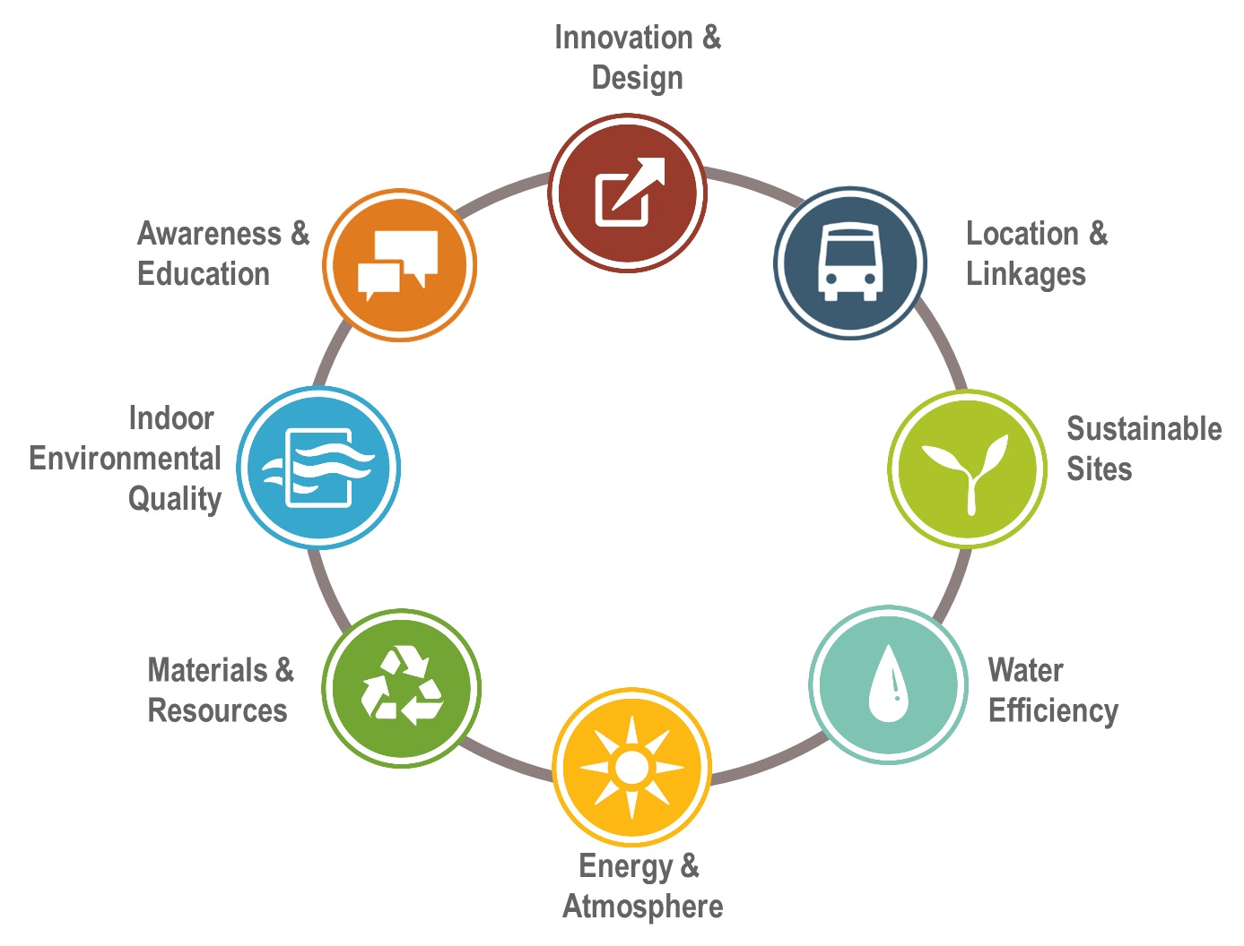

Slide 15
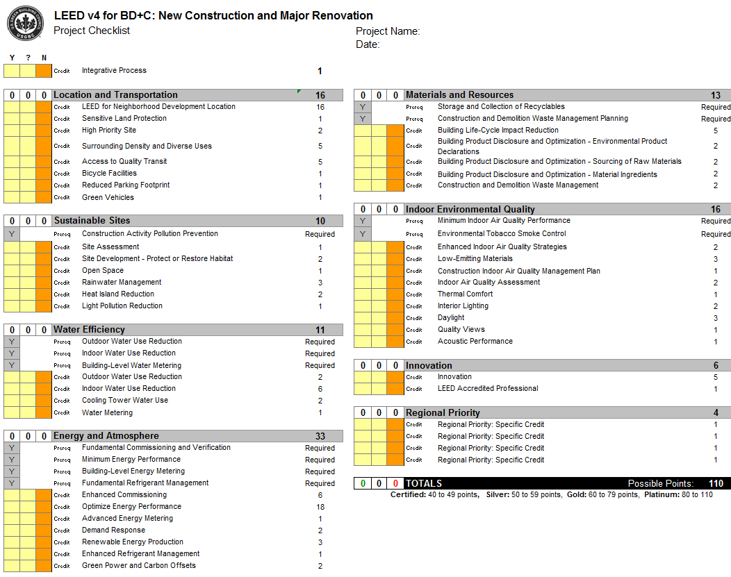

Slide 16
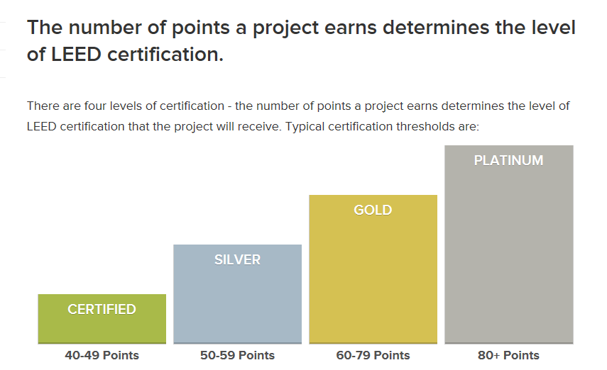

Slide 17
Materials and Resources
This credit category encourages the use of sustainable building materials and reducing waste on site, and has arguably been changed the most for v4. The new credits include “Building Life-Cycle Impact Reduction” and “Building Product Disclosure and Optimization.”
The Building Life-Cycle Impact Reduction credit encourages reuse and lessens the building’s environmental impact. There are four options for a project to achieve: historic building reuse, renovation of abandoned or blighted buildings, building and material reuse or a whole-building life-cycle assessment.
The Building Product Disclosure and Optimization credit encourages projects to use materials that have a limited environmental impact through their lifetimes.
This gives a more comprehensive view of the material’s sustainability and incentivizes product manufacturers to be more transparent on what ingredients and processes they use.

Slide 18
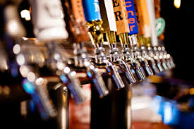
Notes:
A powerful network of fourteen branches in Alaska, British Columbia, Washington and Oregon. The Cascadia Green Bldg is part of the The most extensive green building network in North America.
Each of our communities is shaped by its own unique ecosystem and by its resources, history, character and culture. Our branches push the green building movement’s boundaries in each locale through targeted and locally relevant programming and professional development.
Alaska
Anchorage and Mat-Su Satellite, Fairbanks Satellite, Juneau Satellite
British Columbia
Metro Vancouver, Vancouver Island (Victoria), Thompson Okanagan (Kelowna), Kootentay Rockies (Nelson)
Washington
Seattle, Seattle Eastside (Bellevue/Redmond), Tacoma/Olympia, Inland (Spokane), SnoLEAF (North Puget Sound), NW Washington (Bellingham)
Oregon
Portland, Eugene, High Desert (Bend), Klamath Falls

Slide 19
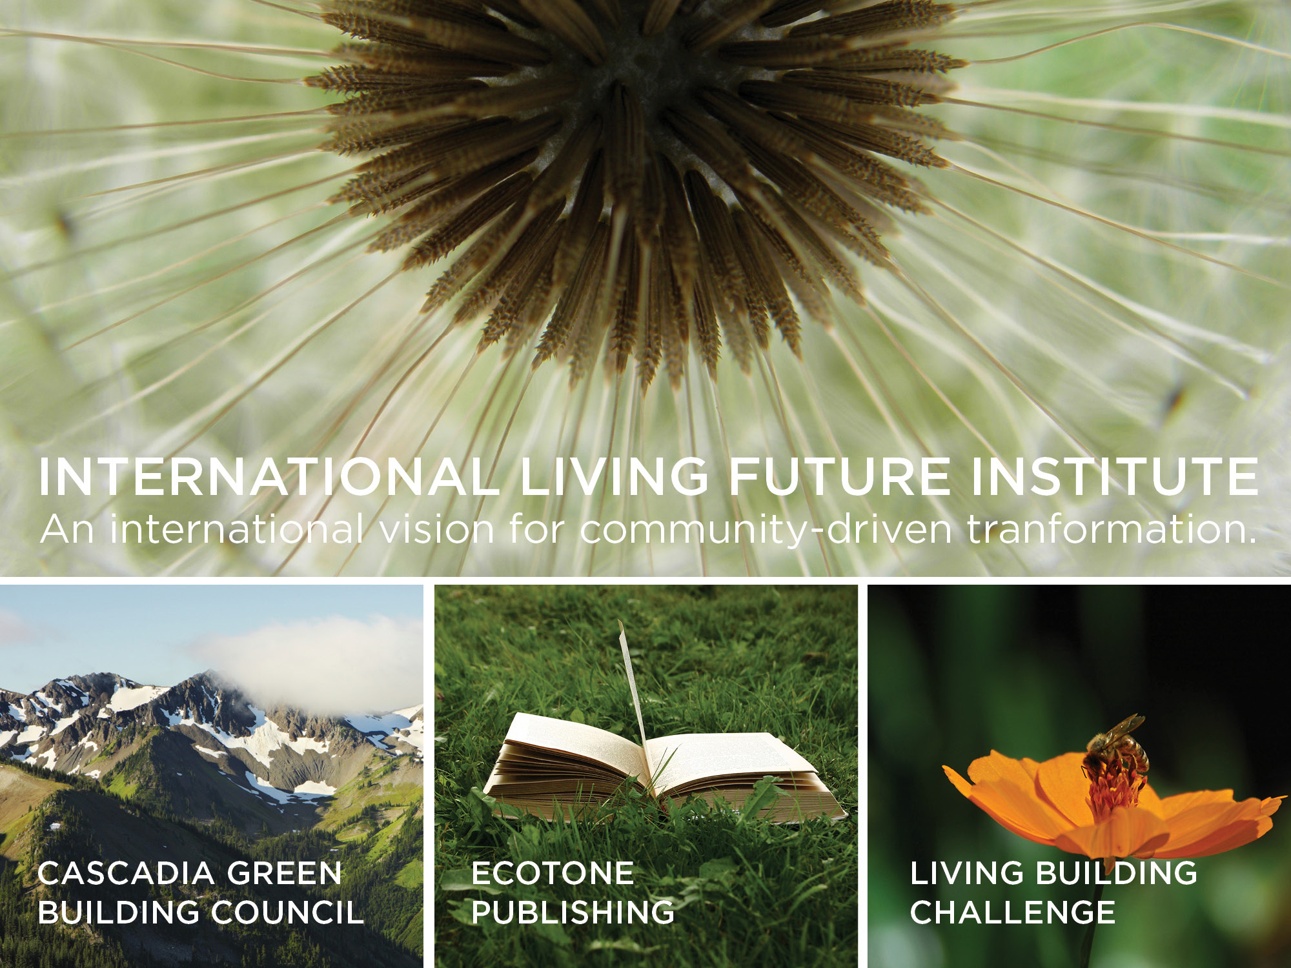
© 2013 Int’l Living Future Institute
www.livingbuildingchallenge.org
Notes:
Cascadia is also a program of the International Living Future Institute and as such we help set the global vision for transformation toward true sustainability.
Wearing all of those hats, we support place-based solutions while pursuing our mission to lead a transformation toward a built environment that is socially just, culturally rich and ecologically restorative.
Ultimately, through our programs, we view our role at the Institute as one to create a model for what the future could be.
This is the kind of stuff that gets me out of bed in the morning!!
AGENDA - The focus of my lecture today will be on:
community-driven transformation through the lens of the Living Building Challenge
how the Challenge provides a visionary path for achieving our mission and vision
where that intersects with ‘sustainable communities’ or more importantly ‘resilient communities’
I’ll start with a brief, high level overview of the Living Bldg Challenge to give you some background and context, as well as an idea of the requirements for projects choosing to participate in the program.
I’ll share an inspiring video
I’ll talk about our Living City Design Competition
And how our work around Scaling the Living Building Challenge project is designed to tap into the enthusiasm generated by the Living Building Challenge and the design competition and help cities transform these visionary efforts into practical, leverage-able and transferrable solutions.

Slide 20
http://living-future.org/

Slide 21
Rooted in the Region. Reaching toward a Living Future.
Notes:
Our mission is to lead a transformation toward a built environment that is socially just, culturally rich and ecologically restorative.
Cascadia GBC is a program of the International Living Future Institute. We help set the global vision for the transformation toward true sustainability, even as we support the place-based solutions that will bring us to the future we hope for, not the tomorrow we fear.
A proud chapter of the United States Green Building Council and Canada Green Building Council. We’ve been actively promoting and supporting LEED® since our founding in 1999, and we continue to do so by educating practitioners and defending the integrity of this extremely important and influential standard.
Cascadia is also a program of the International Living Future Institute and as such we help set the global vision for transformation toward true sustainability.

Slide 22
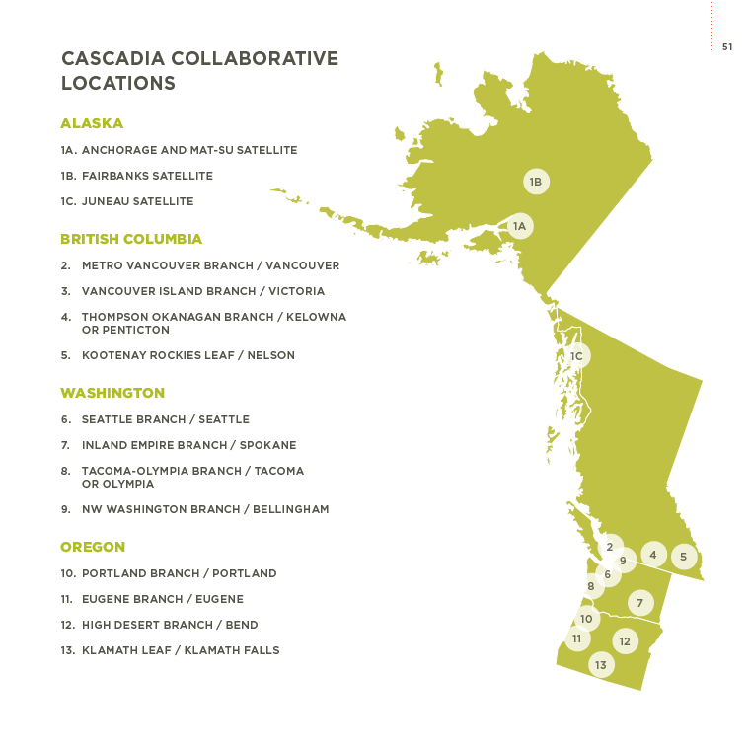
Notes:
A powerful network of fourteen branches in Alaska, British Columbia, Washington and Oregon. The Cascadia Green Bldg is part of the The most extensive green building network in North America.
Each of our communities is shaped by its own unique ecosystem and by its resources, history, character and culture. Our branches push the green building movement’s boundaries in each locale through targeted and locally relevant programming and professional development.
Alaska
Anchorage and Mat-Su Satellite, Fairbanks Satellite, Juneau Satellite
British Columbia
Metro Vancouver, Vancouver Island (Victoria), Thompson Okanagan (Kelowna), Kootentay Rockies (Nelson)
Washington
Seattle, Seattle Eastside (Bellevue/Redmond), Tacoma/Olympia, Inland (Spokane), SnoLEAF (North Puget Sound), NW Washington (Bellingham)
Oregon
Portland, Eugene, High Desert (Bend), Klamath Falls

Slide 23
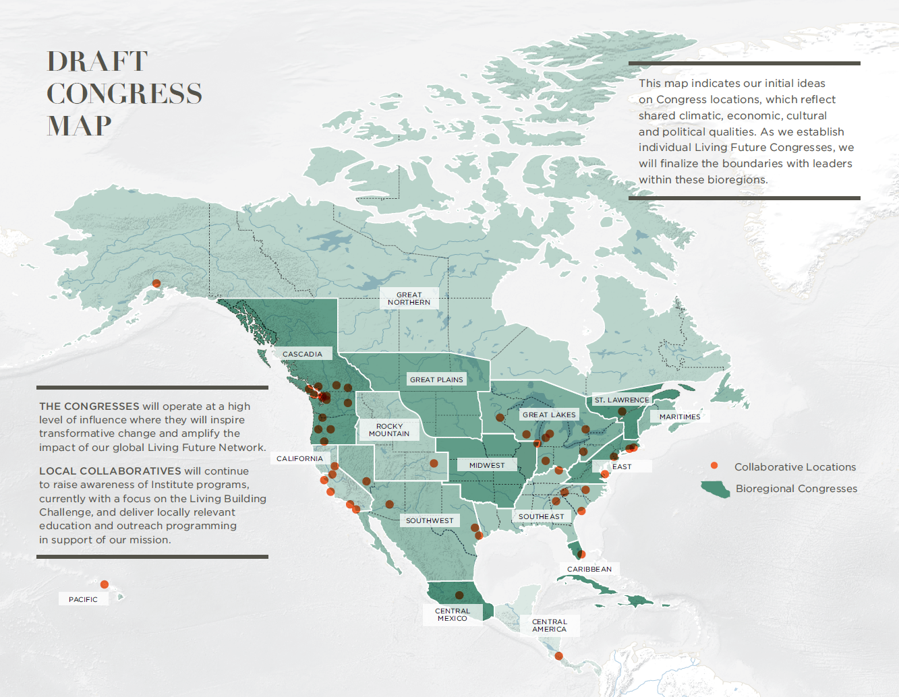

Slide 24
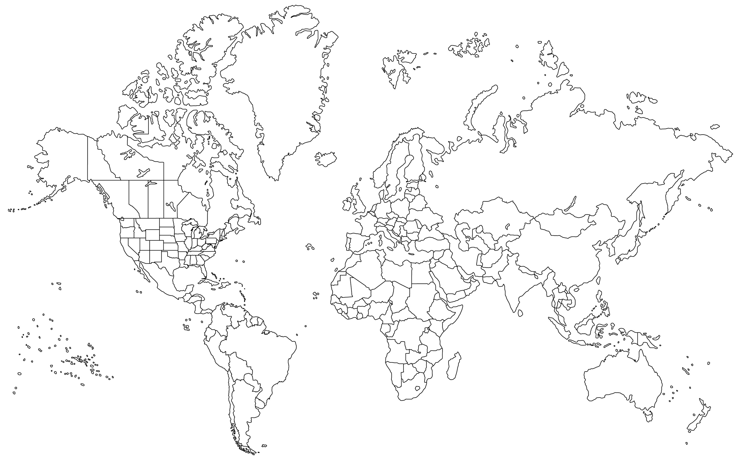
sweden
Canada
uk
Denmark
irelanD
Czech Republic
france
romania
usa
italy
lebanon
mexico
haiti
egypt
india
Costa rica
aruba
Colombia
brazil
Key:
Active institutes
Registered projects
Ambassadors
australia
New zealand
International impact
© 2013 Int’l Living Future Institute
www.livingbuildingchallenge.org
Notes:
The organization’s international impact has also grown.
Currently:
ORANGE = countries with a Living Future Institute (+ Collaborative + Registered Projects)- US, Canada, Ireland and Australia.
GREEN = Countries with at least one registered project. There are currently 10 countries with active projects.
BLUE = Countries with at least one Ambassador and/or Collaborative

Slide 25

Notes:
Now, close you eyes if you need to, but I want you to imagine…
Imagine
a building designed and constructed to function as elegantly and efficiently as a flower.
Imagine
true sustainability in our homes, workplaces, neighborhoods, villages, towns and cities.
Imagine
a city block or a college campus sharing resources from building to building.
What if every single act of design and construction made the world a better place?

Slide 26
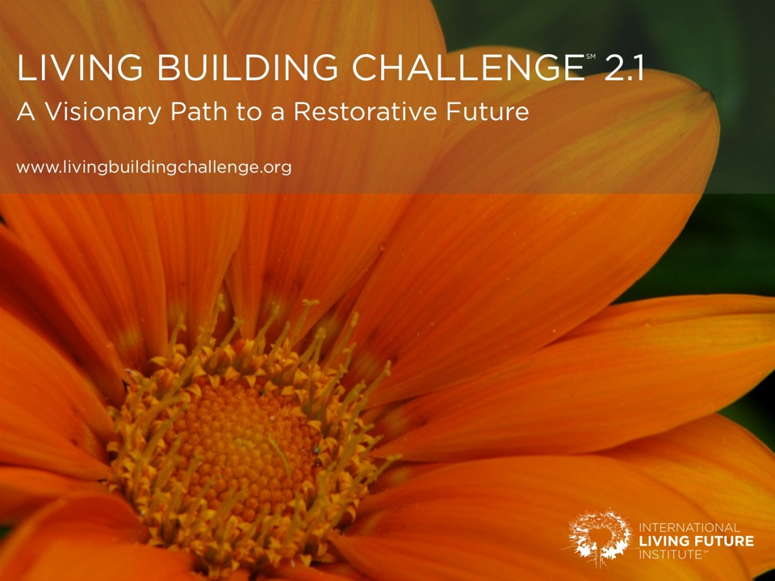
Notes:
Now, close you eyes if you need to, but I want you to imagine…
Imagine
a building designed and constructed to function as elegantly and efficiently as a flower.
Imagine
true sustainability in our homes, workplaces, neighborhoods, villages, towns and cities.
Imagine
a city block or a college campus sharing resources from building to building.
What if every single act of design and construction made the world a better place?

Slide 27
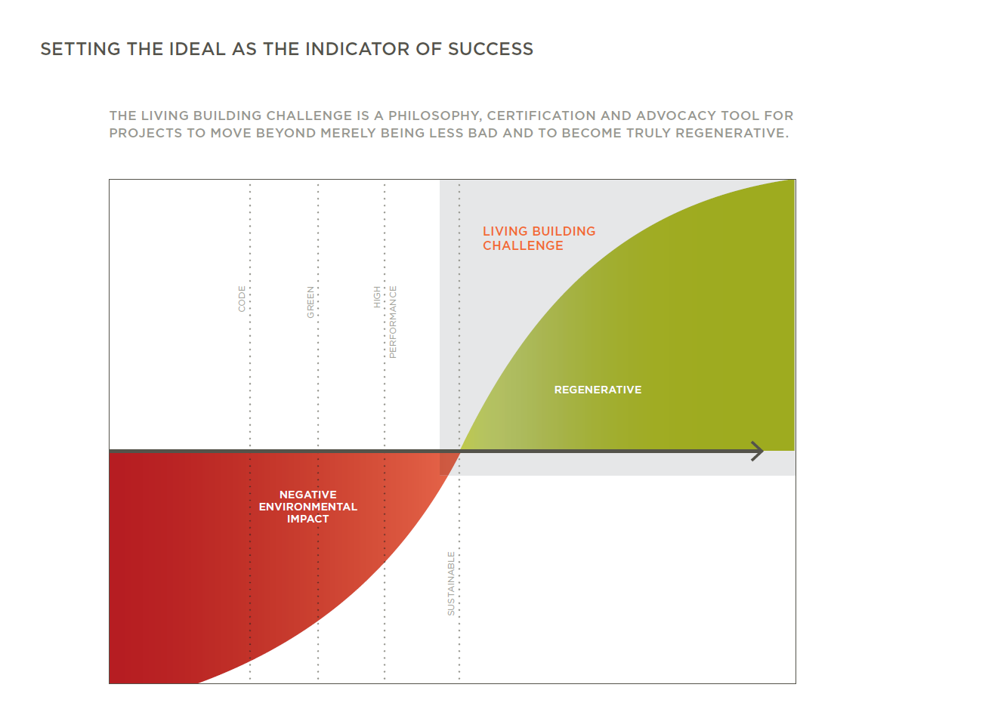
Notes:
True sustainability is embedded within the Challenge.
No negative impact is actually the floor. The program defines a baseline – albeit an elevated one – for all current development.
It is based on a co-evolving relationship with the natural world - Restorative first and at its best, regenerative is the goal.

Slide 28
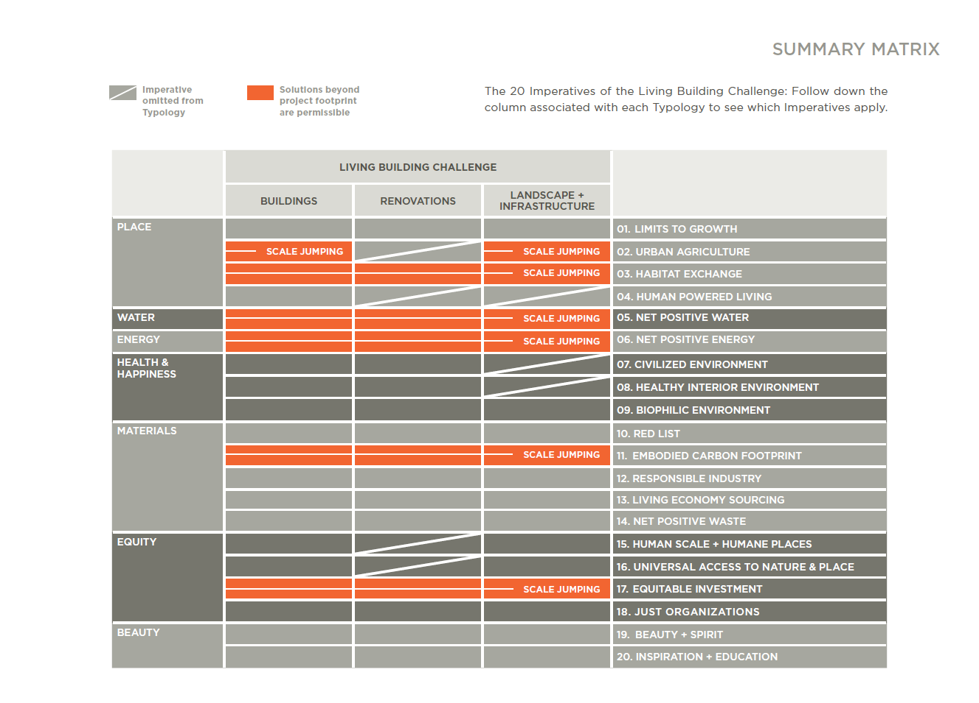

Slide 29
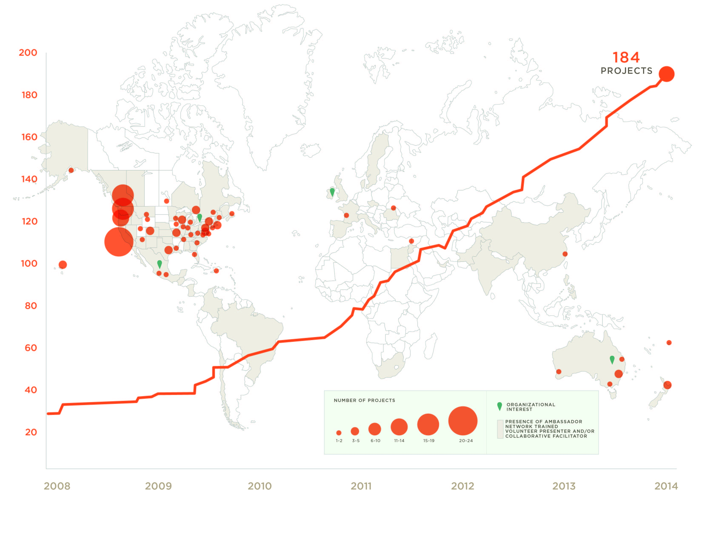
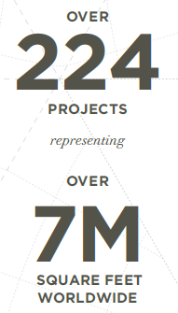
Global Registered Project Map
© 2013 Int’l Living Future Institute
www.livingbuildingchallenge.org
Notes:
We currently have over 110 projects registered in the US, largely in the Cascadia region (home of the Living Building Challenge) but now growing steadily across the country. There are now registered projects in 33 us states.
Globally, there are over 140 registered projects in 10 countries, including the US, Canada, Mexico, Haiti, Lebanon, France, Romania, Australia and New Zealand

Slide 30
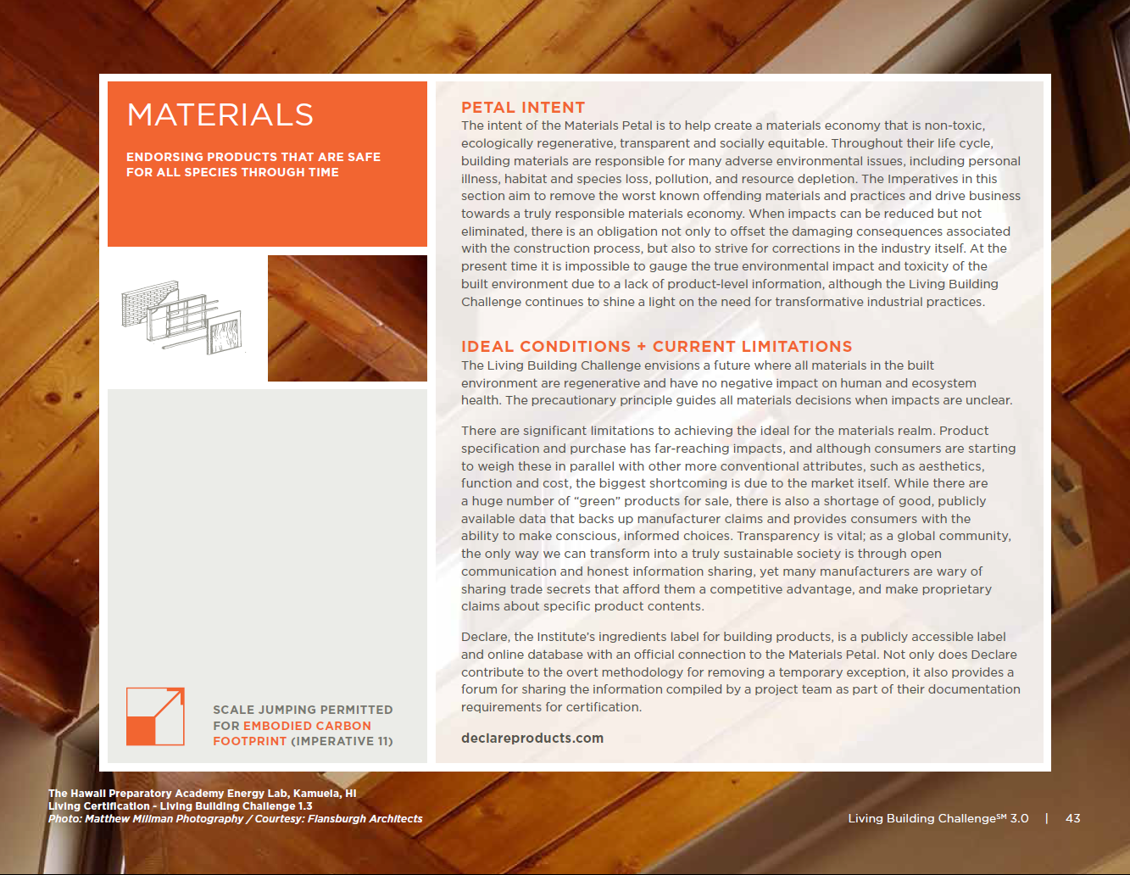
Notes:
Material selection has the most far-reaching and broad impacts on design, construction, and occupancy. It deeply influences – and is influenced by – each of the other Petals in Living Building Challenge. It is unsurprising, then, that the Materials Petal has the most Imperatives, and each issue is distinct. There are some program exceptions that play off the clear synergies between some of the requirements to reinforce the priorities of Living Building Challenge.
The Precautionary Principle is the underlying theme that defines this category, and defines the suggested method for decision making. It poses that “if an action or policy might cause severe or irreversible harm to the public or to the environment, in the absence of a scientific consensus that harm would not ensue, the burden of proof falls on those who would advocate taking the action.”* In layman’s terms, it is the “better safe than sorry” approach.
(* From http://en.wikipedia.org/wiki/Precautionary_principle)

Slide 31
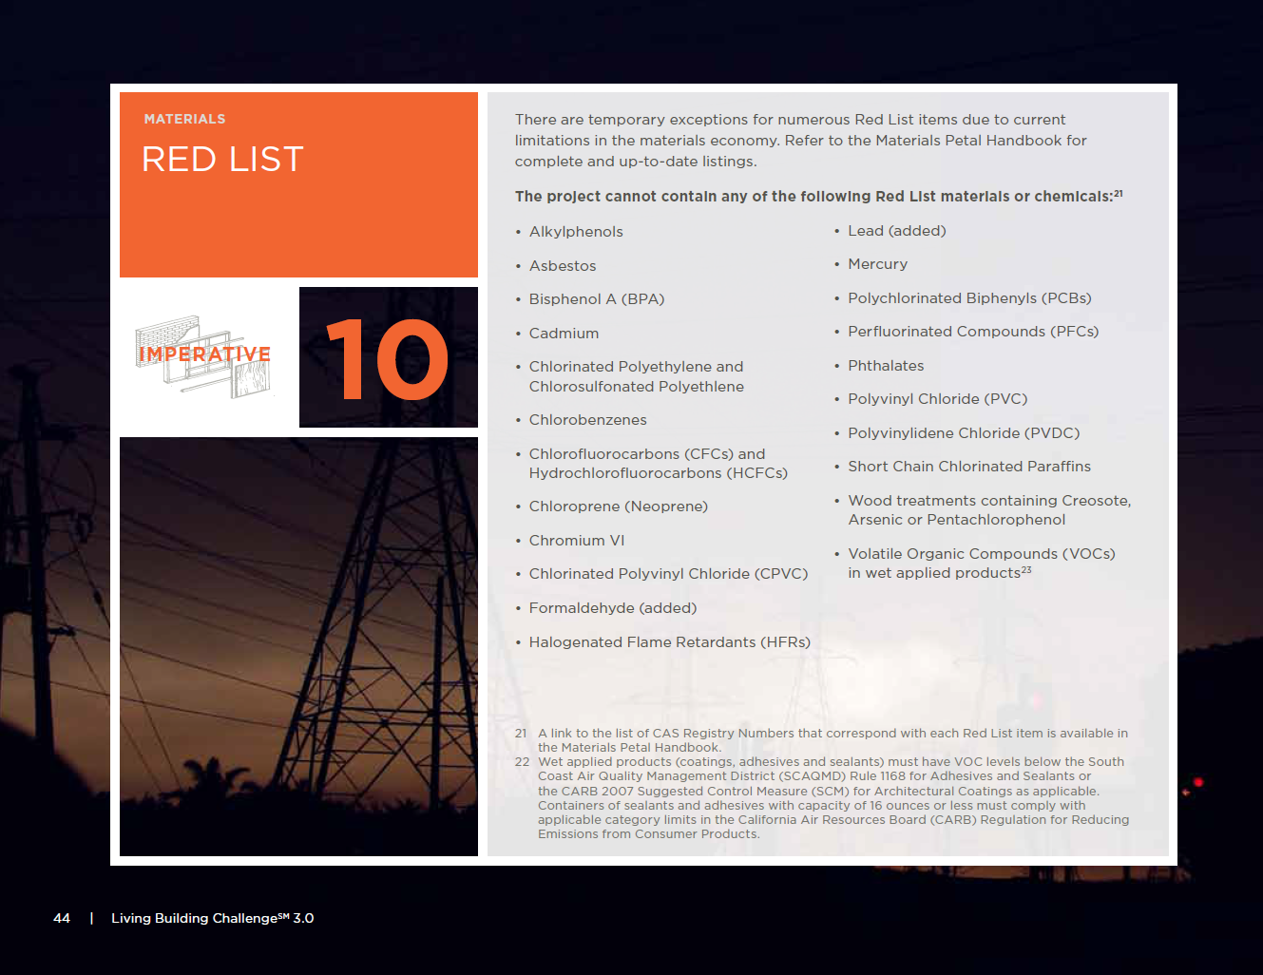
Notes:
(FOR SOME ADDITIONAL INFORMATION ON THE HEALTH ISSUES ASSOCIATED WITH EACH RED LIST ITEM, REFER TO THE ‘RED LIST SAMPLE LETTER’)
The Red List is a perfect case-in-point for the Precautionary Principle. It includes some of the worst in class materials and chemicals that are ubiquitous in the built environment. These are carcinogens, persistent organic pollutants, and reproductive toxicants, many of which are bio-accumulative, meaning that they build up in organisms and the broader environment, often reaching alarmingly high concentrations as they travel up the food chain.

Slide 32
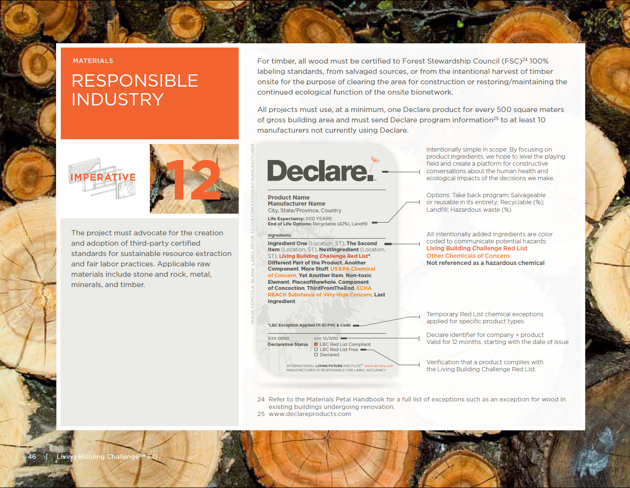
Notes:
The building industry is largely responsible for many of these materials and chemicals in use.
Living Building Challenge recognizes that it is a tall order to eliminate the Red List in all cases due to current market limitations. Because of this, there are several temporary exceptions footnoted in the Standard. As a last resort, the product is allowed to be used. However, when faced with imperfect solutions, project teams must communicate with manufacturers to share expectations about product ingredients. A letter must be sent the manufacturer explaining why the product purchase does not constitute an endorsement – and include a statement that requests that the company stops using the Red List material. The Institute has already seen some great successes as a result of the positive and constructive communication between project teams and manufacturers.

Slide 33
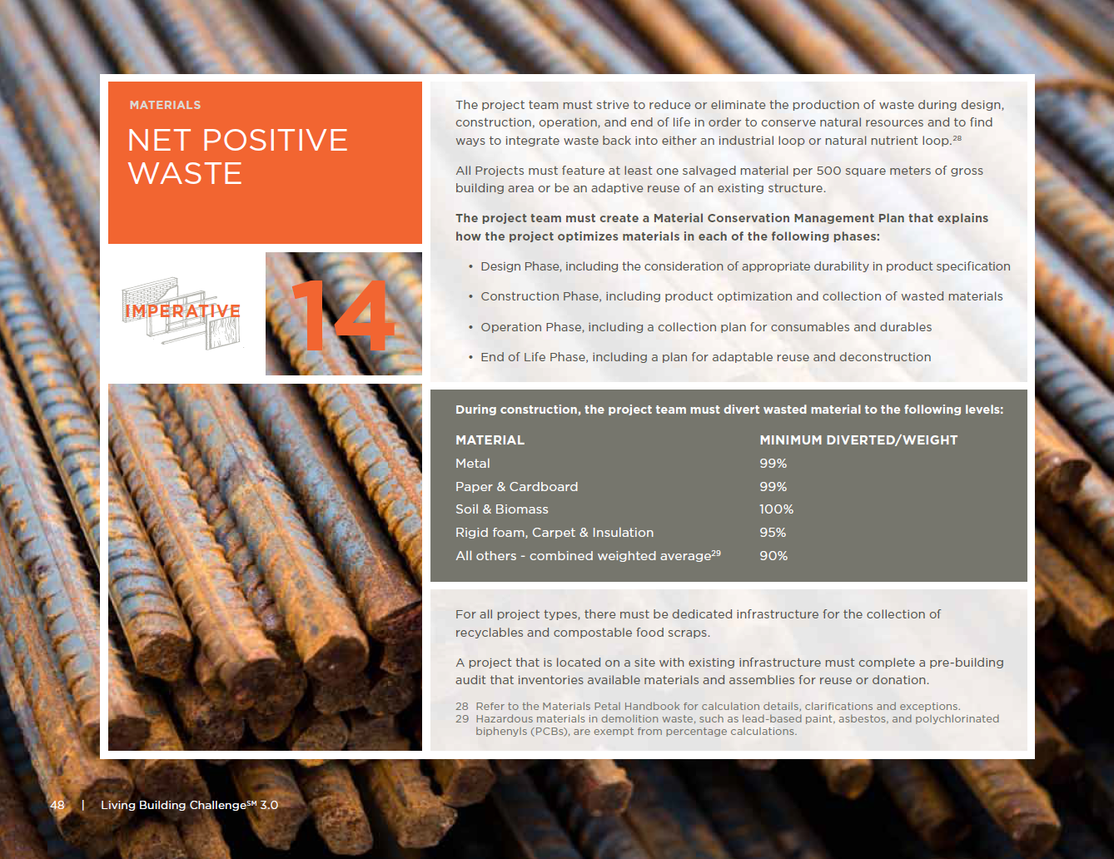
Notes:
An idea can travel around the world, but everything else has limits.
Imperative 14 improves the regional availability of good products and robust knowledge needed to implement restorative principles.

Slide 34
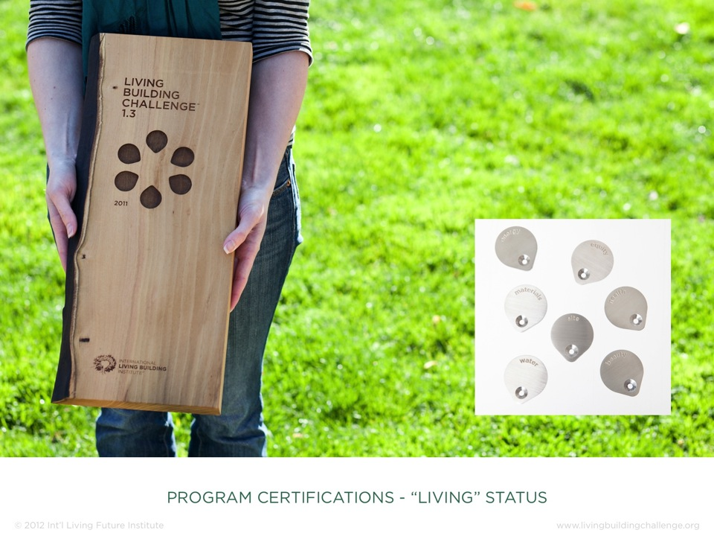
Notes:
As a reminder, there are several paths for certification.
A project can earn “Living” status when it successfully addresses all of the Imperatives of the Living Building Challenge.

Slide 35
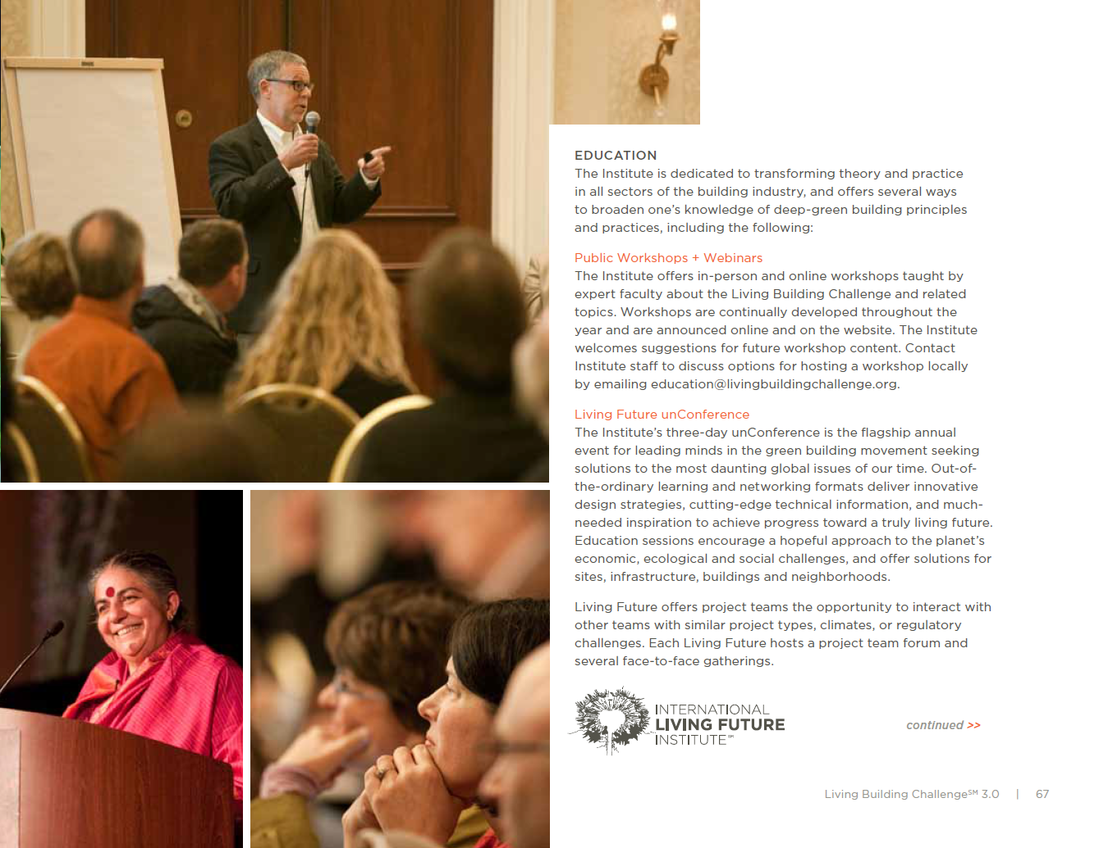
Notes:
This Imperative identifies appropriate sourcing distances for materials and also applies limits to the location of the primary design team. The Zones correlate with product density and function and the MasterFormat classification refers to a product’s primary materials. Heavy materials that typically are used as structural components have the tightest radius. This encourages place-based and climate appropriate solutions for a building’s shell or an Infrastructure project’s most commonly used material. On the opposite side of the spectrum, assemblies that actively contribute to project performance once installed can come from the farthest locations to allow for the most effective and efficient equipment available.
Salvaged products have expanded parameters for Zones 1, 2, and 3, as do remote locations. In addition, teams are allowed to jump a Zone in order to comply with the Red List or Responsible Industry if compliant products are not available within a designated Zone.
Because transparency is a vital element of a sustainable marketplace, teams are allowed to jump a Zone to source a similar product from a manufacturer who publishes product ingredients, when the closer supplier keeps this information secret. Paired with this, teams must write a letter to the manufacturer making "proprietary" claims to let them know why they did not receive the business. This is another instance of Living Building Challenge mirroring as an advocacy tool.

Slide 36
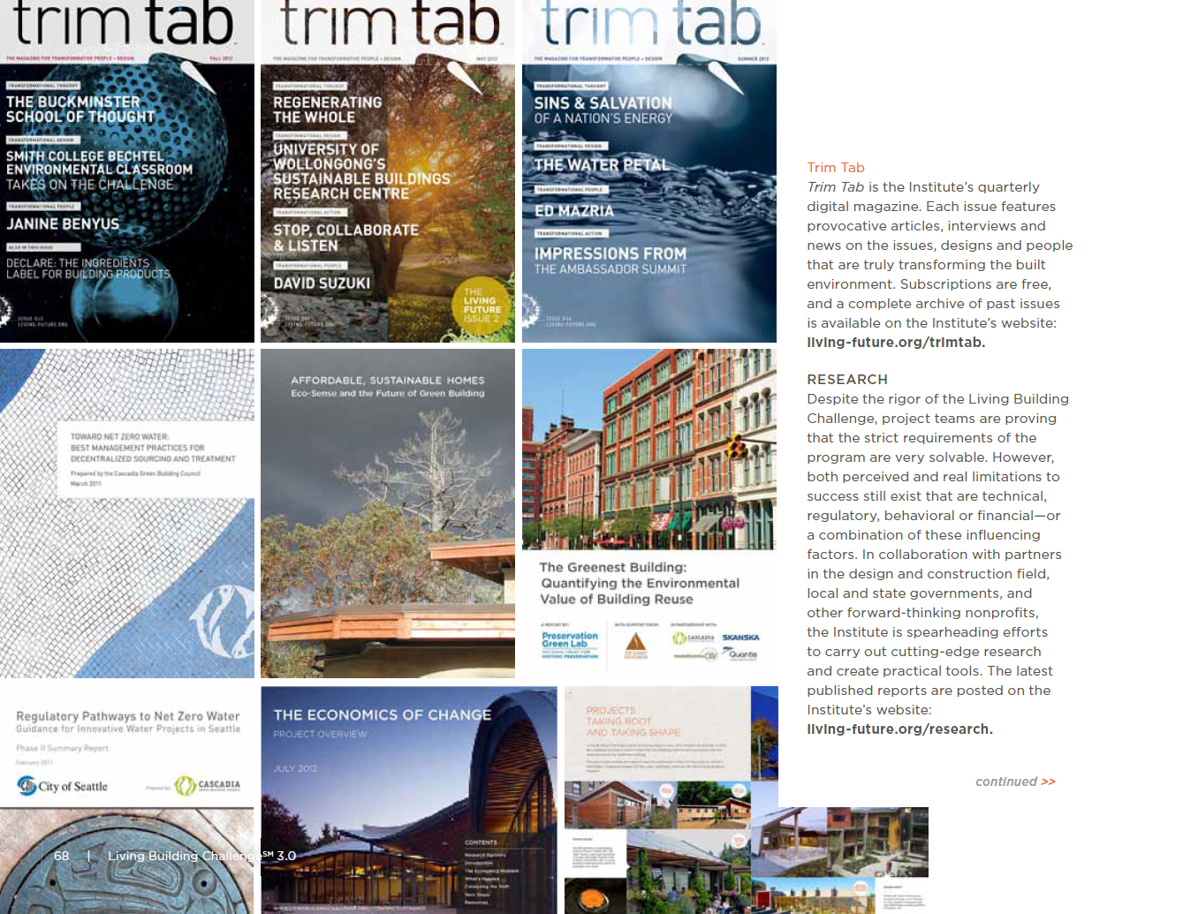
Notes:
In 2003, the US EPA estimated that 170 million tons of building related waste was generated from construction, renovation, and demolition - equal to 3.2 pounds per person per day. The intent of the Conservation + Reuse Imperative is not only to reduce or eliminate material waste, but also to redefine it as a wasted opportunity.
To minimize wasted materials, project teams must consider impacts during the design, construction, operation, and end-of-life phases of a development by developing a Material Conservation Management Plan. In it, teams are encouraged to consider appropriate durability of products. Another focus area is the potential for adaptable reuse of a development to consider how a project can be flexible enough to respond to the needs of the future without getting demolished.

Slide 37

Notes:
Conservation + Reuse also sets stringent levels for material recycling and salvage to deter unnecessary contributions to landfills and to reduce the creation of landfill gases. Gases such as methane, carbon dioxide, hydrogen and volatile organic compounds (VOCs) are created from the waste on site and its degradation over time.
Diversion percentages are based on existing infrastructure that is available for various industry sectors. Although project teams are expected to make every effort to avoid landfill deposits, there is a temporary exception for meeting this level of diversion in jurisdictions where municipalities do not have systems in place to collect all listed construction materials. In this instance, project teams must document that they have communicated with the Authority Having Jurisdiction stipulating that these basic public systems should be created. This also supports the potential for an expanded local industry that can use these materials to create new building products.

Slide 38

Contact Information:
Jason Gamache, AIA, NCARB, LEED AP BD+C
Architect / Associate
Historic Anchorage Train Depot
421 W. 1st Avenue, Suite 300
Anchorage, AK 99501
Phone 907-563-8474 | Fax 907-563-4572
www.mcgalaska.com
Notes:
Declare is an ingredients label for building products that offers answers to three essential questions: What is the product made of? Where was it made? And what will happen to it at the end of its life?
Imperative 11 of the Living Building Challenge: The Red List, addresses the prevalence of building materials and chemicals that pose threats to human health and to the resilience of ecosystems. When attempting to meet this Imperative, many Living Building Challenge project teams have experienced difficulty getting manufacturers to disclose their ingredients.
Declare helps to overcome this barrier by providing an online searchable database of Red List Free and Living Building Challenge compliant building materials. After a manufacturer submits a complete ingredients list to Declare and the company leader responsible for the product signs an agreement declaring that the submittal is accurate, they can be included in the database.
.
Declare is a program of the International Living Future Institute.

