Slide 1
Michael Baker International’s
Alternative Procurement Experience
April 23, 2019

Slide 2
Presentation Overview
1
Alternative Procurement Comparison
2
Utah US-89 Progressive Design Build Experience
3
DOT&PF Horizontal Construction Management General Contractor (CMGC) Experience

Slide 3
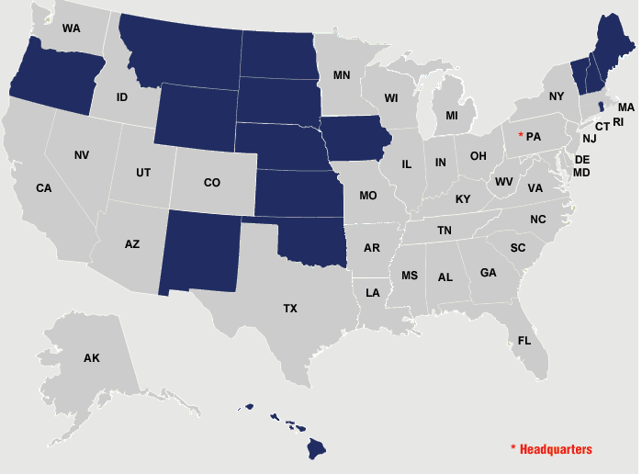
Introduction
Derek Christianson, P.E.
28 years professional transportation experience
Michigan Technological University Graduate
8 years experience with FHWA
20 years experience as a consultant
Leads Michael Baker’s Alaska CMGC Projects
Michael Baker International
3500 Employees
90 offices
In Alaska since 1942

Slide 4
Alternative Procurement Comparison

Slide 5
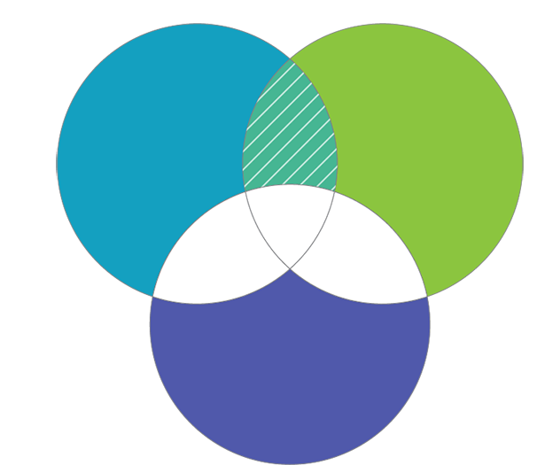
Deliver Method Comparison – Design Build
RESPONSIBILITIES
CONTRACTOR
• Deliver project per RFP
• Low bid
• Schedule driven
• Quality
DESIGNER
• Finalize proposal plans with efficiencies/innovations
• Follow the RFP
DOT&PF & Program Manager
• Create RFP
• Plan review/conformance

Slide 6

Deliver Method Comparison – Progressive Design Build
RESPONSIBILITIES
CONTRACTOR
• Design management
• Cost estimating
• Design review
• Contract documents
• Reduce risk
• Quality
DESIGNER
• Design/options analysis
• Quantity generation
• Specifications development
• Program management
• Quality
DOT&PF & Program Manager
• Contract documents
• Cost control/Price validation (ICE)
• Collaborate on design innovations
• Quality

Slide 7

Deliver Method Comparison – CMGC
RESPONSIBILITIES
CONTRACTOR
• Design review
with innovation
• Estimate refinement
• Reduce risk
DESIGNER
• Design development
• Evaluate contractor ideas in design
• Quantities
• Quality
DOT&PF & Program Manager
• Evaluate contractor innovations; maintain standards
• Independent Cost Estimator (ICE)
• Quality

Slide 8
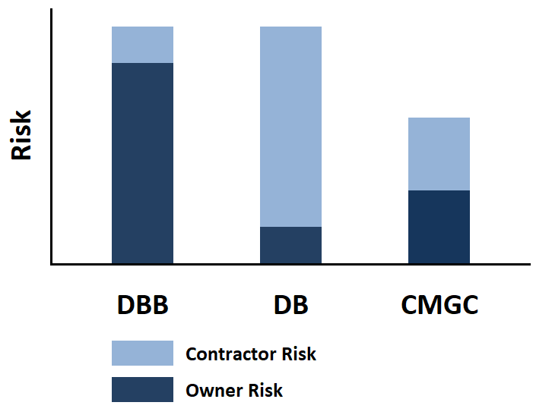
Deliver Method Comparison - Risk

Slide 9
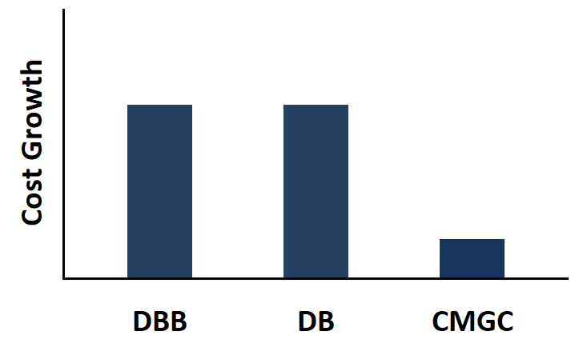
Deliver Method Comparison – Cost Growth
4.1%
4.0%
0.9%
Source: Alternative Contracting Method Performance in U.S. Highway Construction
FHWA Publication No: FHWA-HRT-17-100, Table 14

Slide 10
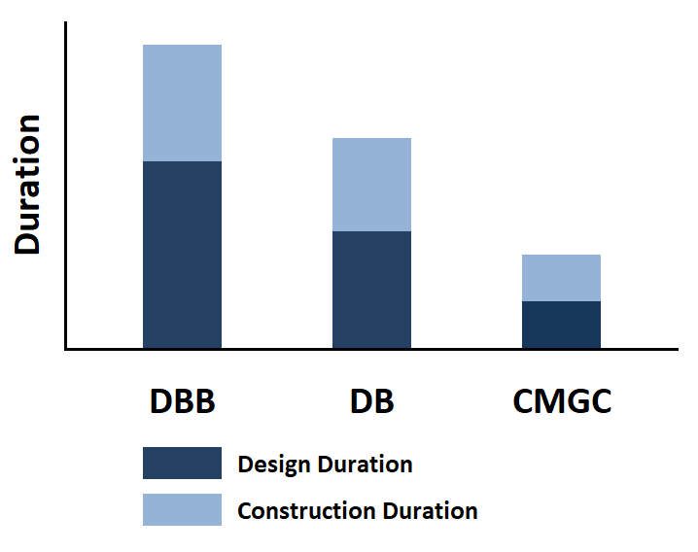
Deliver Method Comparison - Schedule
2,130 days
1,420 days
662 days
Source: Alternative Contracting Method Performance in U.S. Highway Construction
FHWA Publication No: FHWA-HRT-17-100, Table 8

Slide 11
Progressive Design Build Experience
Utah US-89

Slide 12
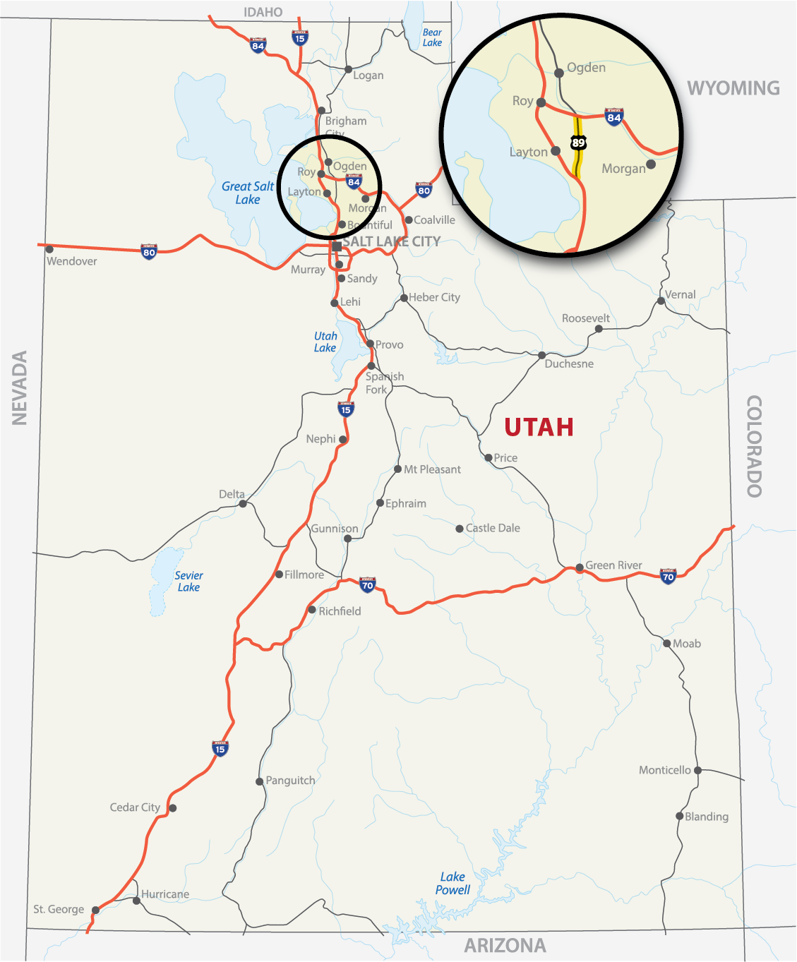
US-89 Corridor Improvements
1st Big PDB for UDOT and U.S.
9.7 Miles
4 New Interchanges
New Surface Street Connections
Additional Travel Lanes
https://udot.utah.gov/us89/

Slide 13




US-89 Progressive Design Builder
Oak Hills Constructors

Slide 14
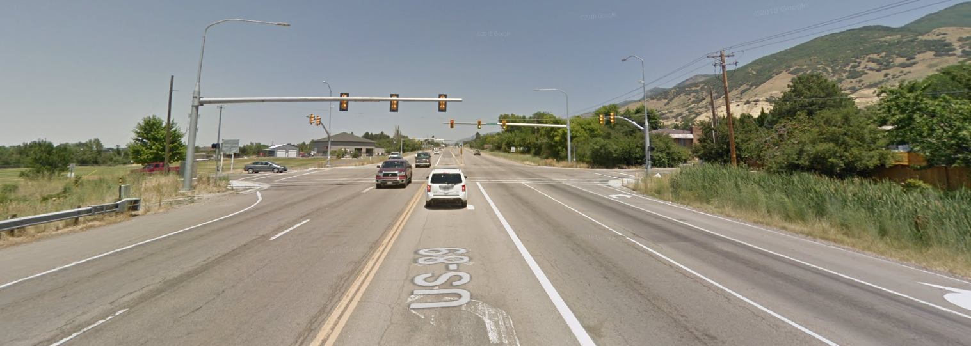
US-89 Progressive Design Build – Why Use PDB?
Residential Impacts
Environmental Concerns
Funding ($275M Programmed vs $365M Estimate)

Slide 15
US-89 Progressive Design Build – Lessons Learned
A “Learning” Project
Want the “Correct” project for PDB
Using PDB to address public concerns
Pricing allows UDOT to “menu shop” options
Will convert to DB summer 2019
  Have 60% design
  Risk mostly quantified
  Will use lump sum instead of unit price

Slide 16
US-89 Progressive Design Build – Lessons Learned
Process Challenges
  Writing PDB Guidelines as the project progressed
  Using a DB ATC process; ATCs ultimately incorporated into the project
  Hired a Program Manager to provide transparency
    Additional cost
    Additional activities delays schedule
    Complicates process

Slide 17
US-89 Progressive Design Build – Lessons Learned
Successes
  Up front effort is more streamlined than DB
  Getting the “Correct” Project
  Projected to save costs and schedule

Slide 18
DOT&PF Horizontal CMGC Experience

Slide 19
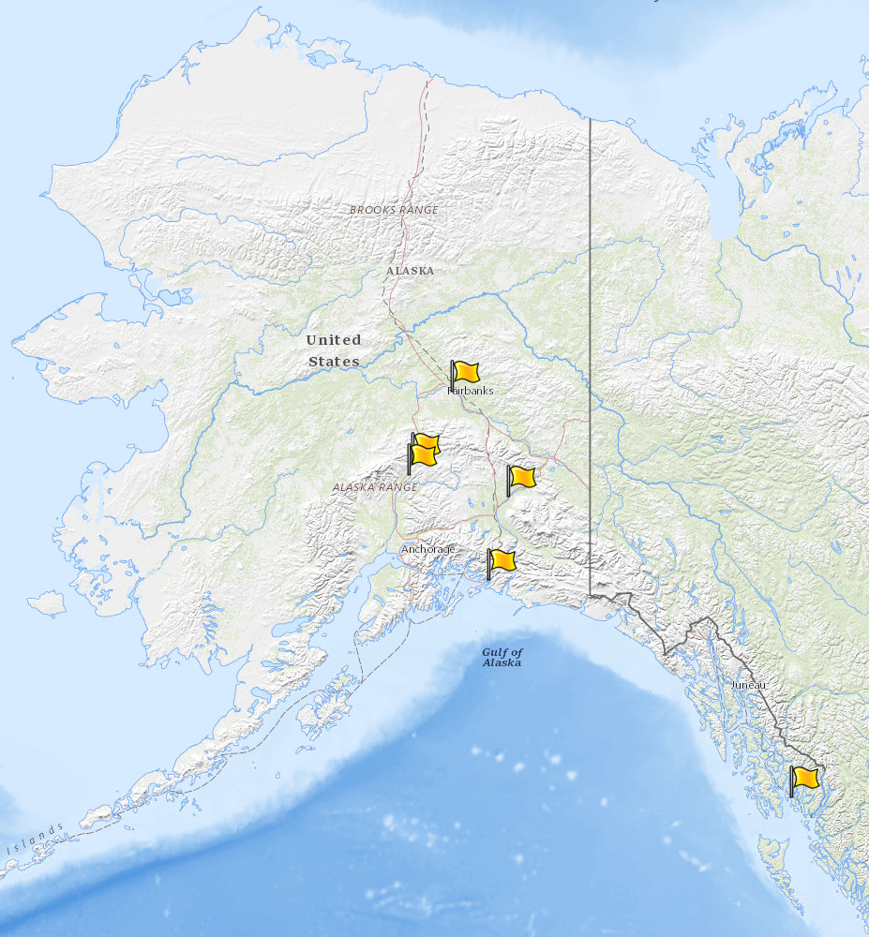
DOT&PF Horizontal CMGC Projects
CMGC Projects
Parks Hwy MP 237 Riley Creek Bridge
  Completed 2015
University Avenue Rehab
  2 Phases Complete; 3 in Design
Parks Hwy MP 231
  Design 75% Complete
Tok Cutoff MP 38-50
  Design 100% Complete
Cordova Whitshed Road
  Started March 2019
Ketchikan Herring Cove Bridge
  Starting in April 2019
2
1
3
4
5
6
CMGC Facilitation
Michael Baker – Facilitation
Brooks and Assoc. – Outreach
Stanton Constructability - ICE

Slide 20
DOT&PF Horizontal CMGC Projects - Why Use CMGC?
Manage Risk
Introduce Innovation
Meet Budget Goals
Optimize Schedule
Transfer Knowledge
Reduce Contract Growth
Protect Owner’s Interests

Slide 21
DOT&PF Horizontal CMGC Projects – Risk Experience

Slide 22
DOT&PF Horizontal CMGC Projects – Risk Experience
Manage Risk During Design
Focus on High Risk Items
Parks 237 Riley Creek
  Mitigated All Risk During Design

Slide 23
DOT&PF Horizontal CMGC Projects – Innovation Experience

Slide 24
DOT&PF Horizontal CMGC Projects – Innovation Experience
Riley Creek Bridge
  Pile Pre-Bore CS Item
Tok Cutoff
  Multiple Material Sources
  Shot Rock Embankment
  Eliminate Detour
University Avenue
  Bore under Chena River for Comm. Utilities

Slide 25
DOT&PF Horizontal CMGC Projects – Cost Experience

Slide 26
DOT&PF Horizontal CMGC Projects – Cost Experience
Independent Cost Estimating is Critical
  Cost Transparency
  Cost Certainty
Can Design Project Around Cost
Knowledge Transfer

Slide 27
DOT&PF Horizontal CMGC Projects – Schedule Experience

Slide 28
DOT&PF Horizontal CMGC Projects – Schedule Experience
Riley Creek Bridge
  Fall 2014 Construction Start ➔ Reduced Schedule by One Season
University Avenue
  Phased Approach
  Identify Scope on Annual Basis
  Contractor Input

Slide 29
DOT&PF Horizontal CMGC Projects – Other Lessons Learned
RFP Development
  Pricing Criteria
Permitting Support
  Construction Methods Certainty
Contractor Engagement
  Can’t Continue with DBB Mentality

Slide 30
QUESTIONS?

