Slide 1
ADOT’s New GIS Archive System
Accessing Data Through GIS
Drew Pavey
State of Alaska DOT&PF
andrew.pavey@alaska.gov

Slide 2

What We Will Cover
Who I Am
Purpose
Demo – How This Works
Why Do This Project?
Why GIS?
What Is E-Docs?
How It Works - Project Workflow
How It Works - Software
Questions
Ask questions at end (if time)

Slide 3
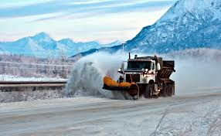
Background
Work for Central Region Materials
Engineering Technician / GIS Guy
  I Do Whatever People Tell Me
7 years experience with ArcGIS Desktop
1 year experience with ArcGIS Server

Slide 4

Purpose of this Project
To Link Historic Project Locations to Electronic Documents
  As-Built
  DSR
  Environmental Documents
  Geotechnical Reports
  Bid Tabs
  Anything! (almost)

Slide 5
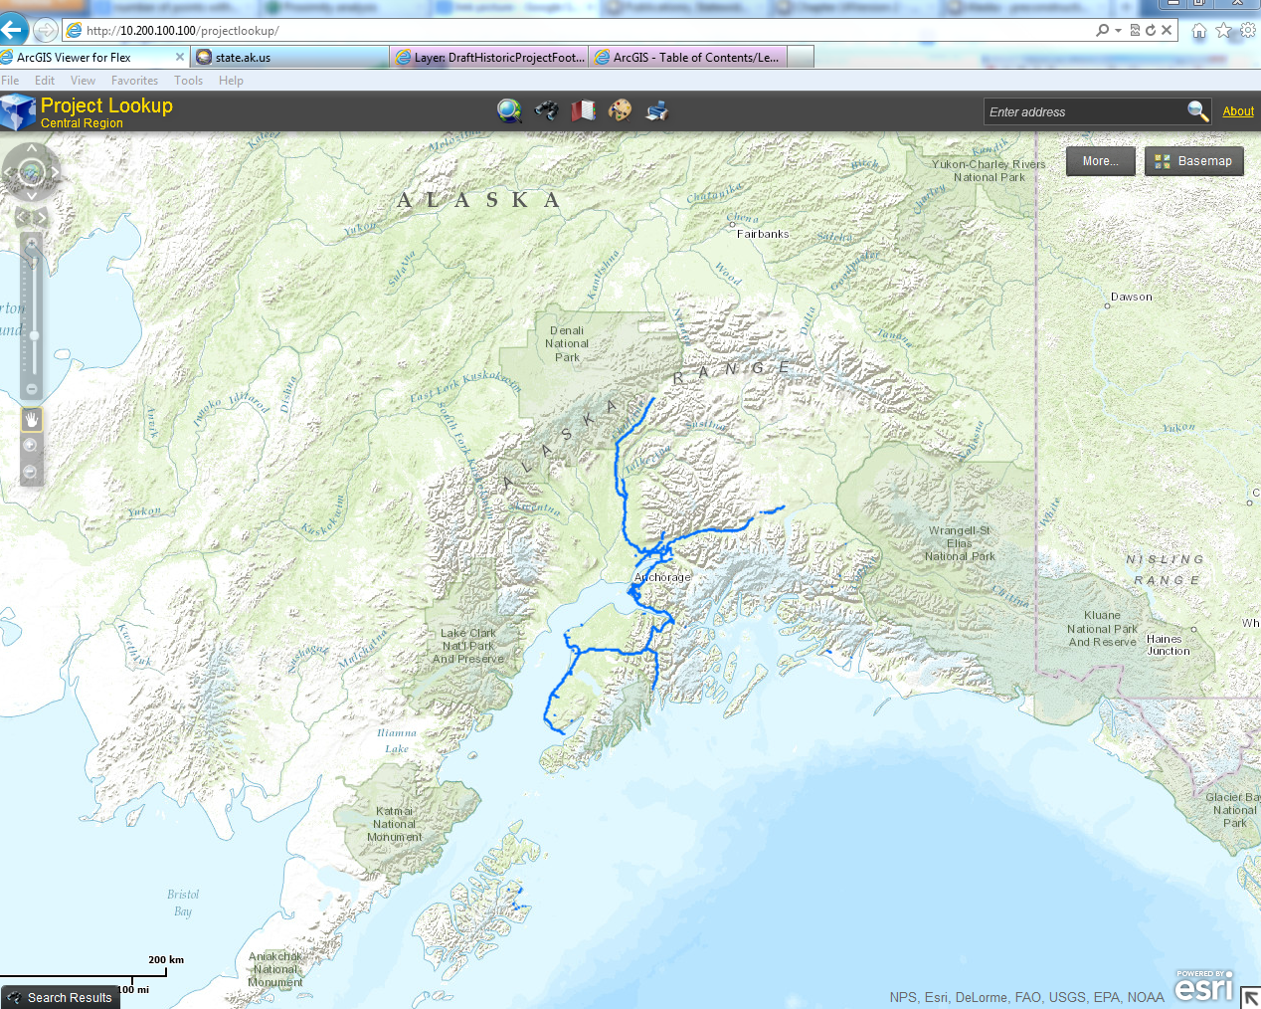
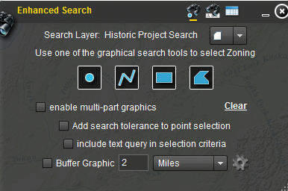
Example
Web Browser
Search Tool
Tools
Search by AKSAS or graphical
Project Footprints

Slide 6
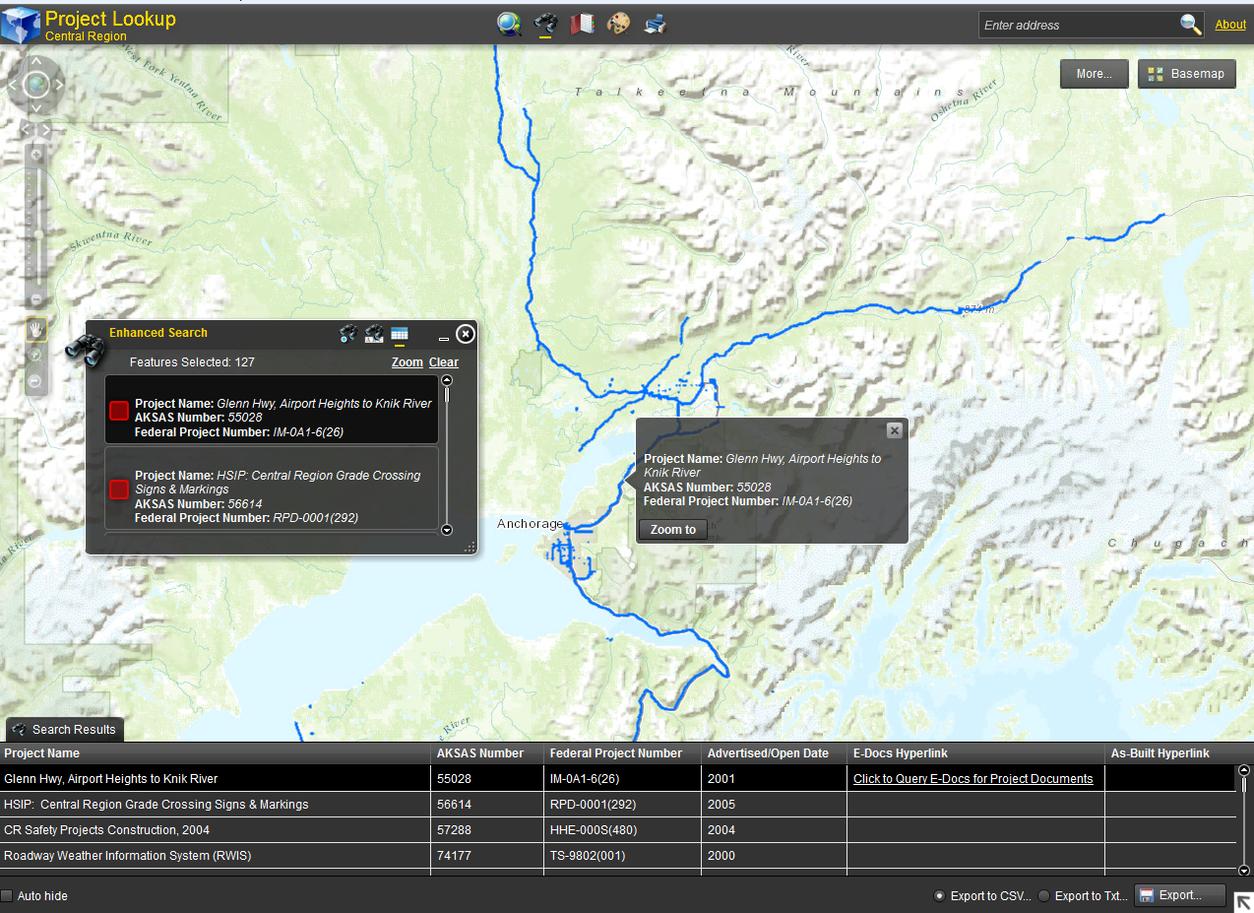
Search Result Summary
The Project You Are Looking At
Search Result Details
Hyperlink to Documents

Slide 7
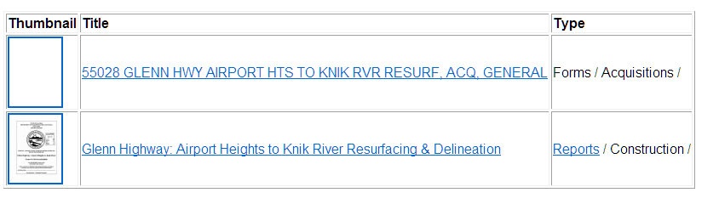
Hyperlinks
Two Types of Hyperlinks
1- Queries for All Documents Tied to Project Number
2 – Link Directly To As-Built

Slide 8

Yay!

Slide 9
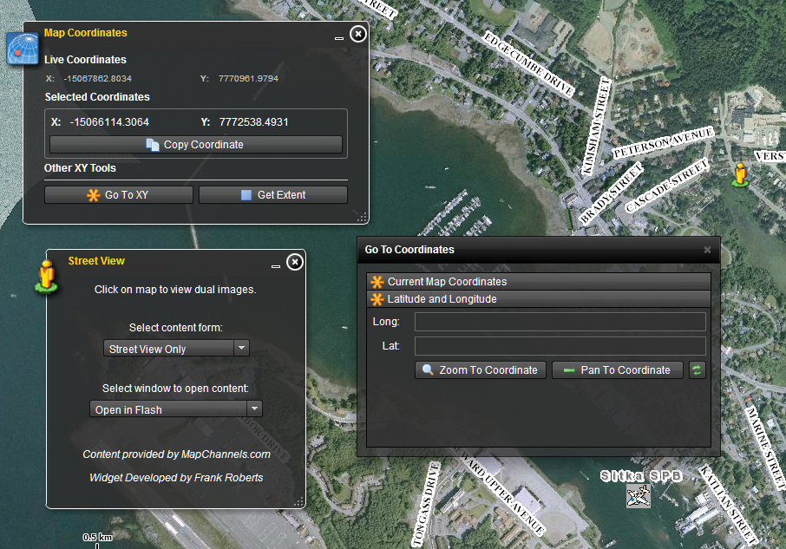
Other Tools

Slide 10
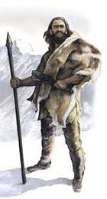

Why Do This Project?
We Hunt For Documents…

Slide 11
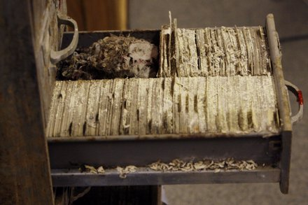

Why Do This Project?
…Fight With File Cabinets

Slide 12

Why
Do This Project?
Getting to data can be like pulling teeth
Documents Are Hard To Get To
  As-Builts
  Geotechnical Reports
  Other Historic Documents
People Waste Time Locating Documents – I Know I Have

Slide 13

What Is E-Docs?
Electronic Document Management System
  Check Report Into This System
  “Meta-Tags”
    Fields You Can Search On

Slide 14
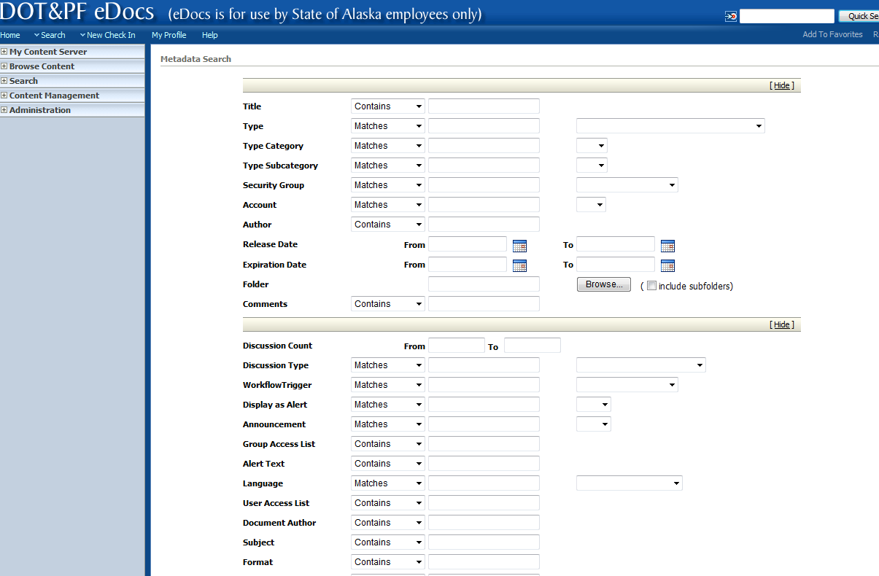
What Is E-Docs?
So
Many
Fields….
More
Below…

Slide 15
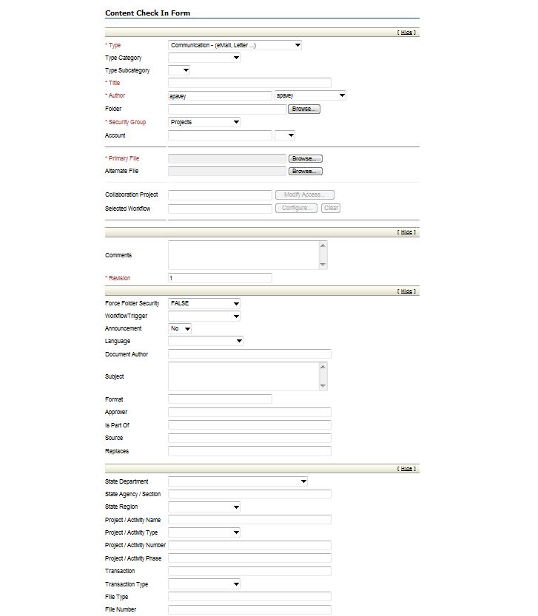
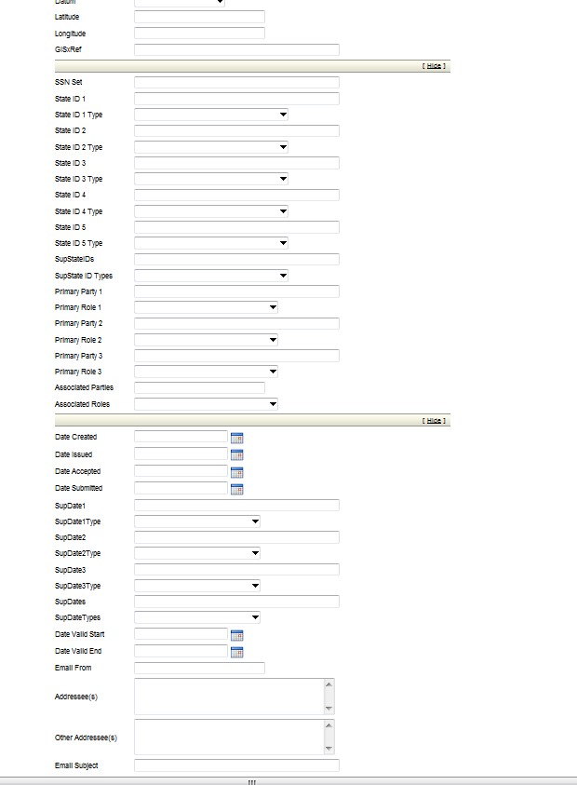
E-Docs Check In
These Are All Those Fields

Slide 16
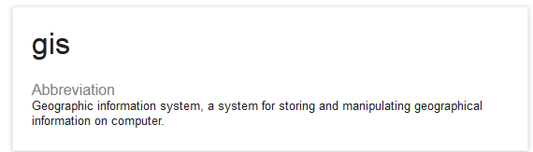
What Is GIS?
Google Says…
We Use ESRI’s ArcGIS Desktop/Server

Slide 17

Why GIS?
Need a Graphical Interface
to Search for Projects
Data Stored in Electronic Document System
    People Don’t Like E-Docs System
GIS Ties Project Footprints to E-Docs
  Hyperlinks
Most Efficient Way We Can Think Of

Slide 18
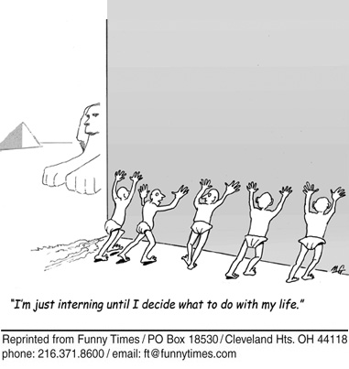

So How Does It Work?
Interns!

Slide 19

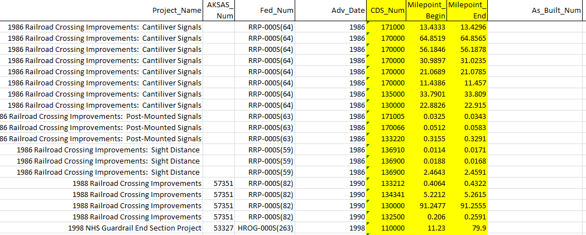
How It Works - Continued
Interns Sort Through As-Builts
  Electronic Files/Hard Copies
Enter Data Into Spreadsheets

Slide 20

How It Works - Continued
After Data Entry Plot Data From Spreadsheets Automatically Using ArcGIS
  This uses “milepoint” values that reference our road centerline (for those of you that care)
Having ArcGIS do
the Hard Work
Saves Time

Slide 21
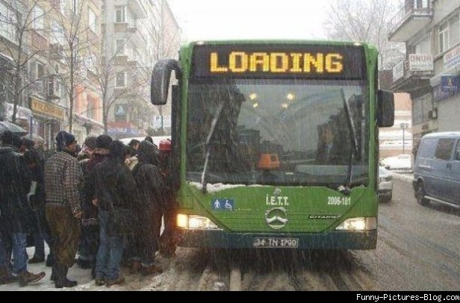

How It Works - Continued
Load Data Into a GIS Database
Make Data Available for People to Search, Filter and Query

Slide 22
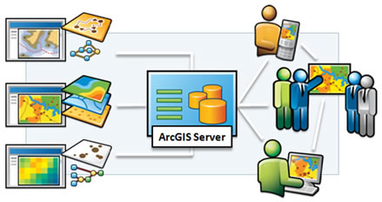

How We Do This
ArcGIS Server
Data Gets to People
Makes People Happy
Data
Instructions

Slide 23

A Few More Things…
This is a work in progress
  A Few Months Away
Internal to DOT Only
  Sorry!

Slide 24
And That Is How It Works
Getting Documents Scanned and Into E-Docs
Loading Into a GIS Database
Running It Through ArcGIS Server
Getting to it People

Slide 25
Well… That’s It Questions?

