Slide 1
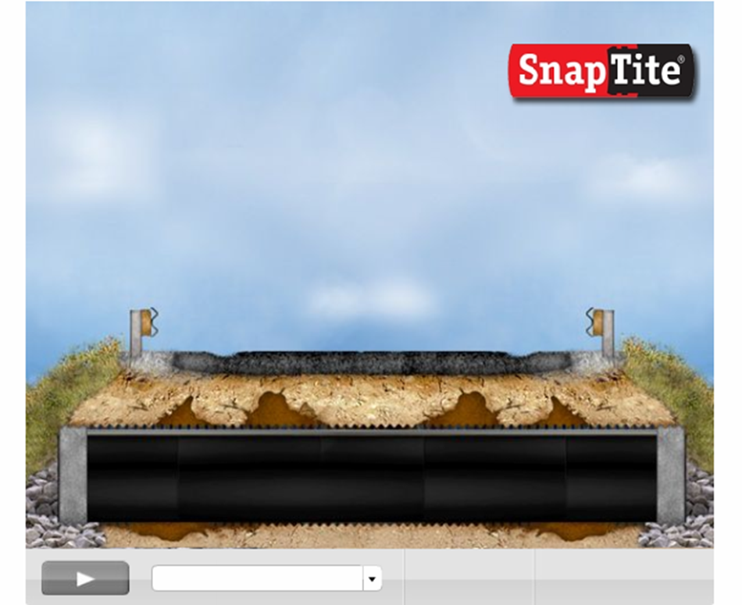
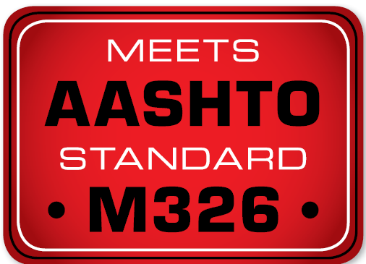
Snap Tite Presentation
Presenter
Mark A. Theetge
markt@isco-pipe.com

Slide 2
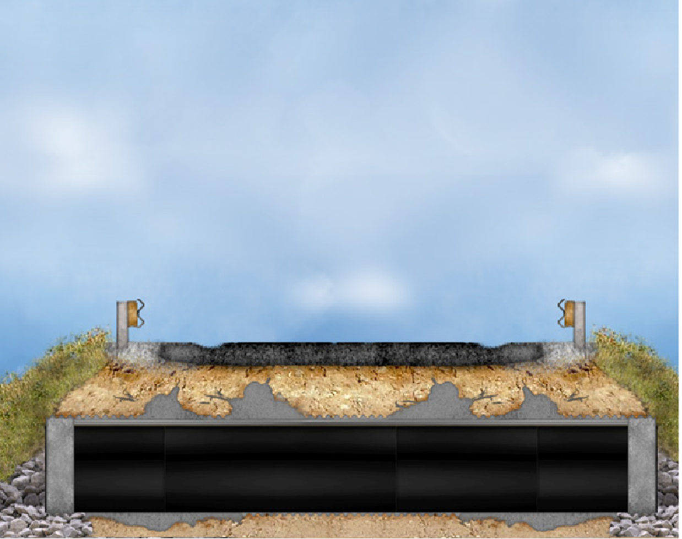
Advantages of using Snap Tite lining solution

Slide 3
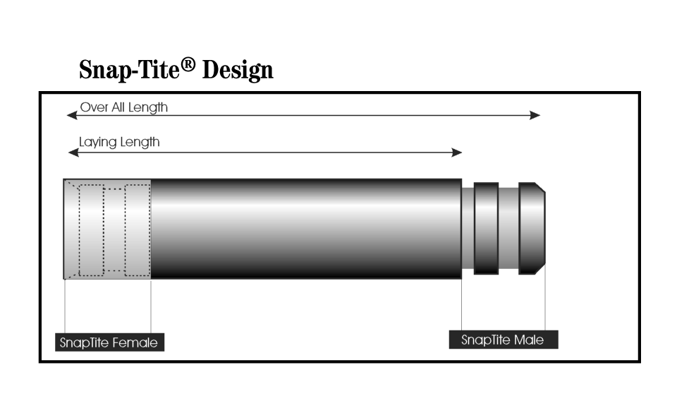

Slide 4
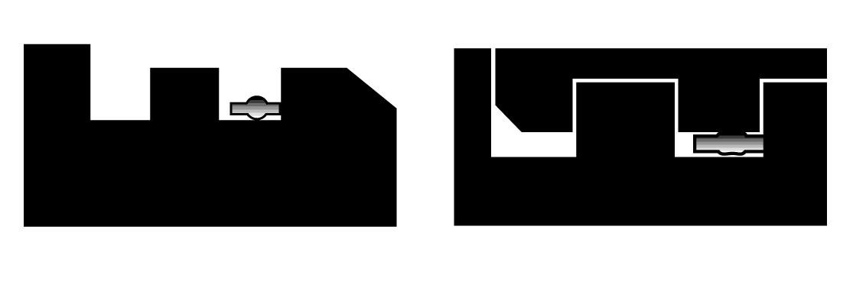
Snap-Tite Connection

Slide 5
SNAP TITE
RELINE PRODUCT MACHINED FROM PRESSURE CLASS PIPE
OD CONTROLED IPS
CUSTOM LENGTHS 2’-49’
REQUIRES NO SPECIAL EQUIPMENT TO ASSEMBLE
MANNING OF .00914
HAS BEEN USED FOR OVER 20 YEARS FOR STATE, FEDERAL HWYS AS WELL AS RAILROAD
AASHTO 326-08

Slide 6
Properties of Snap Tite
Resistant to heavy bed-load
Flexible to movement
Resistant to extreme cold will not fracture
High tolerance to heat 140 degrees under pressure.
Restrained joint
Direct bury product in addition to a liner

Slide 7
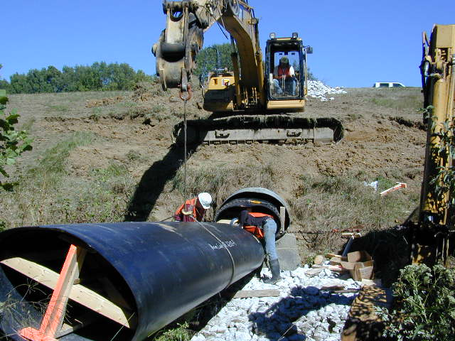
Oval Pipe

Slide 8
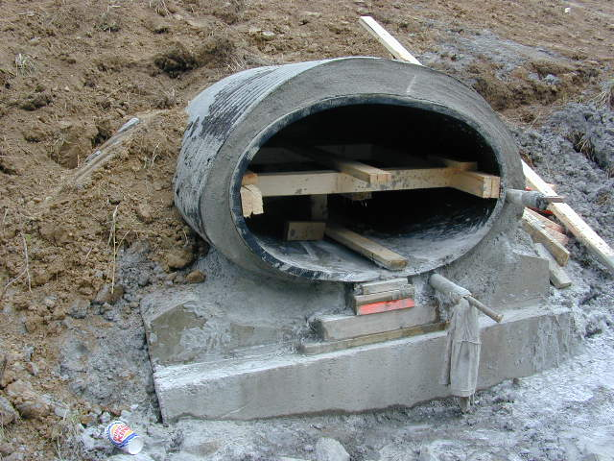

Slide 9
Manufacturing

Slide 11
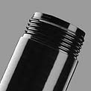
Thread-Loc Joint 4” to 42” same properties as Snap Tite

Slide 12
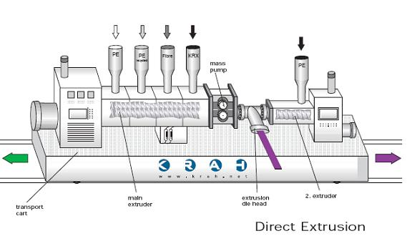
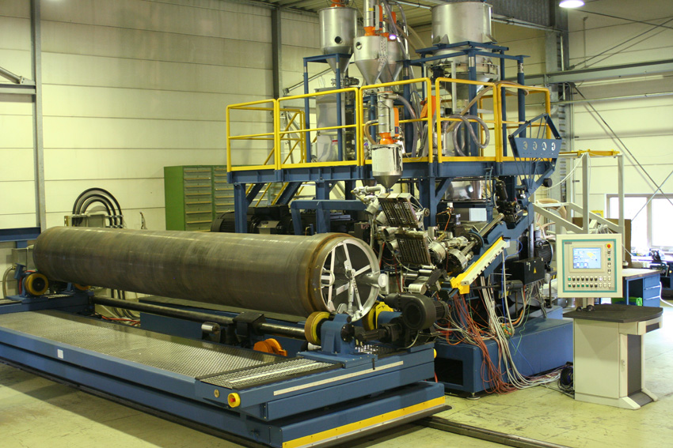
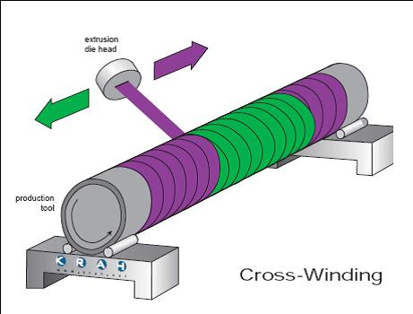
Krah Piping Systems
Krah Piping Technology – a unique spiral winding process

Slide 13
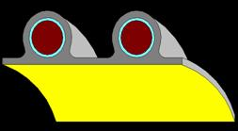
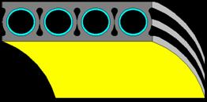
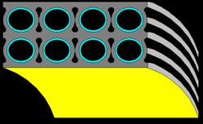
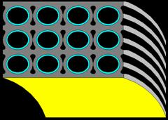
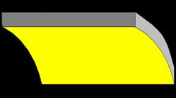
Krah Piping Systems –
Key Features
Spiral winding process used variety of piping profiles
    Profile pipe
    Solid wall pipe
    Fiber reinforced pipe
Process lends itself to alternative joining option
    Bell and spigot
    Integrated electro-fusion joining
    Traditional butt fusion
Overcomes limitations of conventional HDPE pipe extrusion
    Melt strength issues limit OD and wall thickness in conventional extrusion
    Wall and ID uniformity improved
    Throughput issues are minimized
    Downstream production handling needs are simplified
    Diameter range widened significantly
      Up to 154”
    Material capability
      PE3608, PE4710, PP, Reinforced profiles

Slide 14
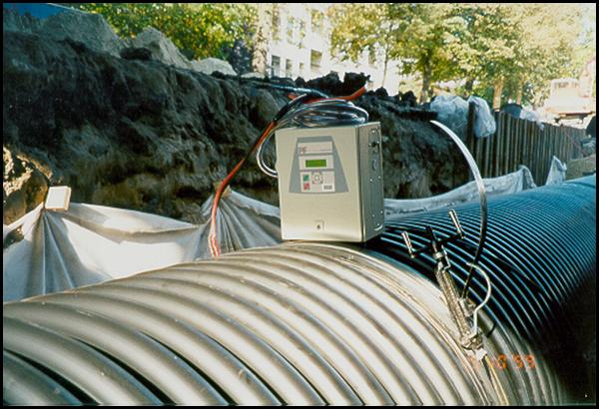
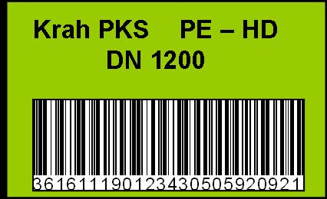
Krah Piping Systems - Joining
Integrated electro-fusion joint
Available on profile wall or solid wall
Brings integrity of fusion joining to large OD pipe
EF process is bar-code automated
Allows for documentation of fusion parameters at time of installation

Slide 15
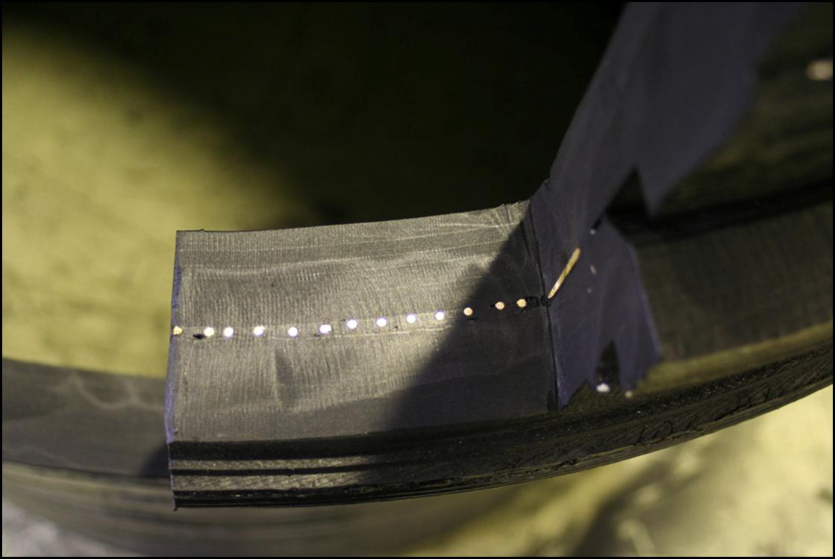
Krah Piping Systems - Joining

Slide 16
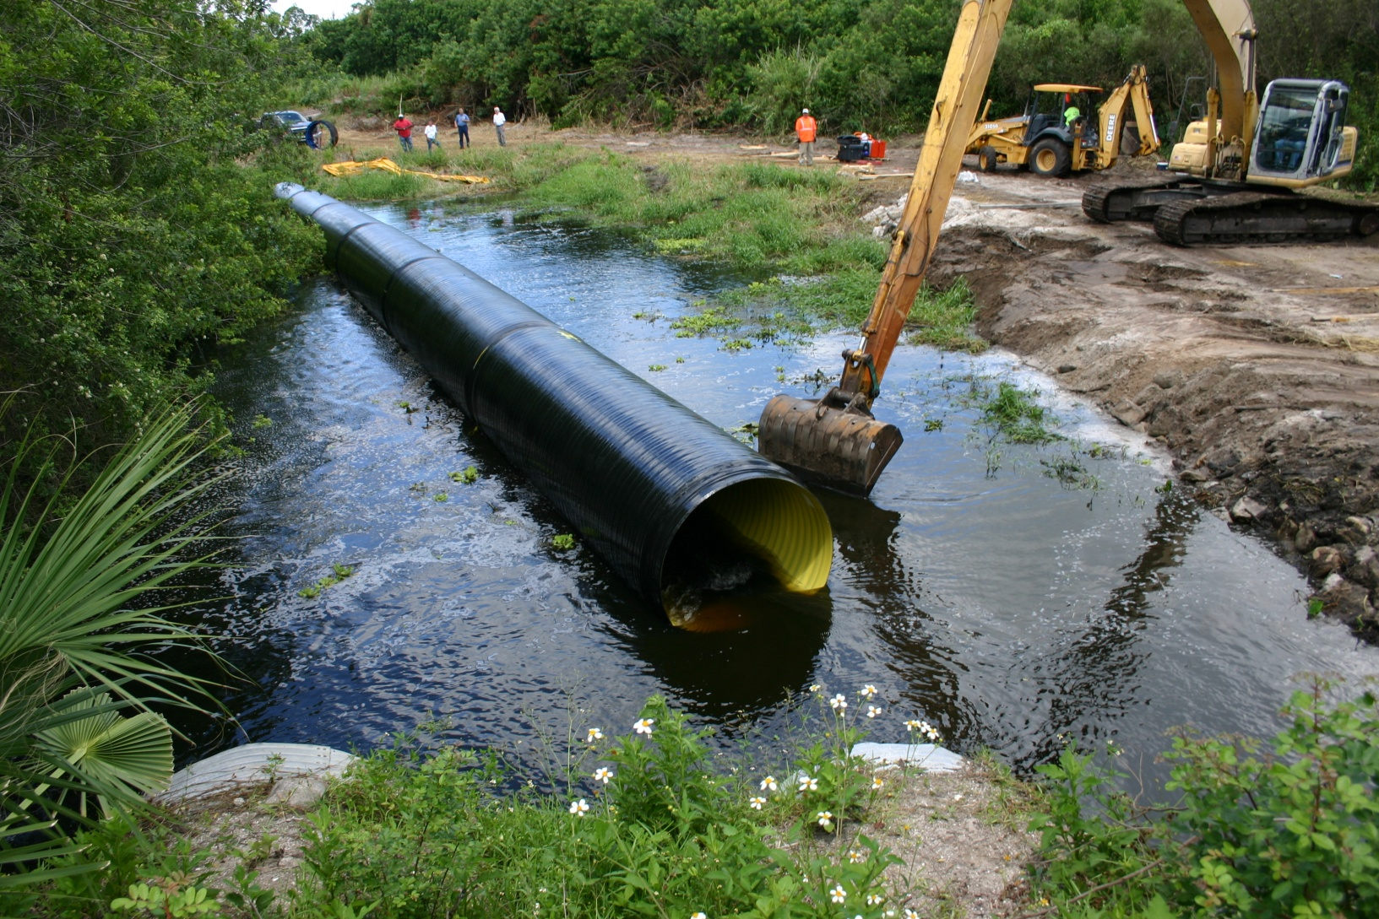

Slide 17
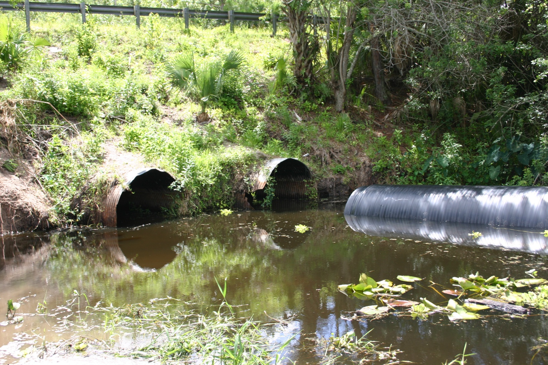

Slide 18
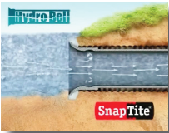
Hydro-Bell

Slide 19
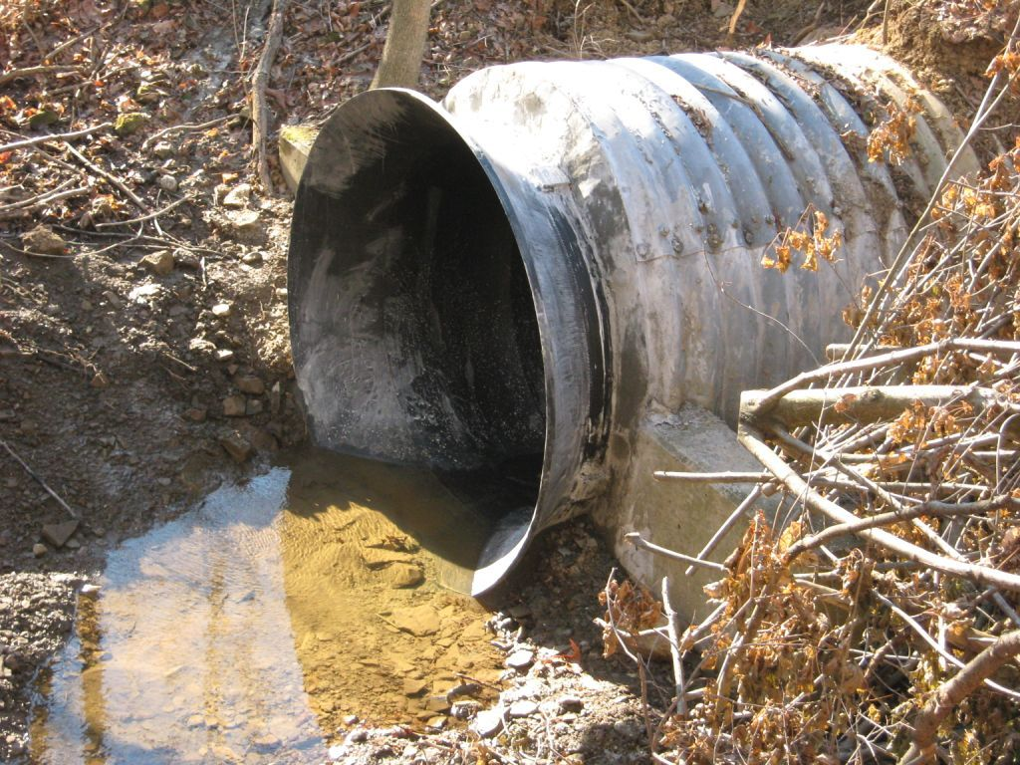
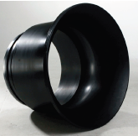
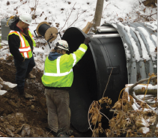

Slide 20
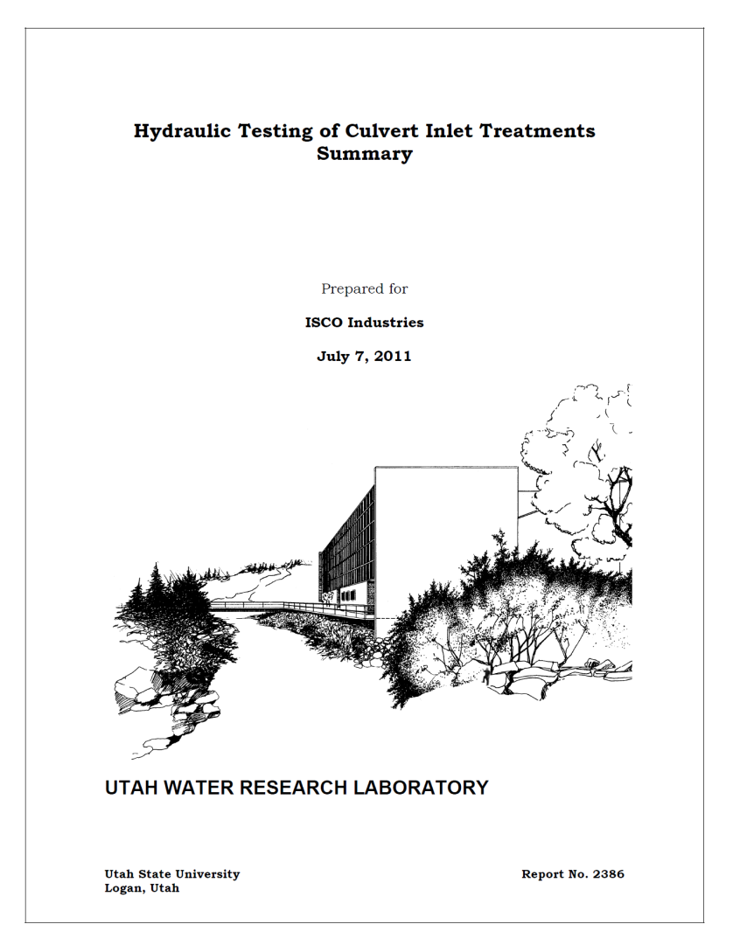
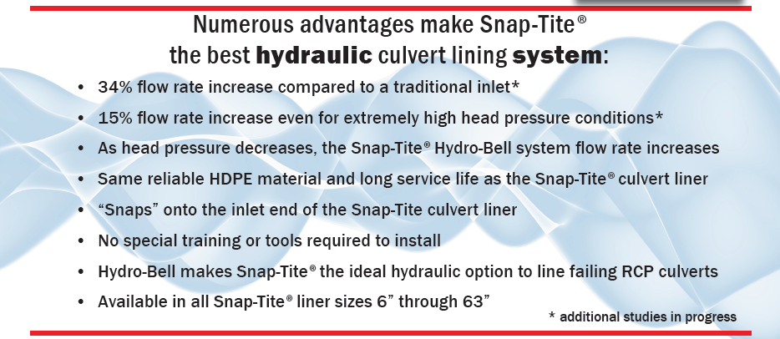
HYDRO-BELL

Slide 21
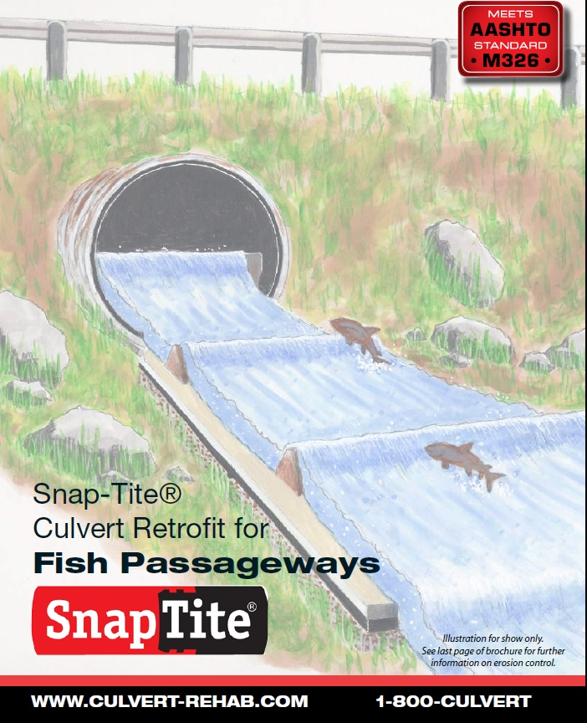
Fish Passageway

Slide 22
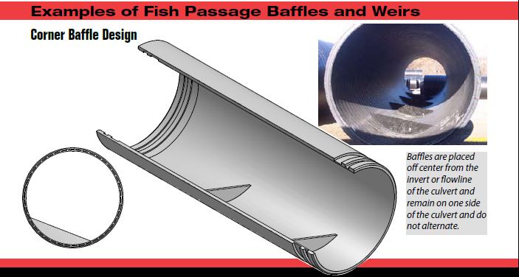

Slide 23
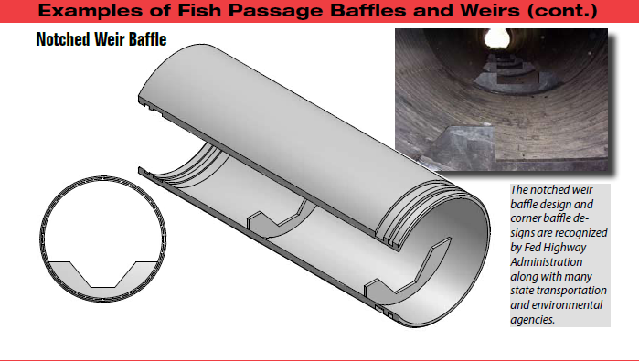

Slide 24
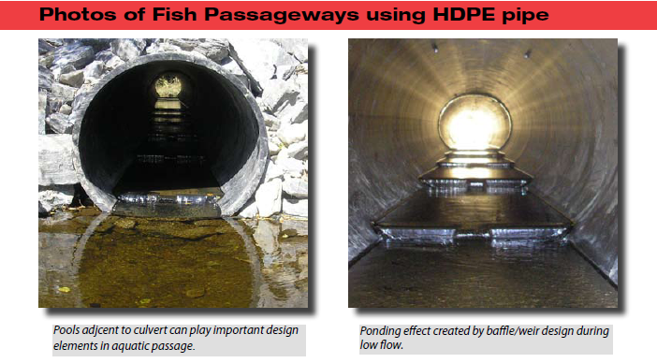

Slide 25
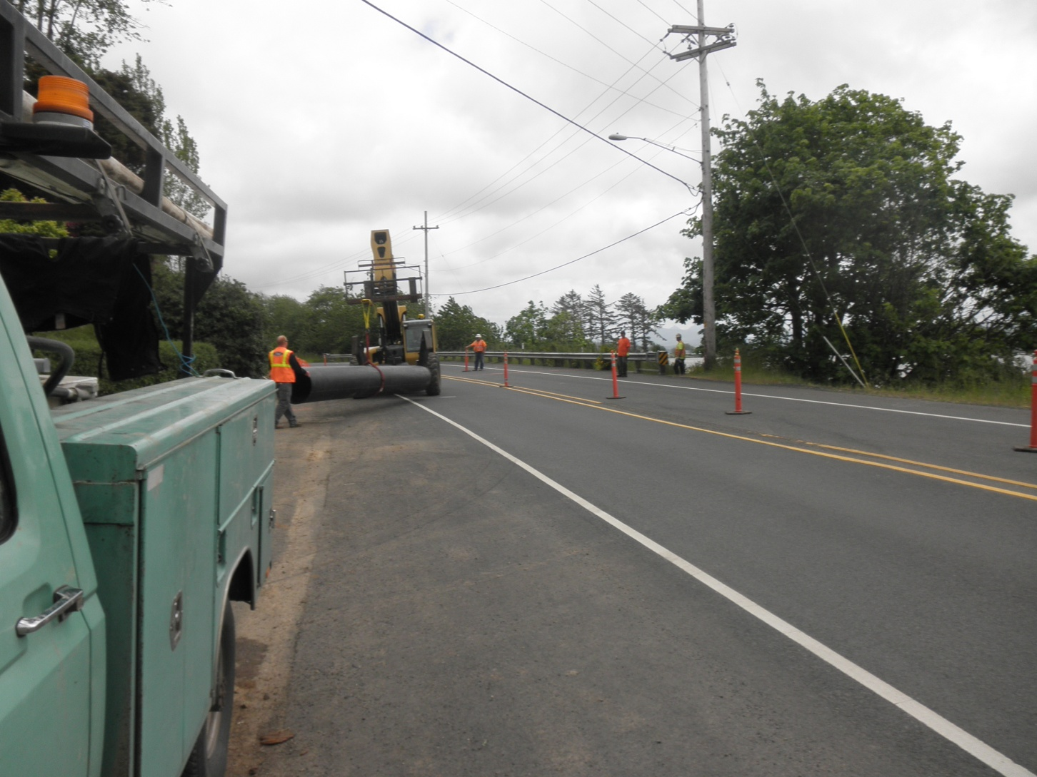
Oregon Coastal Project

Slide 26
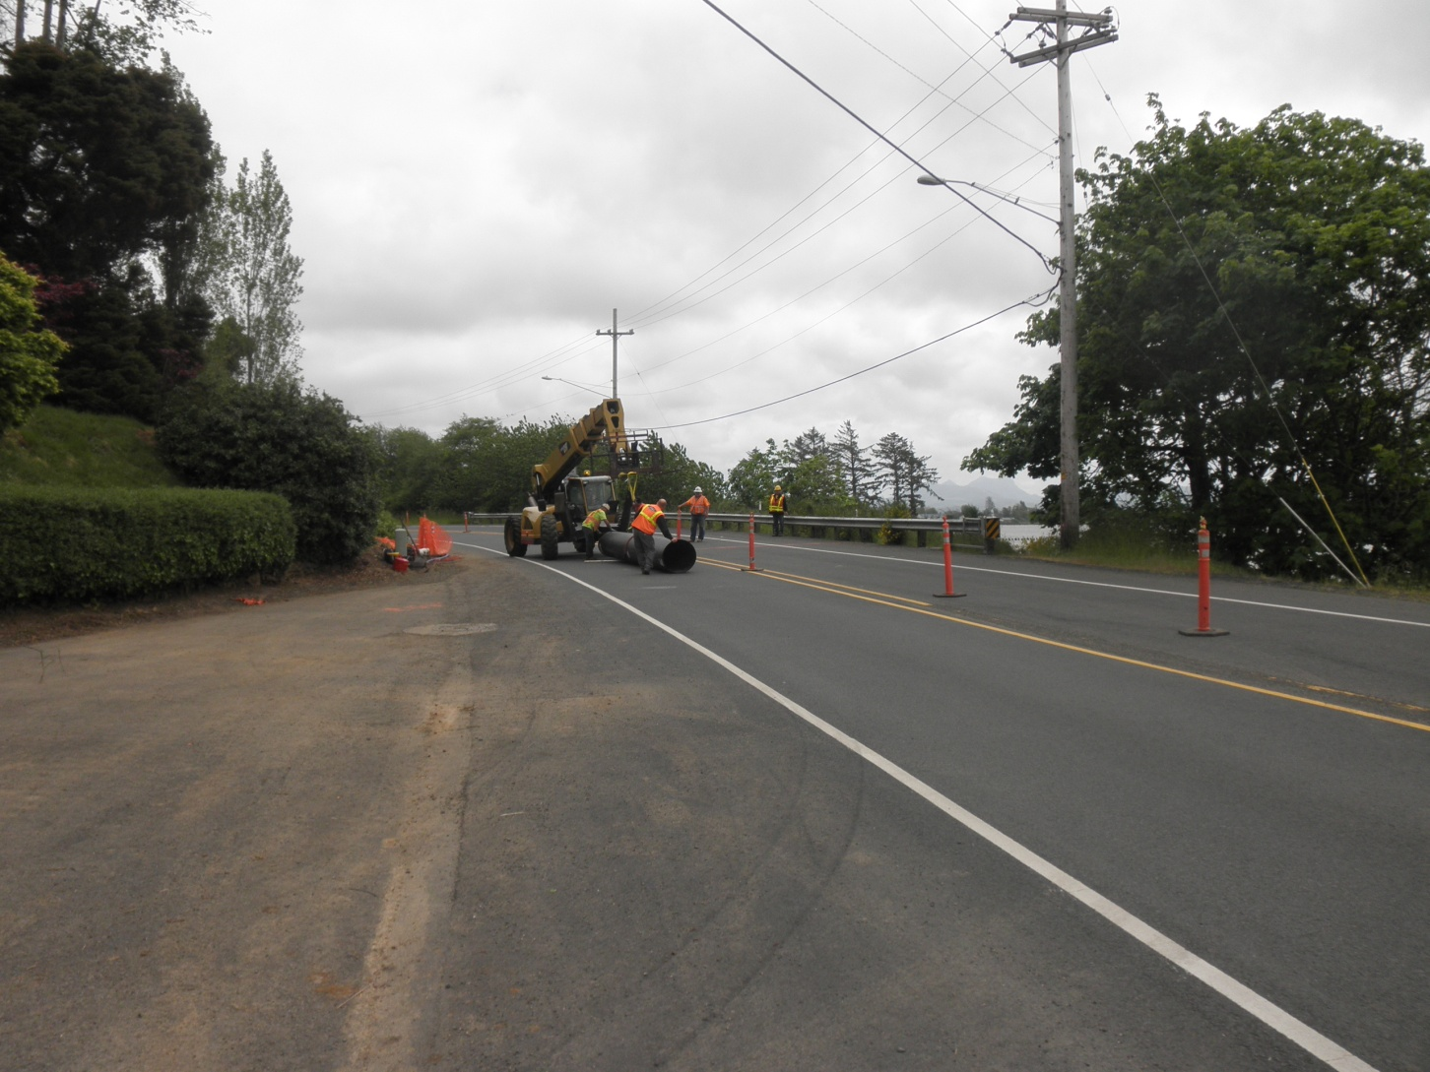

Slide 27
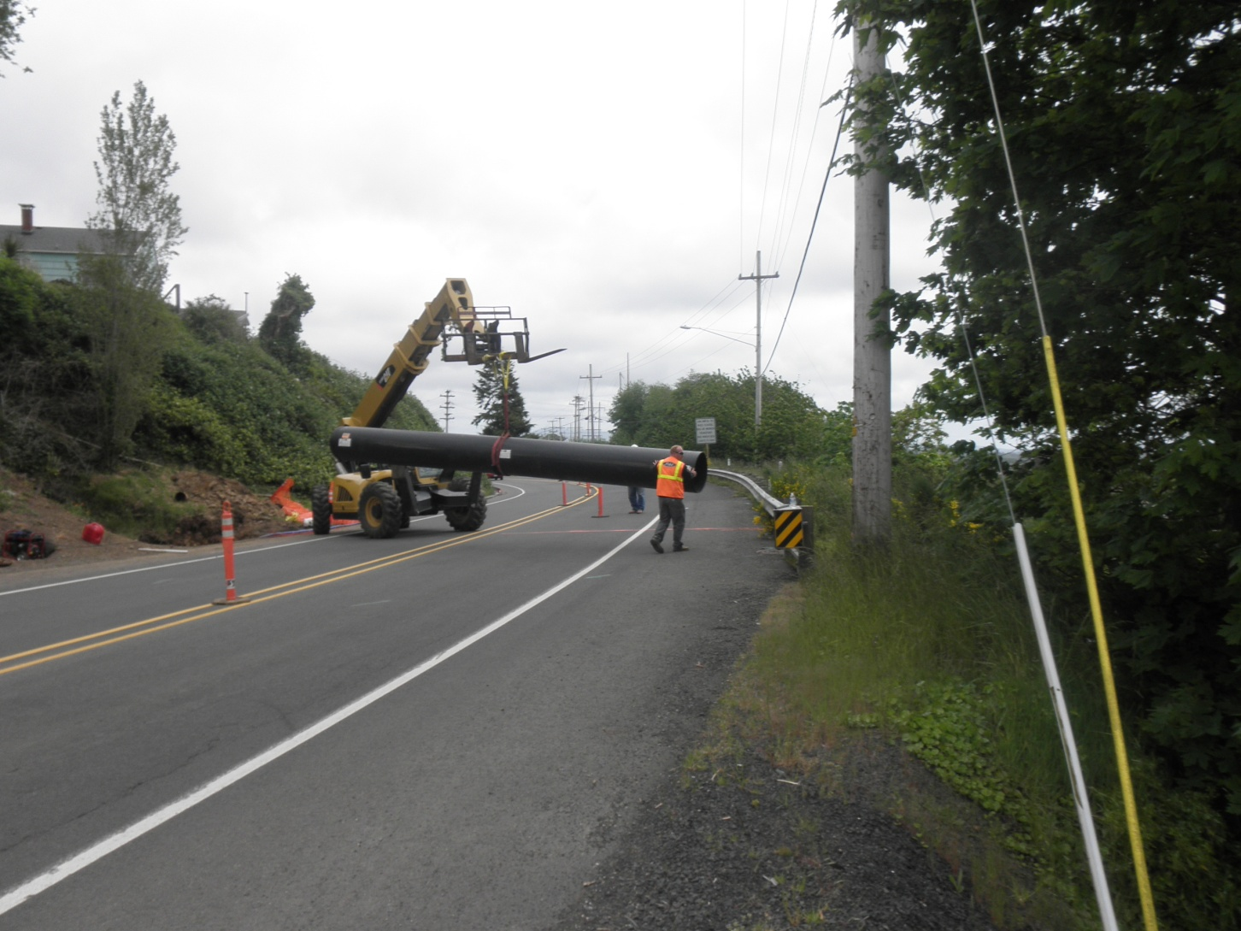

Slide 28
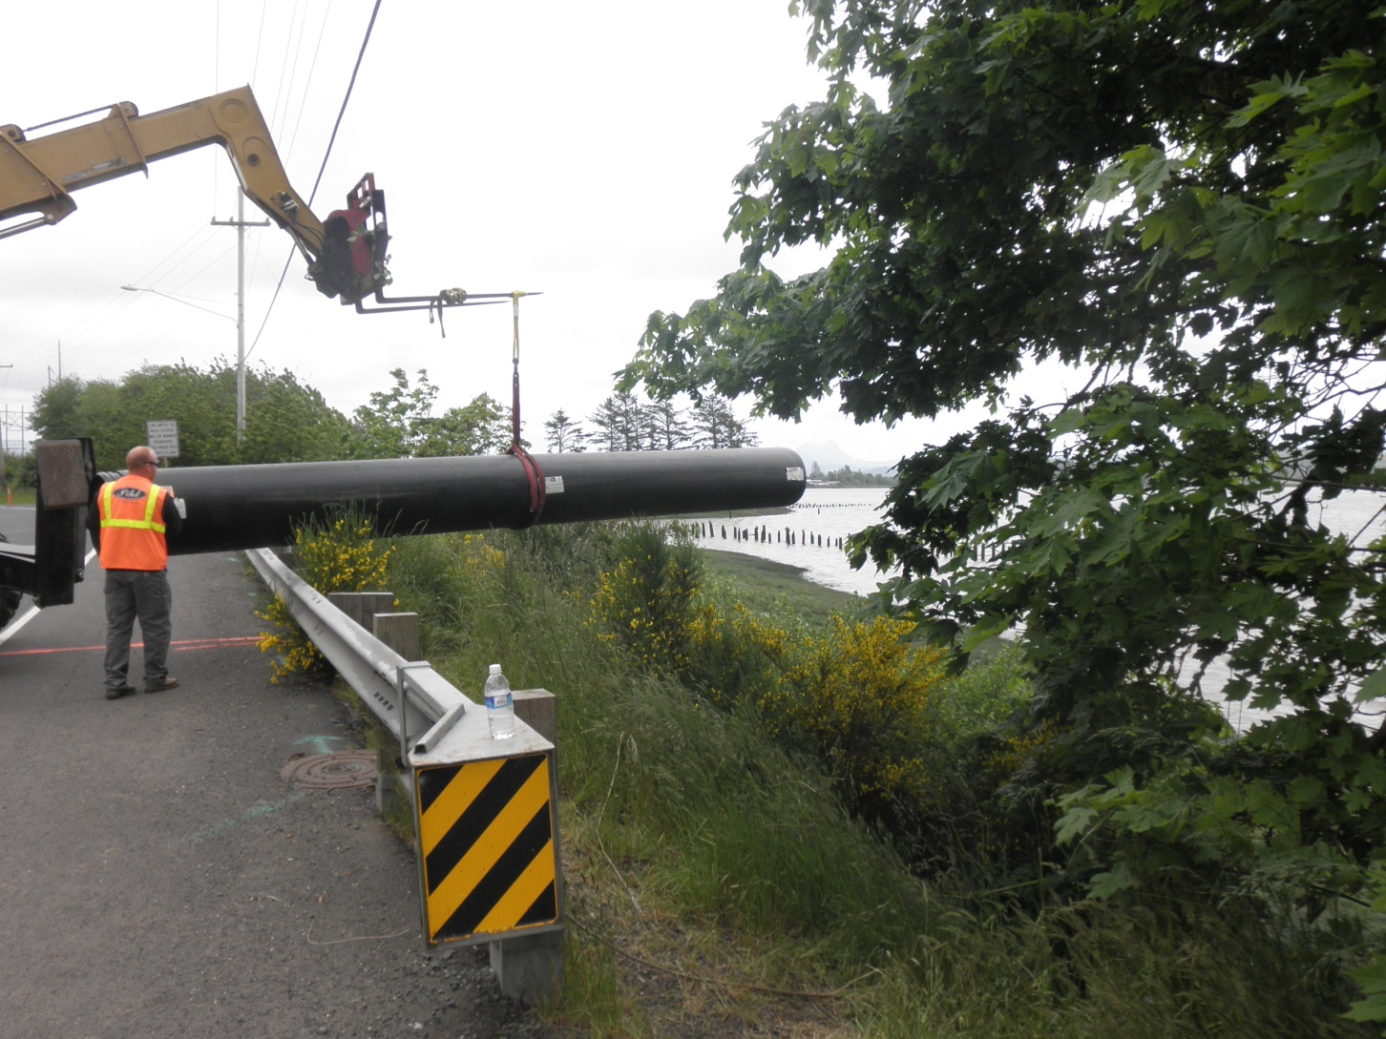

Slide 29
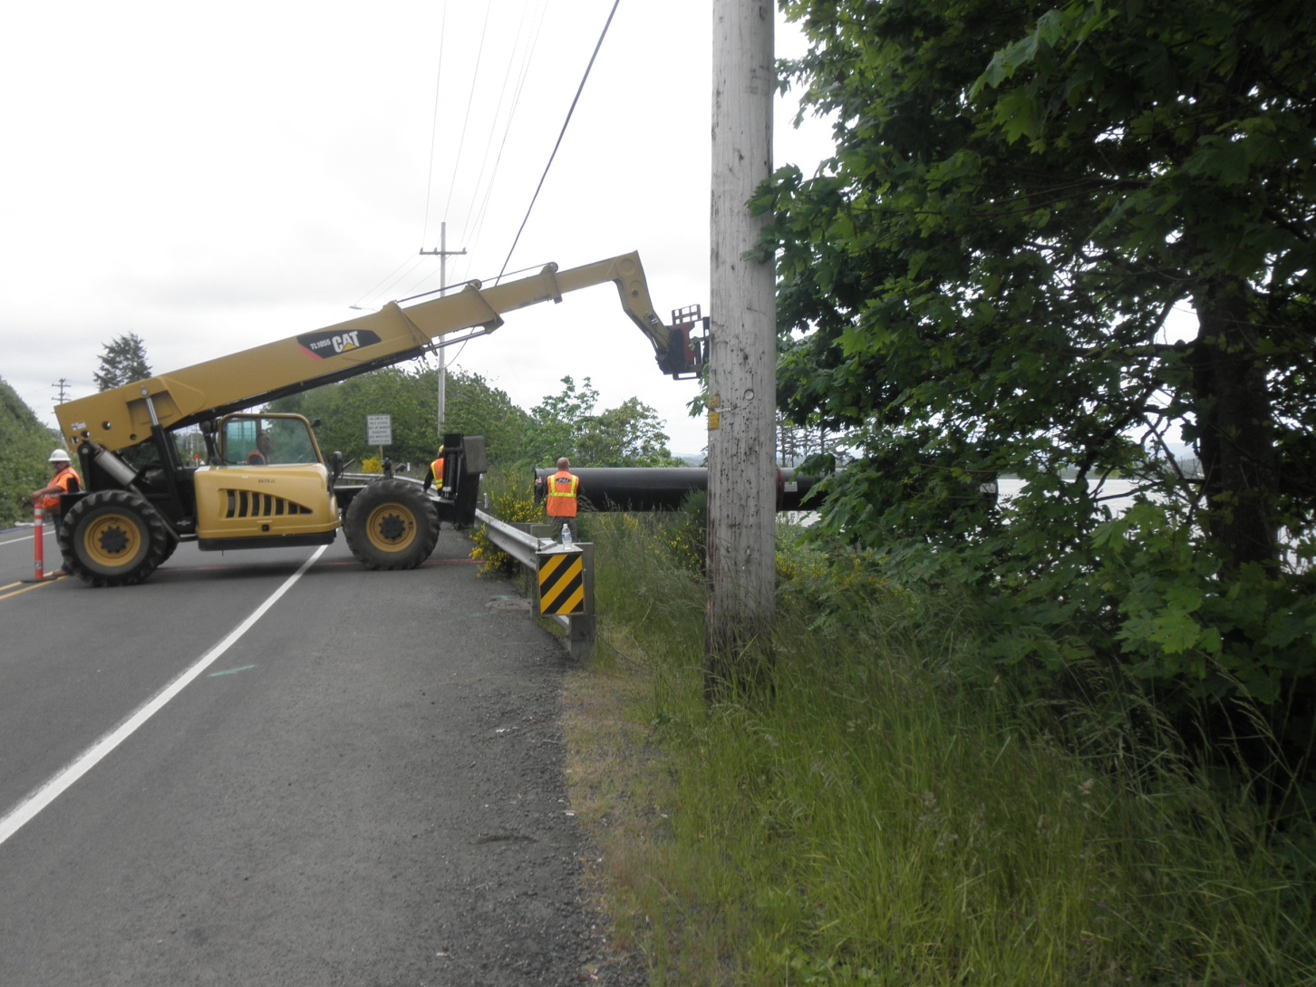

Slide 30
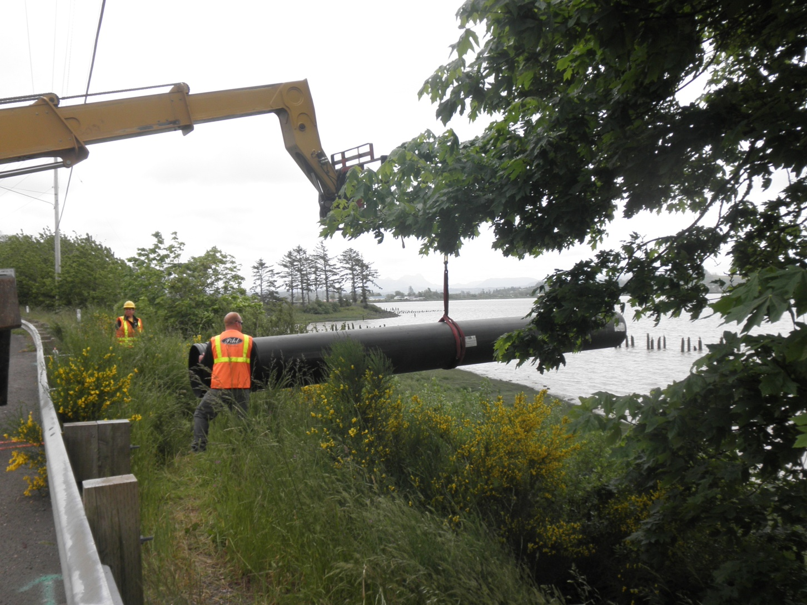

Slide 31
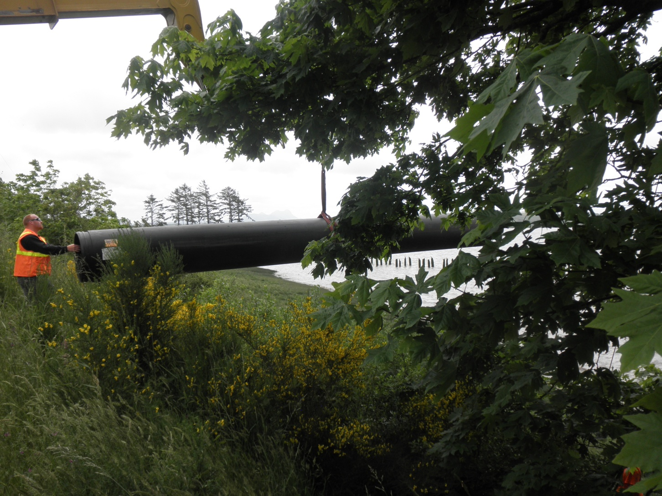

Slide 32
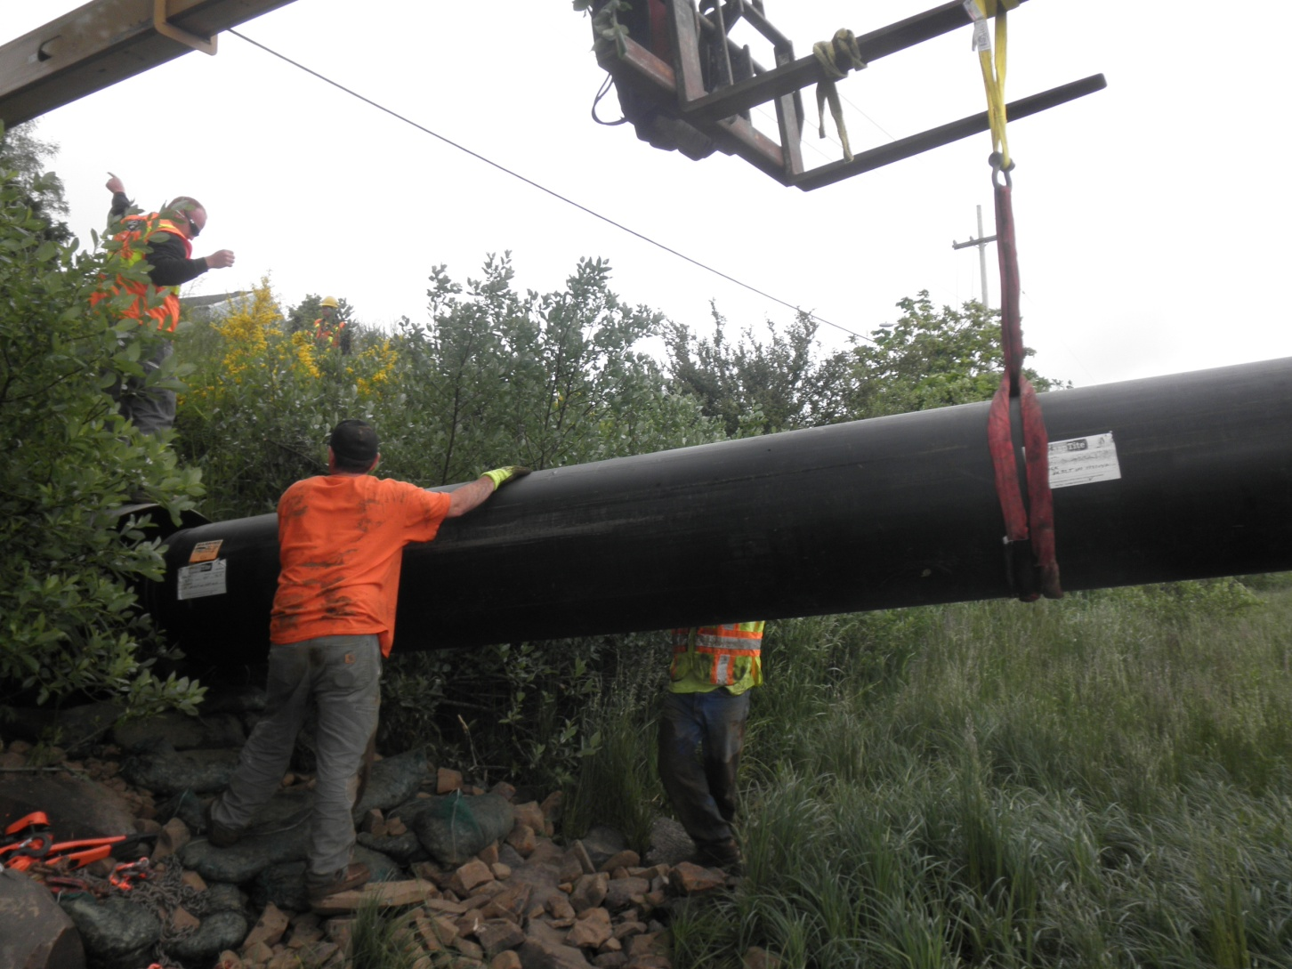

Slide 33
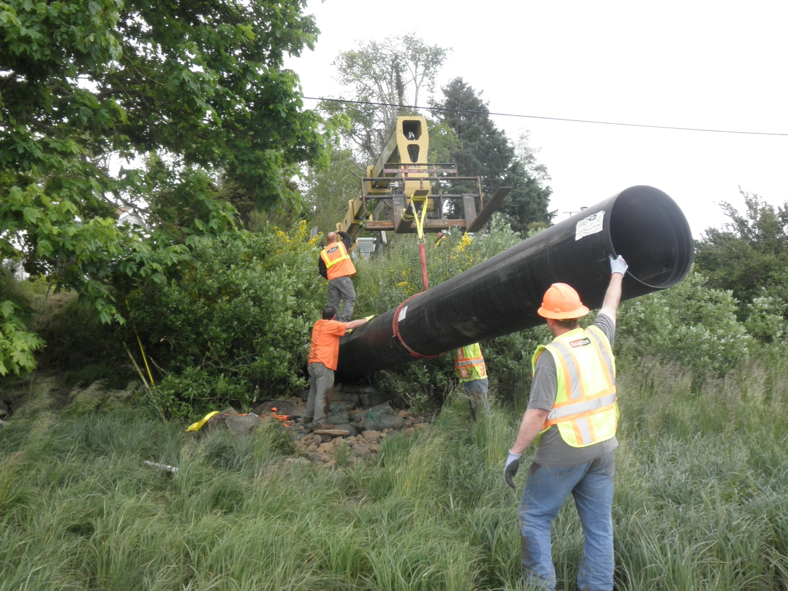

Slide 34
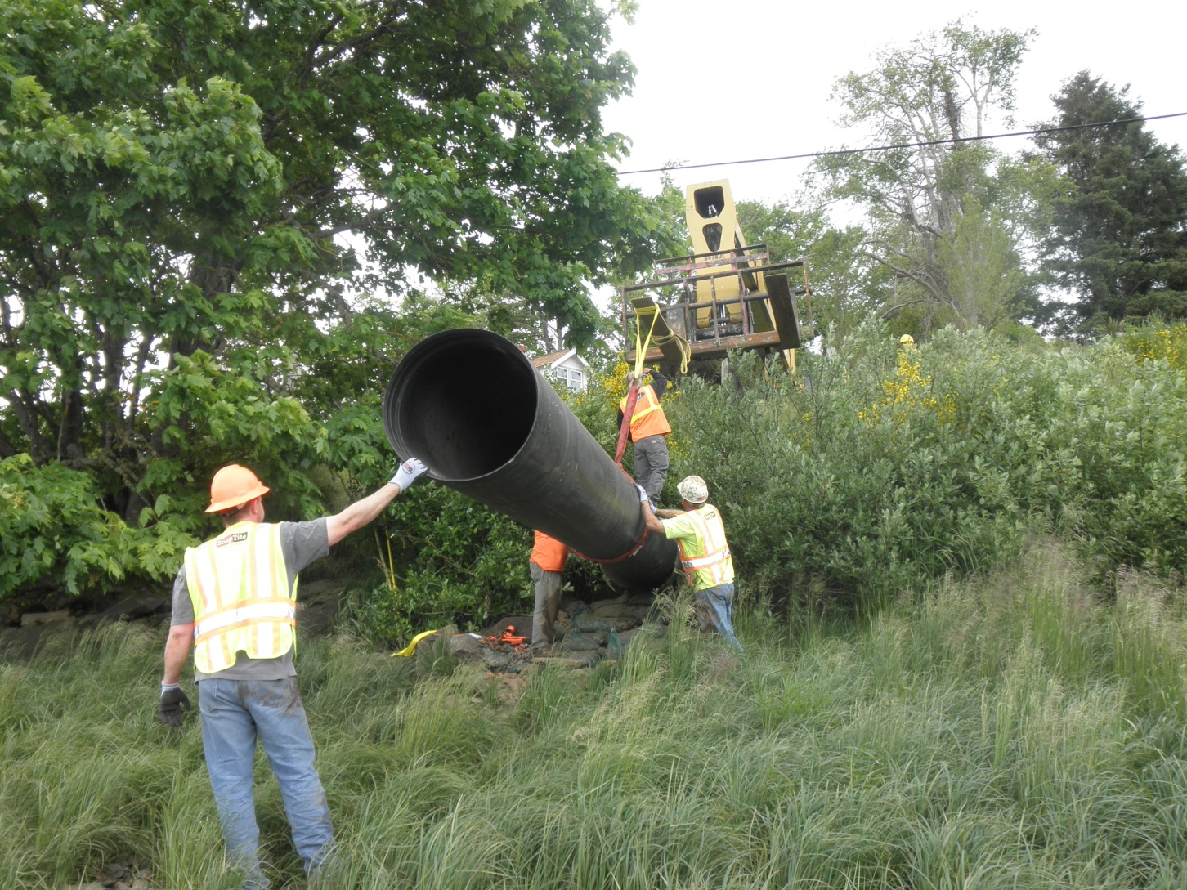

Slide 35
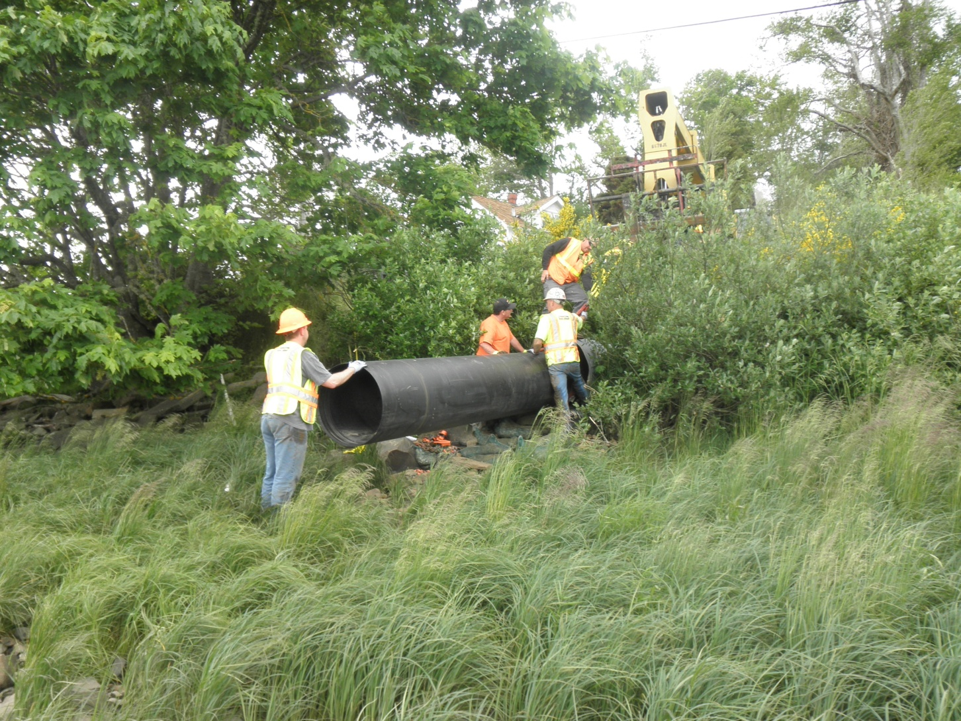

Slide 36
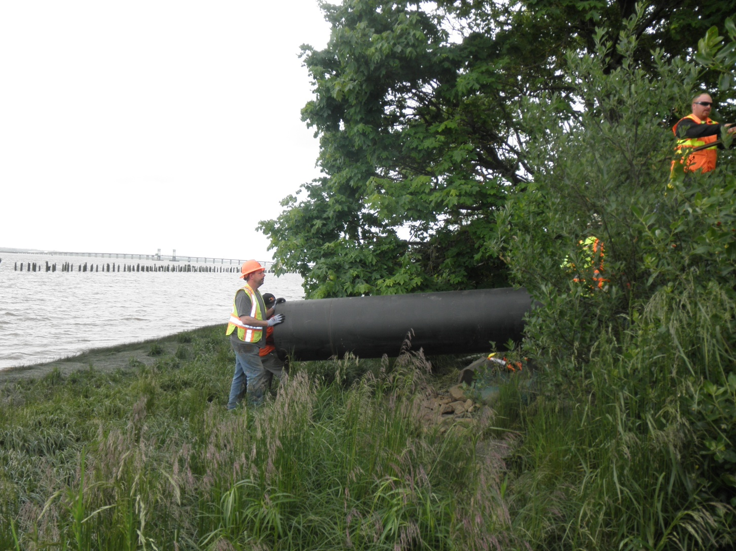

Slide 37
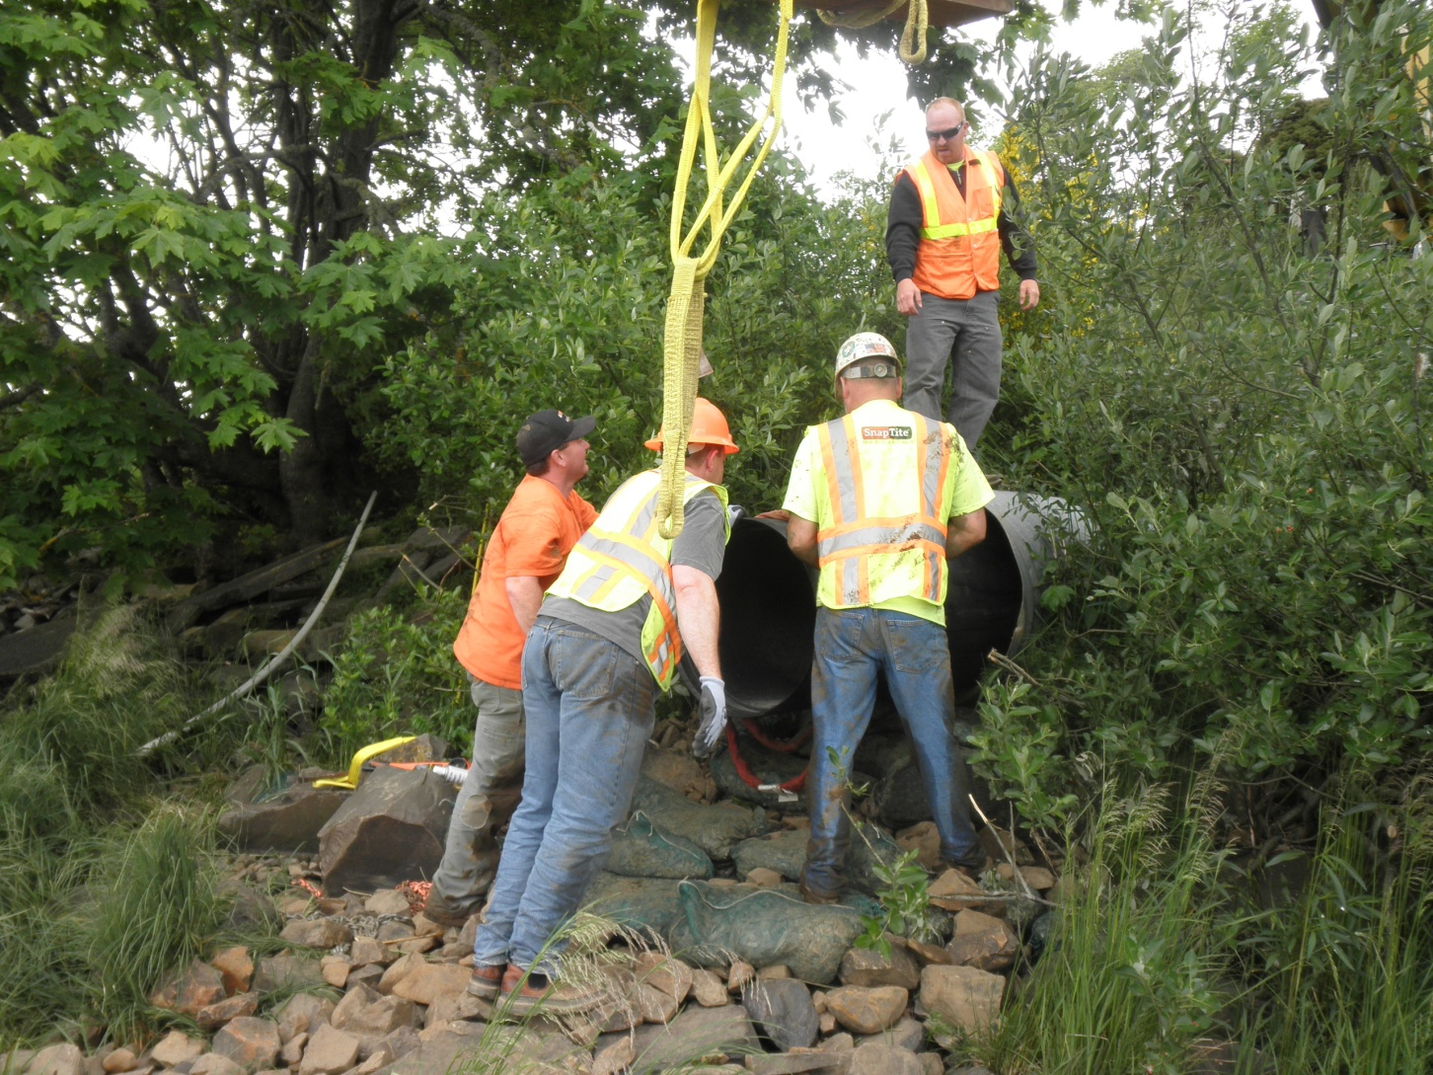

Slide 38
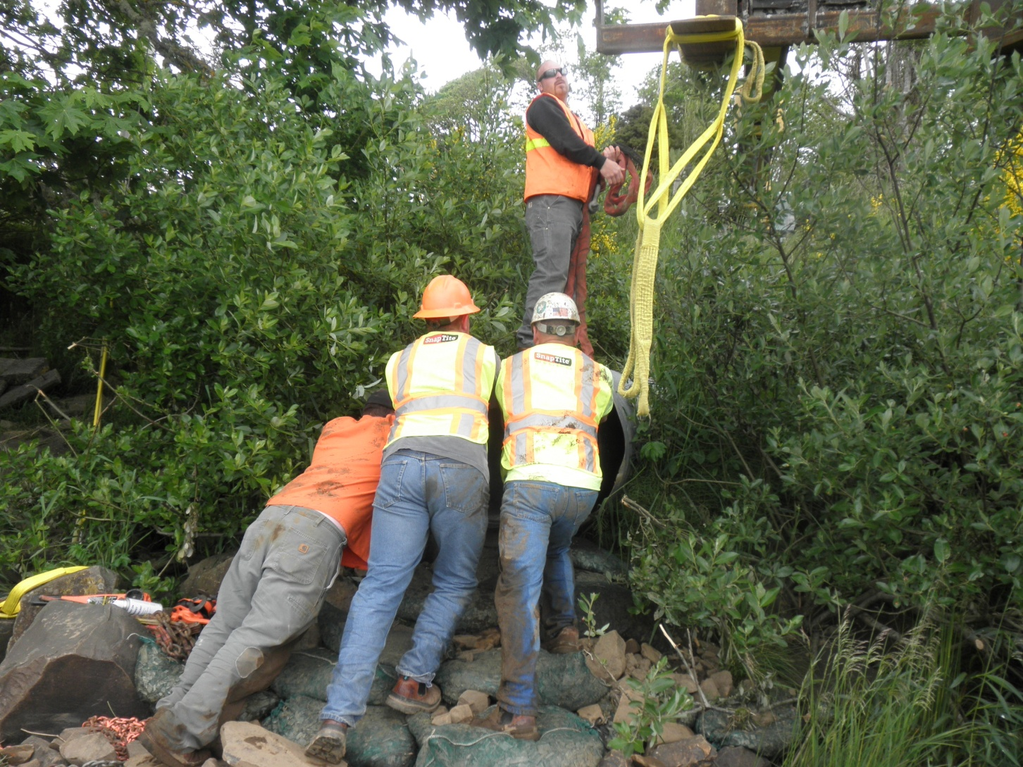

Slide 39
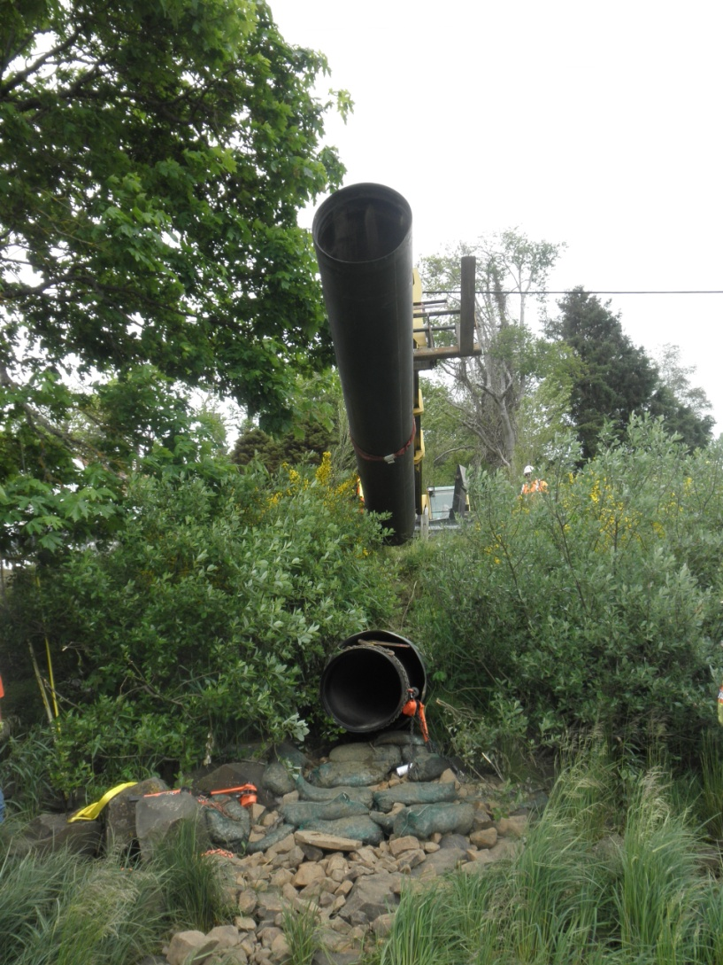

Slide 40
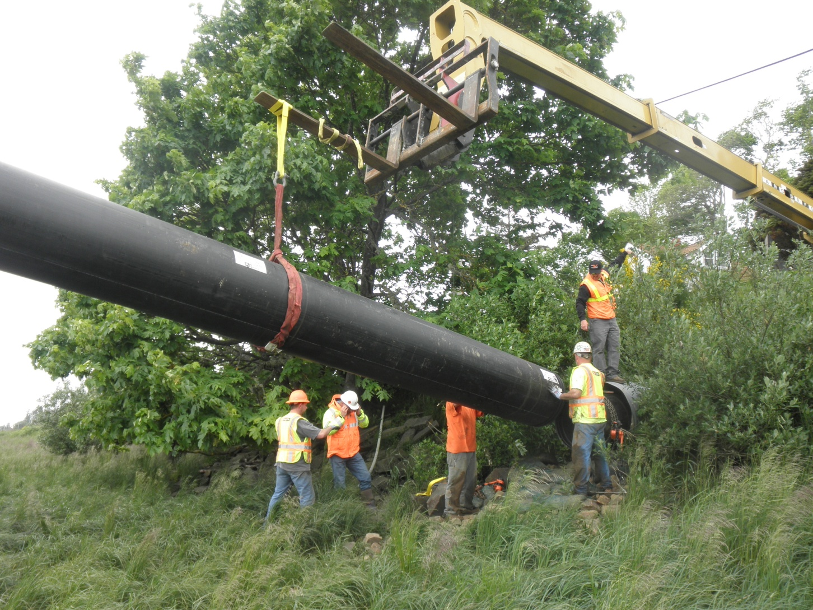

Slide 41
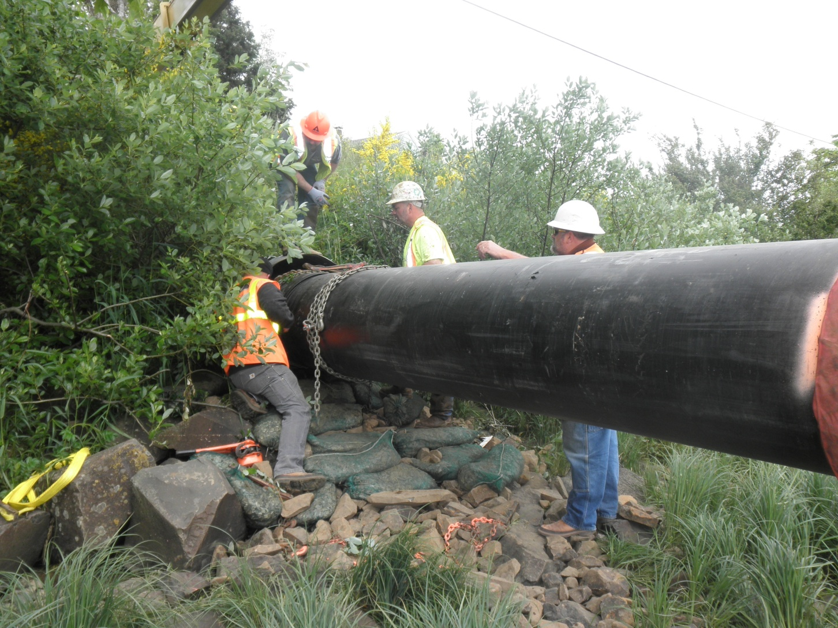

Slide 42
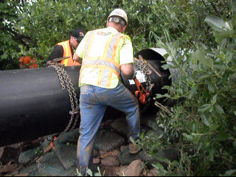

Slide 43
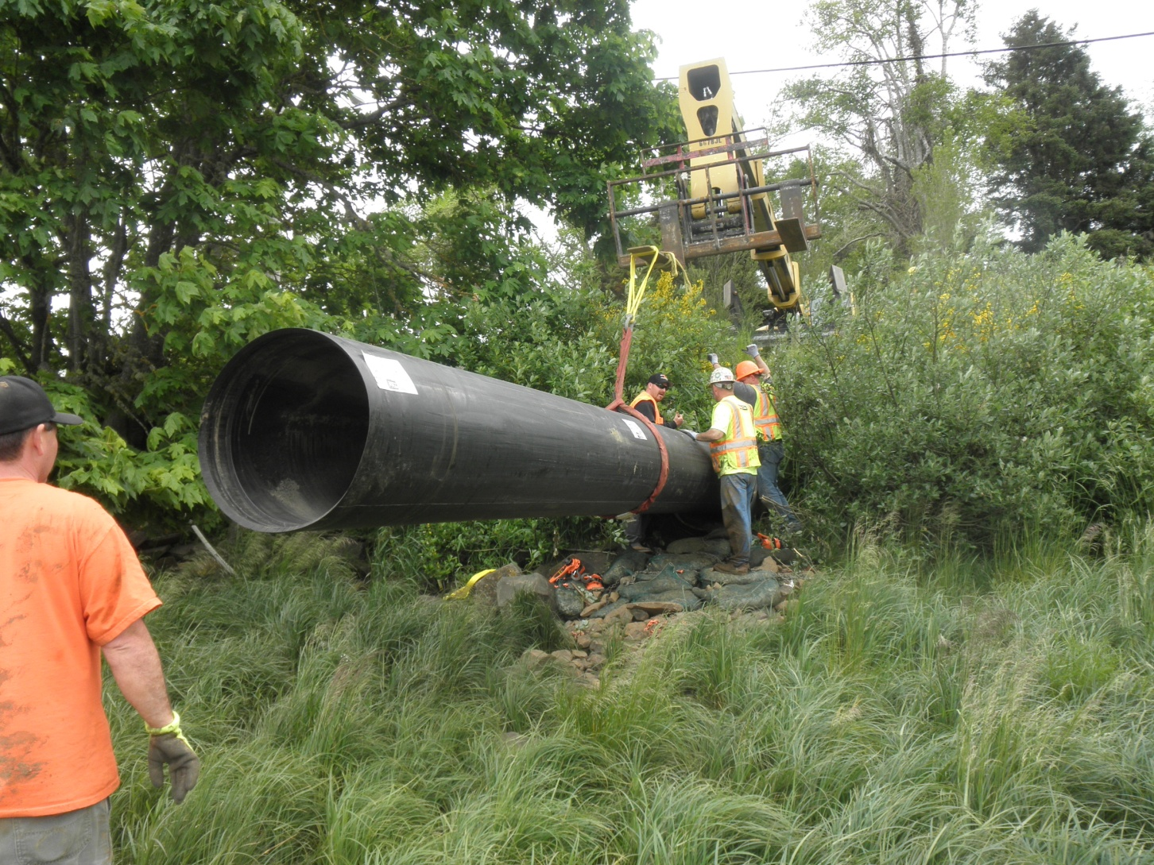

Slide 44


Slide 45


Slide 46


Slide 47


Slide 48


Slide 49


Slide 50


Slide 51

Yakutat Airport Project

Slide 52

Checking on taxiway

Slide 53


Slide 54

2 hours snapped together and ready for insertion

Slide 55

Floated it in

Slide 56


Slide 57

Dried it up

Slide 58

Stalled it with trailer jacks

Slide 59


Slide 60


Slide 61


Slide 62

Lift one

Slide 63


Slide 64

Lift 2

Slide 65

Finished product

Slide 66

Nampa ID project

Slide 67


Slide 68

Holes for water to counteract buoyancy

Slide 69

Welded using a hand welder

Slide 70


Slide 71


Slide 72


Slide 73


Slide 74


Slide 75

Fill tubes and inner tubes

Slide 76

Sand bags soaked in expandable grout

Slide 77

Bags placed under and at spring line

Slide 78

Tubes were used to hold pipe down

Slide 79

Inflated tubes to hold pipe till grout above spring line set

Slide 80

Finished bulk head ready for grout

Slide 81

Finish product

Slide 82


Slide 83

Mullen ID project

Slide 84


Slide 85


Slide 86


Slide 87


Slide 88


