Slide 1

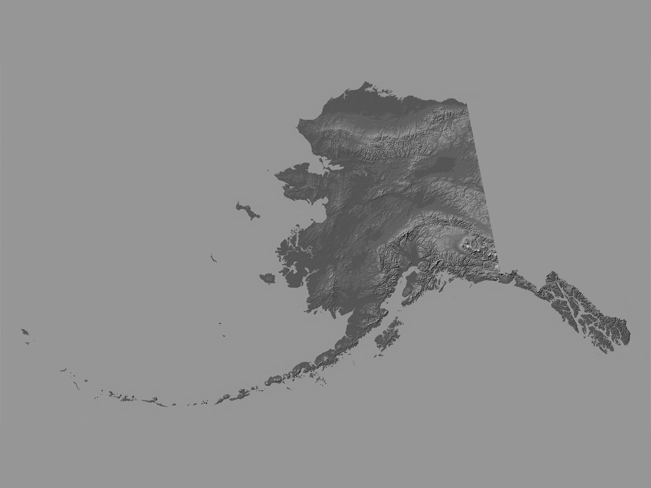
ALASKA HAS NEVER BEEN DIGITALLY MAPPED;
ALASKA’S MAPS DO NOT MEET NATIONAL MAP ACCURACY STANDARDS (NMAS);
ALASKA’S MAPS ARE INACCURATE
ELEVATION DATA IN ALASKA IS WORSE THAN 3RD WORLD COUNTRIES.
Prepared by: Nicholas Mastrodicasa
JOINT PROJECT OFFICE
Notes:
1
1

Slide 2
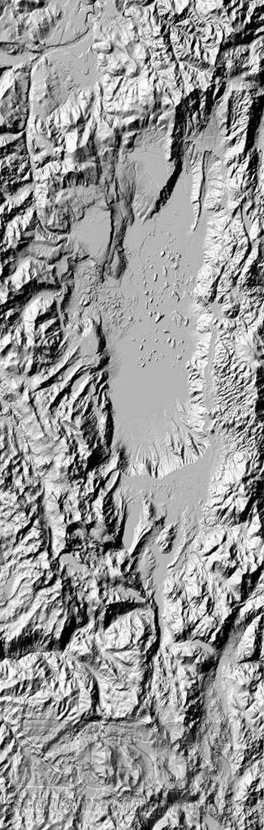
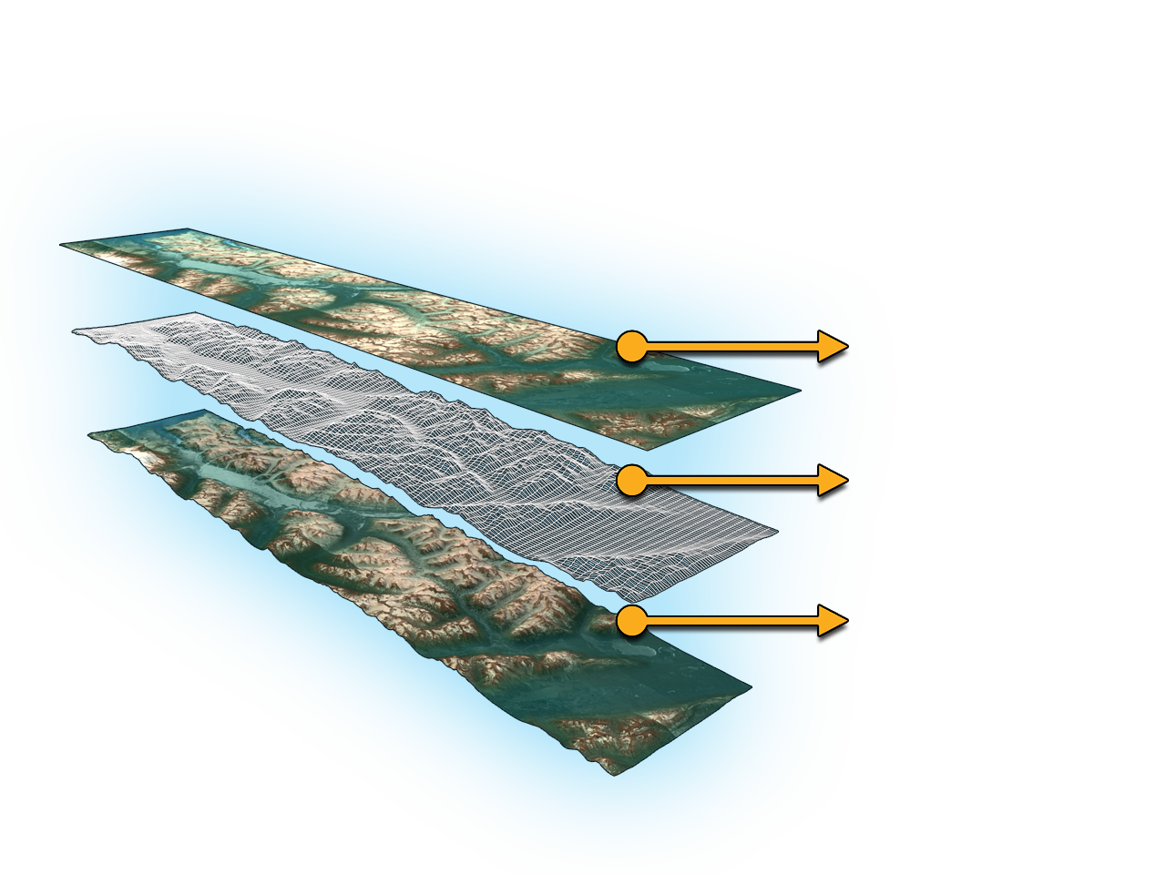
A DEM is:
FOUNDATIONAL
to ALL other data layers
Imagery
+
DEM
=
Precision Geospatial
Dataset
A DEM that is inaccurate or of poor resolution will pass those characteristics onto other data layers…

Slide 3
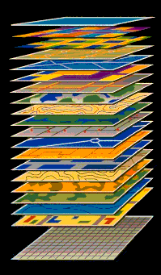
DATA LAYERS
The DEM is the Primary layer
ETC.
Roads
Buildings
Vegetation
Land Parcels
Hydrographic
Imagery
Base Layer-DEM

Slide 4
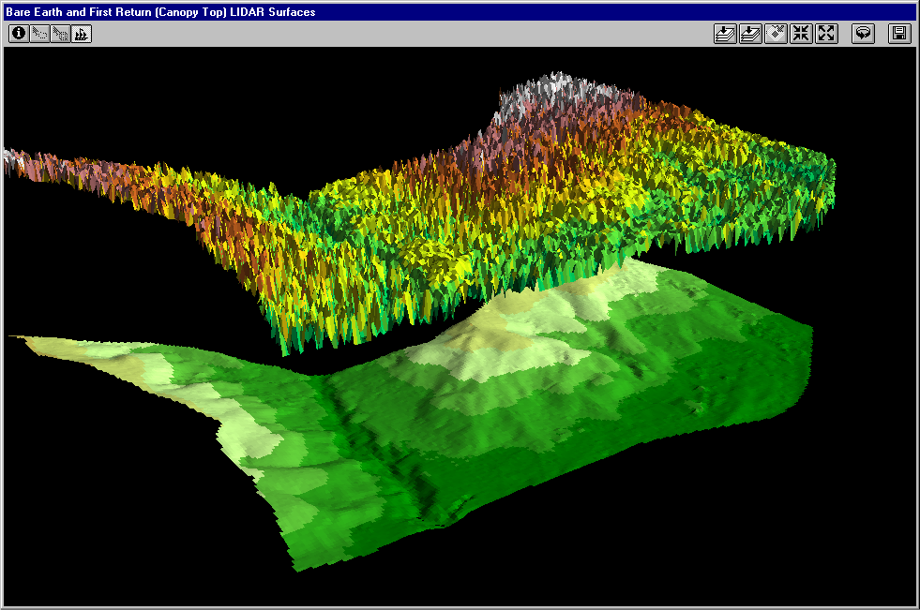
DSM vs. DTM
User Applications: DSM = top reflective surface; DTM approximates bare-earth
DSM
DTM
Need Hydro-Enforcement?

Slide 5
DEM APPLICATIONS
PARTIAL LIST
General Mapping Applications
  Topographic Mapping
  Orthorectification of Digital Imagery*
  Flood Insurance Studies and Mapping
  Wetland Mapping
  Forest Mapping
  Corridor or Right-of-Way Mapping
  Elevation Layer in The National Map
Transportation Applications
  Navigation & Transportation Safety:
  Aviation;
  Land, and
  Marine
  Road Design & Engineering, Centerlines
  Corps of Engineers Design & Construction
Coastal Mapping Applications
  Shoreline Delineation
  Climate Change
  Sea Level Change
  Coastal Management
  Coastal Engineering
  Coastal Inundation Modeling
  Storm Surge Modeling
  Tsunami Modeling
Other Technical Applications
  Water Supply and Quality
  Stormwater Management
  Subsidence Monitoring
  Disaster Preparedness and Response
  Fire Propagation Modeling
  Floodplain Management
  Hydrography*
  Seismic Monitoring
  Geological Applications
  Saltwater intrusion – ecological and engineering implications in the National Petroleum Reserve Alaska and elsewhere on the Slope
Military Applications
  Battlefield Visualization
  Battlefield Simulations and Fly-Throughs
  Line-of-Sight Analyses
  Cross Country Movement Analyses
  Terrain and Slope Analyses
  Weapons Guidance and Targeting
  Defense Support to Civil Authorities
  Military Planning
Commercial Applications
  Timber
  Precision Farming
  Mining
  Recreation
  Real Estate, Banking, Mortgage and Insurance Industries
  Geospatial Industry
  Software Development
  Telecommunications, Utilities & etc.
Individual Applications
  Risks to homes/property from:
  Flooding
  Tsunamis
  Storm Surges
  Wild Fires
  Landslides
  Subsidence
  Evacuation Routes

Slide 6
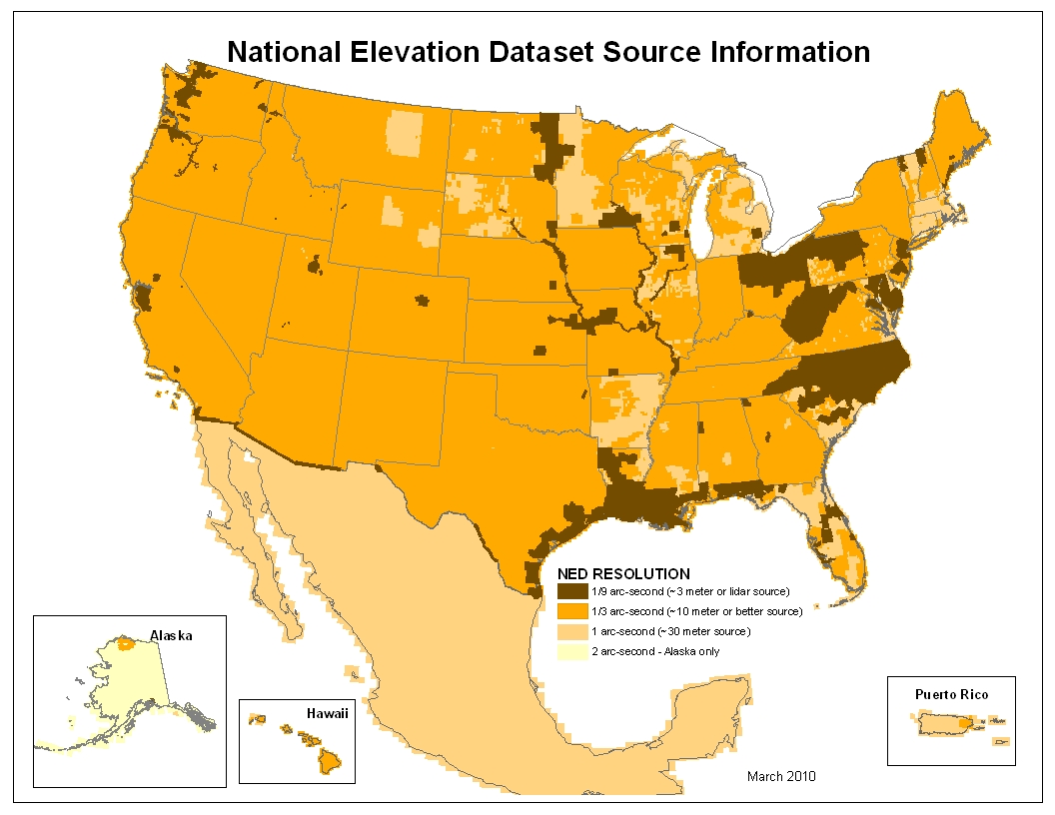
Does Alaska Measure Up?

Slide 7
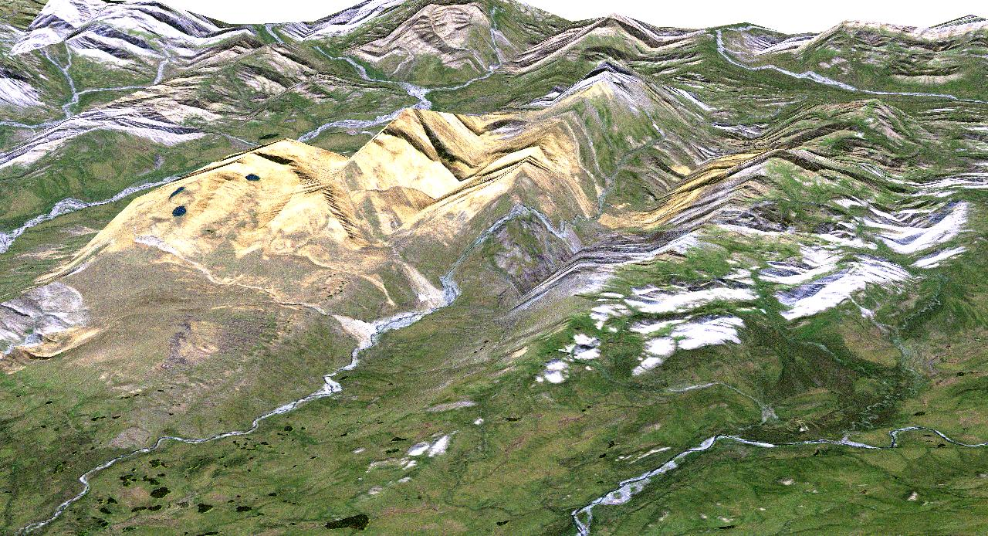
For Example:
RIVERS ARE NOT SUPPOSED TO FLOW UPHILL
Rivers flowing uphill
Imagery Provided by: Kevin Engle – UAF/GINA: http://www.gina.alaska.edu

Slide 8
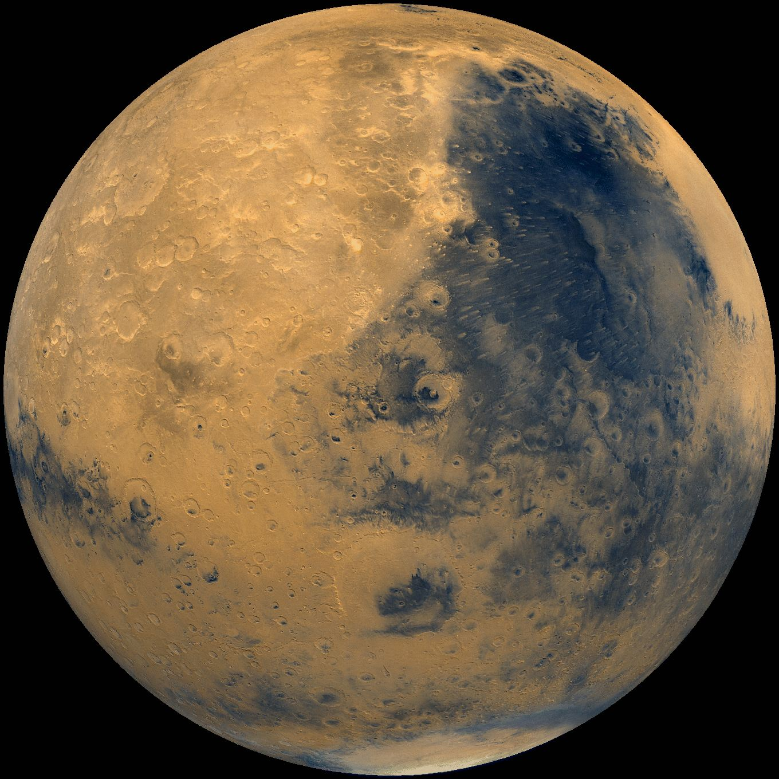
How Does Alaska Measure Up?
MARS:
More Accurately, More Extensively, and More Recently Mapped than Alaska.
20 m/pixel Resolution
NASA Viking Missions
European Space Agency
  $450M in Spacecraft Cost Alone
http://www.isprs.org/congresses/beijing2008/proceedings/4_pdf/183.pdf

Slide 9
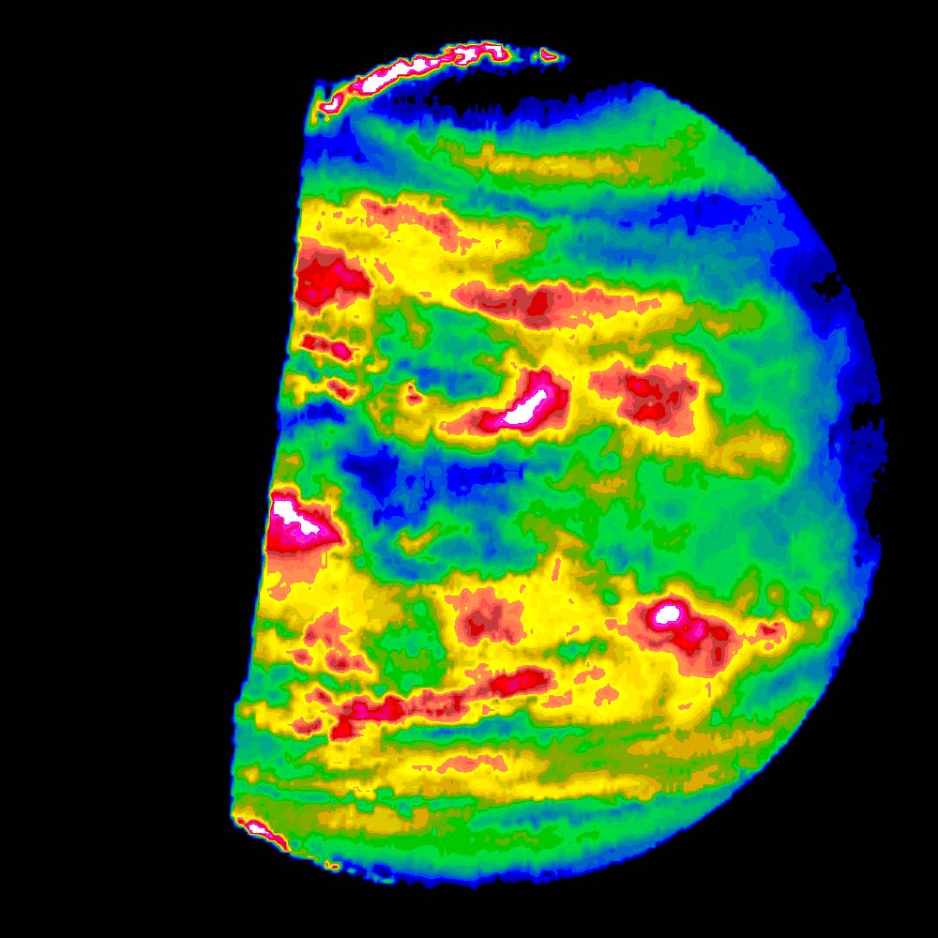
How Does Alaska
Measure Up?
VENUS:
More Recently Mapped than Alaska 1990-1994;
75 meter SAR DTM;
Venus 98% Complete
NASA Magellan Mission;
  $431M Spacecraft
http://www.dlr.de/pf/Portaldata/6/Resources/dokumente/isprs/WG-IV-7-7_Howington-Kraus.pdf

Slide 10
Dr. Maune PhD, PSM, PS, GS, CP, CFM
1963-1991: Active duty Army officer (Topographic Engineer), U.S. Army Corps of Engineers, specialized in Mapping, Charting & Geodesy (MC&G).
M.S. and Ph.D. in Geodesy & Photogrammetry to learn how to map the Soviet Union without their knowledge and/or consent.
1988-1991: Commander/Director of U.S. Army Engineer Topographic Laboratories (ETL) and U.S. Army Topographic Engineering Center (TEC).
1992-Present: Dewberry, Senior Project Manager for USGS, NOAA, FEMA, state and local clients.

Slide 11
STAKEHOLDER DEFINED REQUIREMENTS
DEM User Groups | High-accuracy 10’ and below contour accuracy (Airborne LiDAR) | Mid-accuracy 20’ to 30’ contour accuracy (Airborne IFSAR) | Low-accuracy 40’ and higher contour accuracy (Satellite Sensors)
Alaska Aviation / FAA |  | 20’ contour accuracy ICAO Area 2 standard | 200’ contour accuracy ICAO Area 1 standard
Alaska DCCED | 2’ contour accuracy
Alaska DGGS | 2’ & 10’ contour accuracy |  | 50’ & 100’ contour accuracy
Alaska DNR |  |  | 40’ contour accuracy
Alaska DOT | 4’ & 10’ contour accuracy
Alaska University Users | 2’ & 10’ contour accuracy | 30’ contour accuracy | 50’ contour accuracy
BLM |  | 20’ contour accuracy
DOD |  | 20’ contour accuracy
NGA* |  | 20’ contour accuracy
NOAA | 2’ contour accuracy | 20’ contour accuracy | 40’ contour accuracy
NPS |  |  | 40’ contour accuracy
NRCS |  |  | 40’ contour accuracy
USFS |  | 20’ contour accuracy
USGS | 10’ contour accuracy (“ideal”) | 20’ contour accuracy (“preferred”) | 40’ contour accuracy (“acceptable”)
USF&WS |  |  | 40’ accuracy presumed
*NGA has accepted the Alaska Commands requirement for DTED-4 through NORTHCOM (20’ contour accuracy)

Slide 12
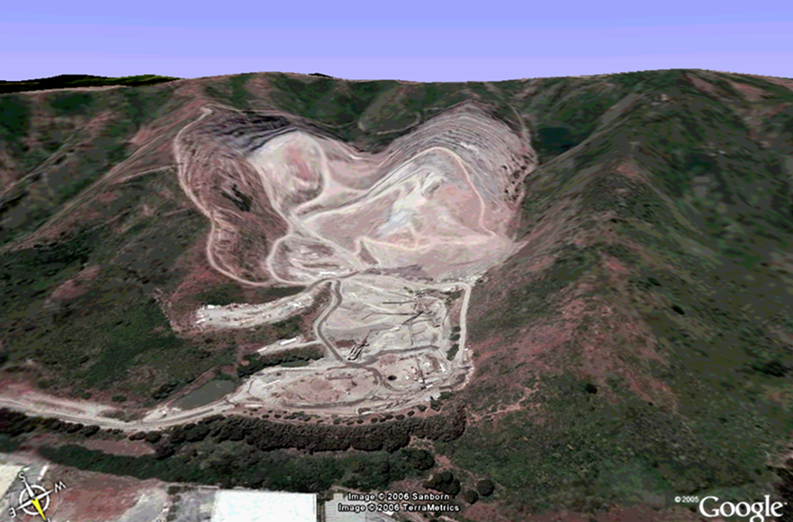
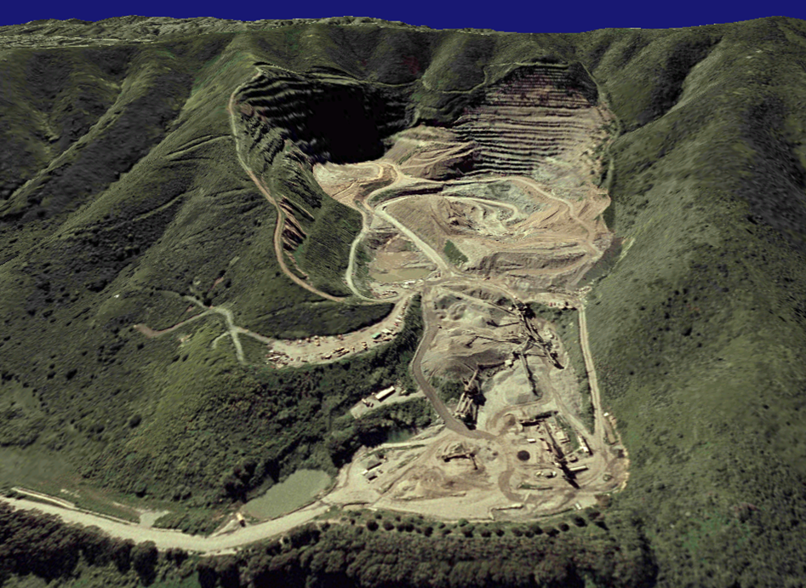
ACCURACY MATTERS
6” Aerial Photo
30 m USGS NED
6” Aerial Photo
5 m NEXTMap DTM

Slide 13
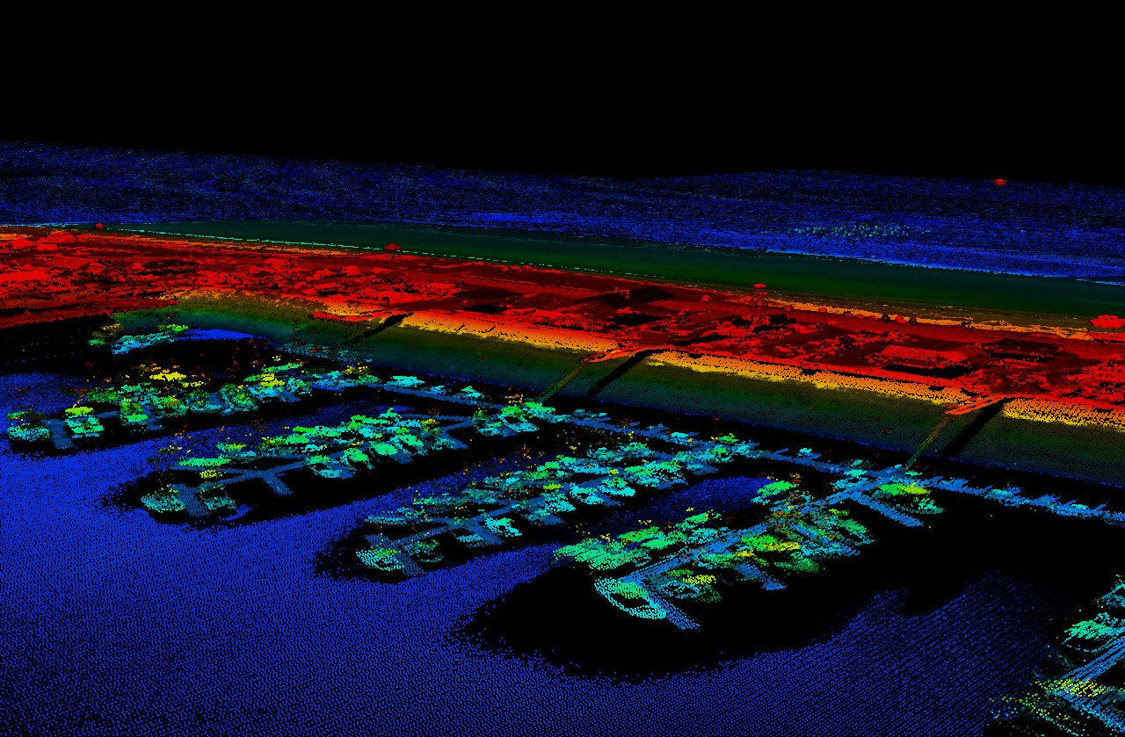
LiDAR
Homer Spit & Boat Harbor

Slide 14
SAR / IFSAR - 20 Foot Contours
Interferometric Synthetic Aperture Radar
Advantages:
  Significant Cost Advantages Over LiDAR
  All Weather & Day/Night Capability
  Ideal for 10’ - 20’ Contours
  Resolution Satisfies Stakeholders Needs Statewide
  Deliverables = DSM, DTM & ORI
  Minimizes GCP expense
  Accurately Maps Perpetually Snow & Ice Covered Features
Disadvantages:
  Some Layover, Shadow & Void - Correctable
  Limited Vendor Pool

Slide 15
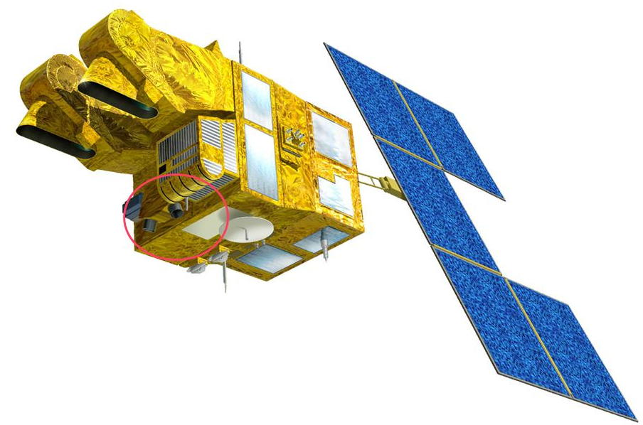
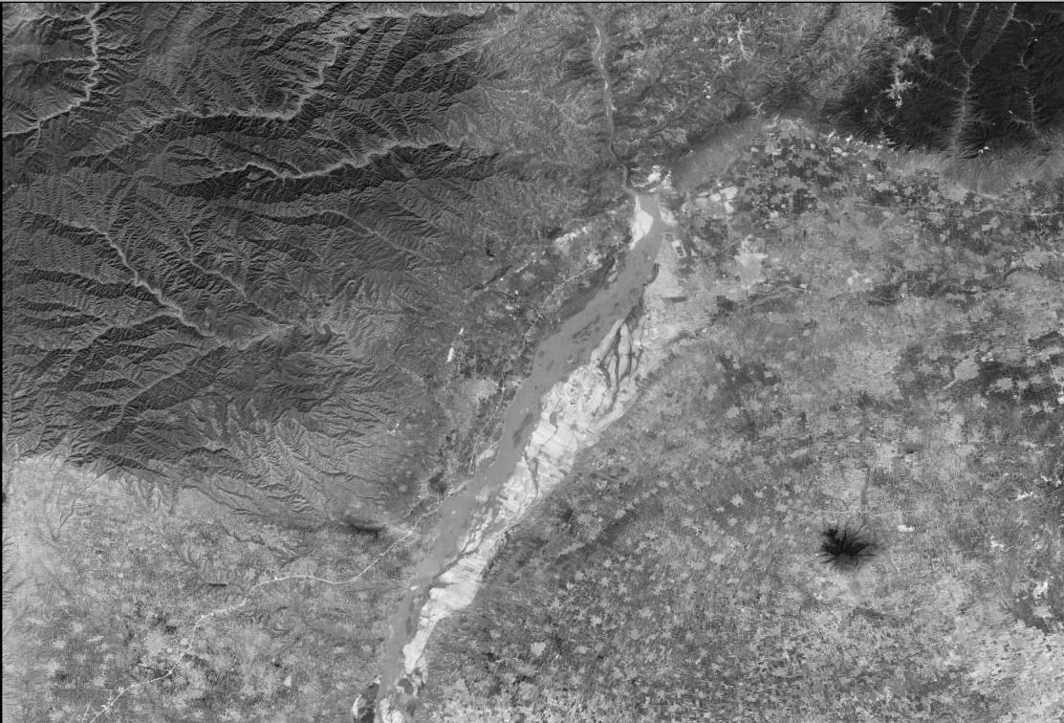
OPTICAL IMAGERY – 40’+ Contours
Low Resolution
  Not All Weather or Day/ Night Capable
  Lower Resolution, Does Not Meet Majority Stakeholder Needs Statewide;
  Long Delivery Time, DSM Only;
  Airborne: Capable of Meeting 1’ – 20’ Contour but Expensive
  Difficult to Map Perpetually Snow Covered Features such as Mountains & Glaciers
  Satellite: Vertical Accuracy Comparable to 50’ Contours is Expensive Compared to 200’ Contours which is Less Expensive w/out GCPs

Slide 16
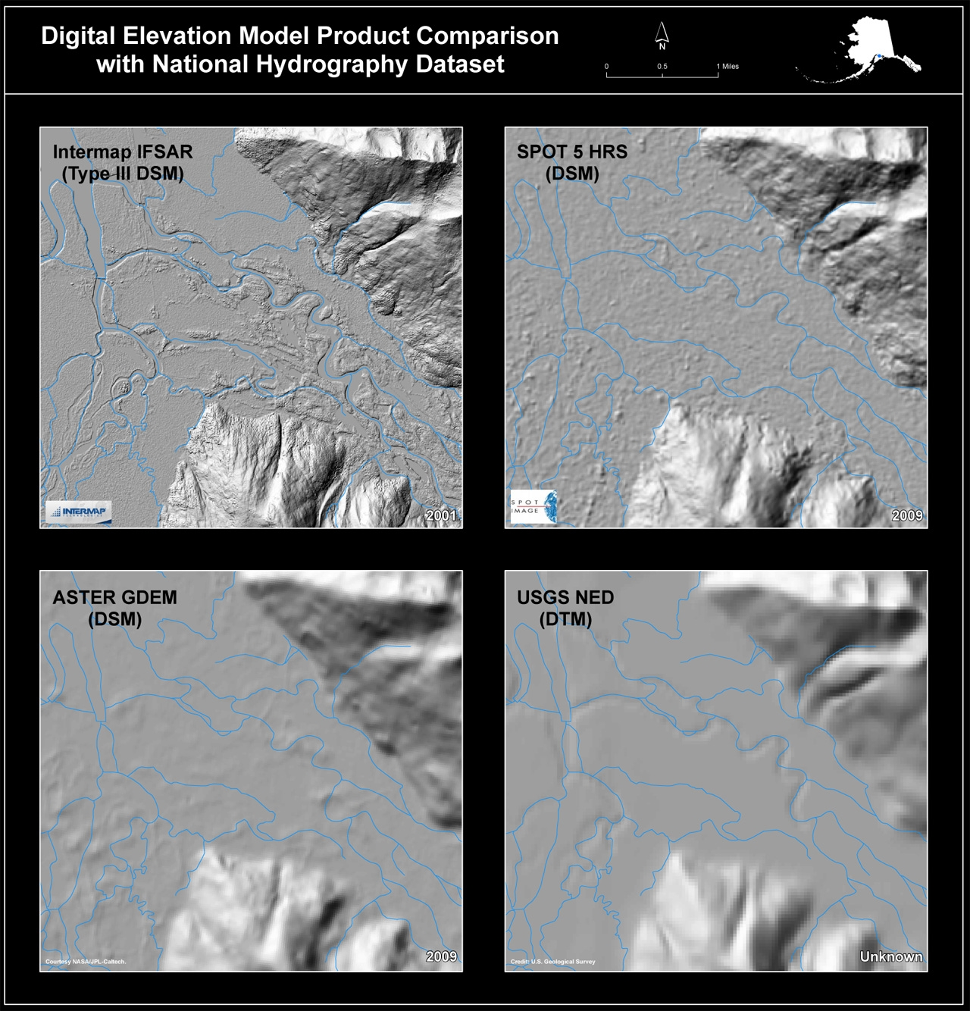

Slide 17
OPPORTUNITY
PARTNERS:
HOW MUCH?
NGA $2.4M
USGS $1.0M
BLM $200k
NPS $100k
NRCS $100k
FED $3.8M 66%
STATE $2.0M 34%
TTL $5.8M
APPROXIMATELY 20 CELLS
114,000 SQKM
7.5% of Alaska
Incomplete 87%

Slide 18
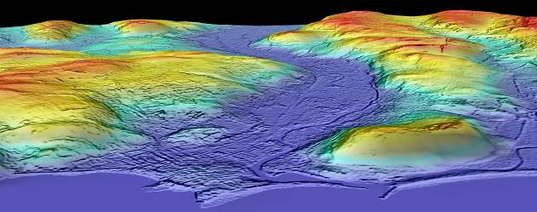
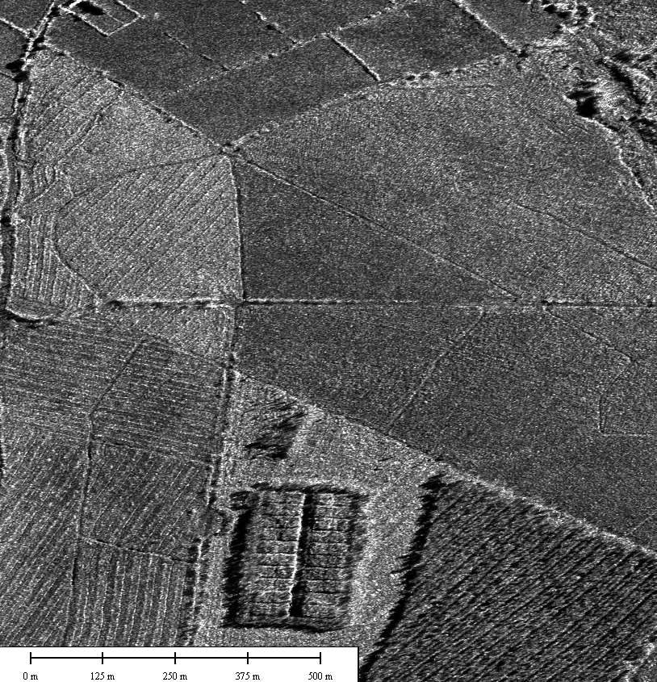
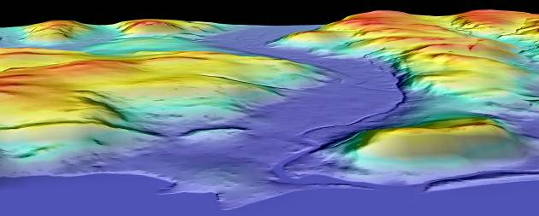
DELIVERABLES
DSM / DTM / ORI
DSM Digital Surface Model
Orthorectified Radar Image (ORI)
DTM Digital Terrain Model (Bare Earth)
The USGS National Elevation Dataset (NED) seeks Digital
Terrain Models (DTM) which the low resolution DEM does not provide
Radar images may be the only imagery
available in areas of perpetual cloud cover

Slide 19
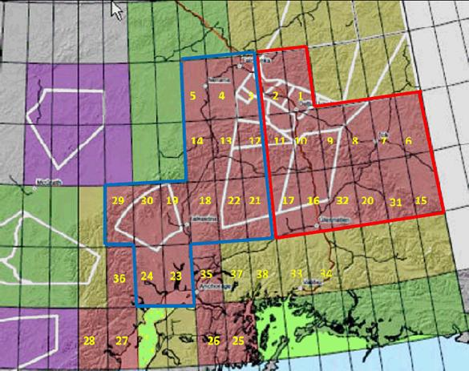
DEM PROCUREMENT RESULTS
28 CELLS ACQUIRED
157,434 k² COLLECT
$34.73/ k²

Slide 20
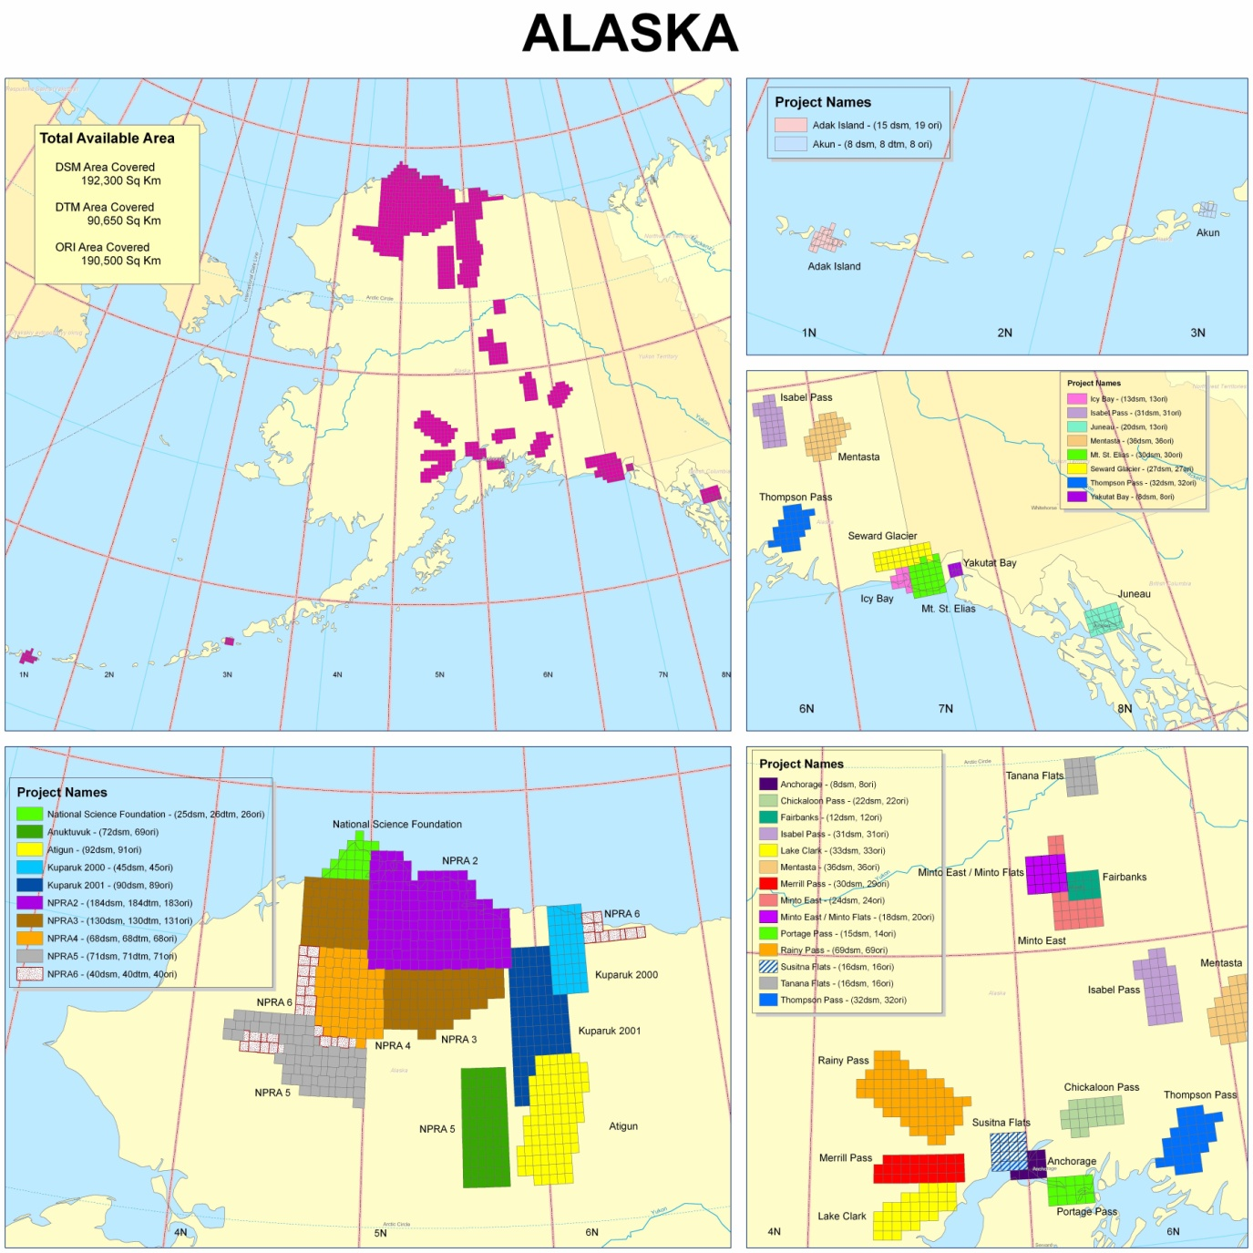

Slide 21
THE DEM FUNDING STRATEGY
State Cost
$12.96M
Federal Cost
$35.04M

Slide 22
DEM COST SHARE ANALYSIS
THREE YEAR PROJECT
STATE/YEAR
$4.32M
FED/YEAR TOTAL
$11.68M
AGENCY/YR
FOUR AGENCIES
$2.92M

Slide 23
NSDI CAP 3 GRANT
AWARDED TO DOT-AVIATION
FGDC Cooperative Agreements Program
$65,000 IN FUNDING AVAILABLE;
$50k FROM USGS / FGDC (FEDERAL GEOSPATIAL DATA COMMITTEE)
FGDC ADVISES THE PRESIDENT, CONGRESS & THE CABINET
RFP TO HIRE THIRD PARTY PROFESSIONAL PLANNER(S)
  ENTERPRISE GEOSPATIAL INFORMATION SYSTEM (GIS) REVIEW
  STAKEHOLDER INPUT / ASSESSMENT
  Vertical Integration & Interoperability of Datasets

