Slide 1

Construction Report
DOT/PF Construction Section
By Pat Wittrock, P.E.,
Construction Engineer

Slide 2
Design Recommendations
DOT/PF Construction Section
By Pat Wittrock, P.E.,
Construction Engineer

Slide 3
Design Recommendations
Construction PEs & PMs
CONNECTION
Design Engineers
& Consultants

Slide 4
Design Recommendations
Construction Project Engineers
Construction Project Managers
About 100 Comment Categories (handout)

Slide 5
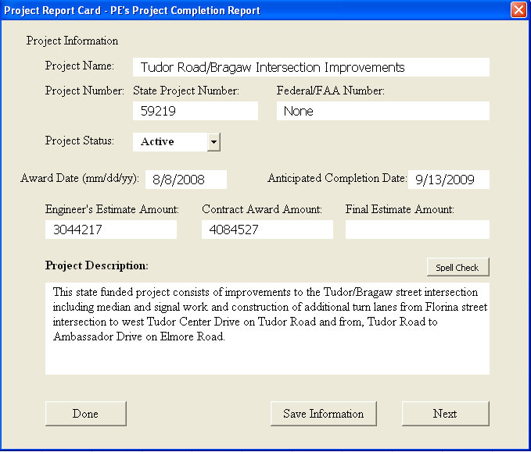
Design Recommendations

Slide 6
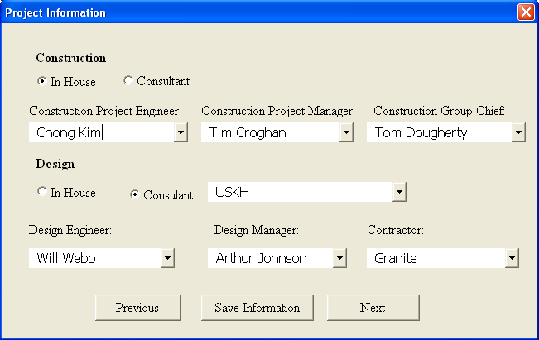
Design Recommendations

Slide 7
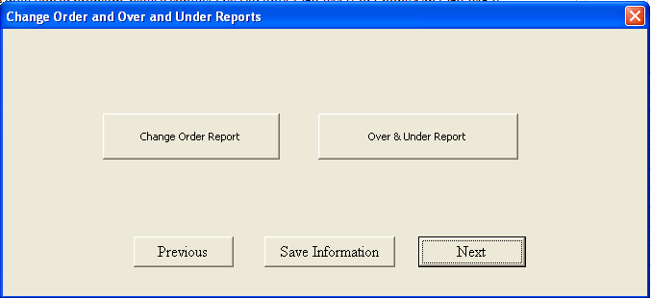
Design Recommendations

Slide 8
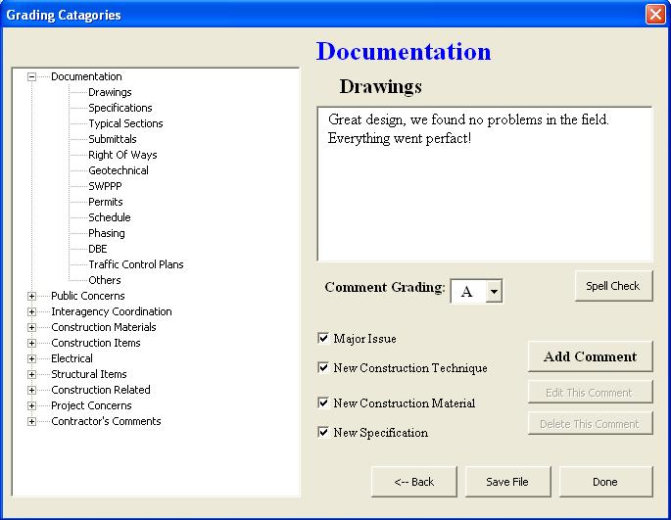
Design Recommendations

Slide 9
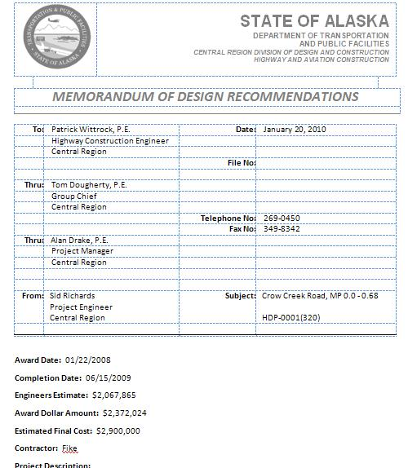
Design Recommendations
Automated Reports

Slide 10
Design Recommendations
For Designers and Design Consultants
View Projects
Review Comments
Feedback
Generate Reports & lists
Improve overall projects

Slide 11
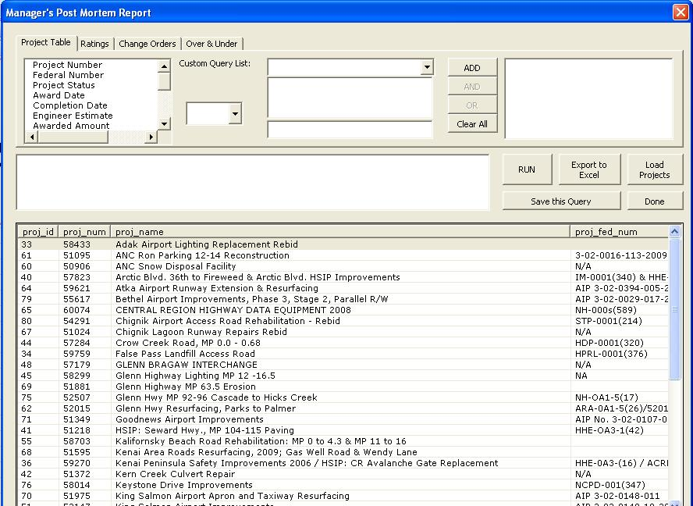
Design Recommendations

Slide 12
Design Recommendations
Improvements needs to be made
Maybe Web based?
Better Report System
Better access with security
Data Collection Standardization
Constructed Comments from Design Teams

Slide 13
Design Recommendations
Demonstration

Slide 14
Design Recommendations
Question?

Slide 15
Construction Report
DOT/PF Construction Section
By Pat Wittrock, P.E.,
Construction Engineer

Slide 16
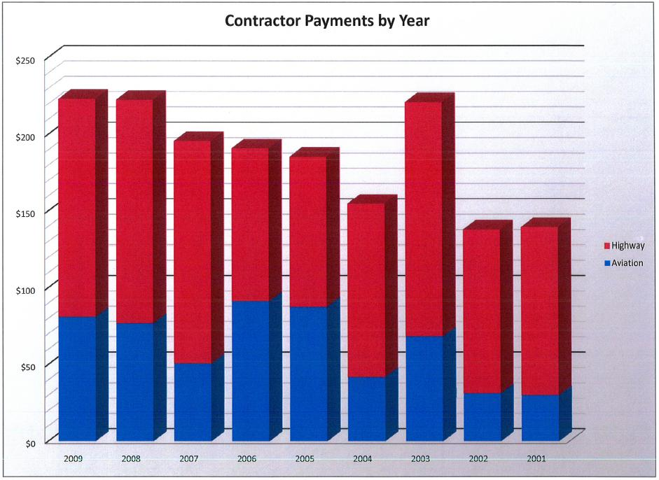

Slide 17
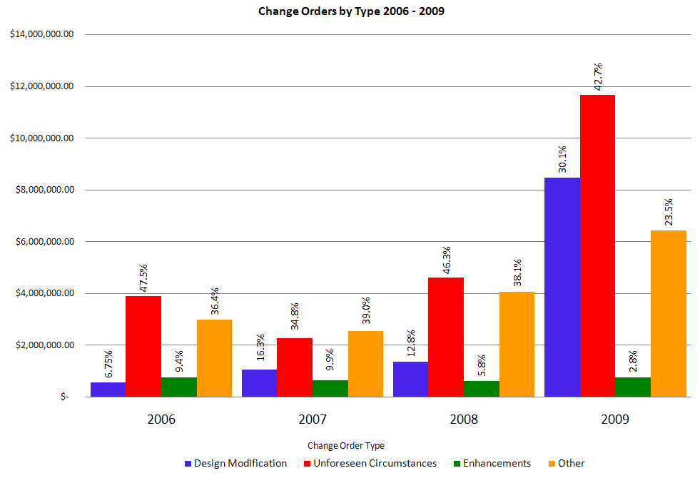

Slide 18
