Slide 1

Packaged Water & Wastewater Treatment Plants for Your Remote Camp in Alaska
Bob Tsigonis, P.E.

Slide 2
Our goal is to make life simpler, more comfortable, and environmentally friendly
by providing worry-free water and wastewater treatment plants

Slide 3
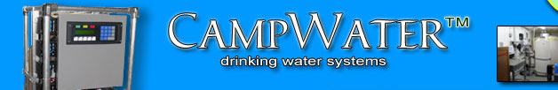
First let’s talk about water treatment plants
Jon Dufendach

Slide 4
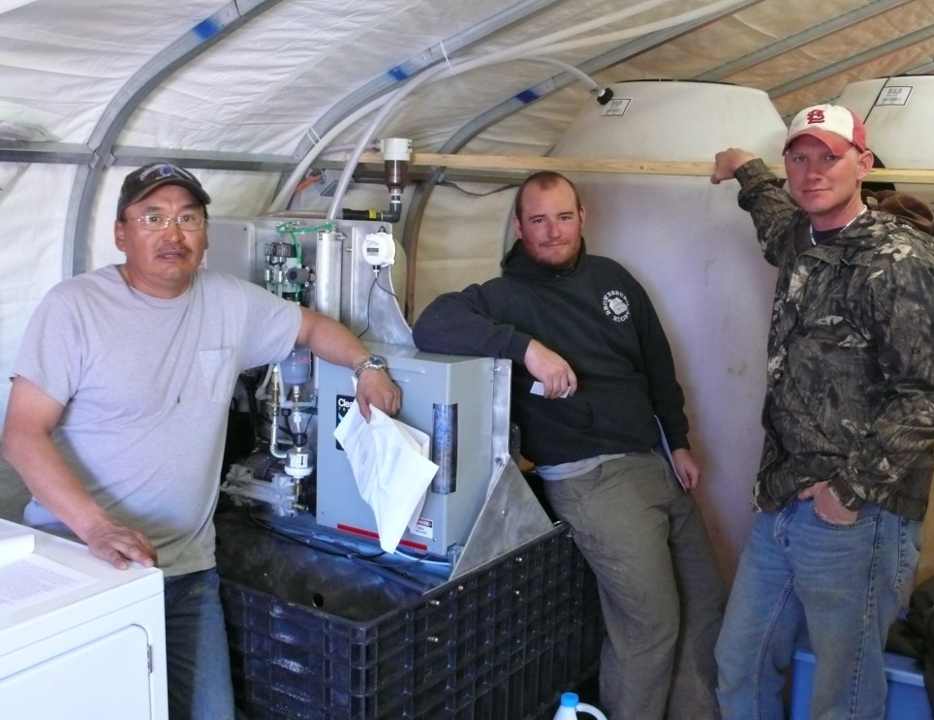
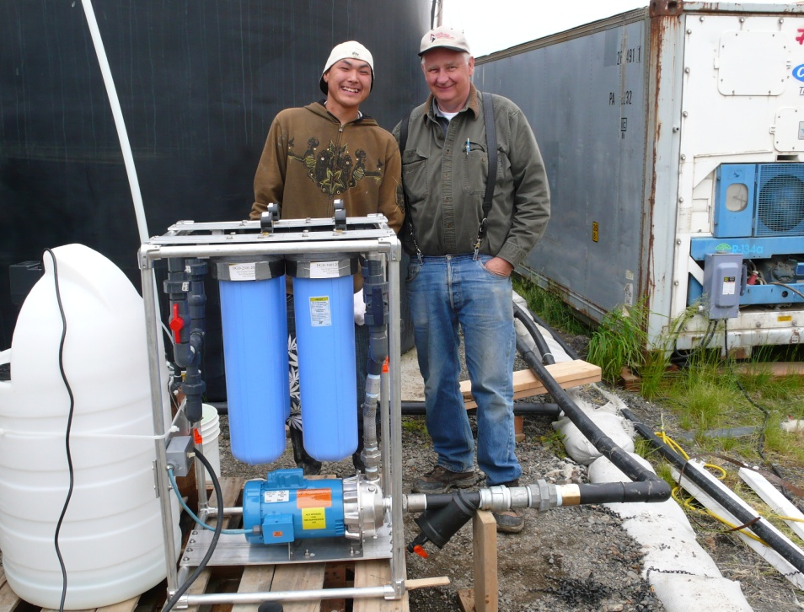
Drinking water plants for temporary camps, remote operations, and emergencies

Slide 5
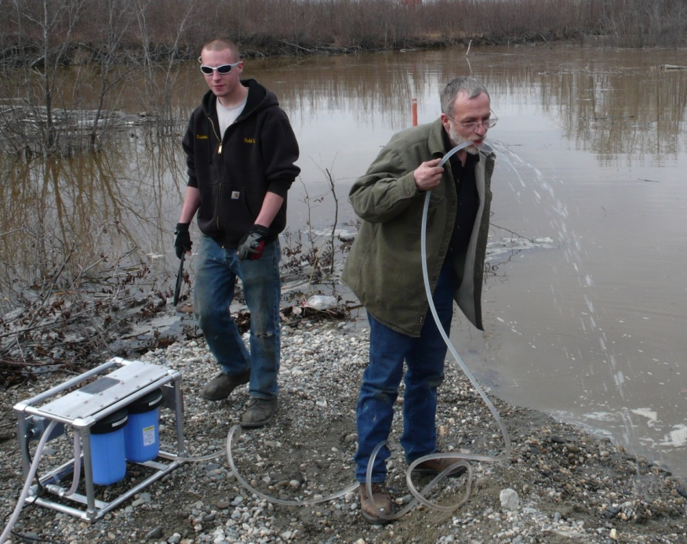
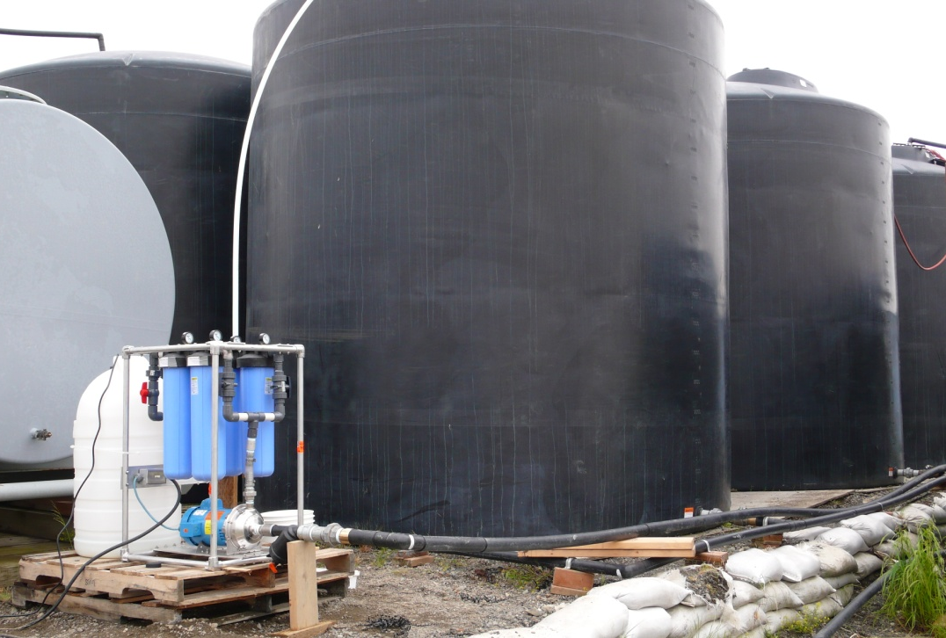
Solutions for a fast response
… from 1500 to 20,000 gallons per day

Slide 6
Eagle Alaska, Spring 2009
Alaska DEC requested two Model FUV2’s for emergency response to Eagle after the Yukon River flooded the city well.
They were delivered to the State in one day.
Two days later the Incident Commander reported that one FUV2 was supplying the entire village and paid for both of them “the first day of operation”.
Contact Lee Johnson, P.E., Alaska DEC for details.

Slide 7
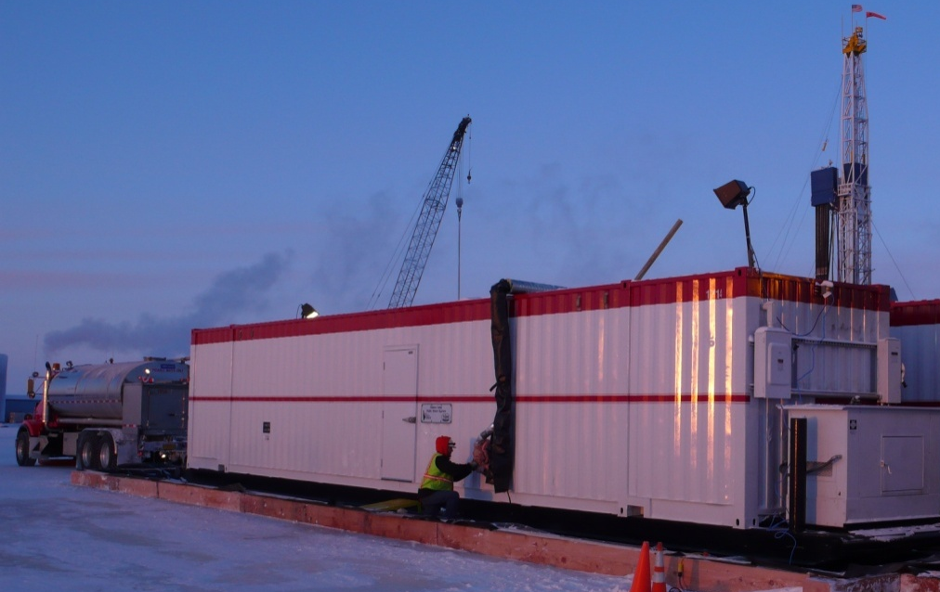
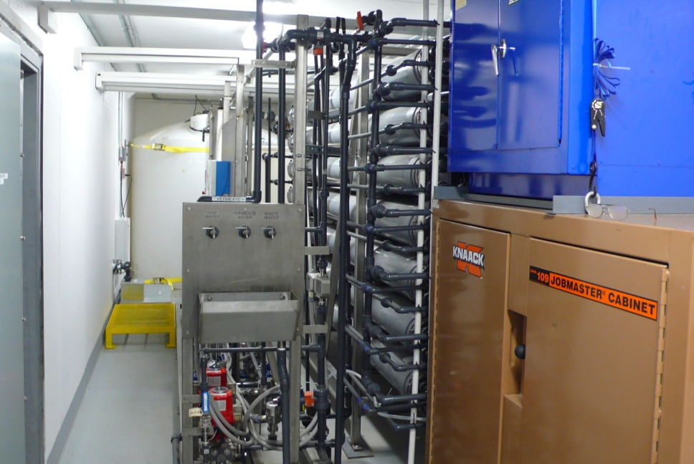
If you are planning ahead…
…Alaska-proven custom plants

Slide 8
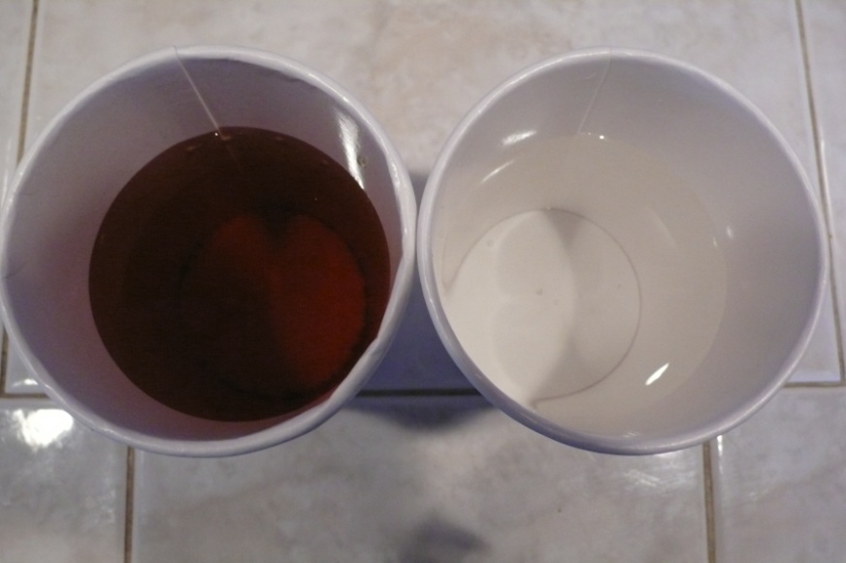
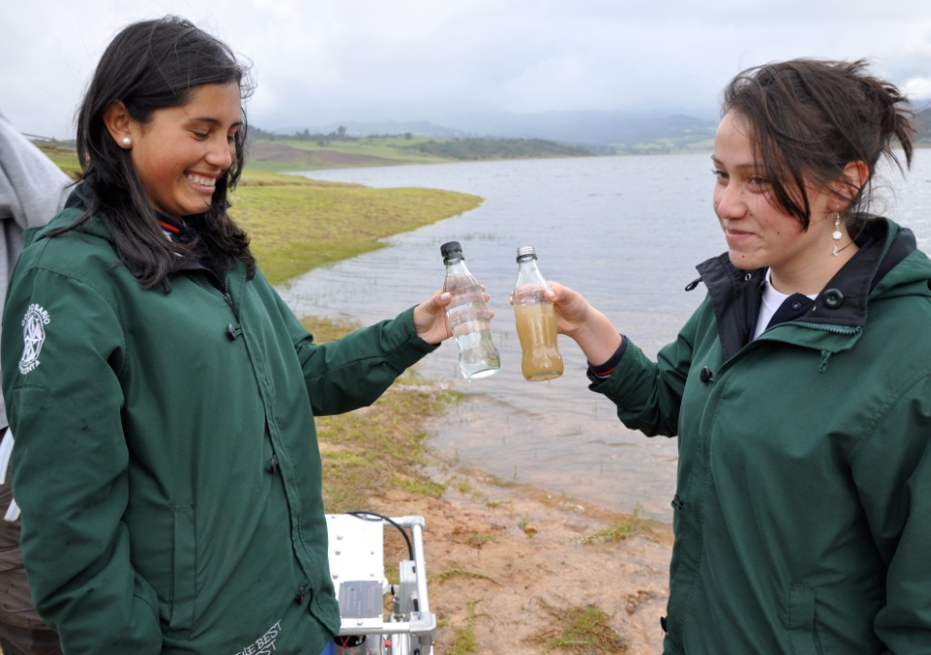
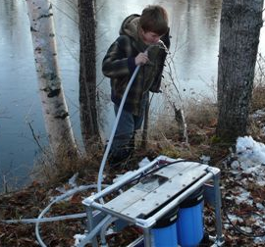
…with good results

Slide 9
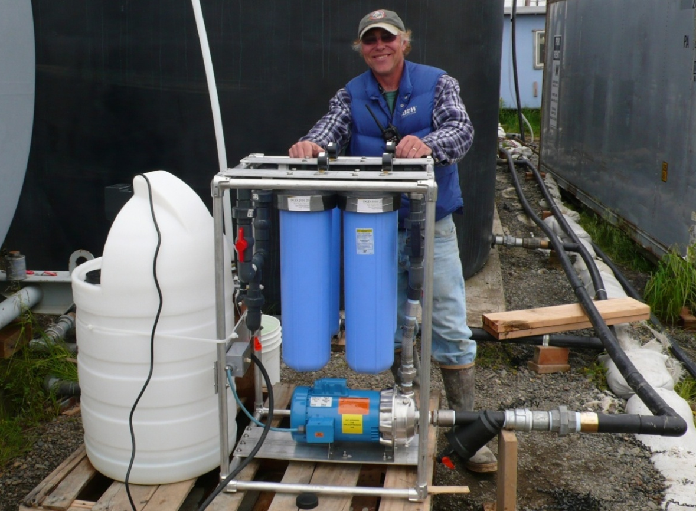
Model F20C at Quinhagak, Alaska
20 gpm, Strainer, 4ea 20”Filters, Chlorinator

Slide 10
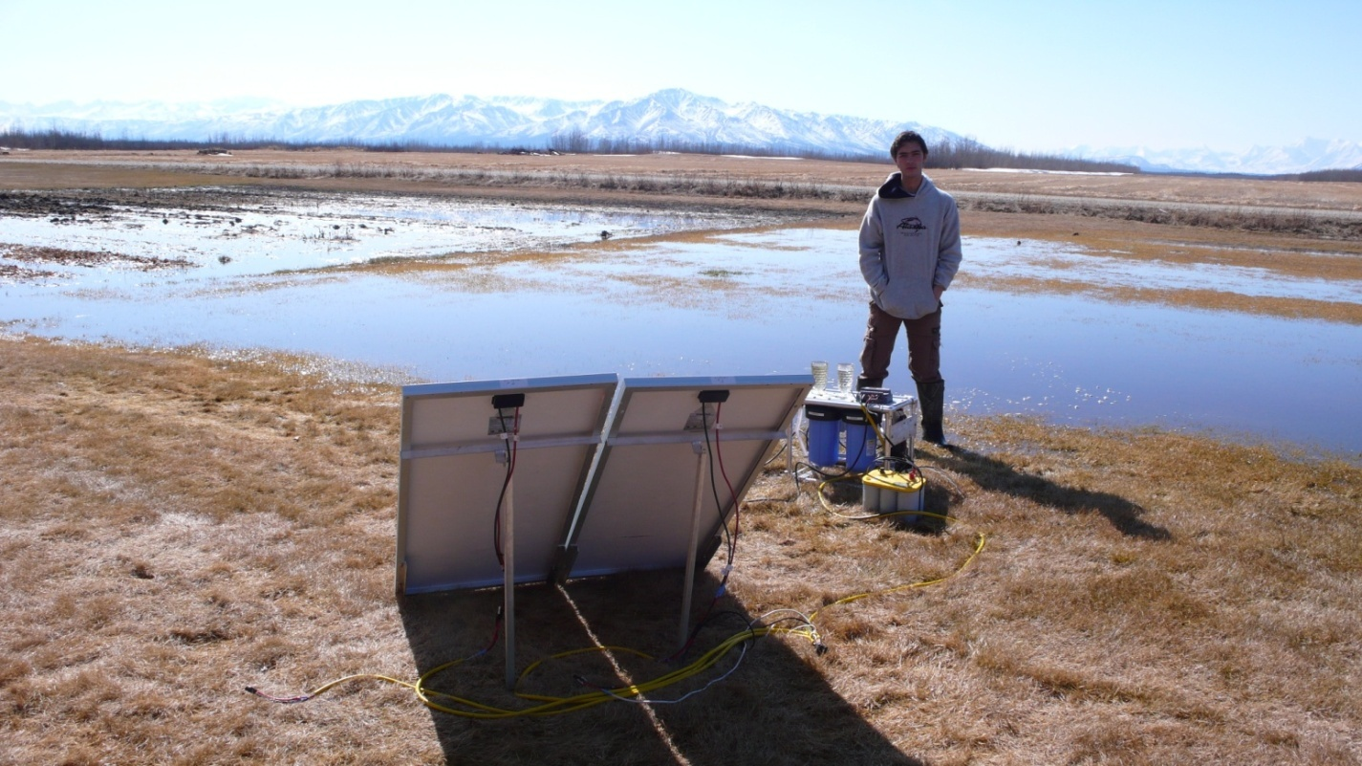
A 12VDC solar powered system

Slide 11
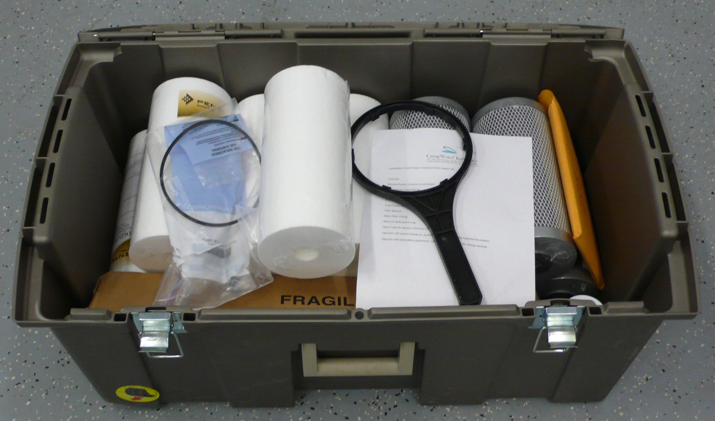
Maintenance Kit Option

Slide 12
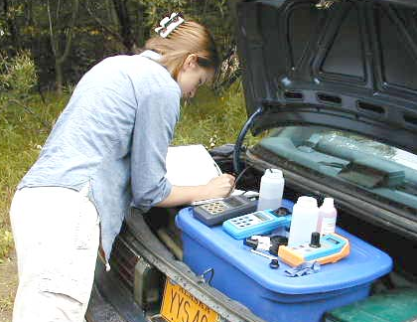
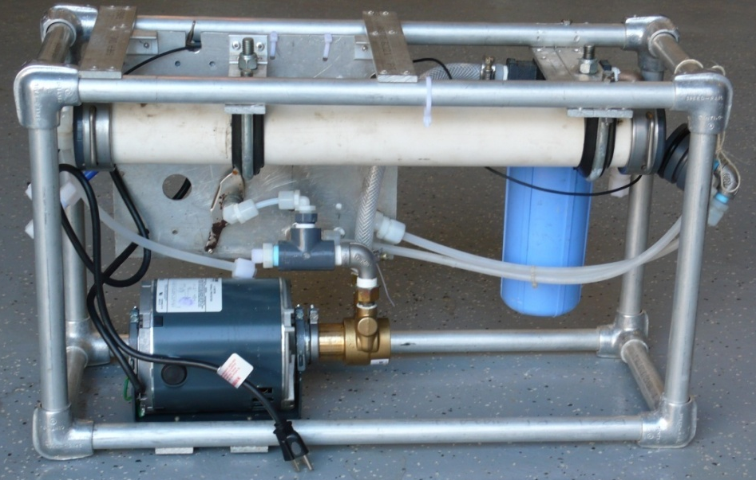
Raw Water Analysis Recommended
Accessories such as nanofiltration may be needed; basic models not for salt, etc.

Slide 13
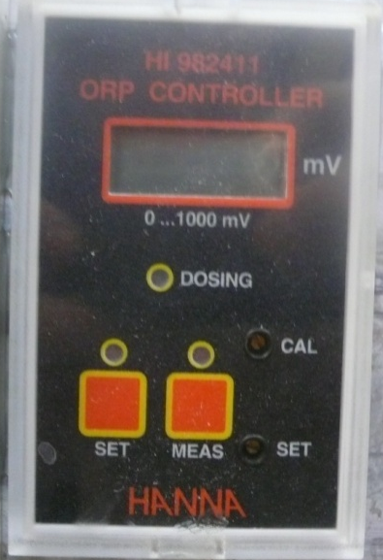
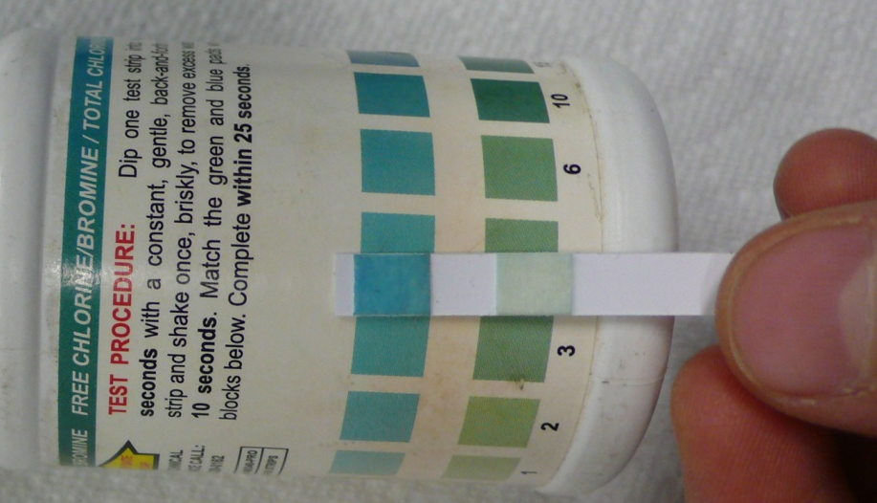
How do I know my water is safe?
All components in contact with water must be NSF PW approved
Built-in measurement of disinfectant potential
Use certified labs to verify results

Slide 14
Now let’s talk about wastewater treatment plants
ExtremeSTP sewage treatment plants

Slide 15
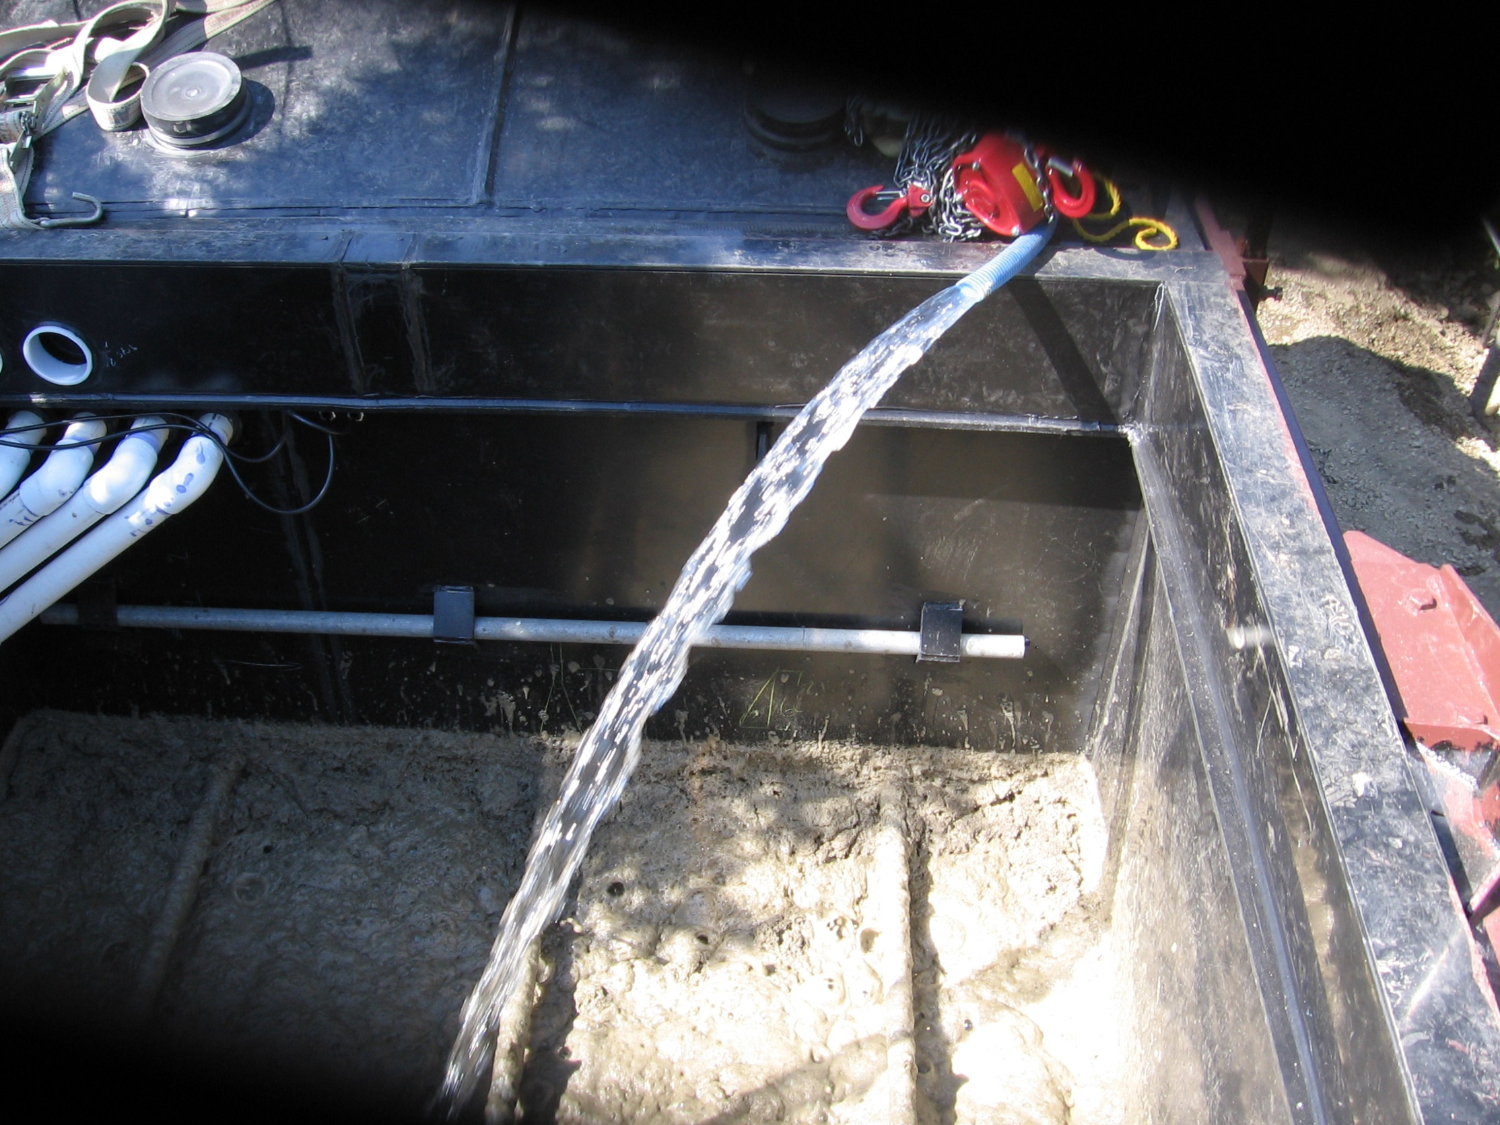
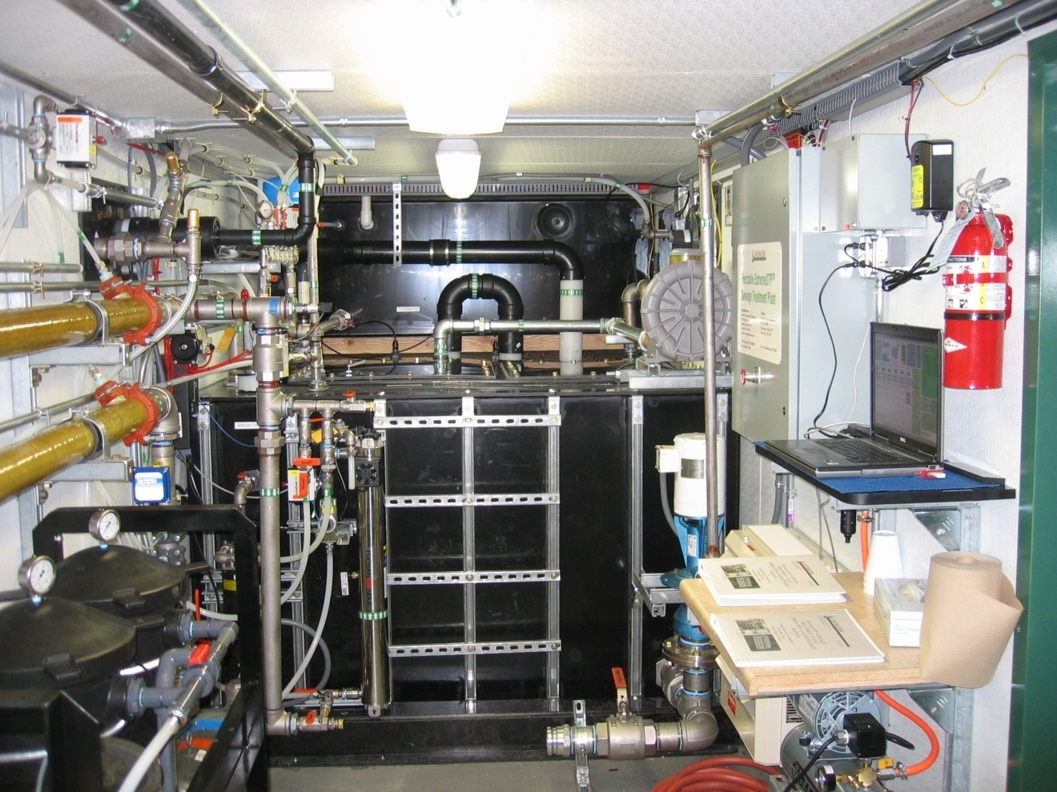
Configuration & treatment technology appropriate to your project
Configuration
Treatment technology
Above ground
Below ground
Insulated
Un-insulated
Aircraft/helicopter transportable
Skid-mounted
Submerged fixed film
Membrane bioreactor
  Immersed membrane
  Sidestream membrane

Slide 16
Treatment technology comparison
Submerged fixed film
Membrane bioreactor
  Immersed membrane
  Sidestream membrane
Simplest
Low power consumption
Best effluent quality
Low power consumption
No handling dirty membranes
Everything is indoors
Smallest footprint
Easily winterized

Slide 17
Control moisture in the STP
The best vapor control is sealed tanks
(control water vapor at its source)
Controlled ventilation of the enclosure
Controlled ventilation of the tanks
A floor sump helps control moisture

Slide 18
We like empty pipes!
Pipes should drain one way or the other
STP
or
STP
Discharge should be dosed

Slide 19
Submerged fixed film technology

Slide 20
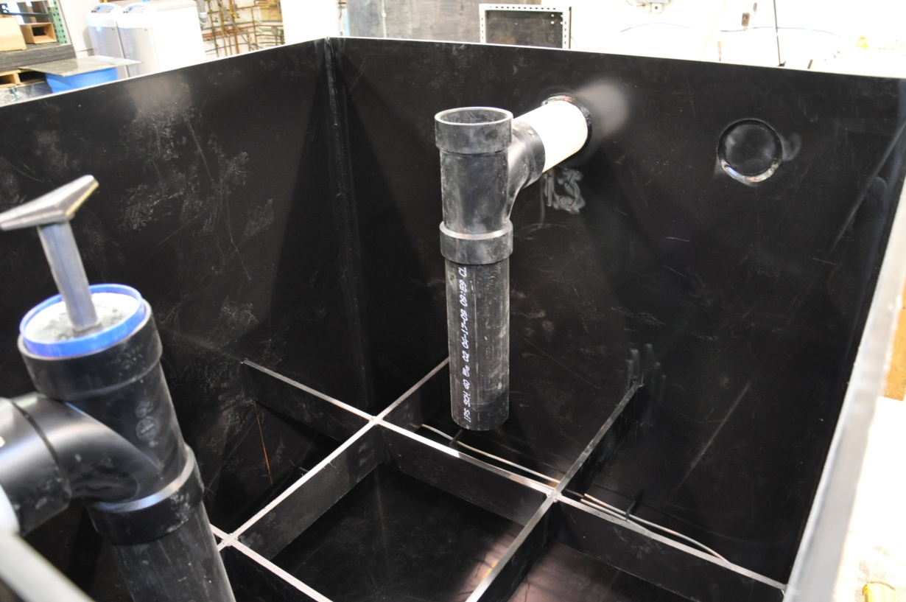
First compartment -anaerobic settling

Slide 21
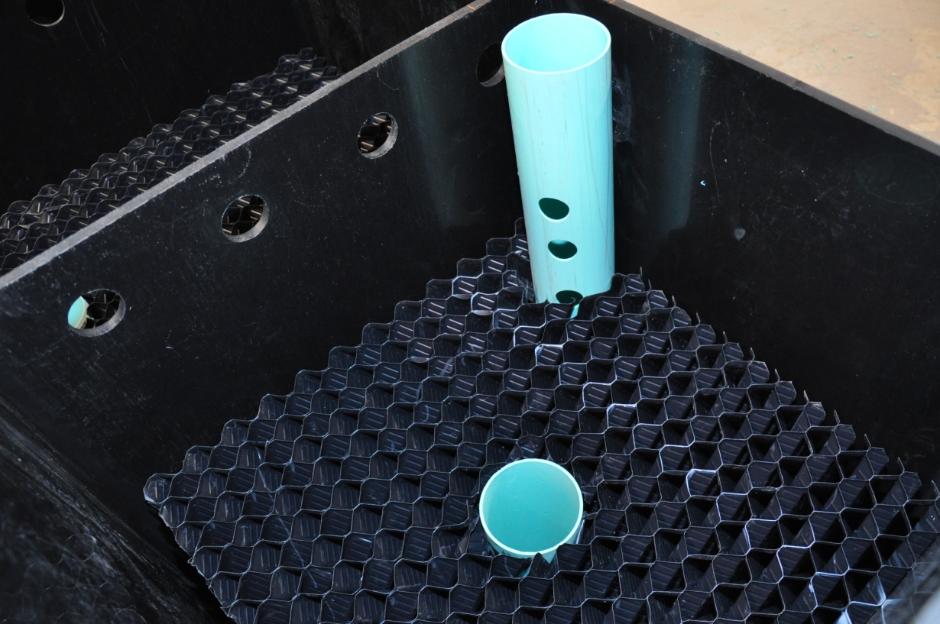
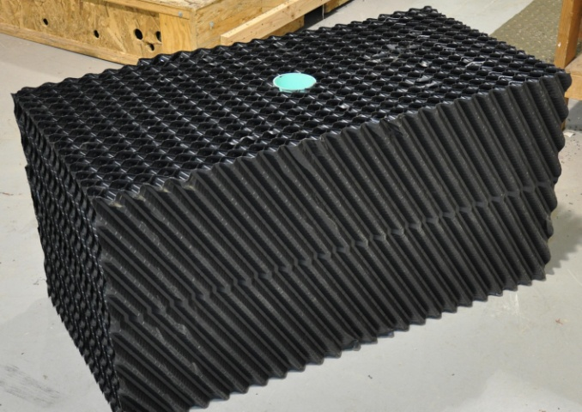
Second compartment - submerged fixed film treatment

Slide 22
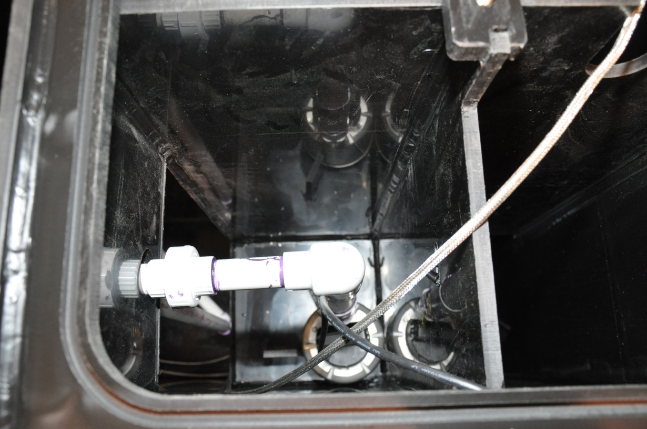
Third compartment -fabric filter, effluent storage & pump, UV

Slide 23
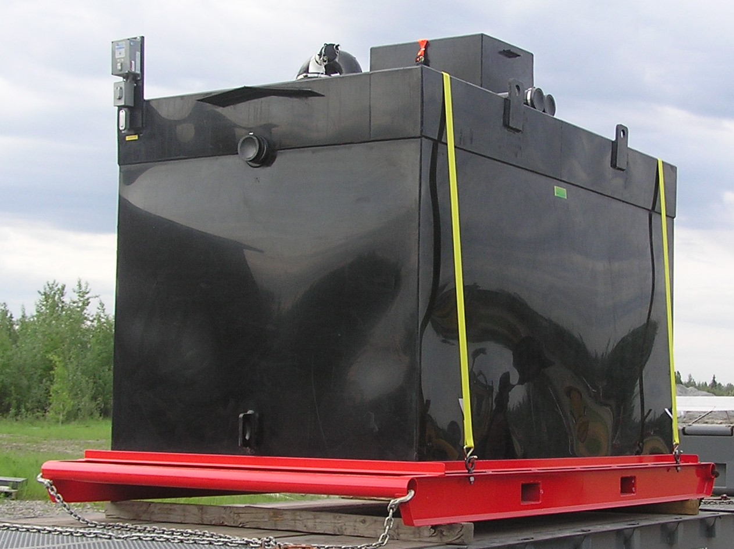
Skid-mounted treatment plant for a 6 to 12-man camp

Slide 24
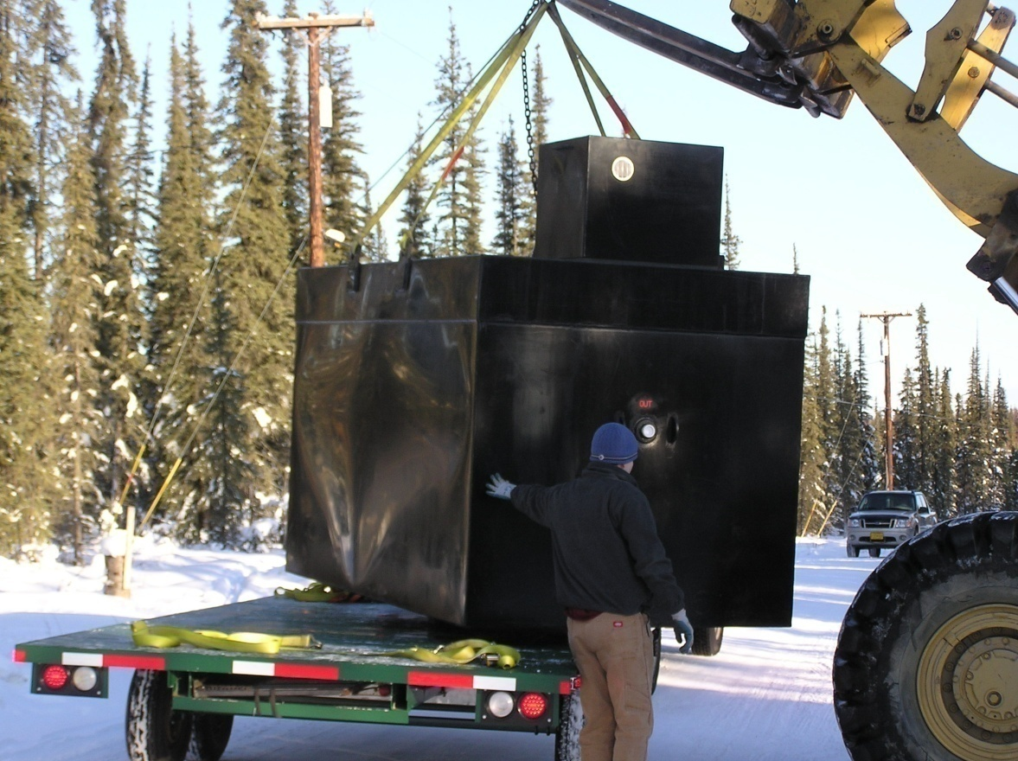
Helicopter transportable treatment plant for a 6 to 12-man camp

Slide 25
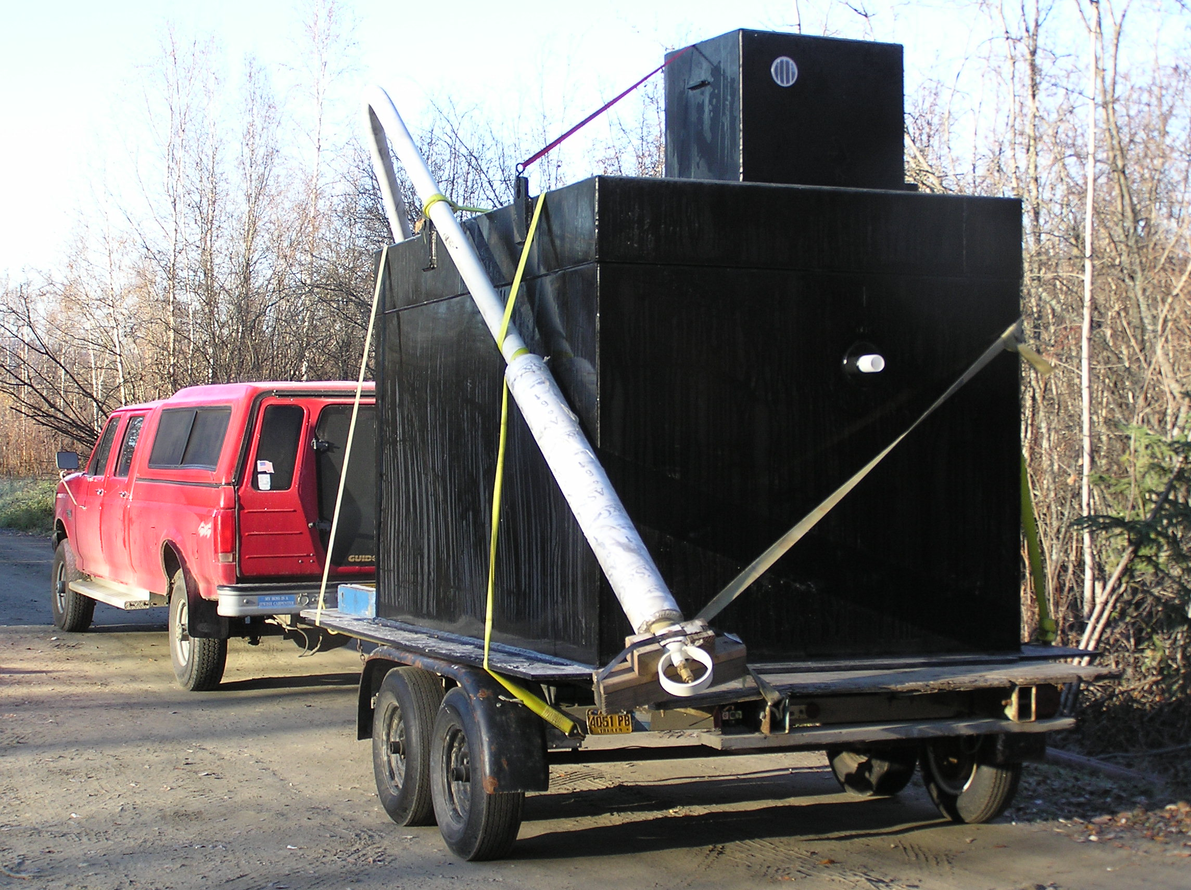
ExtremeSTP sewage treatment plant and thermosyphon for permanent installation on permafrost

Slide 26
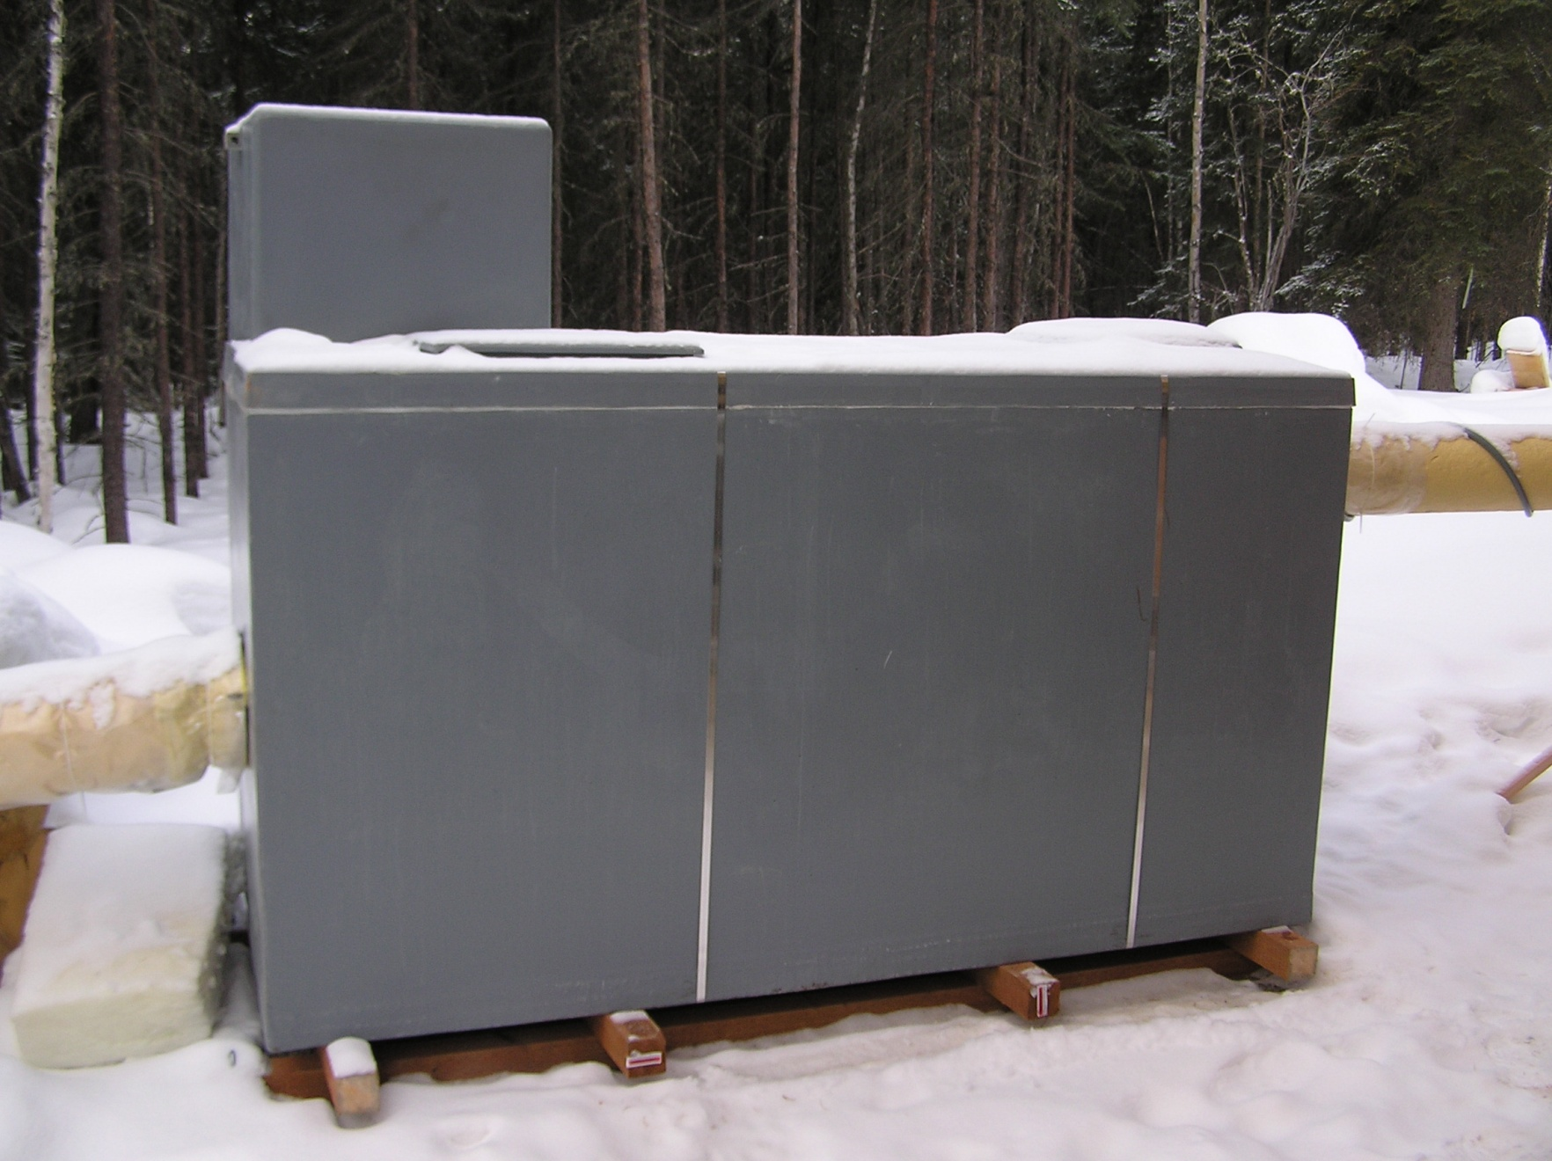
Above ground ESTP thermally decoupled from the ground for permanent installation on permafrost
AIR SPACE

Slide 27
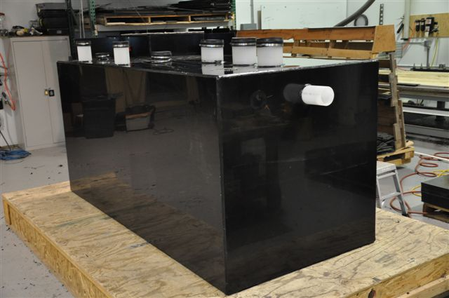
New, low power, submerged fixed film ExtremeSTP sewage treatment plant

Slide 28
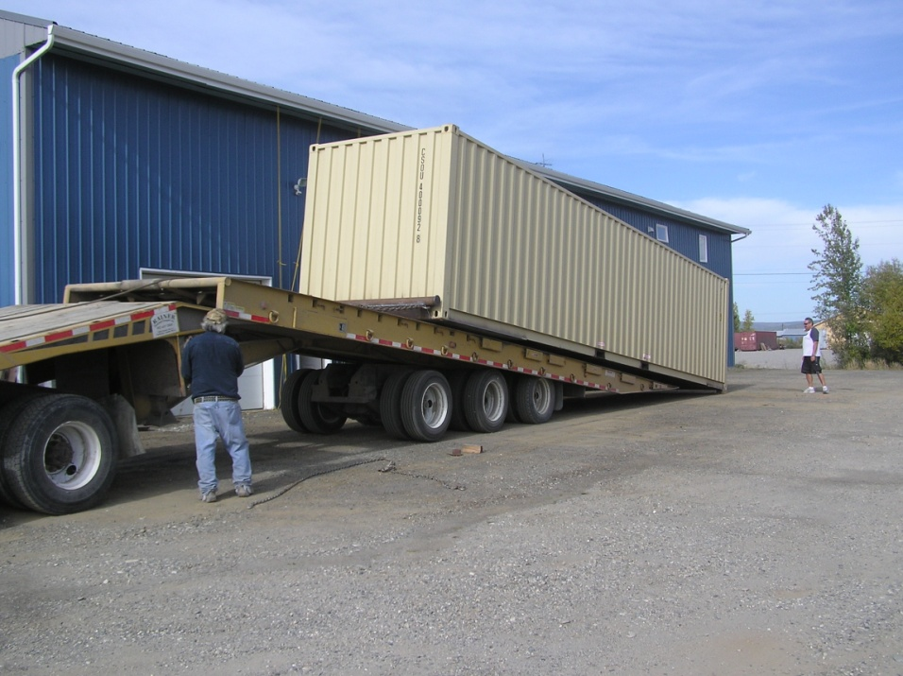
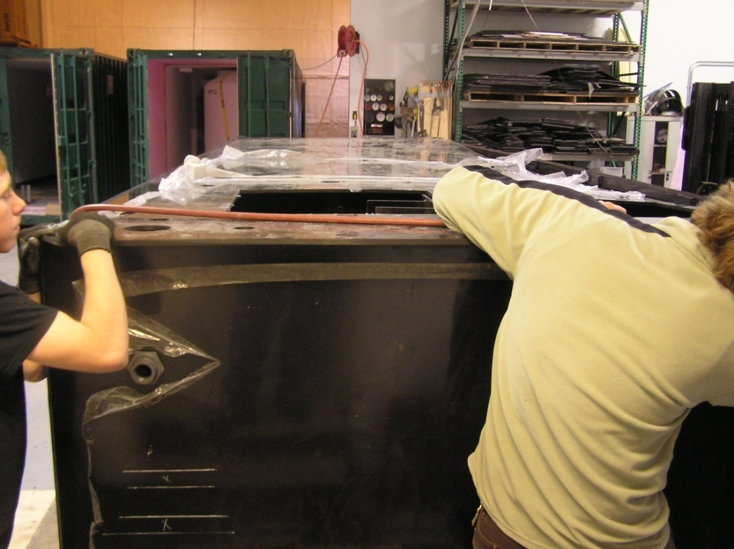
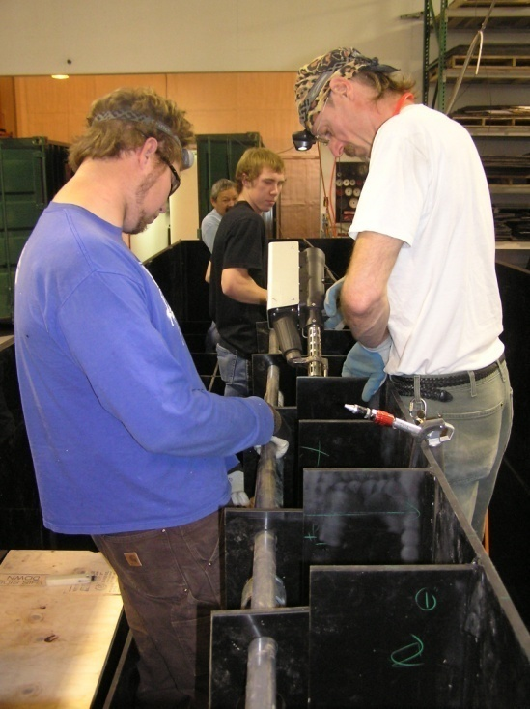

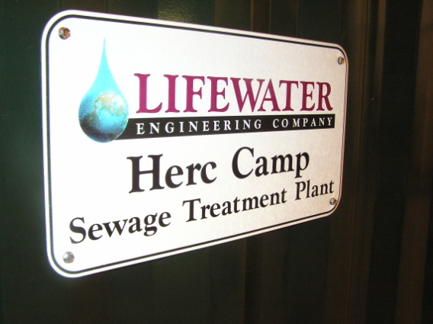
Manufacturing Process

Slide 29
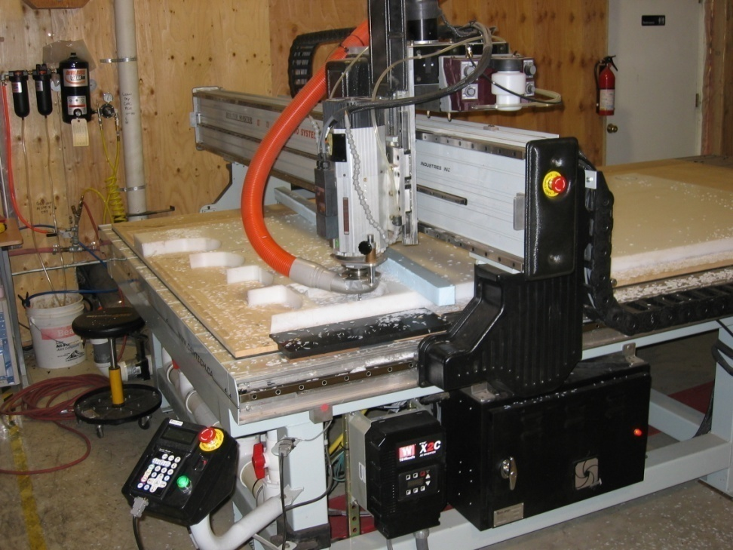
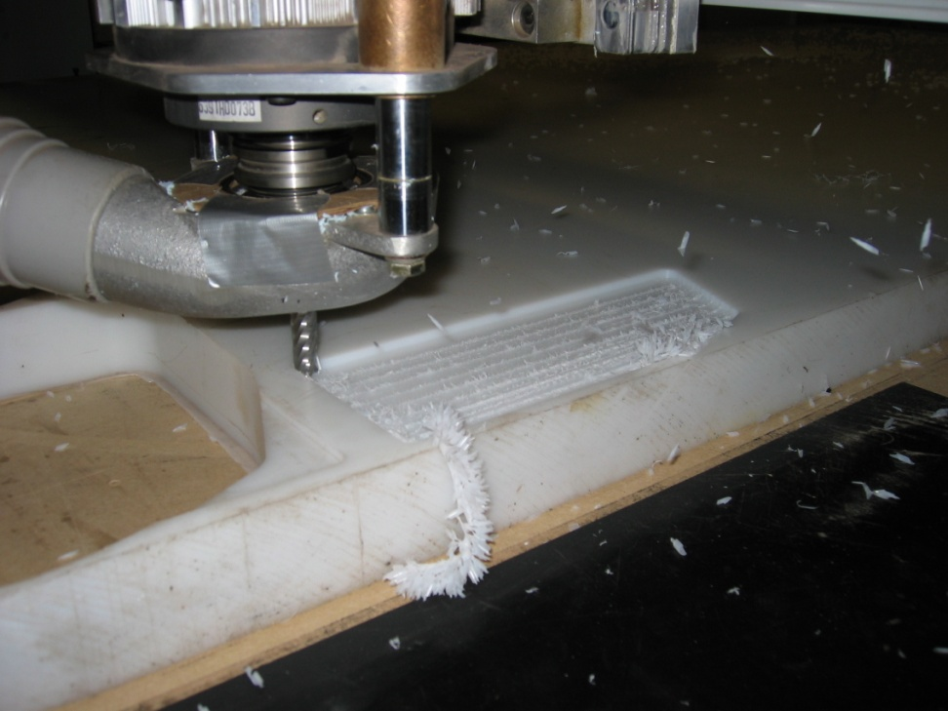
Step 1: Cut plastic parts using a CNC router
(co-polymer polypropylene plastic)

Slide 30
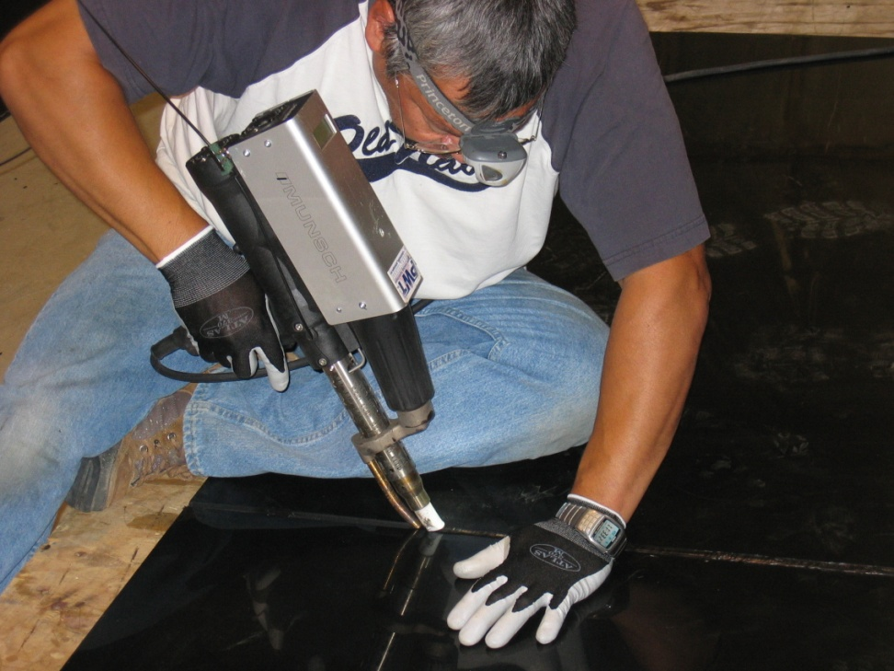
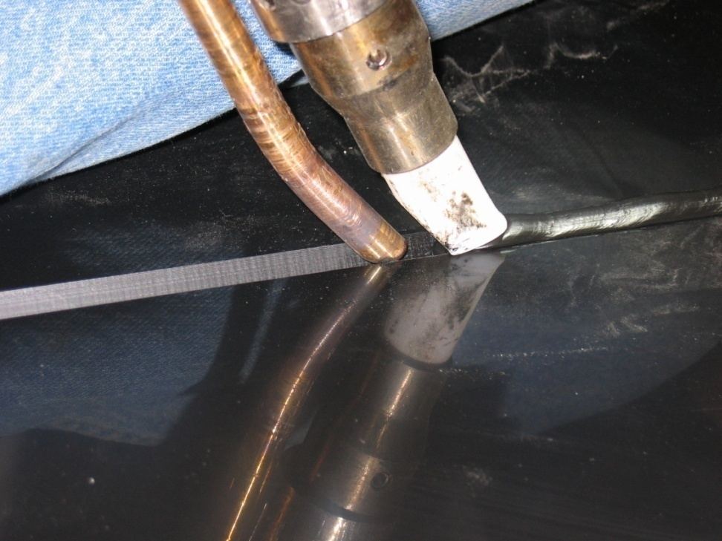
Step 2: Weld tanks together using extrusion welders

Slide 31
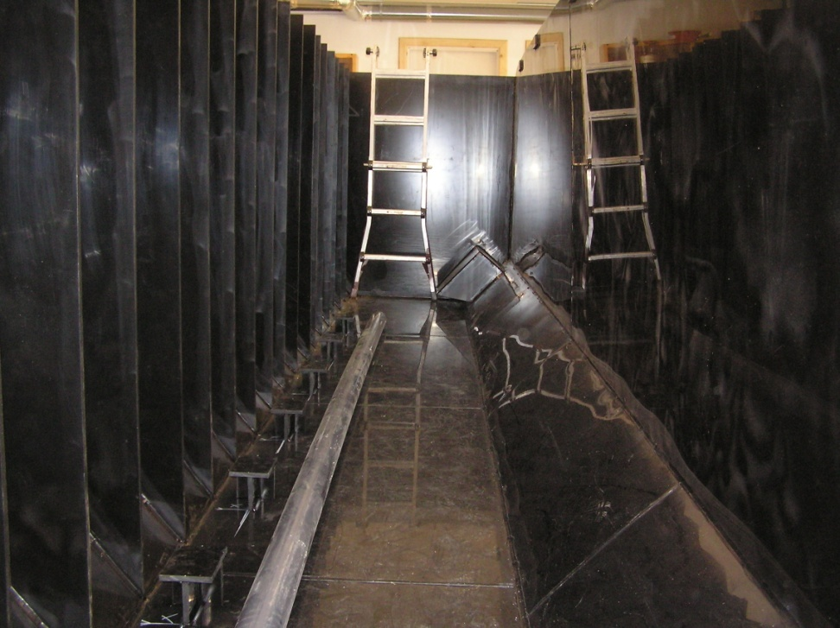
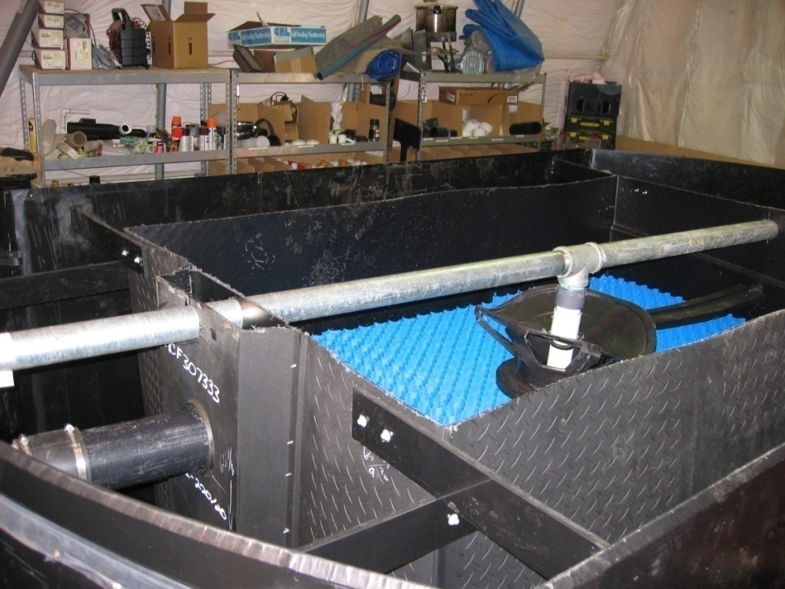
Step 3: Place components into tanks and test

Slide 32
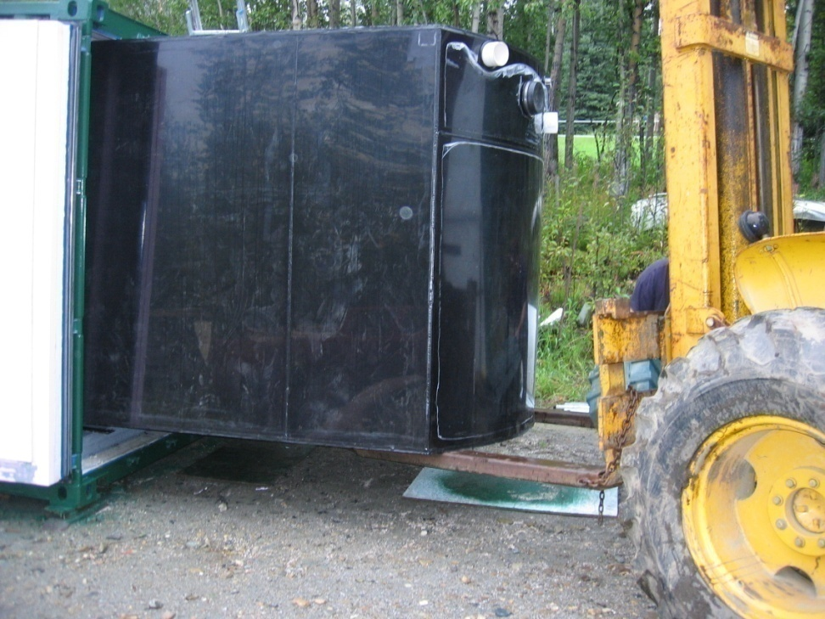
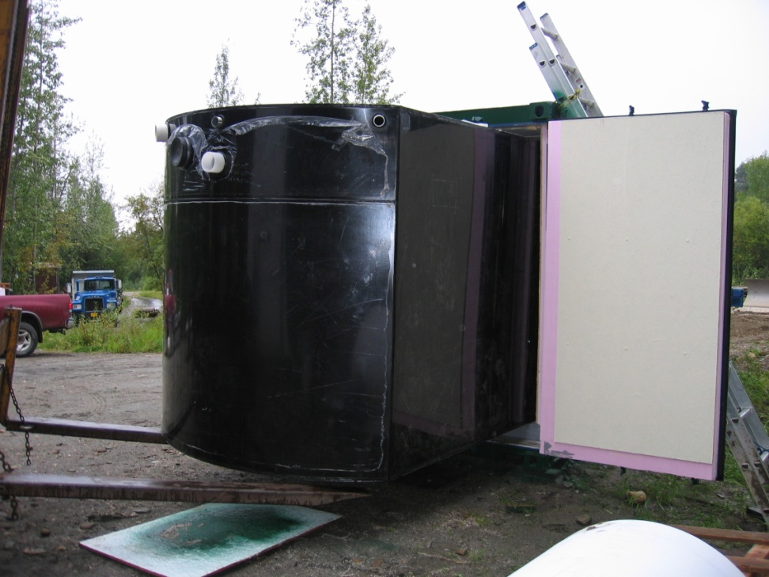
Step 4: For commercial systems – insert tanks and other components into an insulated container (20’/40’/45’/48’/53’)

Slide 33
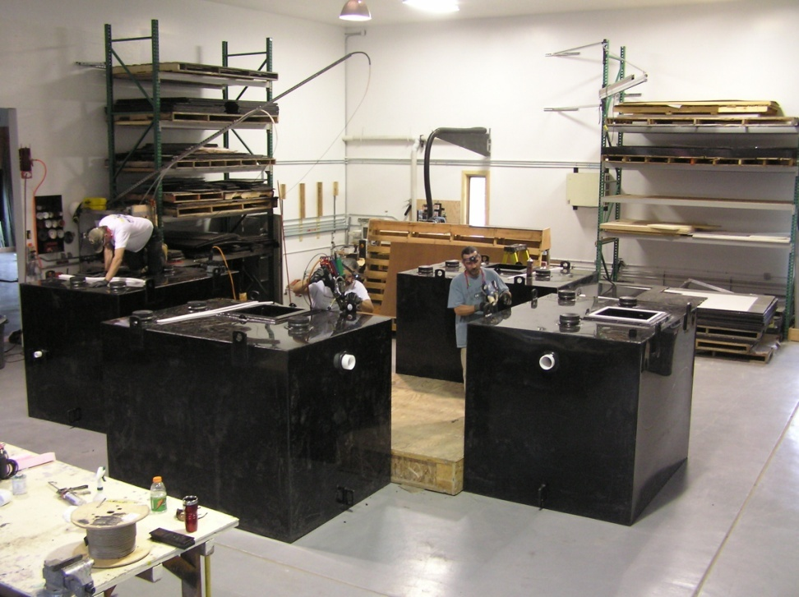
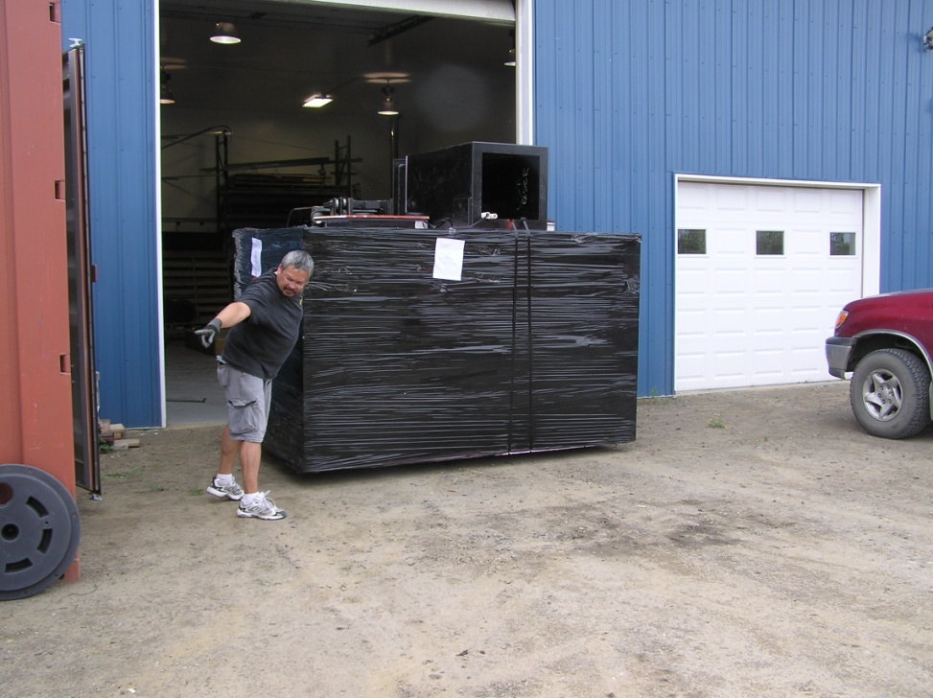
Step 4: For residential systems – finish super-insulated tank, blower base, and other components

Slide 34
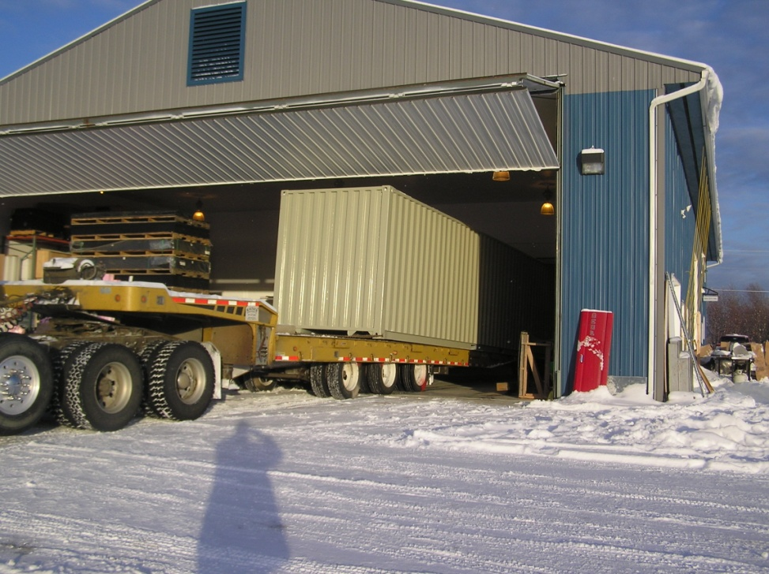

Step 5: Ship or deliver ExtremeSTP^{tm} sewage treatment plant to customer

Slide 35
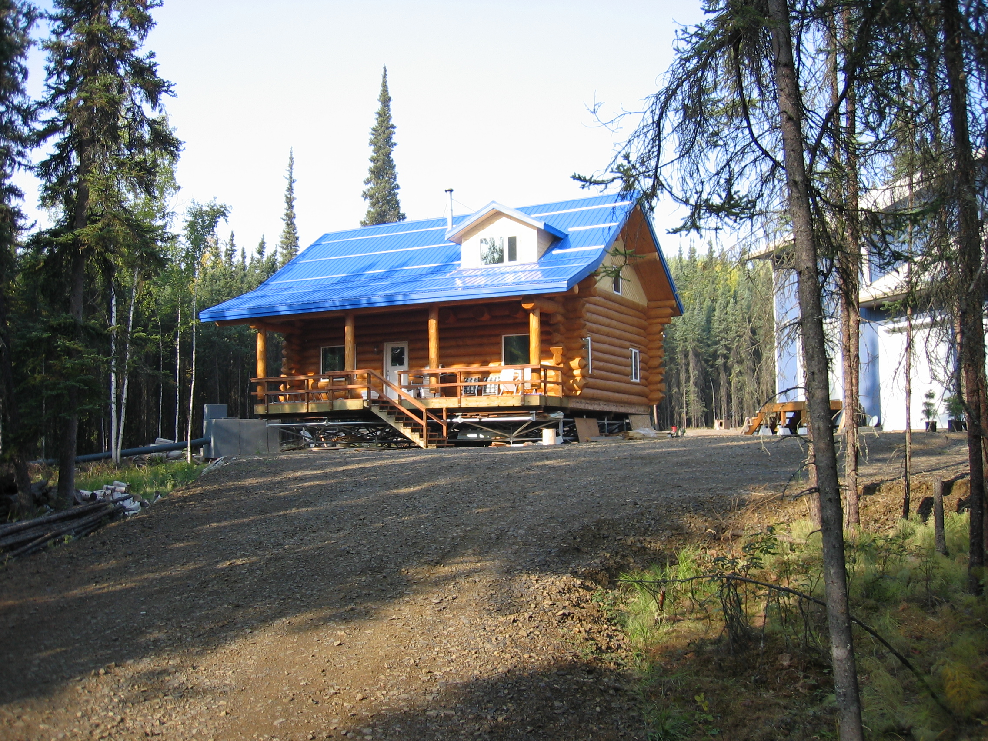
Triodetic foundation
ExtremeSTP Model XSTP150UVP
sewage treatment plant
Effluent line

Slide 36
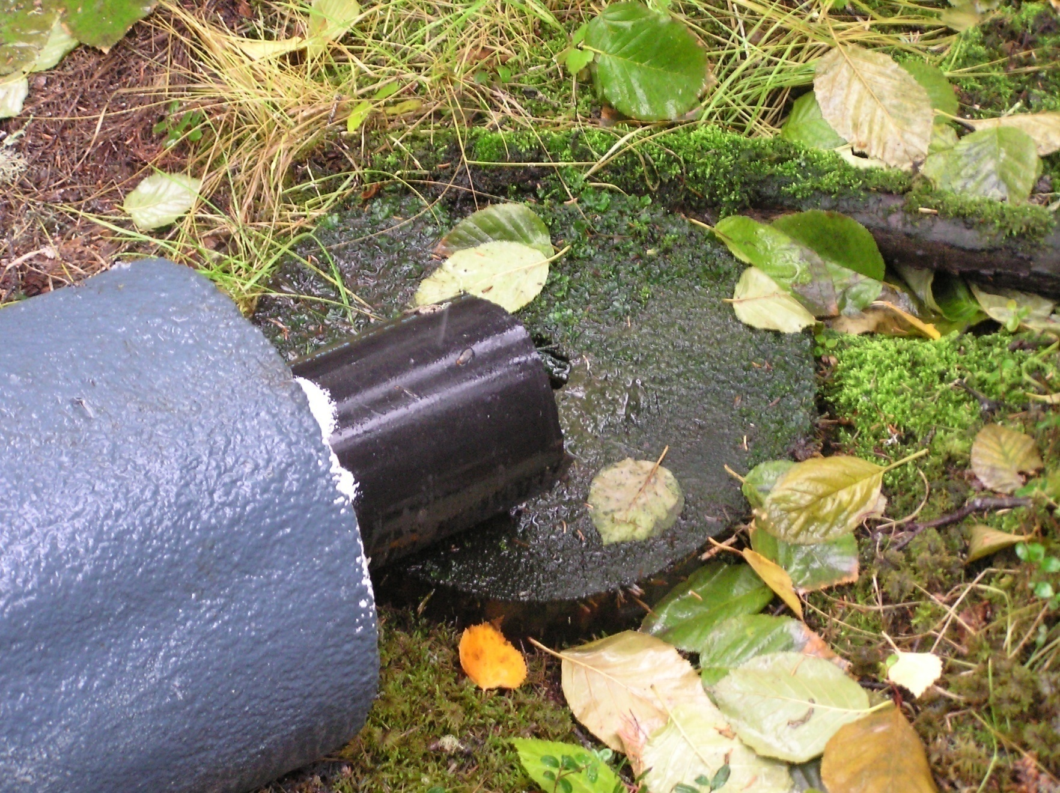
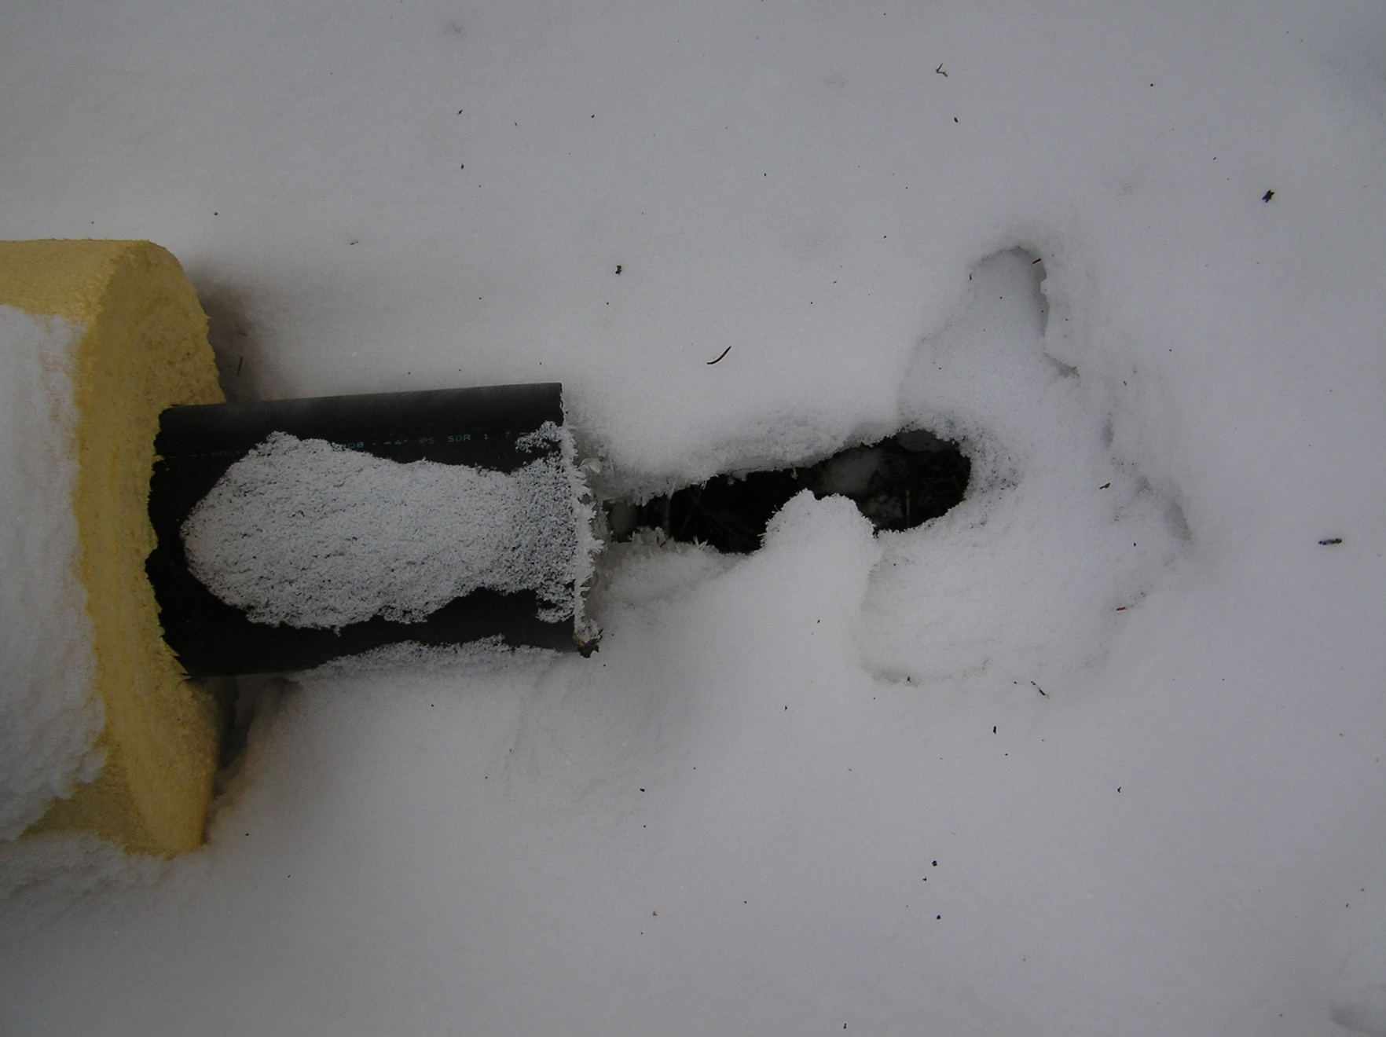
Discharge in summer/winter

Slide 37
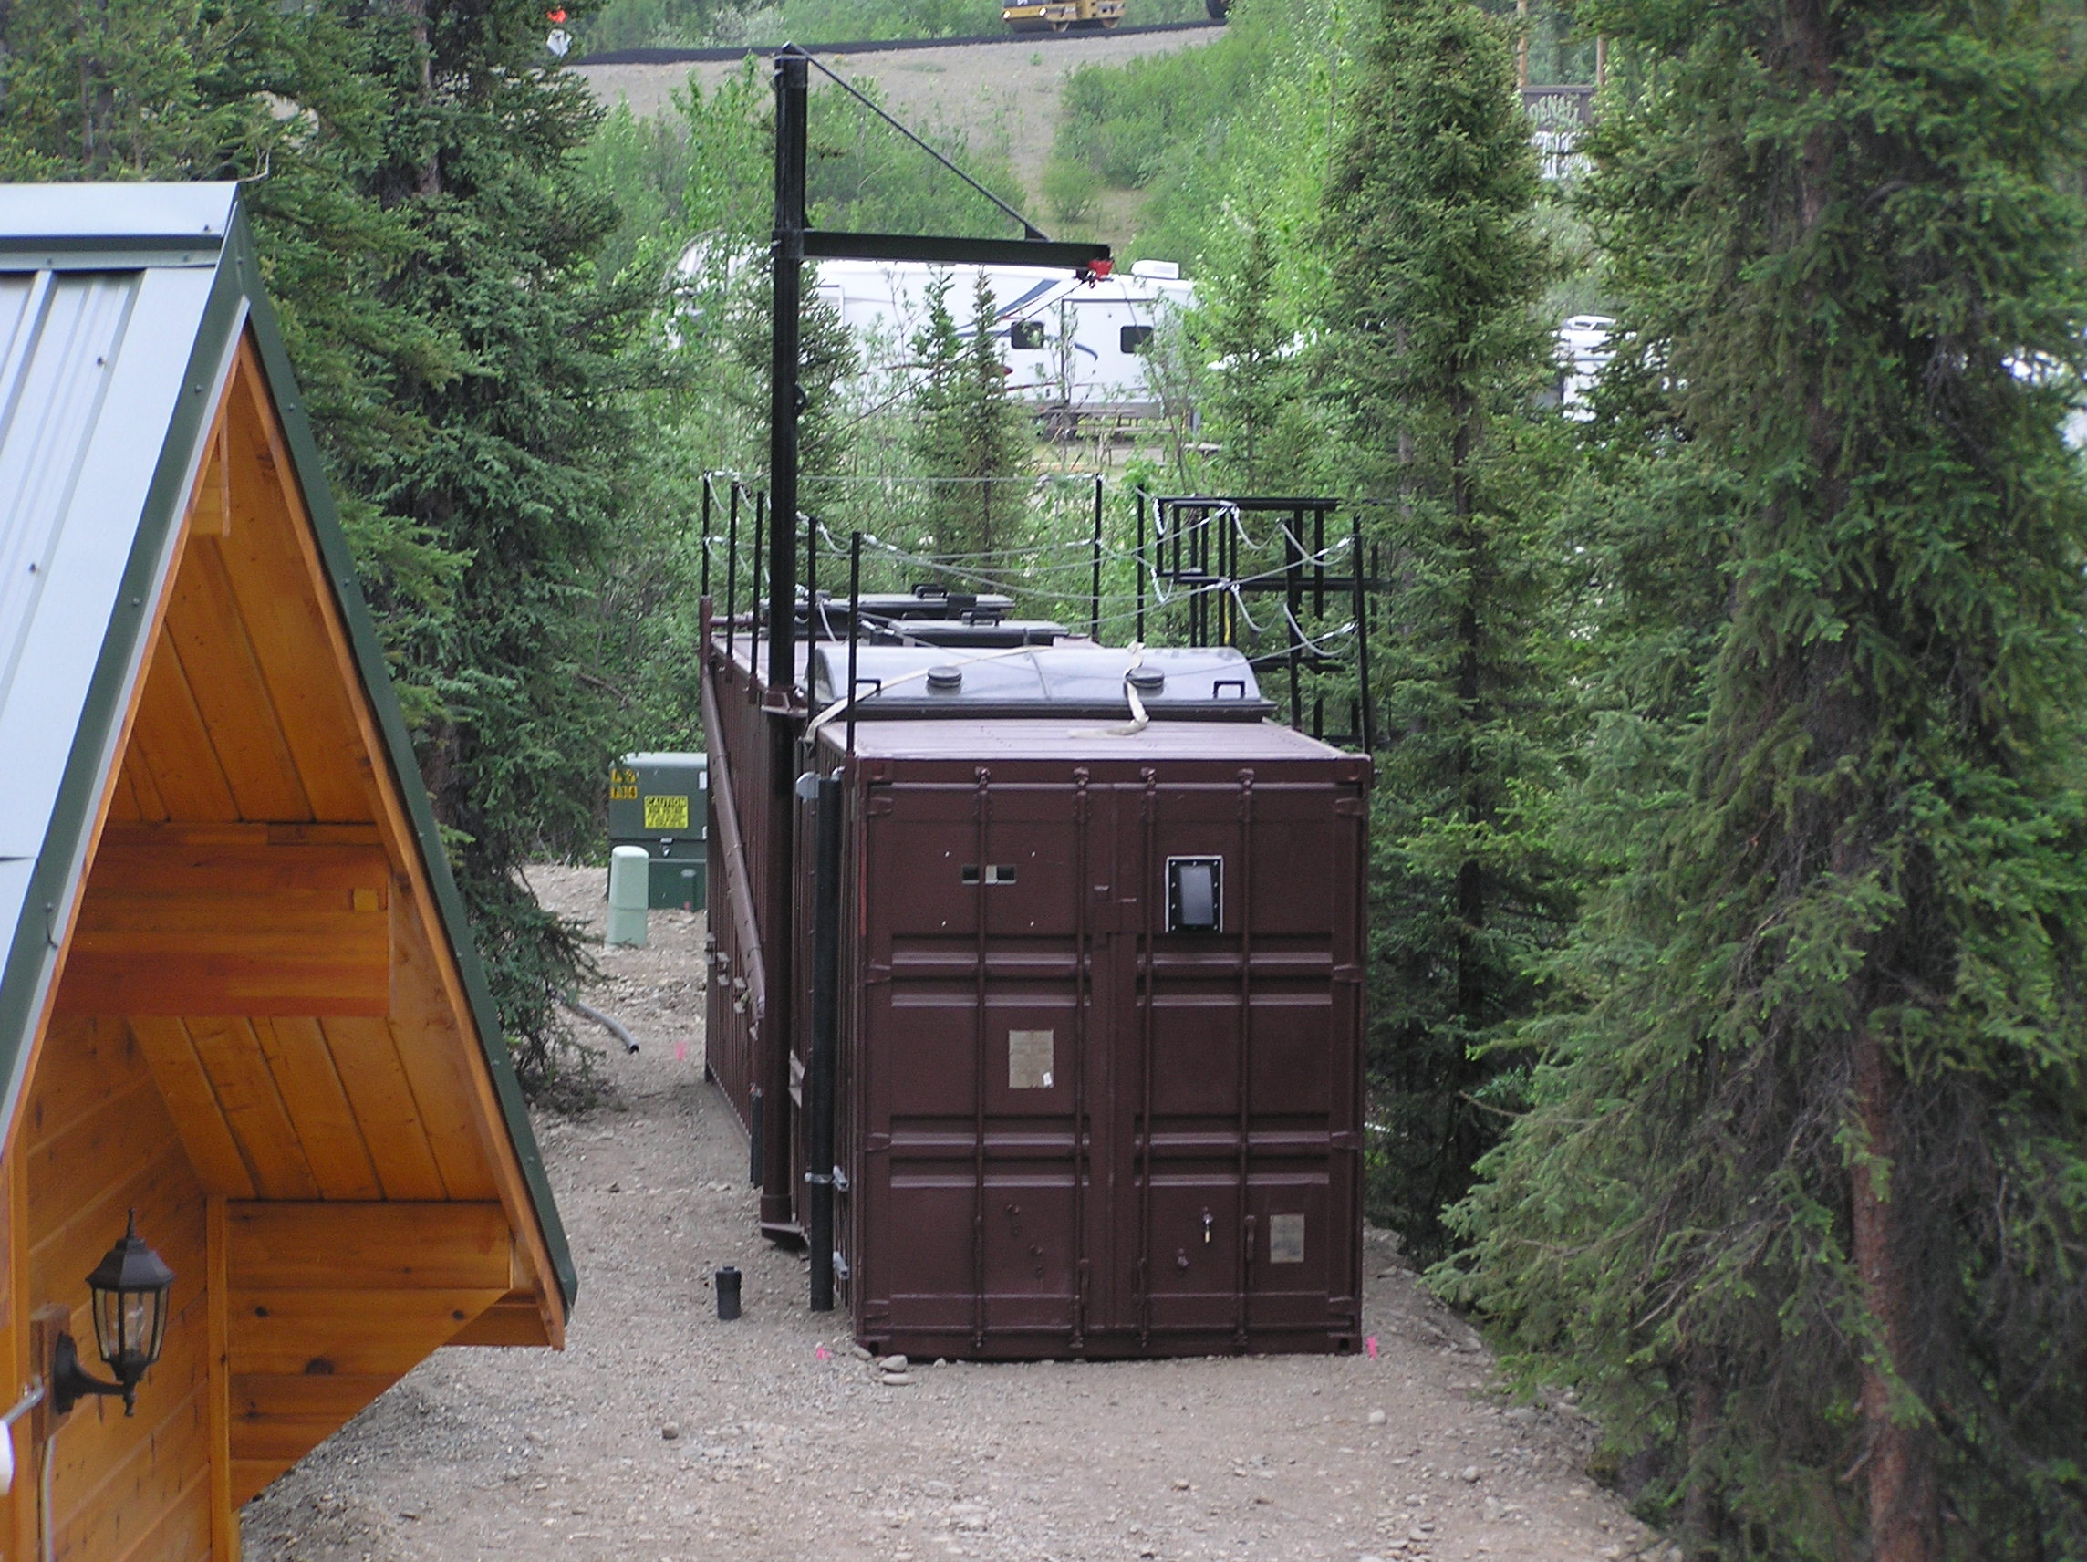
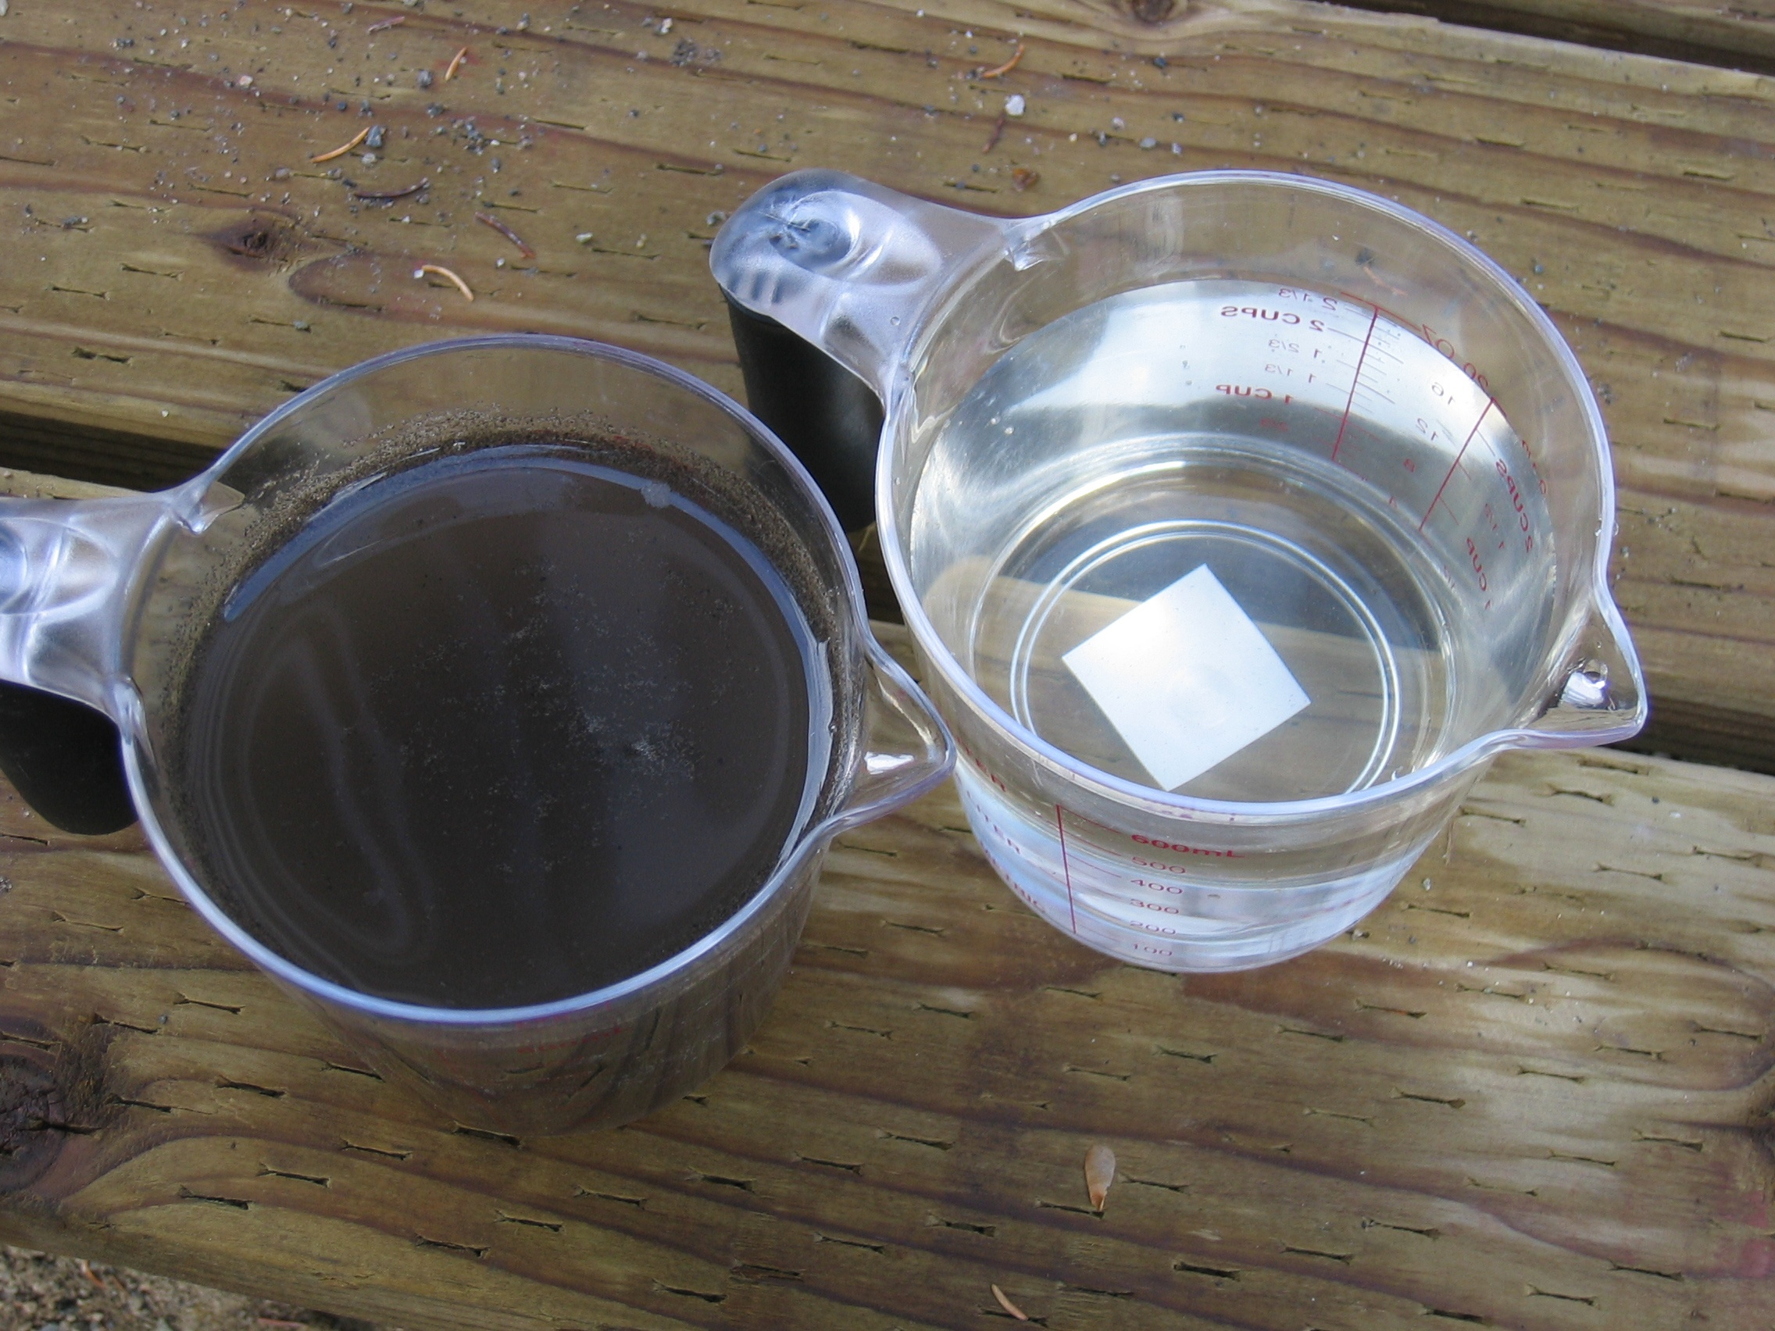
Membrane bioreactor technology
DURING TREATMENT
EFFLUENT (MF)
(Immersed flat plate MBR)

Slide 38
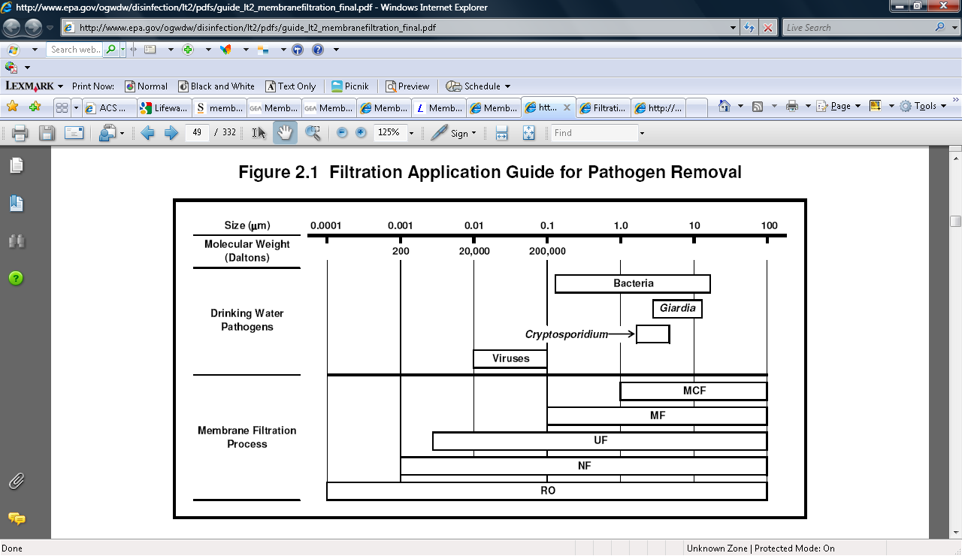
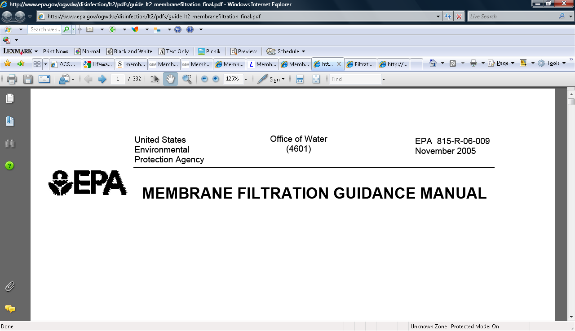

Slide 39



A Hercules aircraft transportable system…
(Sidestream tubular MBR)

Slide 40


…for use in ice road/ice pad construction and drilling support
WTP
STP
24-MAN CAMP

Slide 41

Example control screen
Although complicated at first glance, the operator soon finds it simple and user-friendly. The treatment plant status is viewable and controllable from anywhere in the world
via this screen.

Slide 42



(231 mph wind, -47ºF)
HOME OF THE
WORLD’S
WORST
WEATHERSM

Slide 43

Mt. Washington, NH
(Sidestream tubular MBR)

Slide 44


1 New Hampshire

Slide 45
Our goal is to make life simpler, more comfortable, and environmentally friendly
by providing worry-free water and wastewater treatment plants

Slide 46
ExtremeSTPTM sewage treatment plants are specifically designed to operate in the coldest places, but they also work well in the warmest places. They are ideal for rapid deployment in emergency relief situations.

Slide 47

Bob Tsigonis, P.E., Owner/President
Jerry Fleishman, Operations Manager
Jason Rowland, E.I.T., Lead Mechanical Engineer
Guy Peters, Office Manager
Emails:
Bob@lifewaterengineering.com
Jerry@lifewaterengineering.com
Jason@lifewaterengineering.com
Guy@lifewaterengineering.com
Mailing & Physical Address:
1963 Donald Avenue
Fairbanks, AK 99701
Phone Numbers:
907-458-7024
866-458-7024 toll free
907-458-7025 fax

Slide 48


Separating & drying toilet
(urine can go to a greywater treatment system, dried solids can be burned in a wood stove or placed in a compost pile)

