Slide 1
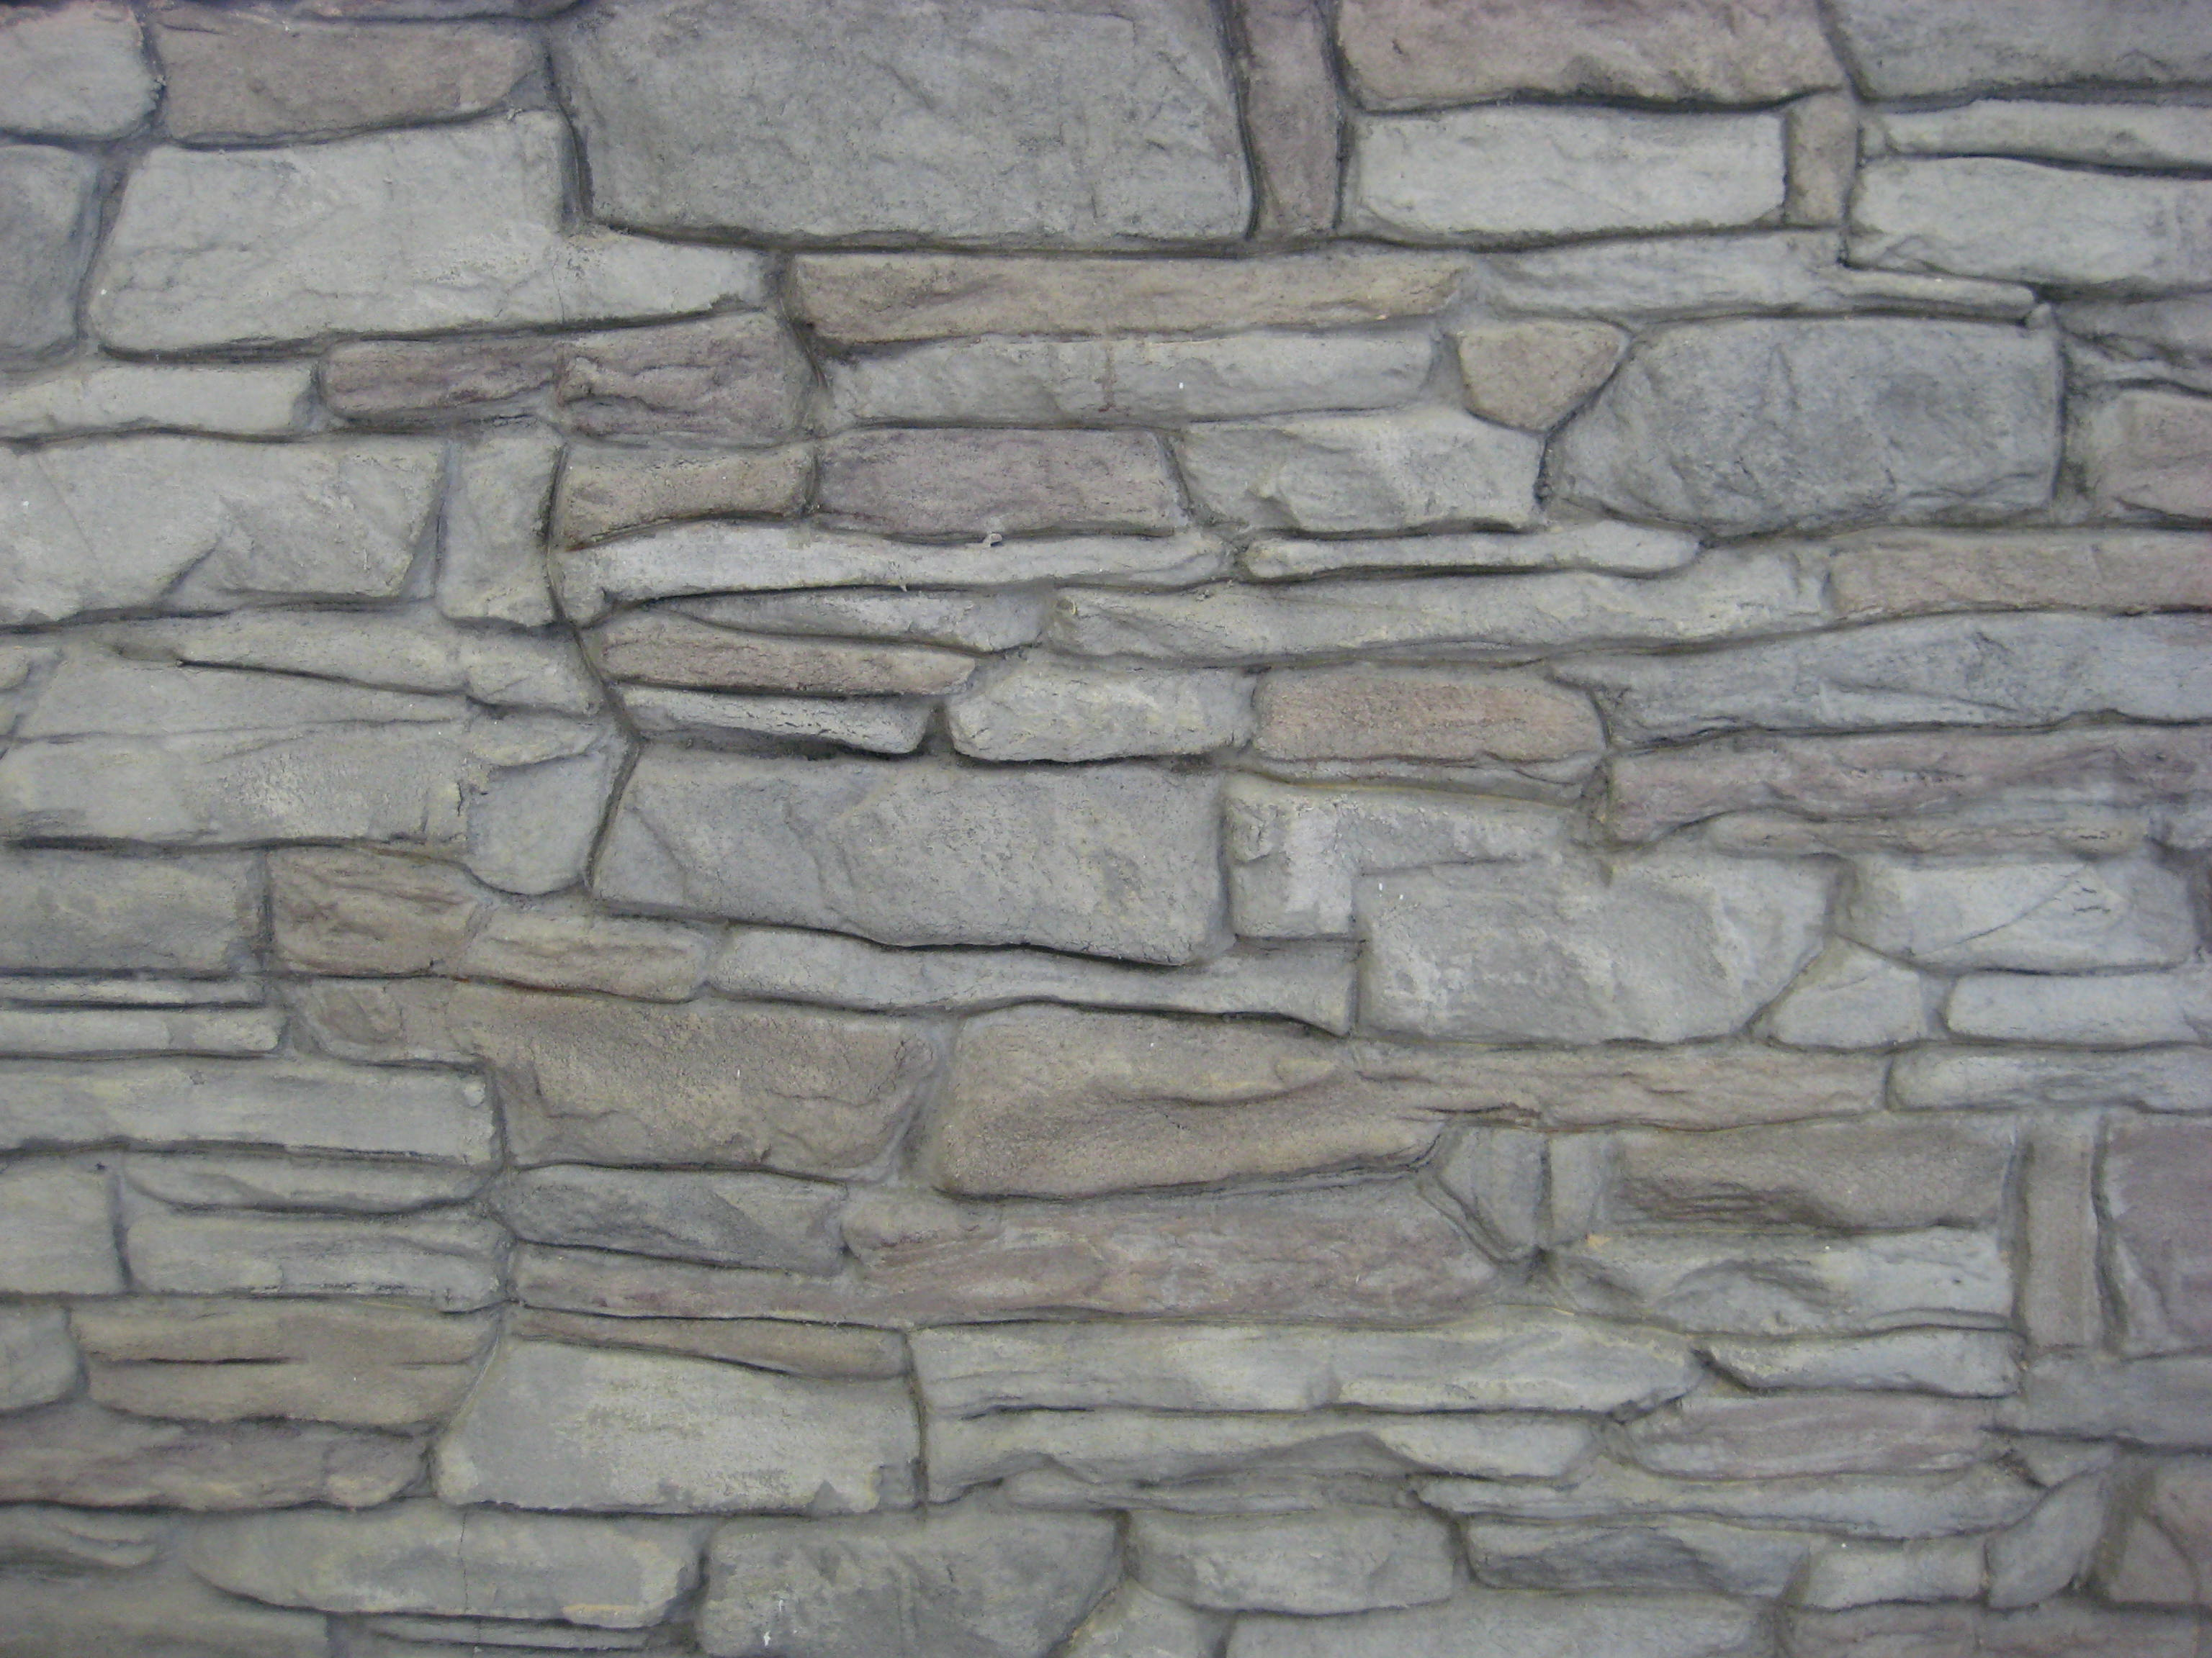
Decorative Concrete
Flex-C-Ment® Vertical Overlay
Shane Perrins, Owner/Operator
Decorative Concrete Supply, LLC
Notes:
Introduction
Goal
Company backround
Wayne Sellon
Dot and vertical overlays
DOT in other states using vertical overlays
Poland freeze thaw durability
Existing and new road system projects

Slide 2
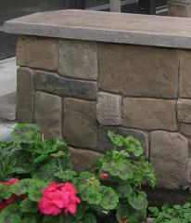
Agenda
Vertical overlay
Flex-C-Ment® background
Comparisons
Freeze/thaw test results
Installation process
Notes:
Intro to vertical overlay composition and varity of uses

Slide 3
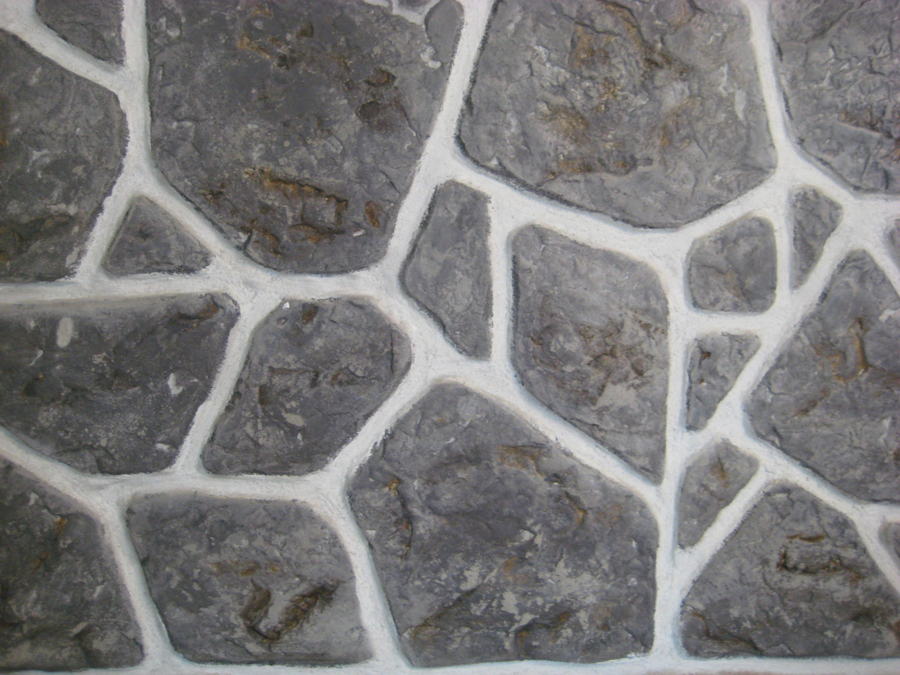
Vertical Overlay
-Excellent Bond strength
-Adverse surfaces
-Quick install
-Three day process
Notes:
Composition
Flex-c-ment™ Wall Mix is a polyacrylate, modified cementations, vertical overlay system
that can be applied over concrete, wood or metal to achieve the appearance of stone, wood, tile or brick.
It is a water-phase elastomeric resin composition incorporating resin primers, cement, cement modifiers, polymers and aggregates.
The components are supplied in a dry, 50 Lb. bagged mix of cement, light weight aggregates additives and polymers.
All ingredients are prepackaged in the 50 Lb. bag. It is a “just add water” mix.

Slide 4
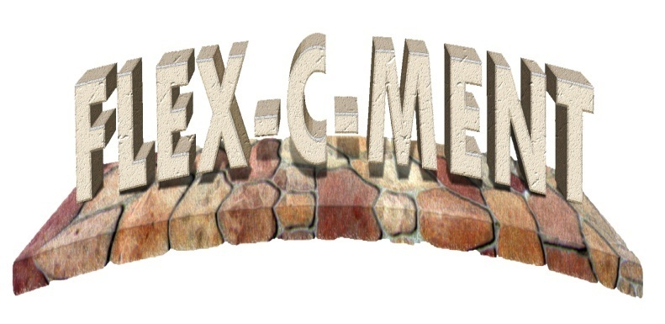
Flex-C-Ment®
Twenty year history
Based out of Mississippi
International Company
Formulated from same product
used at theme parks
Notes:
Andy Yoder developed mix over 20 years ago
Sold to flex-c-ment
Internationally used system with companies in the UK, Poland, Turkey, and Canada
Made out of raw materials in the USA
Original idea came from plasters in theme parks

Slide 5
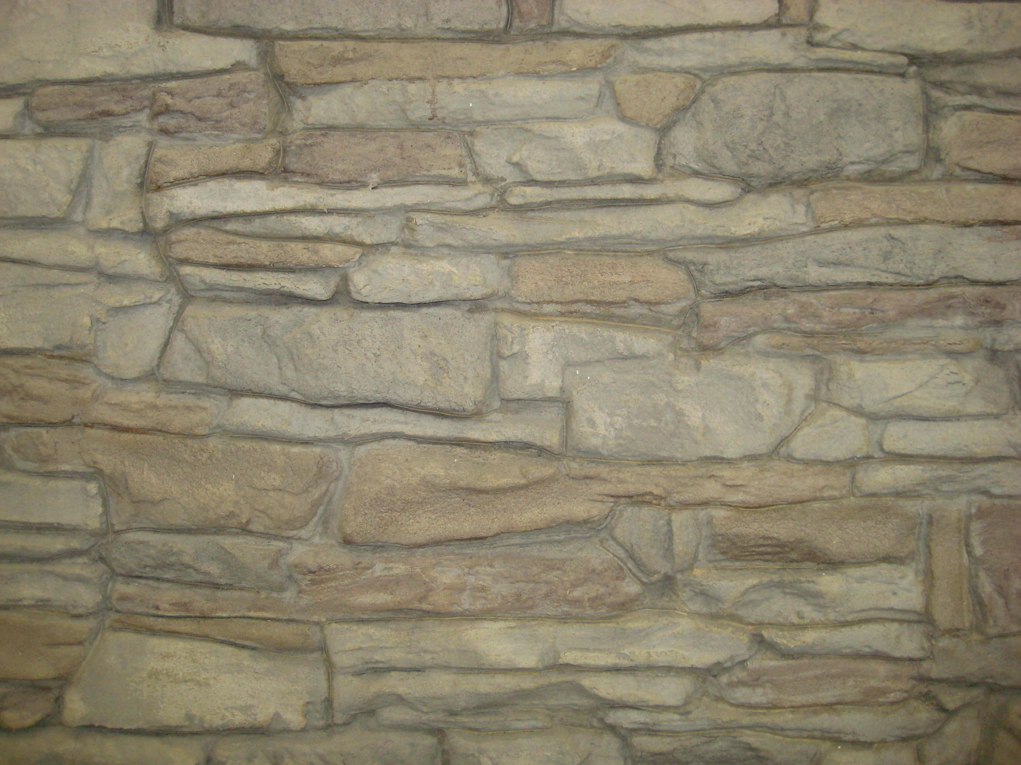
Flex-c-ment VS. Cultured Stone
Flex-c-ment
Cultured Stone
Better Quality
More Realistic
Cost ($15-$35 Sq Ft) Installed
Less prep work
Bonds to almost any stable substrate
Unlimited possibilities in style and color
Has holes from casting
Poor coloring
Cost ($25-$55 Sq Ft) Installed
More prep work with substrate
More labor intensive
Notes:
durable

Slide 6
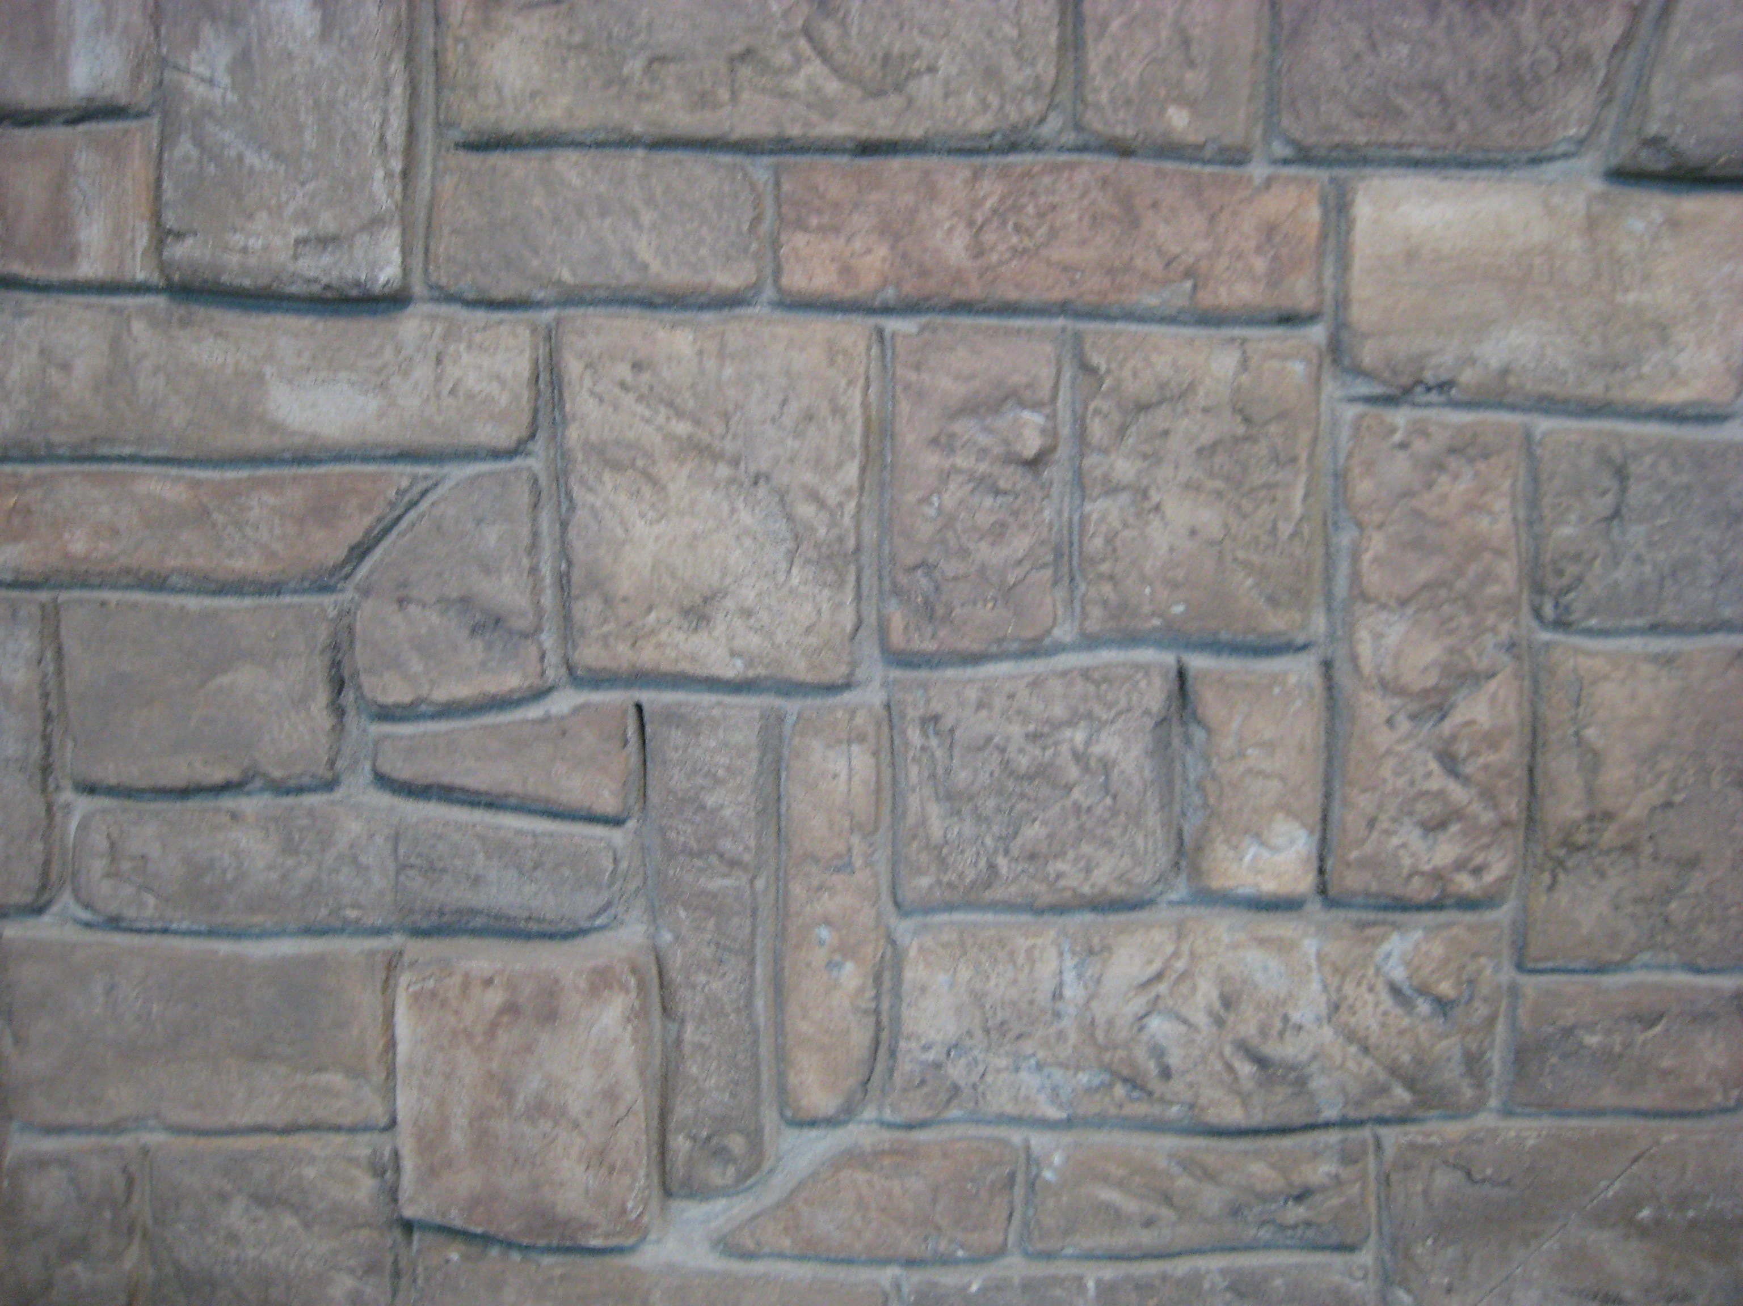
Material Specs
MODIFIED ASTM C 666 PROCEDURE-A
STANDARD TEST METHOD FOR RESISTANCE OF CONCRETE TO RAPID FREEZING AND THAWING
SAMPLE IDENTIFICATIONS | FREEZE-THAW CYCLES | LENGTH CHANGE,% | MASS CHANGE,% | RELATIVE DYNAMIC MODULUS,%
WALL MIX | 0 | 0.00 | 0.00 | 100
WALLMIX | 37 | 0.01 | -0.22 | 97
WALL MIX | 69 | 0.02 | -0.40 | 95
WALL MIX | 99 | 0.03 | -0.56 | 97
WALL MIX | 129 | 0.02 | -0.62 | 94
WALL MIX | 163 | 0.03 | -0.45 | 93
WALL MIX | 193 | 0.02 | -0.50 | 98
WALL MIX | 222 | 0.02 | -0.58 | 98
Notes:
the relative dynamic modulus indicates that flex-c-ment is freeze thaw durable after 300 cycles

Slide 7
Physical Properties
Compressive Strength ASTM C 39 ……………………………………………………………..2,640 psi
Flexural Strength ASTM C 78 ......................................................................515 psi
Adhesion MIL-D-3134 Para. 3.7.14 (Shear from steel plate after 96 hours ..312 psi
Water Absorption ASTM C 642 .................................................................4.2%
Tensile Strength ASTM C190 ................................................... ………………..580 psi
Resistance to Elevated Temperatures MIL-D-3134, Para. 4.7.5.1...............No flow or Slip
Flammability ASTM E162 Flame Spread Index. 0.47. Smoke Deposited……Less than 0.1 mg.
ASTM E84.. Flame Spread Rate – 0
Smoke Density Factor - 3
Fuel Contribution Rate - 0
Coefficient of Thermal Expansion ASTM C531 6.8 E-04
Electrical Conductivity ................................................................................Dielectric
Notes:
Exceptional shear from steel plate
Flexural strength
Engineered to withstand normal surface movement with minimal negative affects
Easy to apply over problematic surfaces

Slide 8
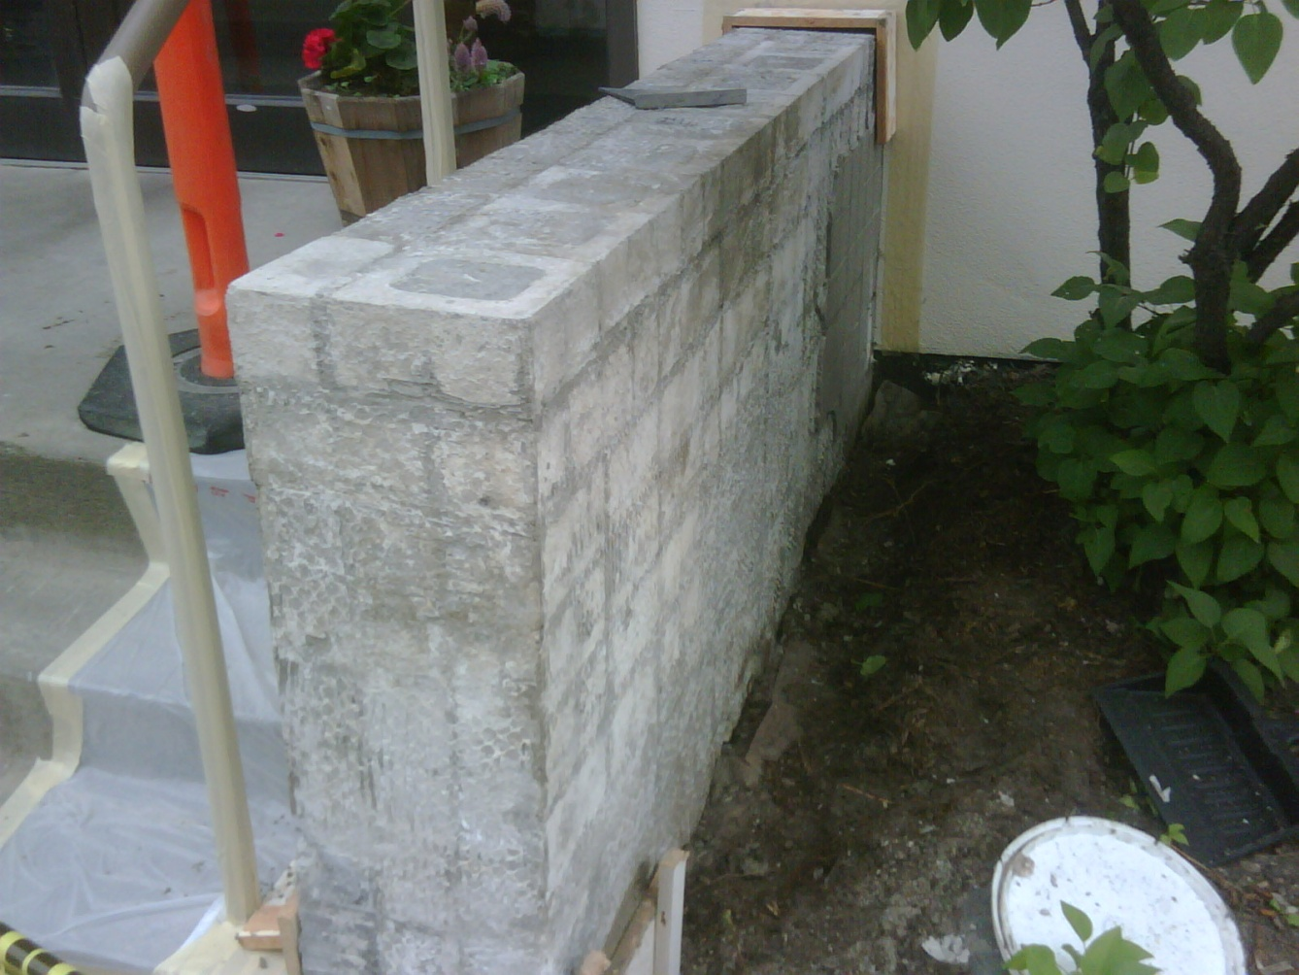
7TH & A St. DOWNTOWN ANCHORAGE
Installation Process
THIS IS WHAT WE STARTED WITH. THE LOOSE TILES COVERING THE BLOCK WERE REMOVED. ALL UNSTABLE SUBSTRATE REPAIRED.
Notes:
Uses
Flex-c-ment™ Wall Mix is typically used as a decorative wall overlay for surfacing in both commercial and residential applications. Its use can be enhanced by incorporating the use of pigments, stains and sealers to finish the coloring and sealing process.
Flex-c-ment™ Wall Mix can be used as a thin overlay for use with stencils or free style finishes or in full 2 1/2 inch thickness with stamps, trowels, carving tools, brushes, sprays or it can be worked freehand to achieve an incredible variety of decorative surfaces.

Slide 9
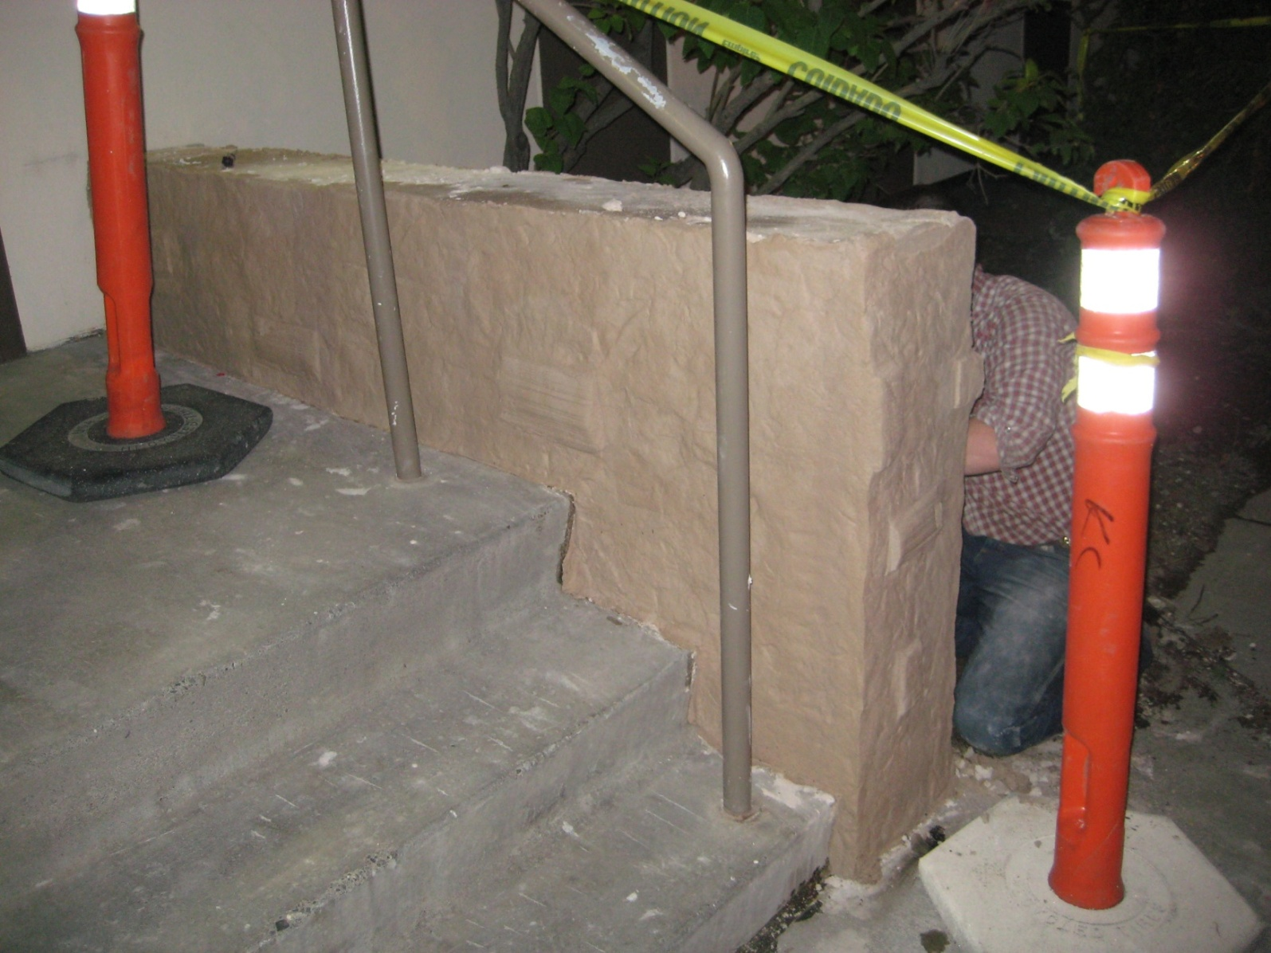
7TH & A St. DOWNTOWN ANCHORAGE
THE SCRATCH COAT WAS APPLIED OVER THE SOLID SUBSTRATE YESTERDAY. TODAY THE BASE COAT WAS APPLIED TO PROPER DEPTH, STAMPED, AND IN THE PROCESS OF BEING CARVED.

Slide 10
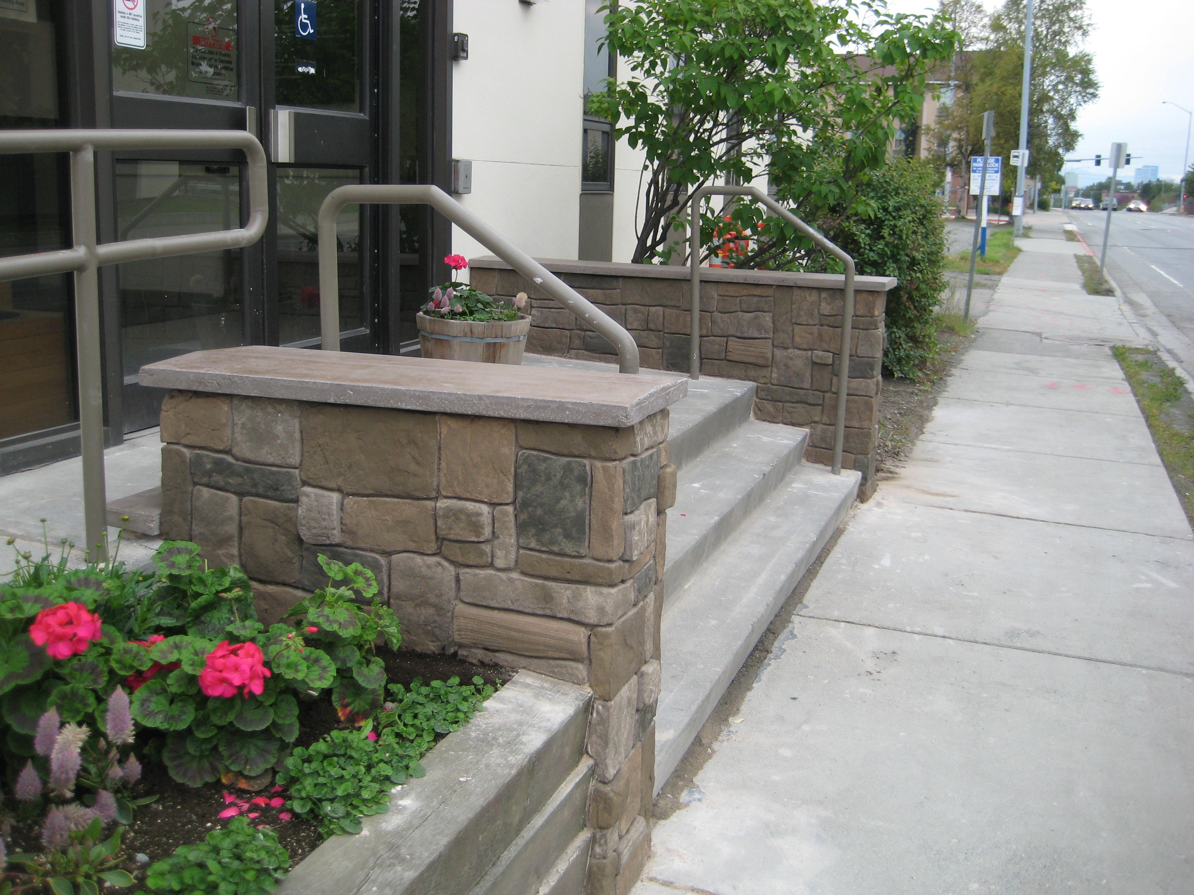
7TH & A St.
DOWNTOWN ANCHORAGE
HERE IS THE FINISHED PRODUCT. THIS IS A THREE DAY PROCESS. WE USED BUDDY RHODES COUNTER TOP MIX FOR THE CONCRETE TOPS. THE VERTICAL OVERLAY WAS DONE WITH FLEX-C-MENT.

Slide 11
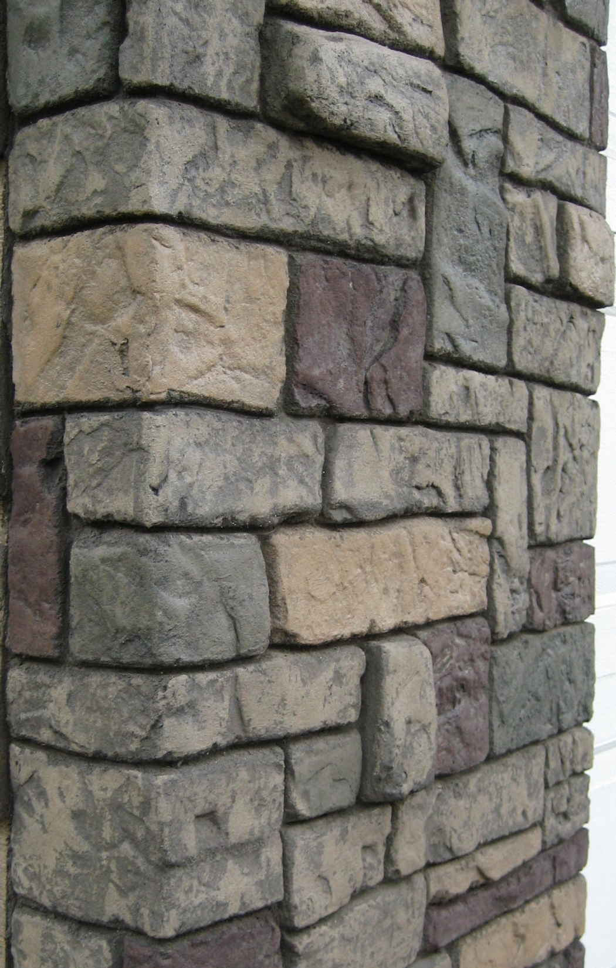

Slide 12
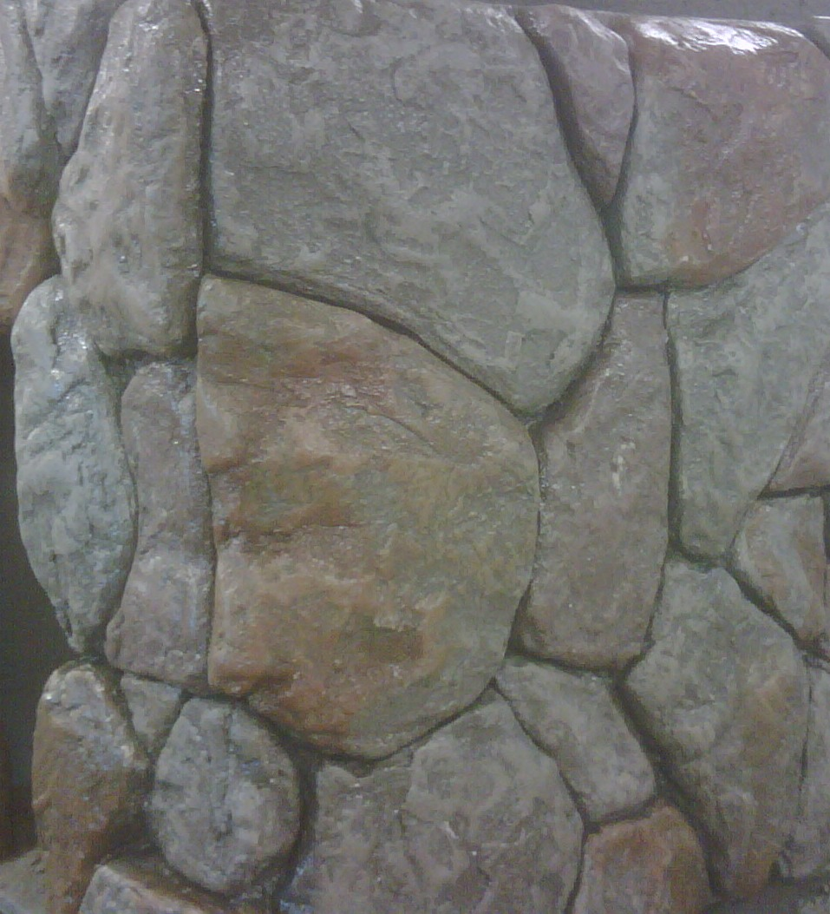

Slide 13
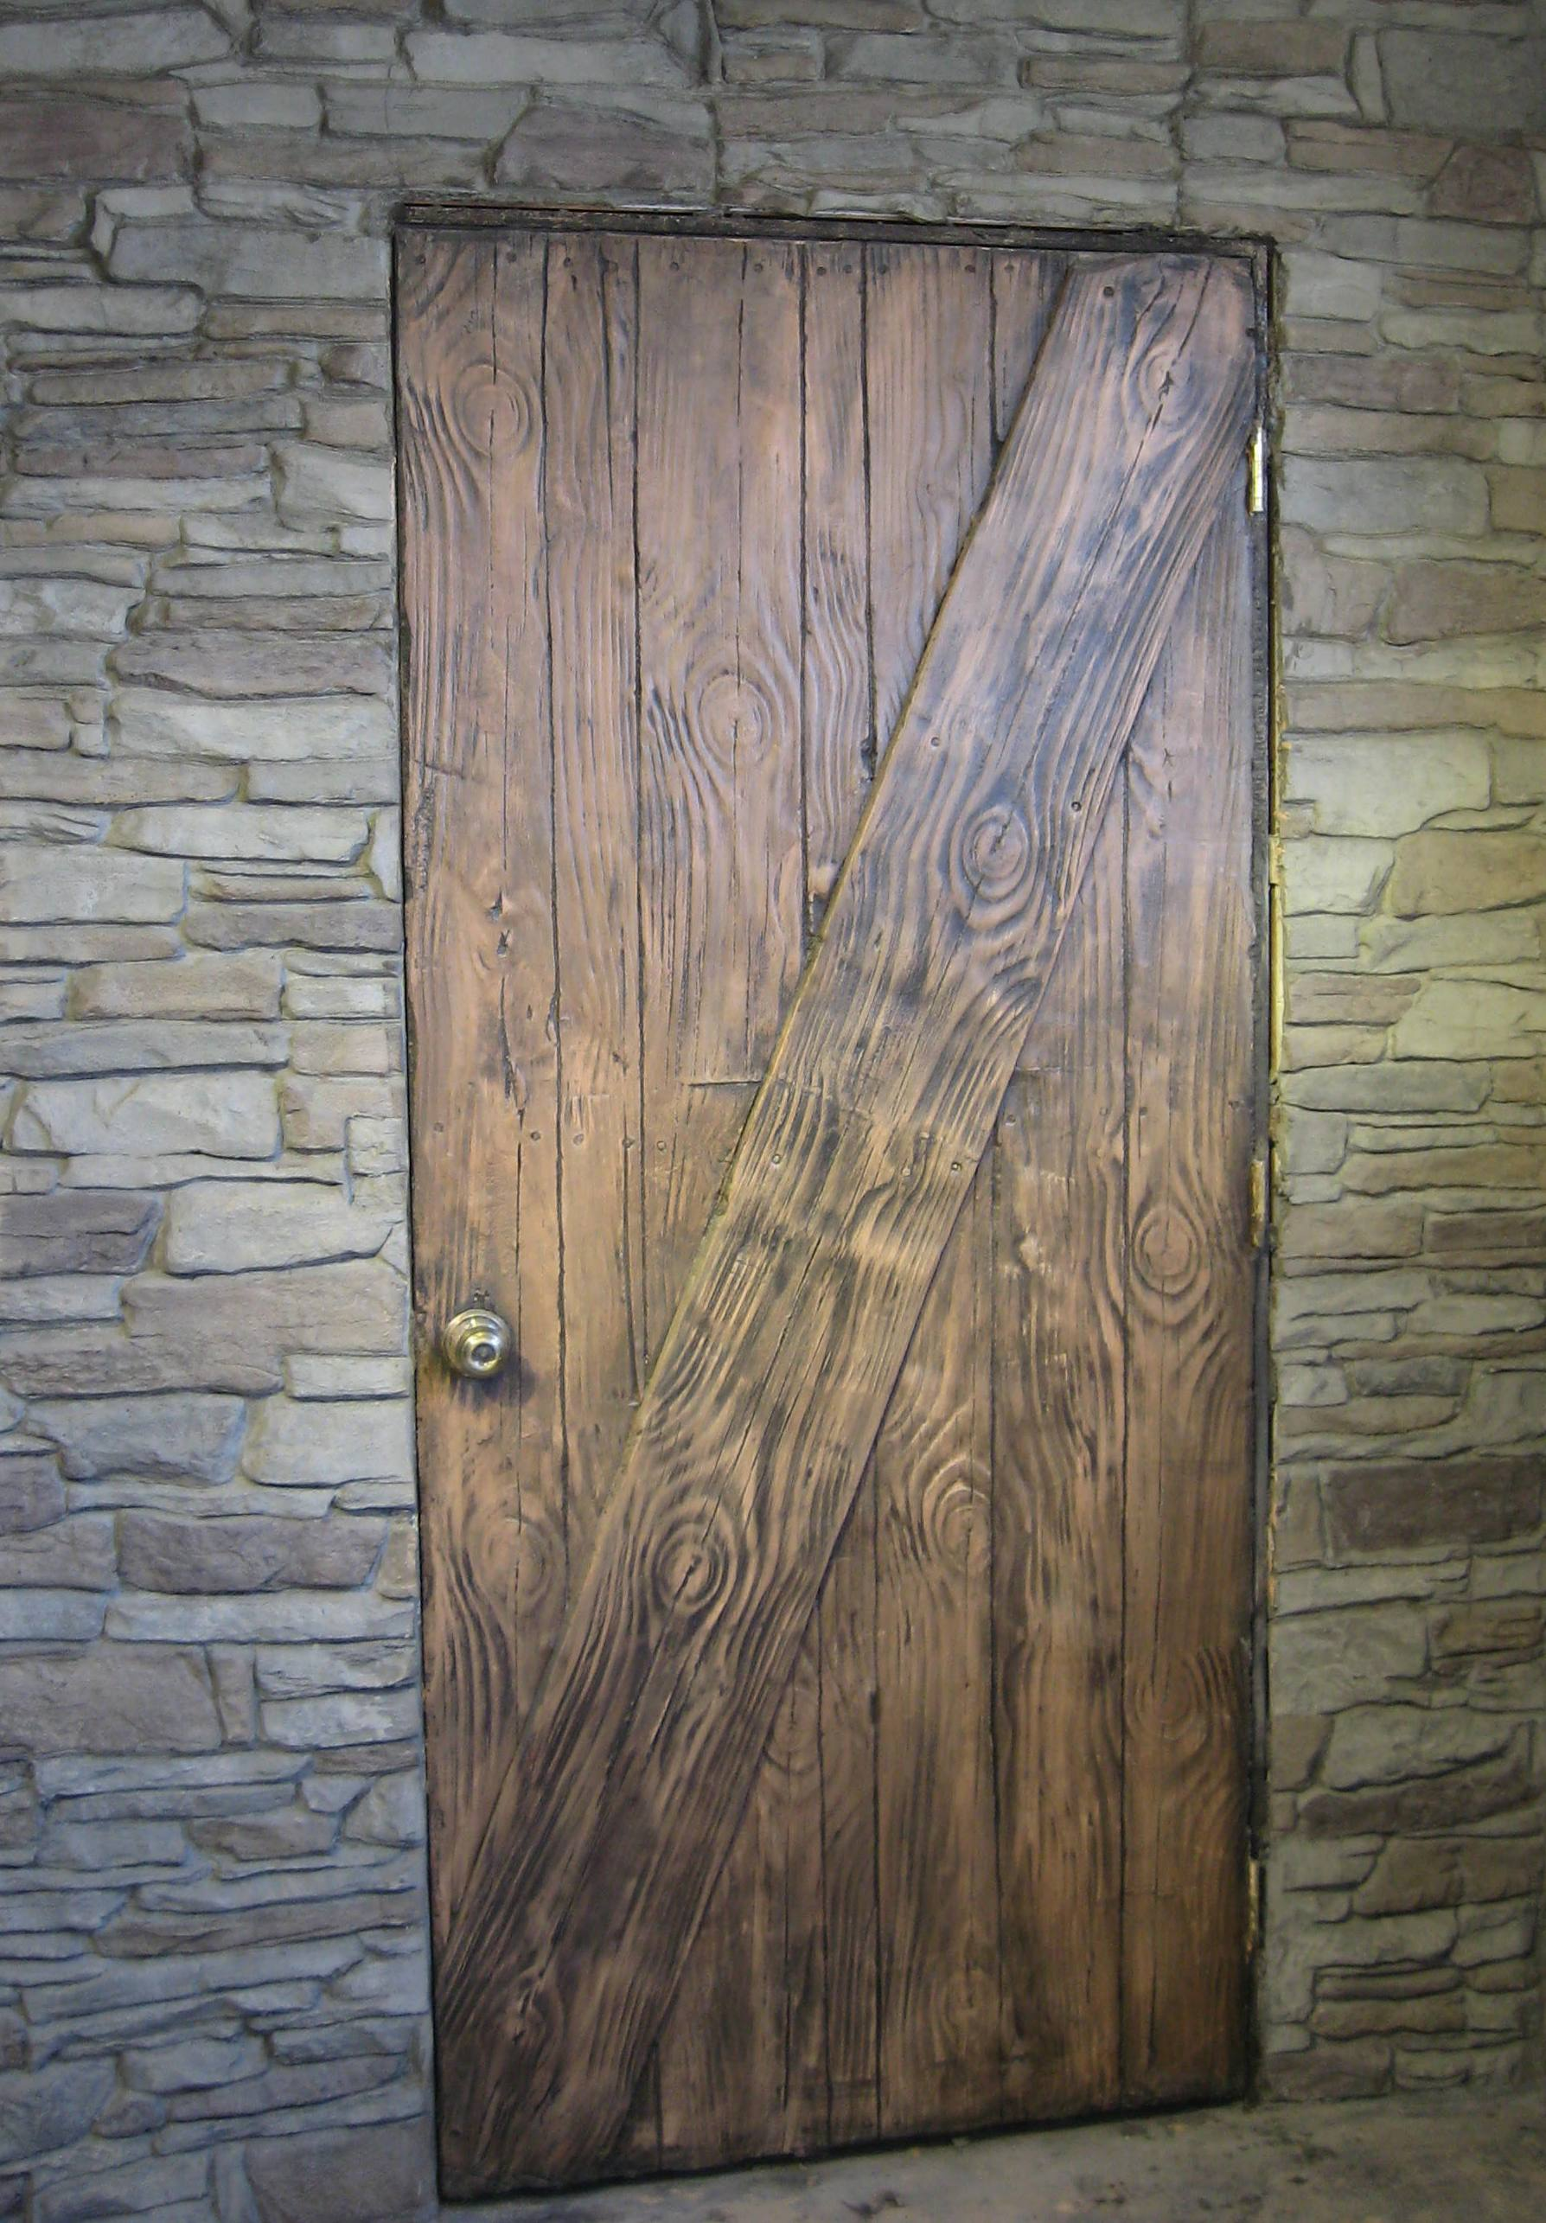

Slide 15
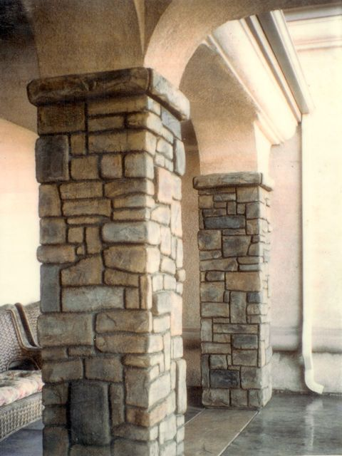

Slide 16
Conclusion
Vertical overlay
Flex-C-Ment® background
Comparisons
Freeze/thaw test results
Installation process
Notes:
Continous system no mortar joints to deteriorate or for water to penetrate and freeze popping stones off
No moisture or insect intrusion
Water clean up no harmful chemicals

Slide 17
Thank You
Contact:
Decorative Concrete Supply
8341 Blackberry Street
Anchorage, AK 99502
907-230-6544
ShanePerrins@yahoo.com
Or vist
www.Flex-c-ment.com

