Slide 1
Module 2
Purpose of Specifications

Slide 2


Lesson 2.1: Specifications as a Contract Document

Slide 3
Learning Outcomes
Lesson 2.1
Compare the functions of standard and supplemental specifications with the functions of special provisions
Explain how the “order of precedence” affects writing specifications and preparing plans
Explain the purposes of a specification

Slide 4
Learning Outcomes (cont.)
Lesson 2.1
Describe the purpose of the general provisions
Explain how specifications are used to assign risk and affect the behavior of different parties, within a given scenario

Slide 5
Definition of Contract
“A contract is an agreement between the parties.”
Notes:
Animation: Click to reveal definition.

Slide 6
AASHTO Definition of Contract
“Written agreement between the agency and the contractor detailing the obligations of each to perform the work. The contract includes the invitation for bids, addenda, proposal, contract form, contract bonds, standard specifications, supplemental specifications, special provisions, standard plans, notice to proceed, and change orders and supplemental agreements that are required to complete the work.”
Notes:
Animation: Click to reveal definition.

Slide 7
Other Contract Documents
Invitation for bids
Addenda
Proposal
Contract form
Contract bonds
Standard and supplemental specifications
Special provisions
Standard plans
Project plans
Notice to proceed
Change orders
Supplemental agreements

Slide 8
Definition of Specification
“A written description from the agency to the contractor of what the contractor is to provide.”
Notes:
Animation: Click to reveal definition.

Slide 9
Group Activity 2.1
Identify and review the definitions of standard specifications, supplemental specifications, and special provisions in the agency’s standard specifications
Discuss the differences between the three terms
Answer the questions
Notes:
Second paragraph appears as the provision written in active voice.

Slide 10
Standard and Supplemental Specifications
Standard Specifications
  “Book of specifications approved for general application and repetitive use.”
  (AASHTO definition)
Supplemental Specifications
    “Approved additions and revisions to the Standard Specifications.”
    (AASHTO definition)
Notes:
Animation: Click to reveal bullets (2).

Slide 11
Special Provisions
“Revisions to the Standard and Supplemental Specifications applicable to an individual project.”
(AASHTO definition)
Notes:
Animation: Click to reveal special provisions (1).

Slide 12
Group Activity 2.2
Review the General Rules for the Use of Plan Notes
Answer the questions
Notes:
Second paragraph appears as the provision written in active voice.

Slide 13
Defined Terms
Use consistently
“Comply with the contract”
Multiple documents and parties provide opportunities for confusion and conflict

Slide 14


Order of Precedence

Slide 15
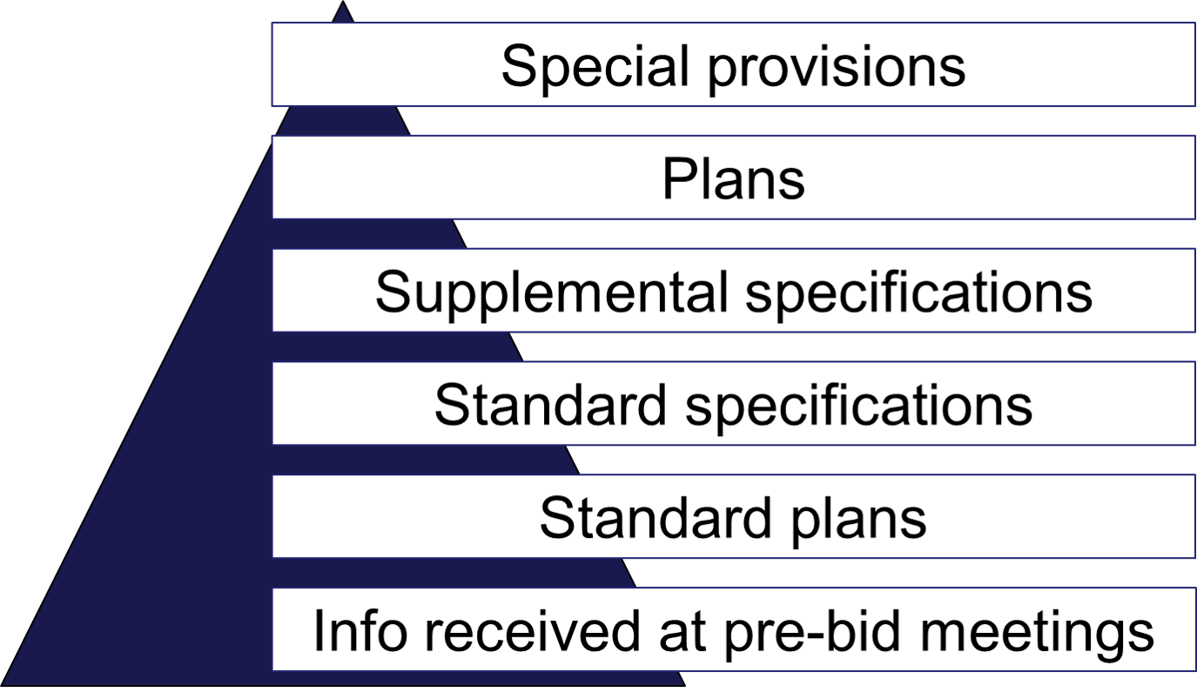
Order of
Precedence Hierarchy

Slide 16
Limitations
Errors and omissions
Ambiguities
Conflicts within a contract document
Contract documents not included in order of precedence
Notes:
Animation: Click to reveal each bullet (4).

Slide 17
Conflict Resolution
General provisions
Other clauses
Notes:
Animation: Click to reveal bullets.

Slide 18
Purposes of Specifications
Address party responsibilities
Set forth contract administration procedures
Describe work performed
Establish quality assurance requirements
Define basis of acceptance
Measurement and payment options set forth
Notes:
Animation: Click to reveal bullets.

Slide 19

Content of Specifications
Administrative Content
Technical Content

Slide 20
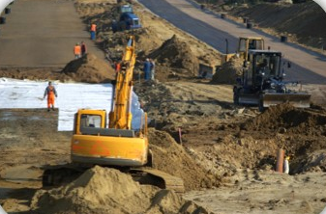
Administrative Content
Conditions and obligations
Roles, rights, and
responsibilities
Requirements, conditions, and restrictions

Slide 21
Technical Content
Include requirements for:
Materials
Equipment
Construction
Acceptance based on inspection, sampling, and testing
Measurement and payment

Slide 22
Inappropriate Content
Requirements for parties not in contract
Procedures not performed by the contractor
The text of laws or regulations
Information not related to contractor’s performance
Construction or design manual information
Explanations or justifications

Slide 23
Group Activity 2.3
Guidance for inspectors or engineers as to how to perform their jobs
Guidance to designers
Explanation as to why work must be done
Notes:
Animation: Click to reveal each bullet (3).

Slide 24

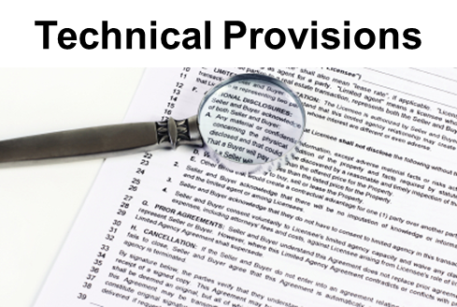
Provisions

Slide 25
General Provisions
Mostly administrative content, little technical content
  Administrative obligations
  Legal responsibilities
  General procedures
  Rights

Slide 26
Technical Provisions
Mostly technical content, little administrative content
  Materials
  Equipment
  Construction
  Acceptance
  Measurement and payment

Slide 27
Agency’s General Provisions
Definitions
Bidding documents
Site of work
Scope of work
Authority of the engineer
Unacceptable and unauthorized work
Responsibility for work
Scope of payment

Slide 28
Agency’s General Provisions
Definitions
Scope of defined terms
Use of defined terms
Terms not defined

Slide 29
Agency’s General Provisions
Bidding documents, Site/Scope
Examination of bidding documents and site of work
  Contractor responsibilities
  Agency responsibilities
  Relation to contract revisions
Scope of work
  Relying on the term “work”
  Avoid repetition by eliminating unnecessary phrases in technical specs
Notes:
Animation: Click to reveal second bullet grouping.

Slide 30
Agency’s General Provisions
Authority, Validate Work
Authority of the engineer
  Interpret contract requirements and direct work
Unacceptable and unauthorized work
  Avoid repetition
  Accept, reject, or order rework
Notes:
Animation: Click to reveal each bullet group (2).

Slide 31
Agency’s General Provisions
Responsibility/Payment
Responsibility for the work
  Prevent and correct damage
Scope of payment
  Payment for completed work items
Notes:
Animation: Click to reveal second bullet grouping.

Slide 32
Provisions:
Repetition

Slide 33
Individual Activity 2.1
Review the sample specification
Identify problems with the technical provisions
Rewrite the provision to address the problems
Notes:
Two animations in this slide

Slide 34
Individual Activity 2.1
Sample 1
“This item consists of furnishing and installing an actuated controller and associated equipment according to these specifications and at the locations shown on the plans or as directed.”
“This item consists of furnishing and installing an actuated controller and associated equipment.”
Notes:
Animation: Click to reveal answer.

Slide 35
Individual Activity 2.1
Sample 2
“Before cleaning with pressurized water, remove all debris from bridge sidewalks, bridge decks, curb tops, beam flanges, gusset plates, abutment bridge seats, pier tops, truss joints, deck drain systems, and other locations where debris has accumulated and as directed by the engineer.”
Notes:
Three animations in this slide

Slide 36
Individual Activity 2.1
Sample 2 answer
“Before cleaning with pressurized water, remove all debris from bridge sidewalks, bridge decks, curb tops, beam flanges, gusset plates, abutment bridge seats, pier tops, truss joints, deck drain systems, and other locations where debris has accumulated.”
Notes:
Three animations in this slide

Slide 37
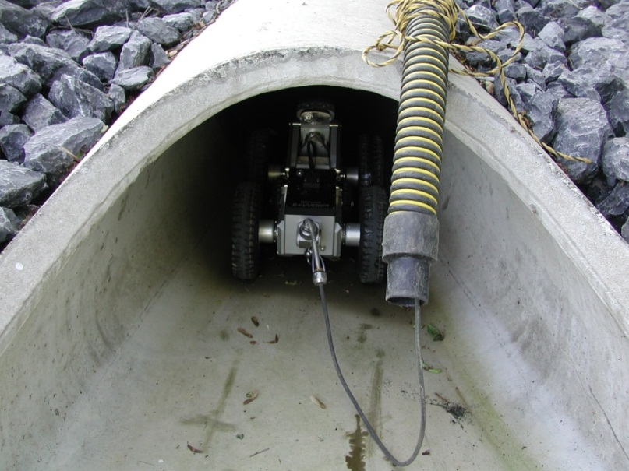
Quality
Quality:
Conformance to requirements
Specifications:
Contract tool for establishing quality

Slide 38
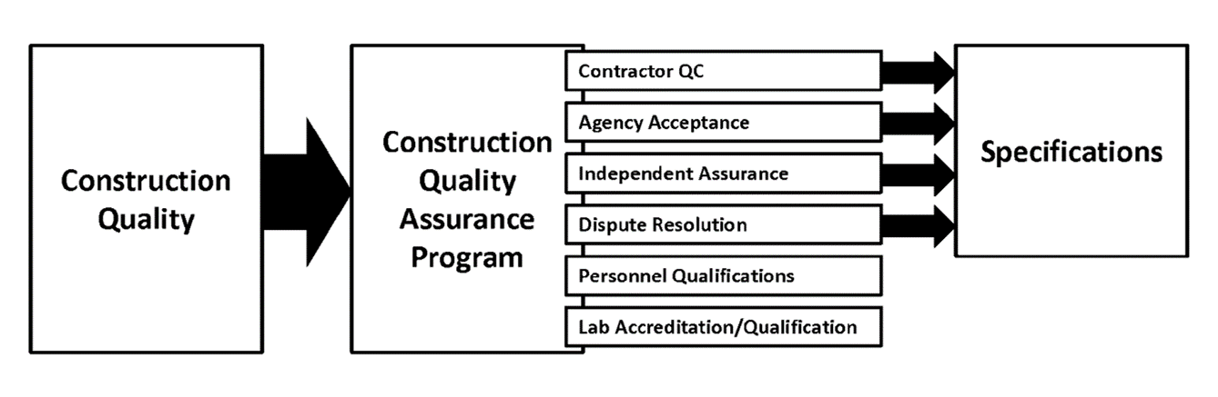
Quality Defined

Slide 39
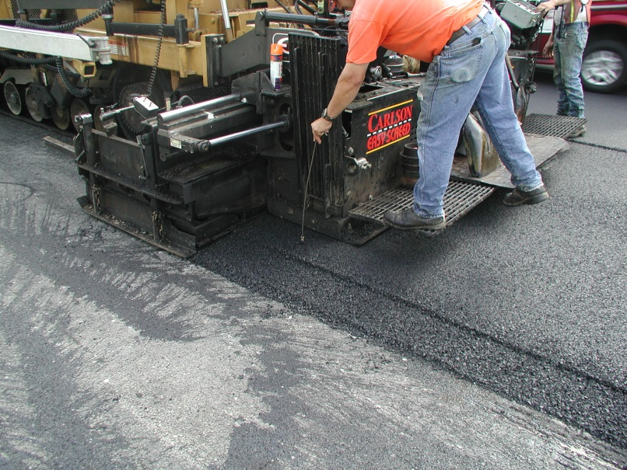
Quality Definitions
Quality Assurance
Quality Control
Acceptance
Independent Assurance
Notes:
Animation: Click to reveal each of the last three bullets.

Slide 40

Engineering Risk
Probability of event occurring
Economic consequences of event

Slide 41
Group Activity 2.4
Review the sample specifications
Identify the potential risks
Write the potential risk in the risk column and place a checkmark in the column for the party to the contract that owns the risk

Slide 42
Group Activity 2.4—Debrief Sample 1
“Remove and dispose of residue from the grooving operations as directed by the engineer to minimize dust and to prevent debris from entering drainage systems.”

Slide 43
Group Activity 2.4—Debrief
Sample 2
“Using methods approved by the engineer, clean dirt and debris from the pavement surface and paved shoulders before placing HMA. Remove loose material from joints and cracks using compressed air. If the engineer determines the compressed air system will not remove deleterious material, remove loose material by a hand or mechanical method, as approved by the engineer. The agency will pay for removal of material by hand or mechanical methods in accordance with subsection 501.04.E.”

Slide 44
Group Activity 2.4—Debrief
Sample 3
“The surface areas of asphalt and concrete pavement that are to receive markings shall be cleaned with a high-pressure air blast to remove loose material prior to placement of the epoxy pavement marking. Should any pavement become dirty, from tracked mud or for other reasons, as determined by the engineer, it shall be cleaned prior to the placement of the epoxy pavement marking.”

Slide 45

Explicit and Implicit Risk
Consider both implicit and explicit risk allocation

Slide 46
Lesson 2.2: Specification Types

Slide 47
Learning Outcomes
Lesson 2.2
Compare method and end-result specifications

Slide 48


Definitions

Slide 49
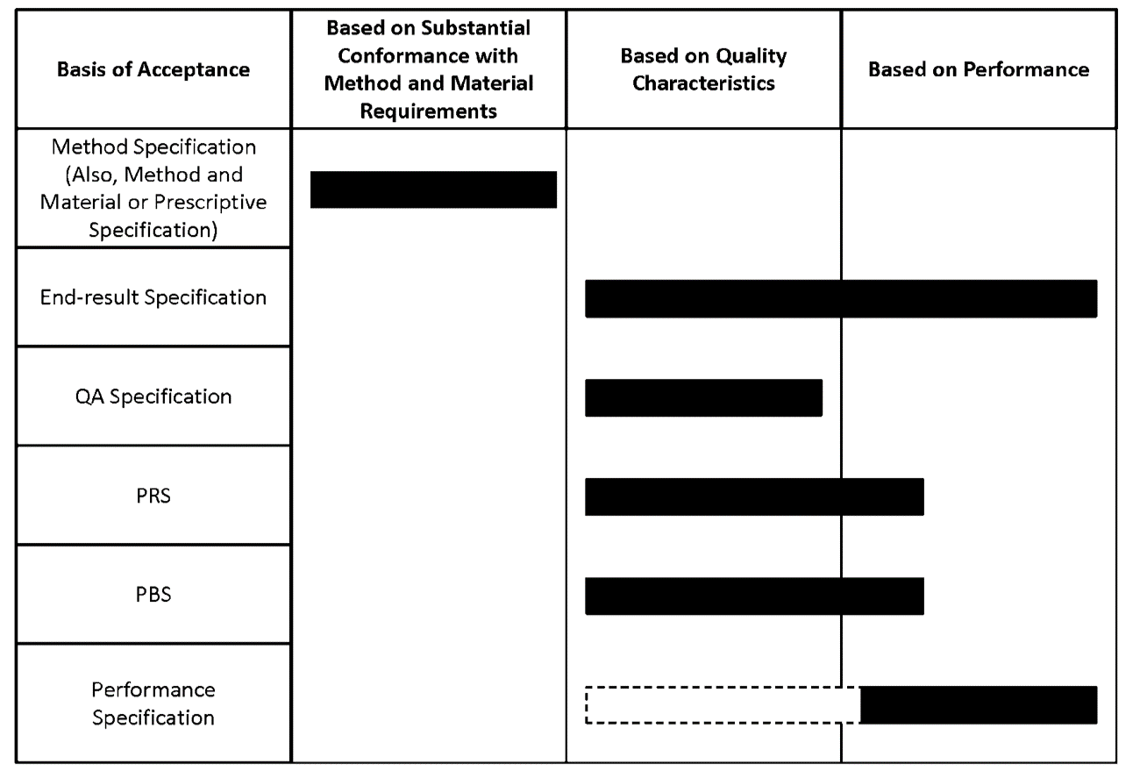
Types of Specifications

Slide 50


Lesson 2.3 Formatting Specifications

Slide 51
Learning Outcomes
Lesson 2.3
Explain each element of the AASHTO five-part format

Slide 52
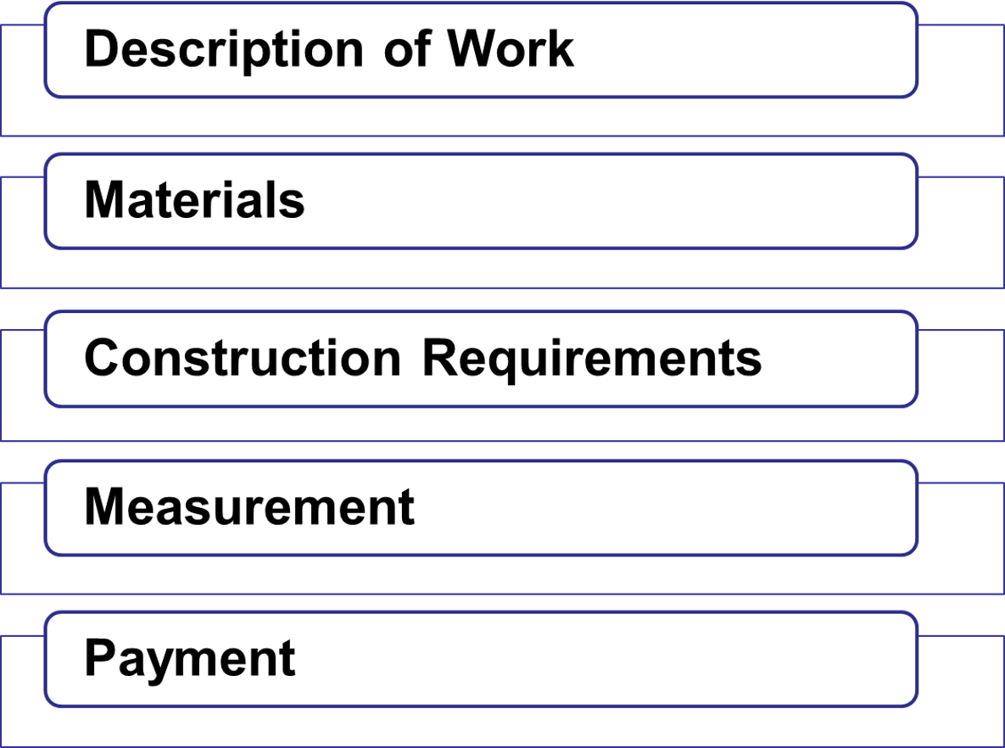
AASHTO Five-Part Format

Slide 53
Individual Activity 2.2
Read the AASHTO Five-Part
Format Functions
Write any questions you have about the structure and function of each
Determine agency’s preferred format
Compare and contrast the agency’s preferred format and the AASHTO
five-part format
Notes:
Two animations in this slide

Slide 54
Group Activity 2.5
Read the context and criteria
Create a general outline for a new concrete sidewalk specification
Write the outline on the flip chart
Notes:
Second paragraph appears as the provision written in active voice.

Slide 55
Group Activity 2.5—Debrief
608 Concrete Sidewalk
608.01 Description of Work
608.02 Materials
608.03 Construction Requirements
  Equipment
  Methods
  Inspection and Acceptance
608.04 Measurement
608.05 Payment

Slide 56
Module 2 Review

