Slide 1
Module 5
Conclusion and End-of-Course Activities

Slide 2
Specification Writing References
Style guides
Checklists
Glossaries
Federal Plain Language Guidelines
Web site
FHWA technical advisory document
Strategic Highway Research Program (SHRP) publication
AASHTO publications
Construction Specifications Institute publication
Notes:
Animation: Click to reveal each bullet (9).

Slide 3

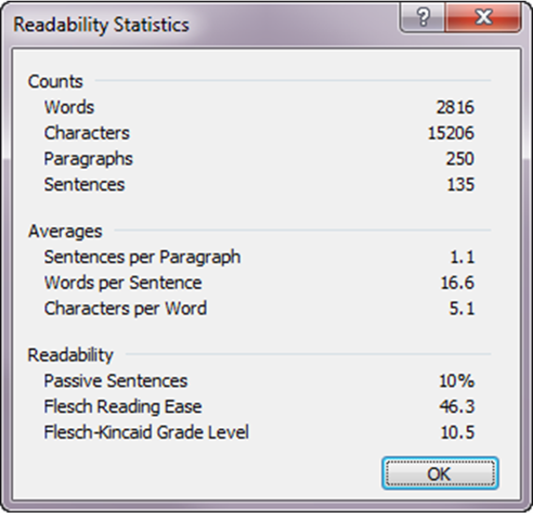
Word Processing Tools
Spelling and grammar
check
Readability statistics
Track changes
Comments
Compare
documents
Notes:
Animation: Click to reveal Readability Statistics screenshot.

Slide 4


Learning Outcomes

Slide 5

Exam and Evaluation
Exam
  60 minutes to complete
  Open-book
  Individual not group
Evaluation
  Required to receive certificate

