Slide 1
Module 4
Method or
End-result Specifications

Slide 2
Learning Outcomes
Write a new specification to a given set of criteria using the five Cs and the agency’s preferred format, given a sample specification
Relate the type of specification to the allocation of risk
Write an end-result specification to replace a method specification, given an excerpt from a method specification

Slide 3
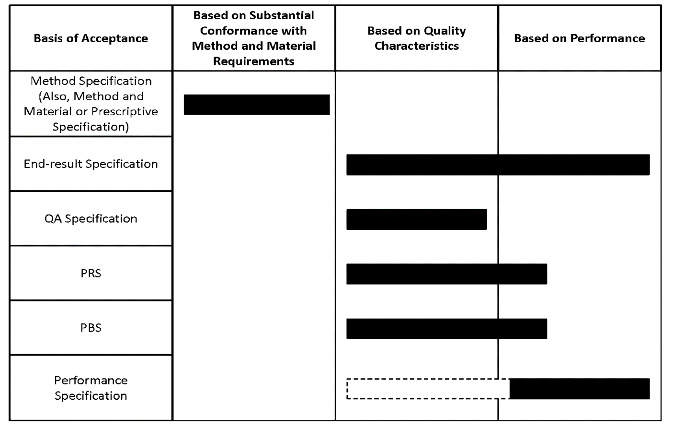
Types of Specifications

Slide 4
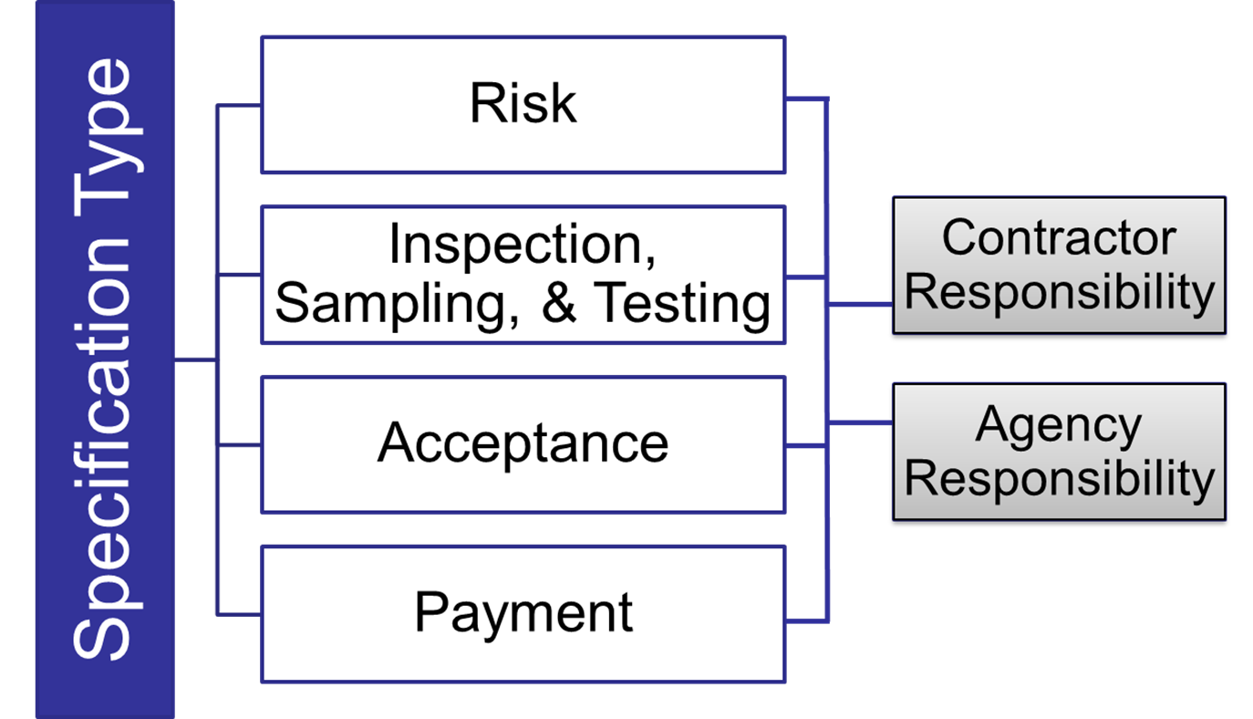
Specification Attributes

Slide 5
Method Specifications
Specifications that require the contractor to use specified materials in definite proportions and specific types of equipment and methods to place the material

Slide 6
Industry Terms
Descriptive
Prescriptive
Recipe
Methods and materials

Slide 7




Method Specification
Characteristics
Notes:
Animation: Click to reveal each photo (4).

Slide 8
Method Specification Advantages
Well established and easily understood
Agency can exert control over the work
Requirements based on methods and materials that have worked in the past

Slide 9
Method Specification Disadvantages
Contractor has little opportunity to deviate from the specification
Few built-in incentives for contractors to provide enhanced performance
Prescribed procedures may discourage contractor from using innovative procedures

Slide 10
Method Specification Disadvantages (continued)
Contractor payment not tied to performance or quality of work
Acceptance decisions based on test results of field samples can increase disputes

Slide 11
End-result Specifications
Specifications that require the contractor to take the entire responsibility for supplying a product or an item of construction

Slide 12
End-result Specification
Characteristics
Notes:
Animation: Click to reveal each photo (4).

Slide 13
End-result Specification Advantages
Contractor innovation is promoted
Contractor assumes more performance risk
Contractors have flexibility to select materials, techniques, and procedures
More rational mechanism for adjusting payment based on quality or performance

Slide 14
End-result Specification Disadvantages
Agency can exert less control over the work
Opportunities for smaller, local construction firms reduced
Challenge to identify all parameters critical to performance
Roles and responsibilities of the contractor and agency can blur

Slide 15
Quality Assurance Specifications
Specifications that require contractor quality control and agency acceptance activities throughout production and placement of a product

Slide 16
Quality Assurance Specification
Characteristics
Notes:
Animation: Click to reveal each photo (4).

Slide 17
Partner Activity 4.1
Review and discuss the notes on the matrix of attributes
Match each sample specification with the best representative type of specification. Use the information you noted and discussed
Write your answers in the Types of Specification table

Slide 18
Specification Sample 1
“609.4.4 Finishing. When using forms, trowel exposed surfaces smooth and give a fine brush finish with brush strokes parallel to the curb line. After removing forms, fill surface blemishes that will be exposed with grout and finish . . .”
Method specification
Notes:
Animation: Click to reveal answer.

Slide 19
Specification Sample 2
“609.4.6 Surface Tolerance. Ensure that the finished top and face of the curb are true and straight and that the top surfaces are of uniform width and free from irregularities. Do not leave the finished surface with variation greater than 3/16 in. [5 mm] every 10 ft. [3 m] in any direction. Correct excess variation by removing and replacing the curb section.”
End-result specification
Notes:
Animation: Click to reveal answer.

Slide 20
Specification Sample 3
“605.03. Concrete Production. The contractor shall provide quality control measures for the production of concrete in accordance with Section 604. The engineer will not sample or test for quality control or assist in controlling the contractor's production operations . . .”
Quality assurance specification
Notes:
Animation: Click to reveal answer.

Slide 21
Specification Sample 4
“401.16 Density. Acceptance will be based on lots and sublots in accordance with 401.07.
Density of the compacted dense graded mixture will be determined from cores except where . . .”
End-result specification
Notes:
Animation: Click to reveal answer.

Slide 22
Specification Sample 5
“716.03 General Requirements. The contractor shall submit a quality control plan, QCP, in accordance with ITM 803. The QCP shall be submitted to the engineer for review and acceptance, at least 15 days prior to the start of trenchless pipe installation operations.”
Quality assurance specification
Notes:
Animation: Click to reveal answer.

Slide 23
Specification Sample 6
“5. Preparing Pavement Surface. Prepare the pavement surface to receive the chip seal. Clean pavements requiring treatment with a motorized power broom to remove loose material. Use a hand broom to clean cracks and other areas inaccessible by power broom. Use pick-up sweepers adjacent to lawns or roadways with curb and gutter.”
Method specification
Notes:
Animation: Click to reveal answer.

Slide 24
Performance-Related Specifications
Specifications that describe the desired levels of key materials and construction quality characteristics that correlate with fundamental engineering properties that predict performance

Slide 25
Performance-Related Specification
Characteristics
Notes:
Animation: Click to reveal each photo (4).

Slide 26
Performance-Based Specifications
Specifications that are based on the desired levels of fundamental engineering properties that are predictors of performance and appear in primary prediction relationships

Slide 27
Performance-Based Specification
Characteristics
Notes:
Animation: Click to reveal each photo (4).

Slide 28
Group Activity 4.1
Review the Example Method Specification for a Concrete Sidewalk
Identify components of the example not appropriate for use in an end-result specification
Strike through the method requirements to be replaced with end-result requirements
Identify and record ideas for
end-result acceptance criteria

Slide 29
Group Activity 4.1—Debrief
608.01 Description of Work
This work consists of constructing a concrete sidewalk.
Notes:
Animation: Click to reveal answer.

Slide 30
Group Activity 4.1—Debrief
(continued 1)
608.02 Materials
Provide material for constructing a concrete sidewalk as follows:
Bed course material in accordance with Subsection 703.12
Reinforcing steel in accordance with Subsection 711.01
Concrete, Class B, in accordance with Section 601 and Subsection 713.01(B)
Joint filler in accordance with Subsection 707.01(D)
Form release agent approved by the engineer
Curing compound in accordance with Subsection 713.02(C)
Notes:
Animation: Click to reveal answer.

Slide 31
Group Activity 4.1—Debrief
(continued 2)
608.03 Construction Requirements
Equipment
Excavator and hand tools for excavation and placement of bed course material.
Hand-driven compactor for compaction.
Forms and hand tools for placing, consolidating, finishing, jointing, and texturing the concrete.
Notes:
Animation: Click to reveal answer.

Slide 32
Group Activity—Debrief
(continued 3)
608.03 Construction Requirements
Methods
Excavating. Excavate to the depth and width necessary to allow for the proper depth of the bed course material and the installation and bracing of the forms. Replace soft and yielding material with the specified bed course material. Place, shape, and compact the bed course material to the line and grade established by the plans.
Forms. Use full-depth forms that, when properly braced, are strong enough to resist the concrete pressure. Maintain horizontal and vertical alignment. Use clean forms and coat with a form-release agent.
Notes:
Animation: Click to reveal answer.

Slide 33
Group Activity—Debrief
(continued 4)
608.03 Construction Requirements
Reinforcing Steel. Place reinforcing steel as specified in Subsection 809.
Placing Concrete. Moisten the foundation prior to placing concrete. Proportion, mix, and place as specified in Subsection 601. Place uniformly in one course.
Finishing. Float and apply a light broomed finish. Edge all outside slab and all joint edges to a ¼ in. (6 mm) radius.

Slide 34
Group Activity—Debrief
(continued 5)
608.03 Construction Requirements
Joints. Fill expansion joints with the specified preformed expansion joint filler. Section the sidewalk using false joints at 5 ft. (1.5 m) intervals ⅛ in. (3 mm) wide and at least 1 in. (25 mm) deep using a jointing tool. Match curb or pavement joints.
Form full-depth construction joints around all appurtenances, such as manholes and utility poles. Install full-depth preformed expansion joint filler between concrete sidewalks and structures.

Slide 35
Group Activity—Debrief
(continued 6)
608.03 Construction Requirements
Curing. Cure concrete as specified in Subsection 808.03(I) for 72 hours. Do not allow pedestrian and vehicle traffic on the concrete for 7 days unless the surface is protected by planks, plywood, or a minimum 1 in. (25 mm) sand layer. Do not place protection directly on the concrete for a minimum 12 hours after application of the curing compound.

Slide 36
Group Activity—Debrief
(continued 7)
608.03 Construction Requirements
Inspection and Acceptance
Notify the engineer 24 hours before beginning the placement of concrete sidewalks.
The engineer will inspect the form work, bed course, and reinforcing steel installation before concrete is placed.
Notes:
Animation: Click to reveal answer.

Slide 37
Group Activity—Debrief
(continued 8)
608.04 Measurement
The engineer will measure accepted sidewalk separately by the square foot (square meter) of concrete placed.
Notes:
Animation: Click to reveal answer.

Slide 38
Group Activity—Debrief
(continued 9)
608.05 Payment
The agency will pay for accepted sidewalk in accordance with the contract pay items for sidewalk.
Notes:
Animation: Click to reveal answer.

Slide 39
Group Activity 4.2
Fill in the blanks of the end-result specification
Use the Specification Writer’s Checklist as a resource

Slide 40
Group Activity 4.2 (continued)
Exchange your group’s end-result specification with another group
Review and comment on the end-result specification
Use the Specification Writer’s Checklist as a guide for review

Slide 41
Group Activity 4.2—Debrief
Review the Example End-result Specification for a Concrete Sidewalk and the other group’s comments
Identify points of disagreement and prepare to discuss them with the group

Slide 42


Deciding Between
Specification Types

Slide 43
Deciding Between Types
Discussion
Performance definitions
Performance measurements
Key performance parameters
Performance risk
Other considerations

Slide 44
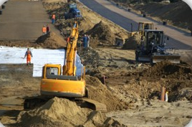
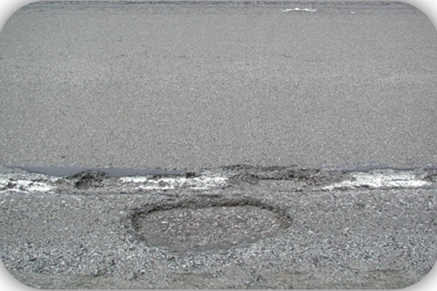
Deciding Between Types

Slide 45
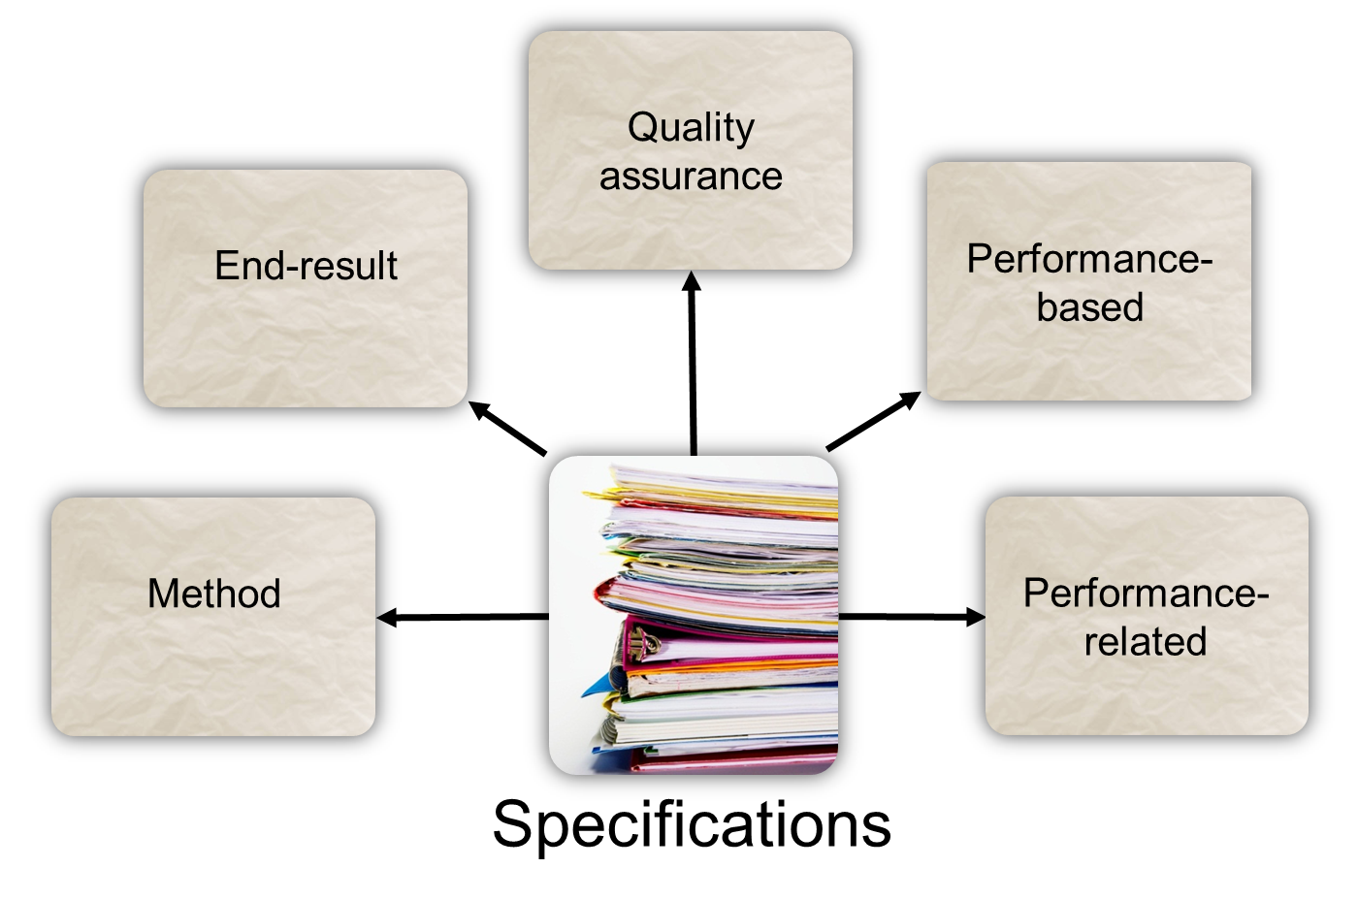
Module 4 Review

