Slide 1
Module 3
Writing and Interpreting Specifications

Slide 2


Lesson 3.1: Introduction to Writing Style and Plain Language

Slide 3
Learning Outcome
Lesson 3.1
Explain how a consistent writing style can affect the interpretation of specifications

Slide 4
The Use of Writing Styles
“Vigorous writing is concise. A sentence should contain no unnecessary words, a paragraph no unnecessary sentences, for the same reason that a drawing should have no unnecessary lines and a machine no unnecessary parts. This requires not that the writer make all his sentences short, or that he avoid all detail and treat his subjects only in outline, but that every word tell.”
—William Strunk

Slide 5

Writing Styles and Specifications
Writing styles
Writing process as a project
Effect of writing styles on interpretation
Plain language approach

Slide 6
Plain Language Approach
Goal: Make information more accessible to reader
The audience can:
  Find information faster
  Understand it accurately
  Act accordingly to understanding

Slide 7
Plain Language Approach
(continued)
Potential to reduce project costs such as:
Agency’s costs responding to questions
Hidden risks and their costs
Contractor’s added costs for contingencies
Both parties’ costs to resolve disputes

Slide 8

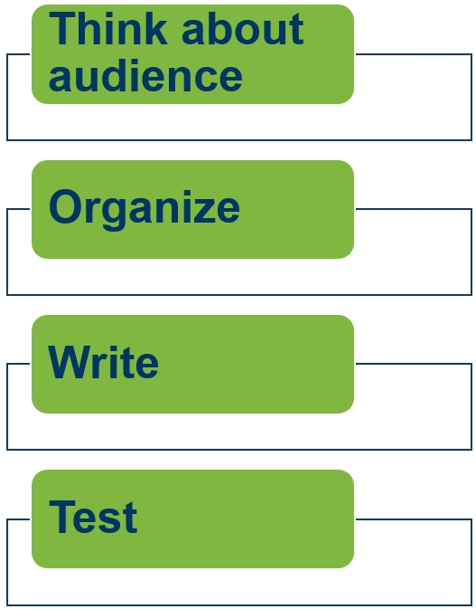
Federal Plain Language Guidelines

Slide 9
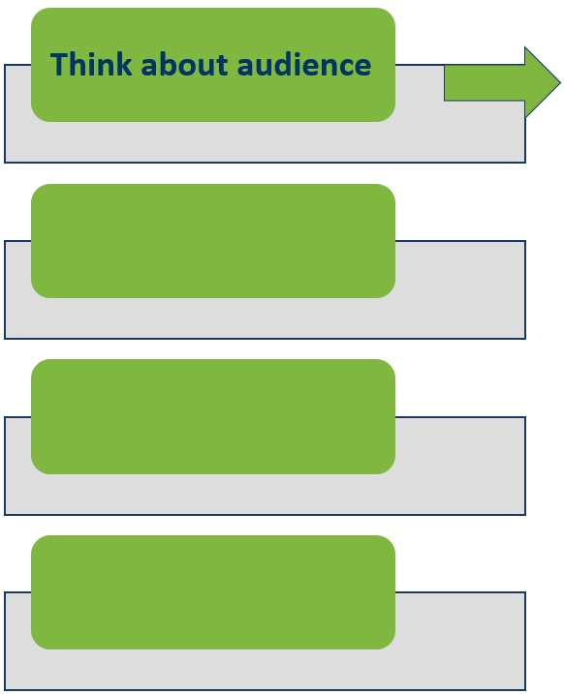
Step 1
Audience research
Level of expertise
Audience/author gap
Separate audiences

Slide 10
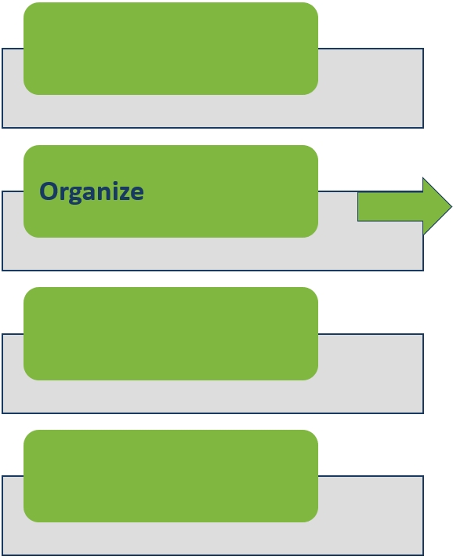
Step 2
Review team
Writing references
National Highway Specification
Web site
Word processing software

Slide 11
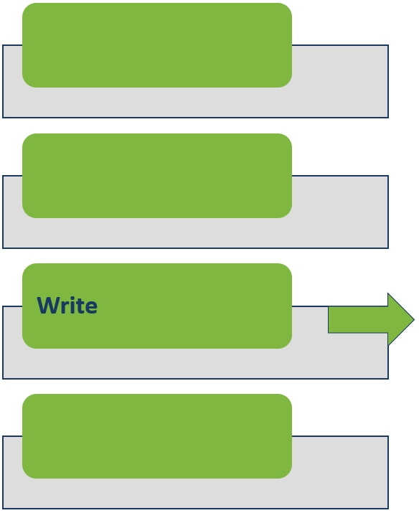
Step 3
Style guide
Review and revision times

Slide 12
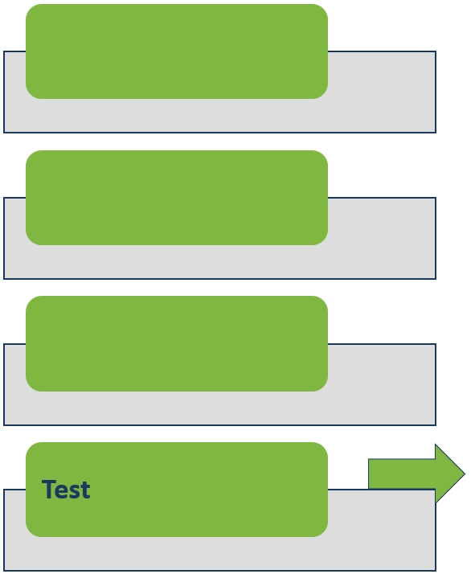
Step 4
Before use
After use

Slide 13
Partner Activity 3.1
What questions do you have about the tasks?
What tasks would you add to your checklist and why?

Slide 14


Lesson 3.2: Voice and Mood in Specifications

Slide 15
Learning Outcomes
Lesson 3.2
Explain the potential benefits of writing in the active voice
Rewrite passive voice sentences into the active voice
Evaluate specifications to determine the need for imperative or indicative mood

Slide 16
Voice—Active and Passive
Characteristic of a verb that reflects whether verb’s subject acts or is acted upon
Active voice: Subject performs action
Passive voice: Subject receives an action

Slide 17

Active Voice Examples
The contractor shall place the concrete in continuous horizontal layers.
The contractor shall test the concrete cores for compressive strength.
Notes:
Animation: Click to reveal the subject, verb, and object of each sentence.

Slide 18


Passive Voice Examples
The concrete shall be placed in continuous horizontal layers.
The concrete cores shall be tested for compressive strength.
Notes:
Animation: Click to reveal the subject, verb, and object of each sentence.

Slide 19
Voice—Active and Passive Use
Passive voice is used in scientific and technical documents
  Who performs the work is not important
Specifications are technical and contractual
  Who performs the work is important

Slide 20
Benefits of Active Voice
More direct
More concise
Shorter
Clearer
Emphatic

Slide 21
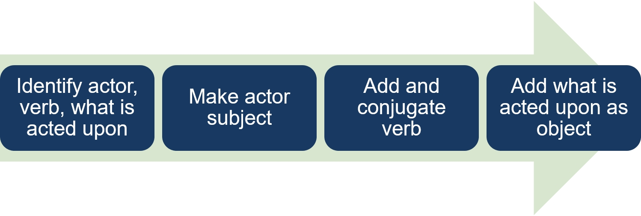
Rewriting Passive to Active
The concrete shall be placed in continuous horizontal layers.
The contractor
shall place
the concrete in continuous horizontal layers.
Notes:
Animation: Click to reveal each of the 3 parts of the rewritten sentence.

Slide 22
Individual Activity 3.1
Rewrite each specification sample to active voice

Slide 23
Individual Activity 3.1—Debrief Samples 1-2
  Sample 1
“The contractor shall store and handle materials to preserve its fitness for the work.”
  Sample 2
“At least 30 days before the beginning of lime treatment, the contractor shall supply adequate quantities of soil and lime to the Materials Division for determination of lime requirements.”
Notes:
Animation: Click to reveal each sample answer (2).

Slide 24
Individual Activity 3.1—Debrief
Samples 3-4
  Sample 3
“The contractor shall remove or uncover completed work to allow inspection by the engineer.”
  Sample 4
“The contractor shall provide the test cylinders and all associated equipment; the engineer will sample and test the concrete.”
Notes:
Animation: Click to reveal each sample answer (2).

Slide 25
Individual Activity 3.1—Debrief
Sample 5
  Sample 5
“The contractor shall correct any pile damaged by reason of internal defects or improper driving, or any pile driven out of its proper location or driven below the elevation fixed by the plans or the engineer at no cost to the agency.”
Notes:
Animation: Click to reveal the sample answer.

Slide 26
Individual Activity 3.1—Debrief
Sample 6
  Sample 6
“The agency will consider the submission of a bid as prima facie evidence that the bidder has made such examination and is satisfied as to the conditions to be encountered in performing the work and as to the requirements of the plans, specifications, supplemental specifications, special provisions, and contract.”
Notes:
Animation: Click to reveal the sample answer.

Slide 27
Mood
Indicative mood “indicates” something
Imperative mood is “imperious” or “imperial” and demands something

Slide 28
Indicative Mood
Makes a statement, asks a question, or states an opinion
Is most common

Slide 29
Indicative Mood Uses
When defining or describing something
With the existing shall/will convention
When minimal or no action is performed
When the contractor may make a choice in how to perform the work

Slide 30
Indicative Mood Examples
“The contractor shall place the concrete.”
“The engineer may reject dowels with coatings not meeting the thickness requirements or dowels with coating damage.”
“A Daily Average Profile Index is a roughness value obtained by averaging . . .”

Slide 31
Imperative Mood
Expresses a command or gives direction
Omits subject of sentence
Is concise and easy to understand

Slide 32
Imperative Mood Use
Subject “contractor” is implicit or understood
Verb generally becomes the first word in the sentence
Verb is conjugated to the second person
Auxiliary verb “shall” is not used

Slide 33
Imperative Mood Examples
“Place the concrete in continuous horizontal layers.”
“Test the concrete cores for compressive strength . . .”
“Remove material from the roadway foundation and salvage or dispose.”

Slide 34
Imperative Mood Examples (continued)
“Roll and bend tube rail sections with a hydraulic ram.”
“Provide Grade D concrete containing . . .”
“Consult with the appropriate utility company before beginning work.”
“When using mineral filler, provide an additional bin.”

Slide 35
Individual Activity 3.2
Rewrite the specification samples in the active voice and imperative mood
Determine how many words were eliminated

Slide 36
Individual Activity 3.2—Debrief
  Sample 1
  “Assemble the truss sections and posts in the shop before galvanizing.”
  Sample 2
  “Obtain the engineer’s approval of facilities and services before installing on the project site.”
  Sample 3
  “Provide a written record of each shop assembly set-up as requested by the engineer.”
Notes:
Animation: Click to reveal each sample answer (3).

Slide 37
General Guidelines
If a provision… | Then write the provision…
Reflects obligation or requirement of contractor | In active voice and imperative mood
Reflects an option, choice, or right of contractor | In active voice and indicative mood
Reflects on obligation, requirement, choice, right of agency | In active voice and indicative mood
Reflects statement of fact | In active voice and indicative mood
Reflects obligation, requirement, choice, right of agency and contractor | In active voice and indicative mood

Slide 38
Partner Activity 3.2
Rewrite the specification samples with the appropriate combination of voice and mood based on the general guidelines discussed

Slide 39
Partner Activity 3.2—Debrief
  Sample 1 - Active/Imperative
  “Compact the fill in accordance with the quality compaction requirements in 205, ‘Excavation and Embankment.”
Sample 2 - Active/Indicative
  “The contractor may use preformed joint filler to form vertical joints.”
Notes:
Animation: Click to reveal each sample answer (2)

Slide 40

Lesson 3.3: The Five Cs of Specification Writing

Slide 41
Learning Outcomes
Lesson 3.3
State the five Cs used in specification writing
Identify potential ambiguities in the wording, given a sample specification
Identify the potential benefits of each of the five Cs

Slide 42
Learning Outcomes (cont.)
Lesson 3.3
Write a new specification using the five Cs and the agency’s preferred format
Complete a checklist of the information needed before writing or revising a specification
Apply the five Cs and the agency’s preferred format to revise the specification, given a sample specification

Slide 43
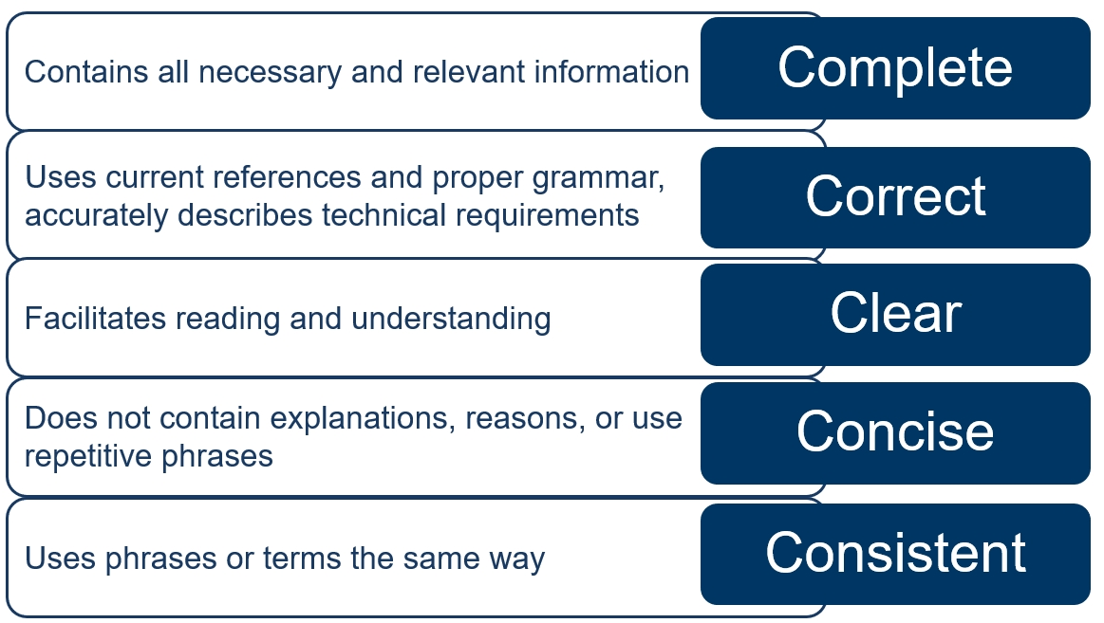
The 5 Cs

Slide 44
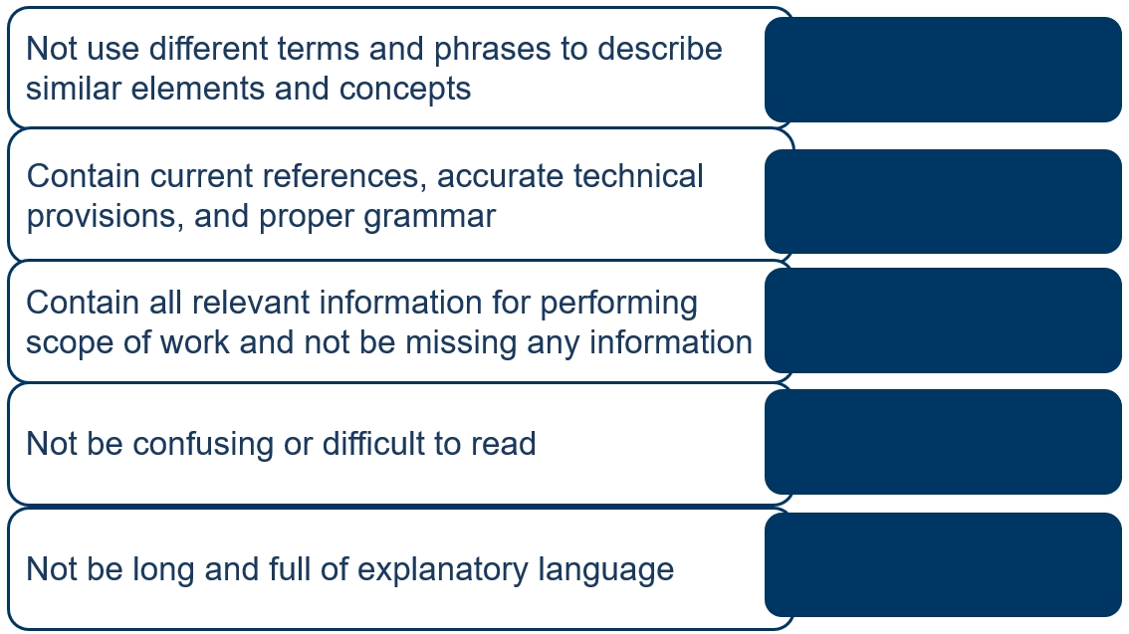
5 Cs of Specification Writing
Match
Consistent
Correct
Complete
Clear
Concise
Notes:
Animation: Click to reveal each answer (5).

Slide 45


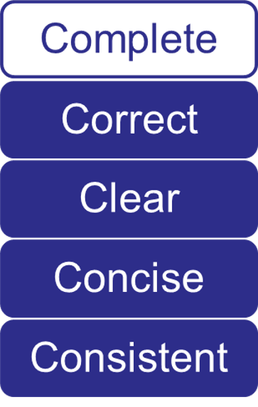

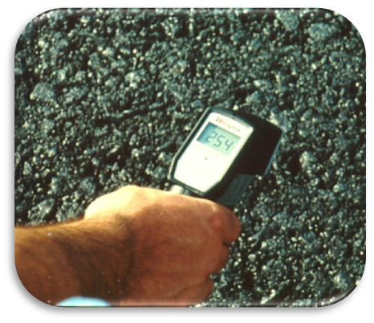
Complete
Notes:
Animation: Click to reveal each of the four graphics as introduced.

Slide 46
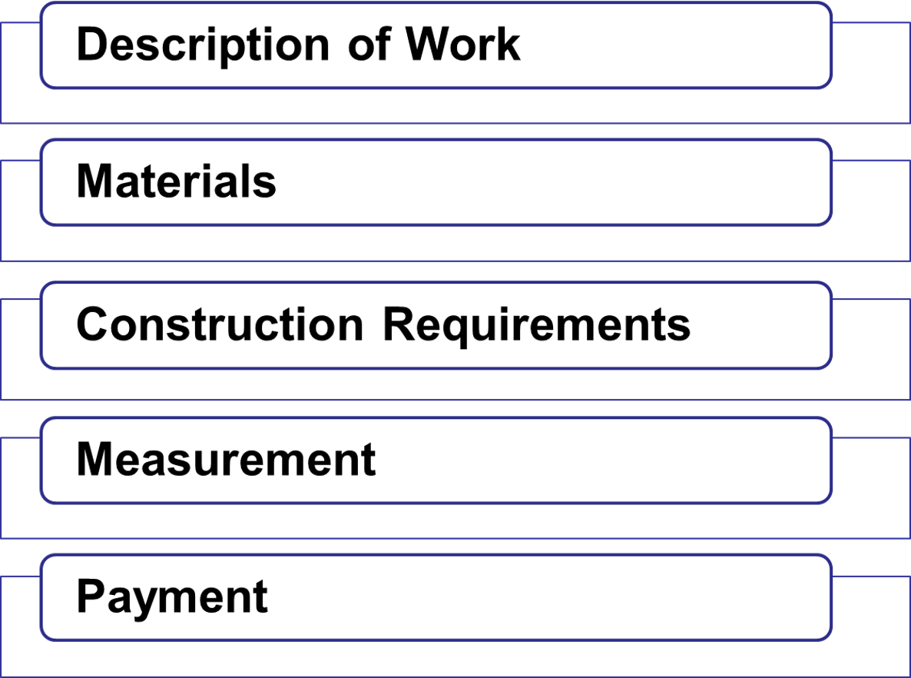
AASHTO Five-Part Format

Slide 47


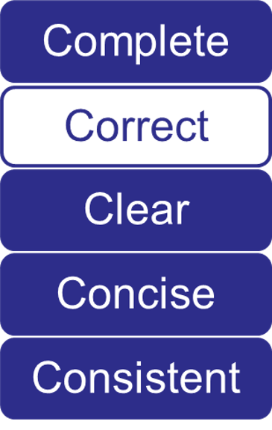

Technically Correct
Notes:
Animation: Click to reveal each picture (3).

Slide 48
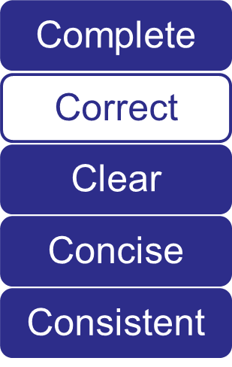
Grammatically Correct
Eliminate misplaced modifiers
Keep subjects and objects close to verbs
Place modifiers next to words they modify

Slide 49
Grammatically Correct
Discussion
“Obtain authorization from the engineer in writing.”
“Obtain authorization in writing from the engineer.”
“Obtain written authorization from the engineer.”
Notes:
Animation: click to reveal bullets.

Slide 50
Grammatically Correct
Rules
Eliminate misplaced modifiers
Do not drop articles
Avoid serious sentence faults
Use proper punctuation
Notes:
Animation: Click to reveal each of the last two bullets.

Slide 51
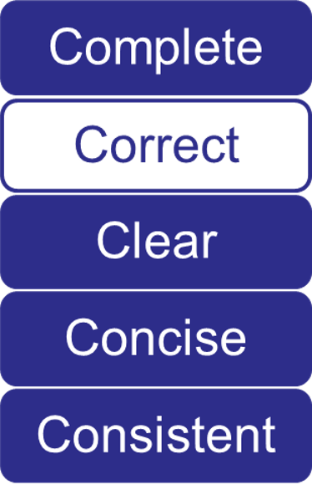

Grammatically Correct
Guidance

Slide 52
Partner Activity 3.3
Read the Costly Comma scenario
Answer the questions

Slide 53
Partner Activity 3.3—Debrief
“This agreement shall be effective from the date it is made and shall continue in force for a period of five (5) years from the date it is made, and thereafter for successive five (5) year terms, unless and until terminated by one-year prior notice in writing by either party.”
Meant the third part of the sentence describing the termination process (one-year written notice) applied to both the five-year term and five-year renewals
Notes:
Animation: Click to reveal answer.

Slide 54
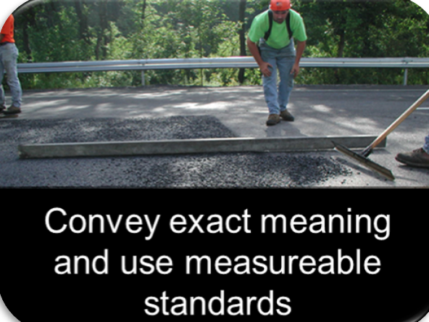
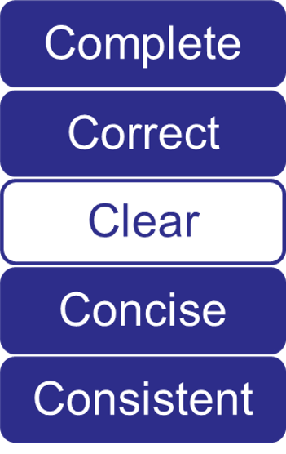

Clear
Avoid Ambiguity
Notes:
Animation: Click to reveal each graphic (2).

Slide 55
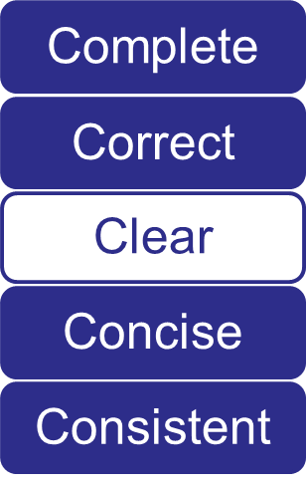
Clear
Correct Usage
Any” vs. “all”
“From . . . to . . .” vs.
“between . . . and . . .”
“Each” vs. “either”
Restrictive and
non-restrictive clauses
Notes:
Animation: Click to reveal each of the remaining bullets (3).

Slide 56
Any vs. All
“Crush any oversized material. Repair all cracks.”
“Crush all oversized material. Repair all cracks.”
“Crush all oversized material. Repair cracks greater than
3 mm wide.”
Notes:
Animation: Click to reveal third bullet (answer).

Slide 57

From…to…vs. Between…and…
“The contractor shall open the ramp between July 3rd and July 5th.”
“The contractor shall open the ramp from July 3rd to July 5th.”
Notes:
Animation: Click to emphasize answer.

Slide 58
Each vs. Either
“A stable shoulder shall be constructed on either side of the roadway.”
“Construct a stable shoulder on each side of the roadway.”
Notes:
Animation: Click to emphasize answer.

Slide 59
Restrictive and Non-restrictive
“The concrete surface must be clean.”
“Provide a concrete surface free of dirt, grease, oil, and other foreign material before applying the coating.”
Notes:
Animation: Click to emphasize answer.

Slide 60
Clear
Use of “which” vs. “that”
“Provide a lock with an audible warning device, which signals each time the lock is released.”
“Provide a lock with an audible warning device that signals each time the lock is released.”
Notes:
Animation: Click to show answer.

Slide 61
Clear
Specification Writer Tips
Terms with subjective
meaning
Vague adjectives and
adverbs
Latent and patent errors
Vertical lists
Notes:
Animation: Click to reveal each bullet (4).

Slide 62
Individual Activity 3.3
Read the “Original Specification” and the “Original Specification Rewritten with a List”
Answer the questions

Slide 63
Clear
Positive phrasing
(Do not overuse negative phrasing)
Parallel construction
Best verb
Other common problems
Clear specifications unambiguously establish roles and responsibilities
Notes:
Animation: Click to reveal bullets 2-4 and Slide statement.

Slide 64
Individual Activity 3.4
Rewrite the sentences using the guidance in the workbook

Slide 65
Positive Phrasing
“Do not add water to the surface of the concrete to aid in finishing without the approval of the engineer.”
“Obtain the approval of the engineer before adding water to the surface of the concrete to aid in finishing.”
Notes:
Animation: Click to reveal bullet 2.

Slide 66
Positive Phrasing (continued)
“Do not bunch up the strokes in the cross-section of each layer.”
“Uniformly distribute the strokes over the cross-section of each layer.”
Notes:
Animation: Click to reveal bullet 2.

Slide 67
Parallel Construction
“Submit the payment application for record keeping and to receive payment.”
“Submit the payment application to provide a record and to receive payment.”
Notes:
Animation: Click to reveal bullet 2.

Slide 68

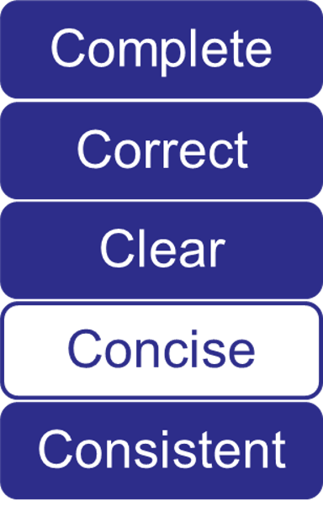

Concise
Notes:
Animation: Click to reveal each graphic (2).

Slide 69
Common Phrases
Common Use | Suggested
absolutely essential | essential
successfully complete | complete
a minimum of | at least
not less than | at least
enclosed herewith | enclosed, included
at a later date | later
commence | start, begin
heretofore | until now, before
prior to | before
at least
at least
enclosed, included
later
start, begin
until now, before
before
Notes:
Animation: Click to reveal each of the remaining suggested answers (7).

Slide 70
Common Phrases (cont.)
Common Use | Suggested
subsequent to | after
for the purpose of | for, to
through the use of | using
until such time as | until
in lieu of | instead of
utilize | use
in order to | to
after
for, to
using
until
instead of
use
to
Notes:
Animation: Click to reveal each of the suggested answers (7).

Slide 71
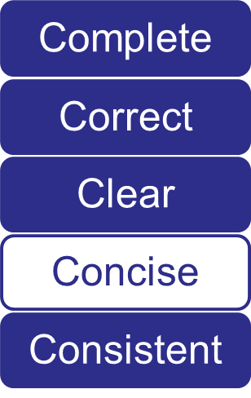
Concise Specification
Contains no reasons or suggestions
Uses indicative and imperative moods
Uses simple words
Uses short sentences
Uses short paragraphs
Eliminates repetition
Notes:
Animation: Click to reveal each bullet (6).

Slide 72
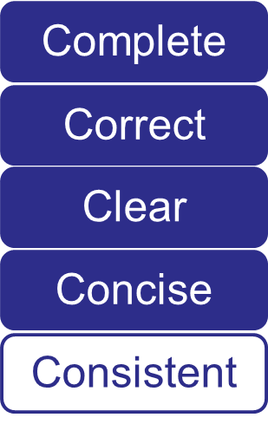

Consistent

Slide 73
Consistent Use
Terms and phrases
Abbreviations and acronyms
Units of measure and symbols
Numbers
Capitalization
Format and organization
General provisions
Style guides and aids
Training and guidance
Notes:
Animation: Click to reveal each bullet (9).

Slide 74
Group Activity 3.1
Write a method specification

Slide 75
Group Activity 3.1 (cont.)
Exchange method specifications with another group
Review and comment on the method specification
Use the Specification Writer’s Checklist as a guide for the review

Slide 76
Group Activity 3.1—Debrief
Return the other group’s specification
Review the comments and Example Method Specification for a Concrete Sidewalk (Appendix D)
Identify areas of disagreement and prepare to discuss them with the group

Slide 77
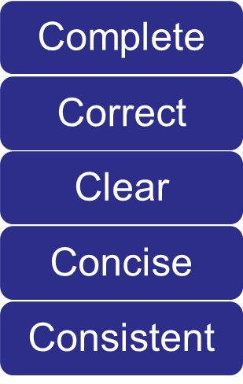
5 Cs of Specification Writing
Order is important
Content comes first, then style
All have equal weight and are interrelated
Notes:
Animation: Click to reveal each bullet (3).

Slide 78
Individual Activity 3.5
Read the sample specification
Identify issues in the sample specification by completing the Specification Writer’s Checklist
Rewrite the specification as necessary

Slide 79
Individual Activity 3.5—Debrief
“616.03 Construction Requirements. Excavation and backfill shall be according to the requirements of Section 801, “Traffic Control Plan.””
“616.03 Construction Requirements. Excavate and backfill in accordance with Section 205, “Excavation and Embankment.””
Notes:
Animation: Click to reveal answer.
Second paragraph appears as the provision written in active voice.

Slide 80
Individual Activity 3.5—Debrief
(continued 1)
“The agency will perform acceptance sampling and testing of the compacted backfill material in accordance with Subsection 208.03 at the frequencies established by the Agency in Section 205, “Excavation and Embankment.””

Slide 81
Individual Activity 3.5—Debrief
(continued 2)
“The agency will sample and test the compacted backfill material in accordance with Subsection 208.03, “Acceptance,” at the frequencies established in Section 205, “Excavation and Embankment.””

Slide 82
Individual Activity 3.5—Debrief
(continued 3)
“Precast reinforced concrete box culvert units shall be bedded on a foundation of firm and stable material, accurately shaped to conform to their base.”

Slide 83
Individual Activity 3.5—Debrief
(continued 4)
“Place precast reinforced concrete box culvert units on a foundation of bedding material provided in accordance with Subsection 835.04, “Drainage Structure Bedding Material.” Accurately shape the foundation to conform to the base of the culvert.”

Slide 84
Individual Activity 3.5—Debrief
(continued 5)
“When required by the plans, special bedding material shall be provided as required in Section 616.02. The special bedding material will be furnished at no cost to the agency.”
“The plans may require special bedding material.”
Notes:
Animation: Click to reveal rewritten sentence.
Second paragraph appears as the provision written in active voice.

Slide 85
Individual Activity 3.5—Debrief
(continued 6)
“Joints and joint materials shall comply with the requirements of Section 608.”
“Provide joints and joint materials in accordance with Section 608, “Structural Concrete Joints.””
Notes:
Animation: Click to reveal rewritten sentence.
Second paragraph appears as the provision written in active voice.

Slide 86
Individual Activity 3.5—Debrief
(continued 7)
“Lifting holes shall be filled with mortar or concrete and cured as directed.”
“Fill lifting holes with mortar or concrete, and cure in accordance with Subsection 620.03.D, “Curing Mortar and Concrete.””
Notes:
Animation: Click to reveal rewritten sentence.
Second paragraph appears as the provision written in active voice.

Slide 87
Individual Activity 3.5—Debrief
(continued 8)
“When precast boxes are used to form multiple barrel structures, they shall be placed in conformance with the details shown on the plans. Material required between barrels shall be as shown on the plans. The material between barrels will be furnished at no cost to the agency.”

Slide 88
Individual Activity 3.5—Debrief
(continued 9)
“If using precast boxes to form multiple barrel structures, place the boxes in accordance with the details shown on the plans. The plans will identify the material required between the barrels.”

Slide 89
Individual Activity 3.5—Debrief
(continued 10)
“Connections of precast boxes to cast-in-place boxes or to any required headwalls, wingwalls, riprap, or other structures shall comply with the details shown on the plans.”
“Connect precast boxes to cast-in-place boxes or to any required headwalls, wingwalls, riprap, or other structures in accordance with the details shown on the plans.”
Notes:
Animation: Click to reveal rewritten sentence.
Second paragraph appears as the provision written in active voice.

Slide 90
Individual Activity 3.5—Debrief
(continued 11)
“Headwalls, wingwalls, and footings shall be according to the details of the plans, except that the overall widths of the headwalls and footings shall be modified to fit the finished width of the various structures.”

Slide 91
Individual Activity 3.5—Debrief
(continued 12)
“Install headwalls, wingwalls, and footings in accordance with the details shown on the plans, except modify the overall widths of the headwalls and footings to fit the finished width of the various structures.”

Slide 92
Individual Activity 3.5—Debrief
(continued 13)
“The number of drainage structures to be furnished will be listed on the plans or in the Proposal. The Contractor shall protect all drainage structures until the engineer has determined that all construction work has been completed.”
“The plans will list the number of required drainage structures.”
Notes:
Animation: Click to reveal rewritten sentence.
Second paragraph appears as the provision written in active voice.

Slide 93


Collaboration

Slide 94
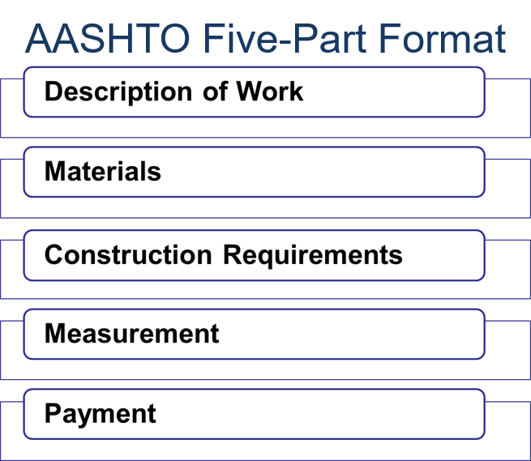

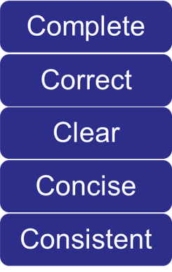
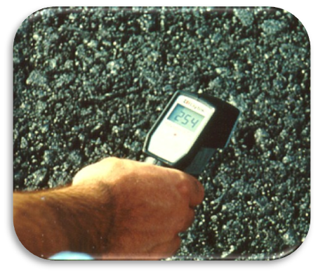
Module 3 Review

