Slide 1
Project Closeout (Archive)
Chris Post, P.E.
Program Development and Standards Manager
April 11, 2023

Slide 2
What is Project Closeout?
Project closeout, or archiving, is the process that closes out the financial award for a local public agency highway project.
We’re closing out the Preliminary Design portion
Other sections produce their own closeout documents
Construction, Contracts, Finance, Project Control
2023

Slide 3
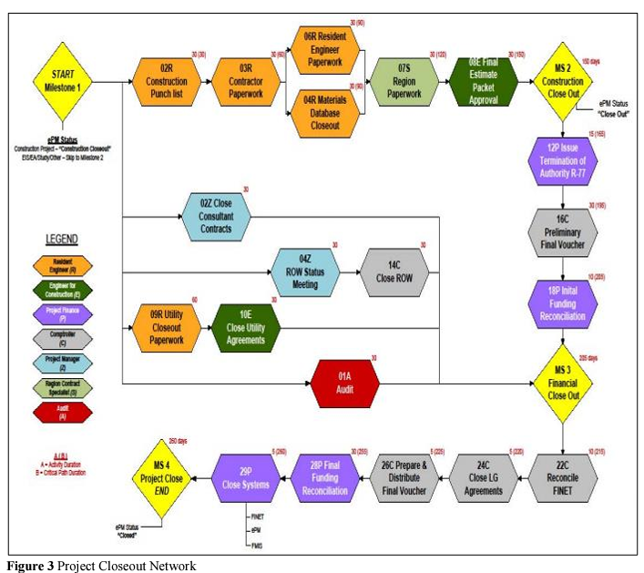
Project Closeout is Simple Right?
UDOT’s Project Closeout Network Courtesy of: KTC Research Report – Streamlined Project Closeout at KYTC
2023

Slide 4
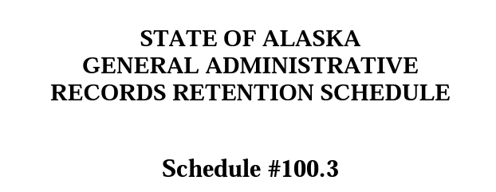
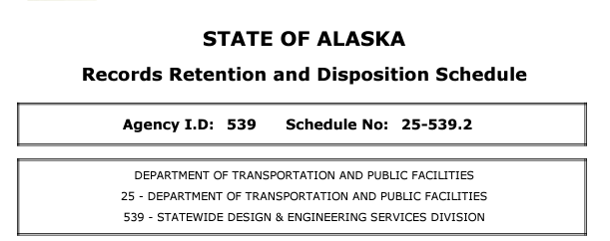
Why do We Need to do Project Closeout?
SOA – Records and Disposition Schedule (RRDS)
https://archives.alaska.gov/documents/rims/schedules/dot/25-539.2.pdf
https://archives.alaska.gov/documents/rims/schedules/100-3.pdf
2023

Slide 5
Benefits of Project Closeout
Benefits of Utilizing the Records Schedule
Locate the right information quickly
Reduce volume of records stored in paper-based and electronic systems
Improve storage and retrieval systems
Increase efficiency of office operations
Reduce costs for equipment, supplies, space, and personnel
Identify and protect vital and confidential records
Improve customer relations and accountability of public funds
Reduce risk and liability
Ensure compliance with applicable laws, rules, and regulations
2023

Slide 6
Schedule No. 100
Schedule No. 100 General Administrative Records Retention Schedule
The purpose of General Administrative Records Retention Schedule #100.3 is to list and describe common records series that many State agencies administer; and, prescribe mandatory minimum retention periods for those records. These records include paper documents, magnetic tape, compact discs, dvd's, flash drives, hard drives, floppy disks, microfiche, microfilm, maps and all other recorded information, regardless of medium or characteristics as defined in AS 40.21.150 (6). Commissioner Office staff should refer to the Commissioner General Records Retention Schedule for guidance.
Records and their proper maintenance are a matter of law and fact. Alaska Statute 40.21 (State Records Management Act) and 4 AAC 59 (Archives & Records Management Services) provide the necessary legal framework for the administration of the State of Alaska’s records. As records constitute a risk that must be managed properly to minimize the liability to the State, Alaska has established an archives and records management program within the Division of Libraries, Archives & Museums to assist state agencies in mitigating this risk.
(Bold and underline text added for emphasis)
2023

Slide 7
Schedule No. 100 – Record Definition
Definition of Record
AS 40.21.150 (6) defines "record" to mean “any document, paper, book, letter, drawing, map, plat, photo, photographic file, motion picture film, microfilm, microphotograph, exhibit, magnetic or paper tape, punched card, electronic record, or other document of any other material, regardless of physical form or characteristic, developed or received under law or in connection with the transaction of official business and preserved or appropriate for preservation by an agency or a political subdivision, as evidence of the organization, function, policies, decisions, procedures, operations, or other activities of the state or political subdivision or because of the informational value in them.”
Definition of Electronic Record
AS 40.21.150 (4) defines “electronic record” to mean “any information that is recorded in machine readable form.” Refer to 4 AAC 59.005 regarding requirements for the retention and preservation of electronic records.
(Bold and underline text added for emphasis)
2023

Slide 8
Schedule No. 100 – Record E-mail
“Record” Electronic-Mail [E-mail]
The State of Alaska runs on e-mail. E-mail is created, received, and transmitted on an electronic mail system. E-mail that constitutes a “record” as defined above in AS 40.21.150 (6), including attachments that are transmitted with the e-mail, are subject to this General Records Schedule and individual agency records retention schedules. Record e-mail, which also may include text and instant messages (text messages in real-time), shall be retained for the same period of time as the records series that most closely matches the subject matter contained within the e-mail. If there is no entry that resembles or matches the subject matter of the e-mail, the agency retention schedule must be updated to include the entry as a separate series. E-mail that is declared a record shall be archived in retention folders or buckets within the Enterprise E-mail Archive System [or other system approved by the State Archivist]. E-mail that is listed as Permanent on a records schedule shall be archived in a 99-year retention bucket and printed out for transfer to the Alaska State Archives in accordance with the appropriate schedule.
(Bold and underline text added for emphasis)
2023

Slide 9
Schedule No. 100 – Non-Record E-mail
Non-Record E-mail
E-mail, attachments, text and instant messages that are not “records” as defined in AS 40.21.150 (6) may be destroyed immediately. Non-record communications include those of a transitory nature primarily generated for informal transmission of information, not the perpetuation or formalization of knowledge. [Refer also to Item 76, Transitory & Miscellaneous Administrative Information.] Personal messages constitute non-records as they are not "accounts" or "writings" "developed or received by a public agency," and are not "preserved for their informational value or as evidence of the organization or operation of the public agency" under AS 40.25.110.
(I’ve added the bold and underline for emphasis)
2023

Slide 10
Schedule No. 25-539
Schedule No. 25-539 DOT&PF RRDS
The agency will follow retention periods for common records as listed in the most current State of Alaska General Administrative Records Retention and Disposition Schedule (GARRDS), unless those records have been listed on this schedule.
Unless otherwise noted, all record series are nonconfidential.
All records that have potential permanent legal and historical value may be reviewed by the State Archivist for possible permanent retention in the State Archives in accordance with AS 40.21.030.
Under 4 AAC 59.005, it is the responsibility of agencies to ensure that records created and maintained in electronic systems remain accessible and durable for their prescribed retention period. This requires addressing the issues of periodic media refreshment, digital migration strategies and security plans. Backups produced for system recovery purposes do not serve a recordkeeping function or substitute for archived business essential duplicates.
(Bold and underline text added for emphasis)
2023

Slide 11
Schedule No. 25-539 - Table
2023

Slide 12
Schedule No. 25-539 – What Files Need to Be Archived by Design?
Record Series Title & Descriptions
003.1 – Capital Project Files
003.2 – Capital Project Files of Historical Significance
004 – Project As-Builts
005 – Technical Services Review
Documentation of review of projects for compliance
006 – Project Specifications
Fall within 003.1 & 003.2
007 – Environmental Actions
2023

Slide 13
Breakdown of Files Required for Project Closeout
Capital Project Files of Historical Significance
Those pesky design files…
Design Study/Locations/Recon. Studies
Hydrology and Hydraulics Reports
Materials Reports
Environmental Document
Memorandum of Agreement/Understanding or Transfer of Responsibility Agreements
2023

Slide 14
Breakdown of Files Required
Capital Project Files
More of those pesky design files…
Design Decisions
Correspondence
Design Computations
Review Files - Adjudicated Review Comments
Public Involvement
Project Management (limited – PJC)
Professional Service Agreements (limited - Contracts)
2023

Slide 15
What does This Really Mean?
Four Tasks to Complete:
Submit CAD Files
Planset Drawings
Functional Drawings (for consultants)
Submit Project Closeout Document (the old ‘box’)
Submit Standalone Project Documents
Project Folder Cleanup & Move to _Archive folder
2023

Slide 16
Standard Operating Procedure (or is it?)
Typical Process:
First Step – Call from Standards Manager
Second Step – Panic and deny all knowledge of the project
Third Step – Acceptance and begin Hunting & Gathering for the project files (think “Blind Squirrel & Nut”)
Fourth Step – Figure out how in the world the files need to be organized because they certainly weren’t filed correctly by Design
Fifth Step – Send to Standards Manager and relax until the next call
2023

Slide 17
Ok, so I’ve gotten all these files…now what? Answer = Microfilm…Err Wait…
In the way back times…think late 2010’s…the region decided to stop using microfilm as our long term storage media
It was decided we’d go all electronic…
However as with all great proclamations, this effort was left to us on how to do this…
There have been a number of hurdles…including Personally Identifiable Information issues (reason eDocs currently doesn’t allow external access)
2023

Slide 18
When Should We be doing This?
Doesn’t start only after bid opening…it’s an ongoing process throughout project development
Reduces effort at the end
Design development doesn’t end until this is completed
When does this need to be completed?
Right after bid opening/award
Funding is still in place and it’s fresh in your mind
Eliminates situations where staff who worked on a project are no longer around
2023

Slide 19
Guidance Available
Project Closeout Guide Update
Provides narrative of why we’re doing this along with how we’ll be doing this moving forward
Highway Design Project Closeout Instructional Guide (Big Thanks to Deidre & Abram!)
Provides instructions on how to create your Closeout Document in the format we want
Located at in the Project Closeout (Archive) Folder on the LIB in the HighwayDesign folder
2023

Slide 20
Where do Files Live After Submitting?
It depends…
When in doubt look in the Archive Folder on the LIB drive
Most will be stored in the As-Built Folder on LIB drive
CAD Files, As-Built Plans, Project Closeout Document
Until As-Built plans are available they’ll be in the As-Advertised Folder
Standalone Documents live in the Reports Folder on the LIB drive.
Project files live in the _Archive Folder on the HYD drive.
Goal is to tie this into a GIS Map for easy retrieval
2023

Slide 21
Where do Go From Here?
What does the final product look like?
Let’s take a look at the Project Closeout Guide & Instructions
We need to catch up on some outstanding projects – limited files available* - See Project Archive List
*Can’t recreate what we don’t have (or know about)
Working with PMs to dedicate time on a regular basis to allow for catchup and to complete this for current projects. (Like the good ol’ Filing Fridays)
2023

