Slide 1
Q&A - Traffic Design, Safety and Utilities Share the Knowledge
October 14, 2020

Slide 2
Ground Rules
Mute yourself
Question? Type it in, speak up, or “raise your hand”

Slide 3
Agenda
Introduction of Panelists
Chris Post and Leisha Sweeney – Traffic Design
Scott Thomas – Traffic Safety
Devki Rearden and Talisa Rodrigues – Utilities
Round Robin Q&A

Slide 4
Question 1
Traffic Design
What's the difference between Traffic Engineering and Traffic Safety?

Slide 5
Question 2
Traffic Safety
What does the Traffic Safety Section do? Besides collecting & analyzing crash data, what else is the Traffic Safety section responsible for?

Slide 6
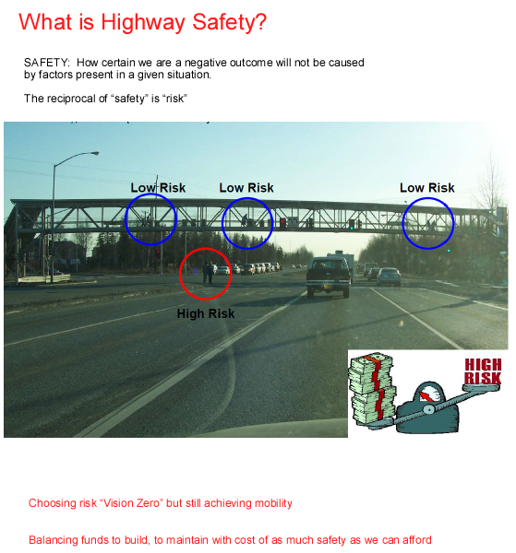
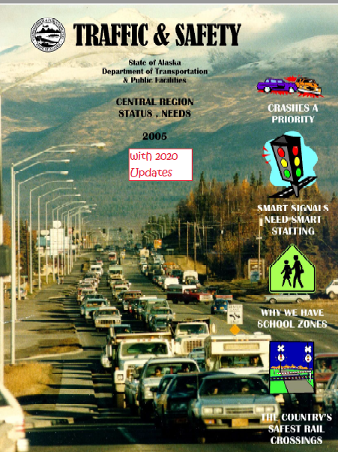
Question 2
Traffic Safety

Slide 7
Question 2A
Traffic Design
What does a Traffic engineer do? What does a Traffic “Design” engineer at DOT do?
"Traffic engineering is a branch of civil engineering that uses engineering techniques to achieve the safe and efficient movement of people and goods on roadways . It focuses mainly on research for safe and efficient traffic flow , such as road geometry , sidewalks and crosswalks , cycling infrastructure , traffic signs , road surface markings and traffic lights." -Wikipedia
https://en.wikipedia.org/wiki/Traffic_engineering_%28transportation%29

Slide 8
Question 3
Utilities
What does the Utilities Section do? And what is their role in a DOT project?

Slide 9
Utilities Section
The Utilities Section permits and relocates utility facilities in accordance with State law and DOT&PF policy.
Governed by:
Alaska Statutes (AS)
Alaska Administrative Code (AAC)
DOT&PF Utility Manual

Slide 10
Alaska Statute 19.25
AS 19.25 Utilities, Advertising, Encroachments, and Memorials
Gives the utilities rights to occupy the state right-of-way in accordance with regulations adopted by the department and with a department-issued permit.
Gives the department the right to issue an Order to Relocate if utility facility has to be changed/relocated to accommodate a construction project
Identifies when state pays for relocation
http://www.akleg.gov/basis/statutes.asp#19.25

Slide 11
Alaska Admin Code
17AAC15 Utility and Railroad
Specifics rules and regulations for issuing utility permits, including on section line rights-of-way and railroad permits
Specifics about utility relocation, including agreements and railroad-related work
http://www.akleg.gov/basis/aac.asp#17.15

Slide 12
Utility Manual
http://dot.alaska.gov/stwddes/dcspubs/assets/pdf/directives/attach/utility_manual_all.pdf

Slide 13
Question 4
Traffic Safety
Why is a Traffic Safety engineer’s work important? What are the benefits from quality Traffic Safety engineer work?

Slide 14
Question 4
Traffic Safety

Slide 15
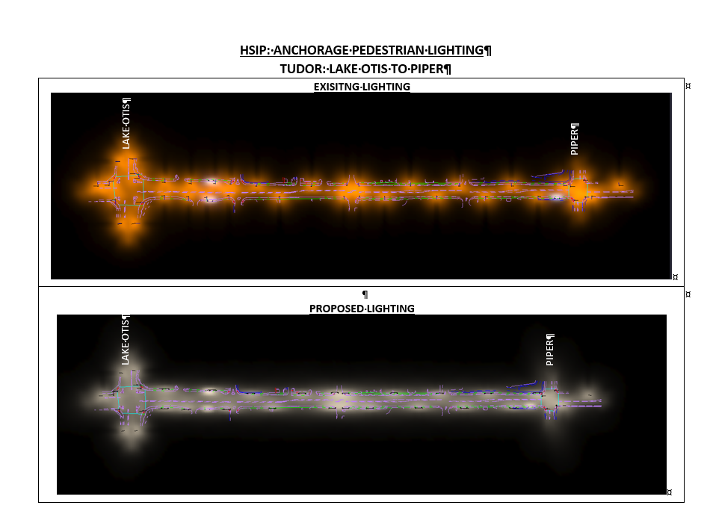
Question 5
Traffic Design
Why is a Traffic engineer’s work important? What are the benefits from quality Traffic engineer work?

Slide 16
Question 6
Utilities
What do the engineers in the Utility Section do?
UTILITY PROJECT COORDINATION = Redline request (4-6 wks) + PE Auth (1-6 mo) + Utility Agreement (2-6 mo)
Utility Permits

Slide 17
Question 7
Traffic Design
I'm in HYD. When should I ask for help in creating signing & striping plans versus asking the Traffic Engineering section for help?

Slide 18
Question 8
Traffic Safety
How does traffic safety implement new safety features on our roadways?

Slide 19
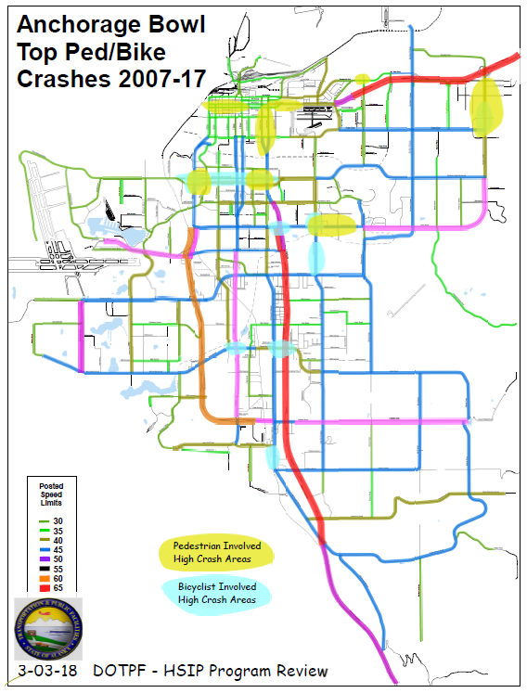
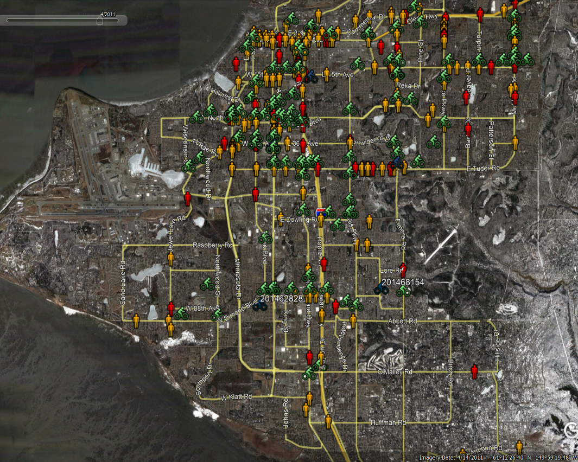
Question 8
Traffic Safety

Slide 20
Question 9
Utilities
Are there any plans in the works for a total utility asset management database to better keep track of the location of utilities in the public ROW and easements?
Northern Region has a project to develop a manual for implementing an Alaska Utility Information Management System. To date no updates have been provided to Central Regions.

Slide 21
Pipe Dream, no pun intended

Slide 22
Question 10
Traffic Design
How are the size of roads determined for 4R projects?

Slide 23
Question 11
Traffic Safety
How does Traffic Safety figure out the timing on signal systems so that traffic flows better in one direction during high traffic times?

Slide 24
Question 12
Utilities
In the event of a potential utility conflict or guaranteed conflict, when should a designer coordinate with the Utility section for a cost comparison of the relocation option vs mitigation?
Always contact us ASAP when big things are discovered or if you have any questions about your project and utilities.

Slide 25
Question 13
Traffic Design
Does Traffic Section use Pedestrian or Bicycle Level of Service to make decisions?
HPCM Section 1000.1 - Target Level of Service (LOS) goals are not established in the HCM, LOS targets for 3R and new construction are established on a project-by-project basis using the 2011 AASHTO Green Book, Section 2.4.5. The result is the opportunities for transit and non-motorized LOS will be no less than for mainline or side street vehicular LOS. Traffic control devices to improve LOS are subject to selection criteria in the Alaska Traffic Manual.
HPCM Section 1000.2 –
Chapters 1-15: No changes.
Chapters 16-23: Transit and non-motorized LOS design analysis is not required.

Slide 26
Question 14
Traffic Safety
When and how should the Traffic Safety Section be involved in a project being designed & delivered by another section (AVD/PD&E/HYD)?

Slide 27
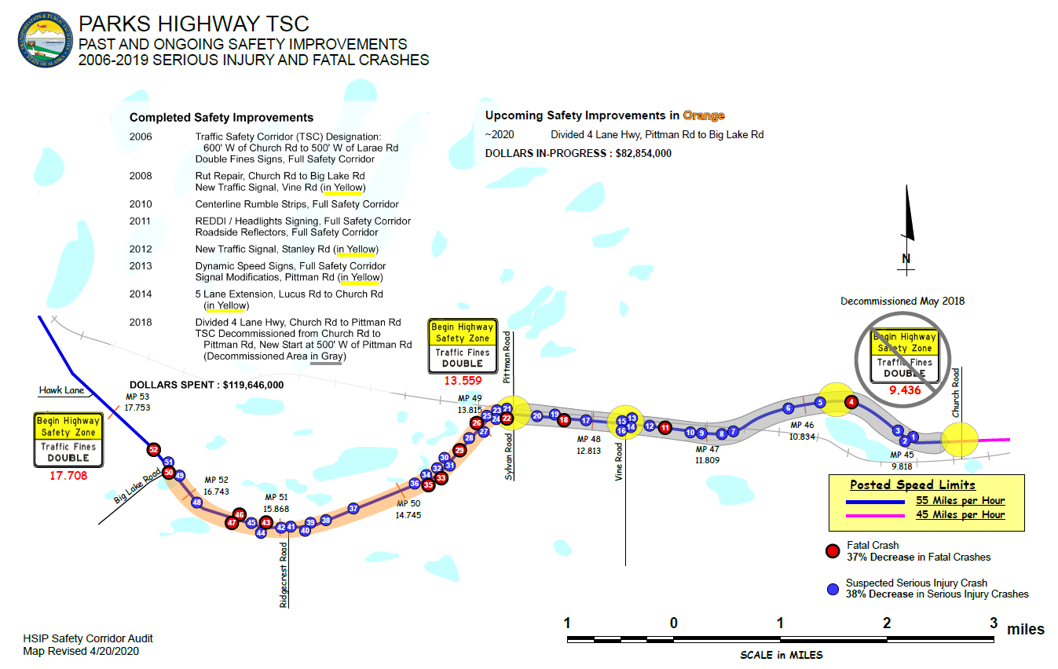
Question 14
Traffic Safety

Slide 28
Question 15
Utilities
How early during the project development process can we get the ball rolling on the redlines/agreements/relocation process?
Rule of thumb: Include Utilities as soon as possible
We will need: A plan set WITH utilities shown (typically occurs at PIH)

Slide 29
Question 16
Traffic Safety
If I have ______, ________, or ________ on my project, I should contact the Traffic Safety section immediately.

Slide 30
Question 17
Utilities
Can you talk a little bit about the various Utilities we commonly share ROW with, which ones are easy (if any) versus slow/difficult to work with, and examples of minor versus major impacts (i.e. digging near versus adjusting elevation versus relocating)?

Slide 31
AS 19.59.001
AS 19.59.001 defines what a "utility" is.
Typical coordination for permits and relocations are for:
Electric
Natural Gas
Water and Sewer
Telecommunications
Kenai Peninsula and Ted Stevens Airport will occasionally has an oil or gas (fuel) permit.

Slide 32
Relocation Coordination
Electric- tends to meet project schedule. Can easily reroute and tie into existing system. Will install temp facilities to keep customers live.
Water and Sewer- requires deep excavation. Typically designed and constructed by the project and inspected by the utility company. Can easily reroute and tie into existing system.
Natural Gas- tends to meet project schedule. Can easily reroute and tie into existing system. Temp facilities are not feasible therefor have to keep customers live.
Telecommunications- struggle to meet project schedule. Their system is a 'spider web' network and relocations always go off project. Temp facilities can be feasible but customers to keep customers live.

Slide 33
Question 18
Traffic Safety
Have Studies and efforts been conducted by CR DOT to implement Pedestrian Lead Time intervals at crosswalks in areas of high volume pedestrian and vehicle traffic? If so, which would have priority, public safety or throughput capacity?
Several cities much larger that Anchorage achieved zero-pedestrian traffic deaths in 2019 through engineering design. What takeaways has Alaska DOT gained from those examples, and what is DOT doing now to capture that same success?

Slide 34
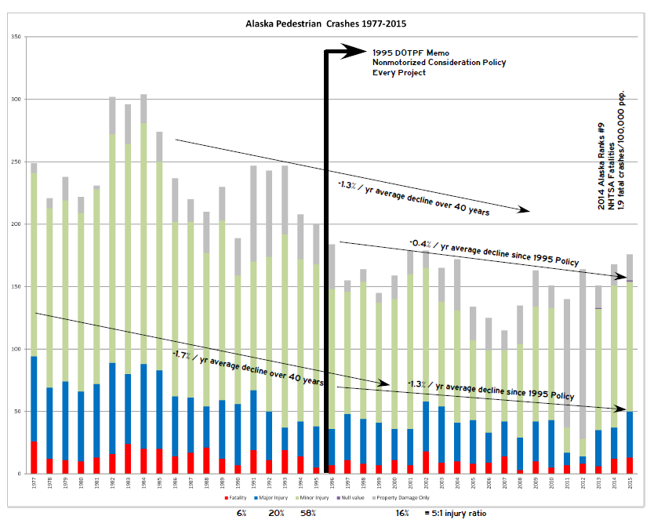
Question 18
Traffic Safety

Slide 35
Question 19
Utilities
What are some of the greatest challenges for each department?
Schedule, Staffing, Historical Documentation

Slide 36
Question 20
Traffic Design
What are some of the greatest challenges for each department?

Slide 37
Question 21
Traffic Safety
What are some of the greatest challenges for each department?

Slide 38
Thank You
Thank you for your time!
Panelists
Chris Post and Leisha Sweeney – Traffic Design
Scott Thomas – Traffic safety
Devki Rearden and Talisa Rodrigues – Utilities
Remaining Questions – email dotcrtraining@alaska.gov

