Slide 1
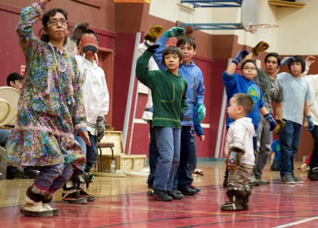
ALASKA NATIVE PEOPLES
A BITE SIZE BRIEFING OF A FEW ESSENTIAL CONCEPTS

Slide 2
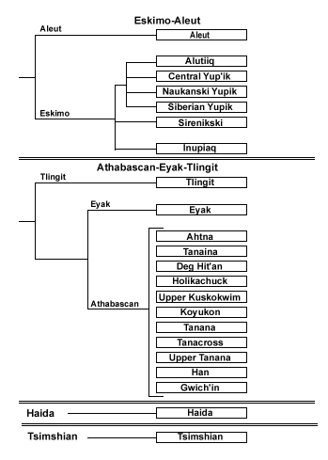
ALASKA NATIVE PEOPLES
231 Federally Recognized Tribes (often overlap villages)
20 + cultural groups and distinct languages
19.5% of the state’s population

Slide 3
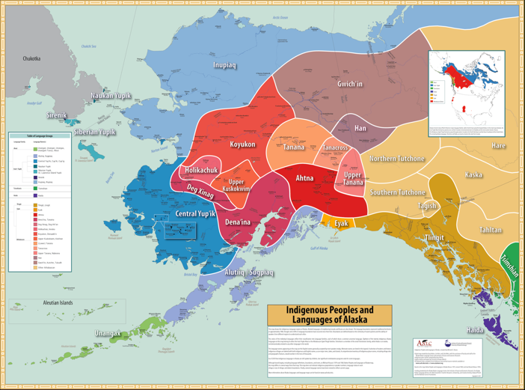
Notes:
Krauss, Michael, Gary Holton, Jim Kerr, and Colin T. West. 2011. Indigenous Peoples and Languages of Alaska. Fairbanks and Anchorage: Alaska Native Language Center and UAA Institute of Social and Economic Research. Online: http://www.uaf.edu/anla/map

Slide 4
A COMMUNITY SNAPSHOT
Three Sovereigns operate in Alaska:
Tribal Governments, Federal Government, State Government
Types of Alaska Native Organizations
Numerous Major Cultural Groups
231 Tribal Governments
7 Statewide Native Non-Profit Orgs
12 Regional Native Non-Profit Associations/Consortiums
50 Cultural and Heritage Centers/Museums
12 ANCSA Regional Corporations
195 ANCSA Village Corporations
5 Marine Mammal Commissions
Alaska Migratory Bird Co-Management Council
1 Indian Reservation
Plus others…

Slide 5
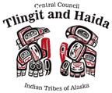
Important to Note
TRIBES
Inherent sovereignty, pre-date US Constitution
“Federally Recognized Tribes” Pre-date ANCSA, but not mentioned in Act
Govern and maintain jurisdiction over members; can enact laws
Government to government relationship with the U.S. government
Often own little or no land (problematic for governance)
CORPORATIONS
Construct of law; are state incorporated; exist to make profit; own ANCSA land in fee simple
They do not govern
Same relationship with state and federal govts as any other corporation; they pay dividends to shareholders
Some federal laws include ANCSA corps as beneficiaries to the law that also include Tribes as beneficiaries
Can develop land to increase revenue, if develop natural resources must share 70% of revenue with other ANCSA corps (7(i)
12 REGIONAL NATIVE NON-PROFITS
Aleutian/Pribilof Islands Association
Arctic Slope Native Association, Ltd.
Association of Village Council Presidents
Bristol Bay Native Association
Chugachmiut
Cook Inlet Tribal Council
Copper River Native Association
Kawarek, Inc.
Kodiak Area Native Association
Maniilaq Association
Tanana Chiefs Conference
*Central Council of Tlingit & Haida Indians –Federally Recognized Tribe
OTHER STATEWIDE NATIVE NON-PROFITS
Alaska Federation of Natives
First Alaskans Institute
Alaska Native Science Commission
Alaska Native Health Board
Inuit Circumpolar Council
Alaska Native Arts Foundation
Alaska Native Heritage Center

Slide 6
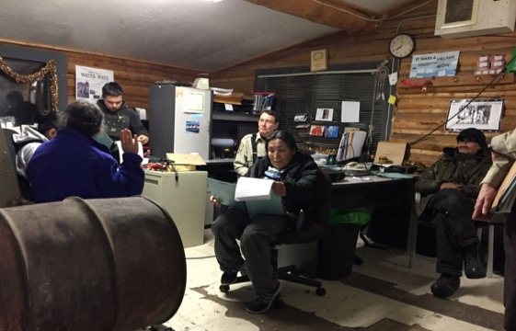
Layers of Organizations in Villages
Many villages have a:
Tribal Government
Municipal Government (State Charter)
ANCSA Village Corporation
Every village deals with:
ANCSA Regional Corporation
Regional Non-Profit
Consortiums and Commissions
Statewide Non-Profits
Borough Governments
Borough School Districts
State Government, and all its departments
Federal Government, and all its departments, agencies, offices and programs
Important to Understand:
Many tribes and municipal governments are separate types of governments. Tribe’s sovereignty exists inherently and is also recognized by federal law, local governments derive their authority from their sovereign, the state government
Some Tribes and Municipalities operate cooperatively, some do not, some enter into contractual agreements to share resources and administrative duties

Slide 7
Western World View

Slide 8
Native World View
We Belong to Alaska.
Notes:
Krauss, Michael, Gary Holton, Jim Kerr, and Colin T. West. 2011. Indigenous Peoples and Languages of Alaska. Fairbanks and Anchorage: Alaska Native Language Center and UAA Institute of Social and Economic Research. Online: http://www.uaf.edu/anla/map

Slide 9
OUR WAYS OF LIFE
“I share what's on my table with you.
When I share with you my heart is happy,
so is yours, and this is the
way of [the] subsistence way of life.
I never heard the word Subsistence
until l97l under the Native Land Claims Act.
Before that time, when I was brought up
in the culture of my people,
it's always been our culture and our land.”
-Jonathon Solomon, Fort Yukon
Notes:
Add photos

Slide 10
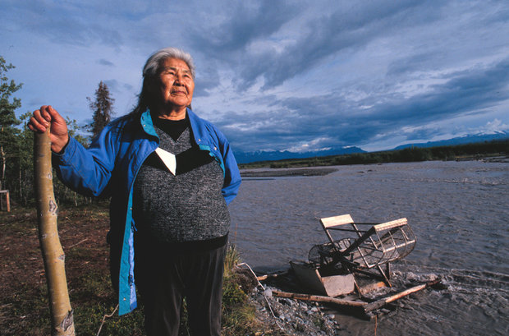
It is who we are. It is a vital collective and personal experience (like being human, in community and breathing)
It is central to what makes us able to live a healthy, strong, active, productive, cultural, and spiritual way of life.
It is hard work, it is “expensive”
It often requires working in the harshest of environments.
And we LOVE IT.

Slide 11
Our Ways of Life
Stewarded and managed for thousands of years by Native peoples
– Our Ways of Life -a rigorous management system with exacting behavior & interaction expectations (ceremonies, protocols, societal laws, customs, practices)
Federal and State wildlife laws have a resource shortage use priority
State law
All residents qualify
ANCs may have add’l regulations
Federal law - Rural resident priority under ANILCA
#Its Complicated… ANCSA/ANILCA/…
Federal and State management regimes are complicated
devalues Native needs

Slide 12
Eras of Federal Indian Policy
Treaty-Making
Removal to Reservations
Assimilation & Allotment
Reorganization & Tribal Preservation
Termination & Relocation
Self-Determination &
Self-Governance
TODAY…

Slide 13
What is “Indian Country”?
As a term of art, identity, modern indigenX phrasing:
all the lands where indigenous peoples have always existed
a way of referencing our collective “community”
a.k.a homelands, village, our lands, ‘The Vil’
As a term of law (Federal Law 18 U.S.C.): (*in Alaska)
(a) all land within the limits of any Indian reservation under the jurisdiction of the United States Government, notwithstanding the issuance of any patent, and, including rights-of-way running through the reservation, [METLAKATLA, ALASKA]
(b) all dependent Indian communities within the borders of the United States whether within the original or subsequently acquired territory thereof, and whether within or without the limits of a state, and
(c) all Indian allotments, the Indian titles to which have not been extinguished, including rights-of-way running through the same

Slide 14
Why is it important?
Tribes with “Indian Country”
extensive governmental powers
can manage fish & game, natural resources, have tribal courts and law enforcement, enact zoning ordinances, impose taxes, run businesses
Tribes in Alaska, even without territorial jurisdiction, have the same legal status with the federal government
ANCSA didn’t address Tribes; ANCSA lands aren’t tribal land
Alaska v. Native Village of Venetie (1998): SCOTUS held that ANCSA lands, even §19(b) lands, were not “Indian Country” because the land was no longer under federal supervision
Native lands pre-dating ANCSA were not included in the law and have same status (allotments, trust land, …)

Slide 15
Tribal Jurisdiction in Alaska
PL 280 -state to exercise federal authority over some aspects of criminal and civil jurisdiction
Unwillingness by state to recognize Tribes’ concurrent jurisdiction, =>frequent litigation
Native Village of Venetie v. Alaska, 944 F.2d 548 (9th Cir. 1991) Alaska must give full faith and credit to tribal child-custody determinations as neither ICWA or PL 280 prevent tribes from exercising concurrent jurisdiction
John v. Baker, 982 P.2d 738 (AK. 1999) Alaska must recognize tribal jurisdiction over members even in the absence of Indian Country, reversing their earlier decision in Native Village of Nenana v. State of Alaska DHSS, 722 P.2d 219 (AK 1986)
Kaltag v. Hogan (AK. 09 960) Concerned adoption of an Indian child handled by tribal court. Court declined to hear the State’s appeal, sending strong message to the State to recognize Tribe’s ICWA jurisdiction

Slide 16
PL 280 Consequence
State = bulk of law enforcement, but often lacking, centralized system
Villages tribal courts hear civil and misdemeanor offenses, but State may dispute
Courts limited by funding, trained personnel, or may limit themselves, by choosing what cases to hear
DOI balks at funding tribal courts in PL 280 states
2010 Tribal Law and Order Act had beneficial provisions for Alaska tribes, but were eliminated due to a State complaint and Congress members unwilling to create an “Alaska earmark”

Slide 17
Alaska Law Enforcement
Alaska State Troopers respond to serious crimes, response can be slow or non-existent; vast territory, limited resources
VPOs/TPOs (Village/Tribal Police Officers)
Hired by villages using BIA funding; low pay, inadequate resources for training; More Tribal Law and Order Act funds available since 2010
VPSOs (Village Public Safety Officers)
Funded by State, tribal non-profit consortiums supervise
Responsible for public safety, fire fighting, water safety, emergency medical assistance, search and rescue
Often only ‘law enforcement’; expected to be available 24/7
Low pay, distance supervision by troopers, lack back up

Slide 18
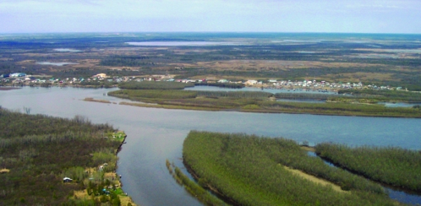
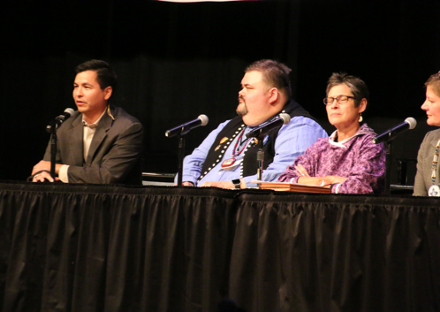
Land into Trust
DOI underwent rulemaking earlier this year
State continued litigation but ultimately withdrew
Tribes can now petition to take land into trust, thus potentially creating new Indian Country in Alaska
Notes:
First tribe to submit a petition: Craig, CCTHI has also submitted a petition
Petition doesn’t guarantee DOI will grant it; lengthy process taking sometimes years to finish; many AK tribes have limited amounts of land they can take into trust so this is not a panacea to jurisdictional or tribal governance issues – AK is still a PL 280 state also

Slide 19
What is ANCSA?
A land settlement
Alaska Natives who opted in relinquished aboriginal title to roughly 350 million acres of land in exchange for (fee simple title to) 44 million acres of land and almost $1 billion (roughly $3/acre)
Signed into law on December 18, 1971
Result of a decade long effort led by AFN
After Alaska became a state, land selections began but Native claims still needed to be settled; oil was key driver by state
Amended numerous times
Settlement split among 12 (later 13) regional corporations (not tribes)
All Alaska Natives alive on Dec. 17th who met requirements became shareholders
Regional corporations have subsurface rights (eg, minerals)
Village corporations have surface rights (eg, timber)

Slide 20
ANILCA (separate law but connected to ANCSA)
Has 3 sections important to Alaska Natives – most critical:
Title VIII subsistence management on federal public lands due to ANCSA § 4(b) extinguishing aboriginal hunting & fishing rights; per Congressional committee reports Congress expected AK & DOI to protect Native rights, but this did not happen
Native leaders went back to Congress to obtain a solution
Congress responded with Title VIII – provides a subsistence priority for Native hunting and fishing on fed lands during shortages; Alaska complained that priority was race-based and in conflict with State Constitution => language changed to “rural resident” instead
Fails to properly protect Alaska Native communities, especially those located in areas considered “non-rural”; potential solution: change the language to read “Native and rural” and have Title VIII officially declared to be Indian law
When Congress enacts Indian law that law can give rights to Native people different from those enjoyed by other Americans; Alaska Natives have two separate and distinct statuses: 1) Political, as noted above, and 2) Racial, as protected class of citizens under US law
Other: Title IV ANCSA/State Law, XIV ANCSA “1991 amendments”, etc

Slide 21
EDUCATION (Before Statehood)
Native peoples educated their children and community members throughout life, used rites of passage to demarcate life changes, grow responsibility, continue knowledge learning and sharing
After immigration started happening at the front end of the colonial period, saw a shift as church, state, and business beginning to work together to colonize Alaska.
Colonial educations efforts varied
Before Treaty of Cession, about 50+ Russian Orthodox Church schools
Between 1867 -1884 education largely ignored
Presbyterian Church schools in Sitka, Wrangell, and other places in SE; Russian Orthodox Church in Aleutian Islands, SW Alaska, and Sitka
1884 Organic Act made provision for education; 99% of children- Alaska Native; DOI to provide for education “without reference to race”
1905 Nelson Act codified segregated school system; 1929 lawsuit by William Paul finally changed this
1885 DOI Dept. of Education appointed Sheldon Jackson, a Presbyterian Missionary to carry out education in Alaska
Responsibility for education given to different religious denominations
Schools segregated where enough White children for separate schools
Pribilof Islands schools maintained by the Alaska Commercial Company
Notes:
The “Report of the Task Force on Alaska Native Education” online at http://www.alaskool.org/resources/anc2/ANC2_sec4.html provides a very detailed history of education during this period.
You can read about school segregation and Jim Crow laws in Alaska at http://www.alaskool.org/projects/jimcrow/jimcrow.htm

Slide 22
Boarding Homes and Boarding Schools
Many damaging effects from church and state run boarding schools from removing children – still seen today as intergenerational harm and trauma (see Alaska Native statistics)
Alaska boarding schools and boarding homes were part of the colonial process – just as it had been in the Lower 48
Sheldon Jackson was a student of the Carlisle Indian Boarding School experiment – “Kill the Indian, save the man”
Easy and cheap for Territory (and later State) to take children from their families and communities
Many attendees suffered atrocious acts of violence and degradation being taken from their families and exposed to bad-acting adults; some attendees had positive experiences; many of today’s AK Native leaders attended Sheldon Jackson, Mt. Edgecumbe, Wrangell Institute, Galena Interior Learning Academy, and Nenana Living Center…
Now, though the state constitution requires equal opportunity for children to receive local education, there are still a number of boarding schools in AK and each year the state legislature brings up consolidation/boarding schools as solutions despite the legacy of harm to most students and communities.
Notes:
The ISER power point, “Thirty Years Later” at www.iser.uaa.alaska.edu/publications/ThirtyYearsLater2.ppt provides a variety of comments from boarding school attendees.
Current boarding schools in the state:
https://sites.google.com/a/mehs.us/home/
(http://gila.galenaalaska.org/public/About/index.html)
(http://nenanasd.org/director.aspx)

Slide 23
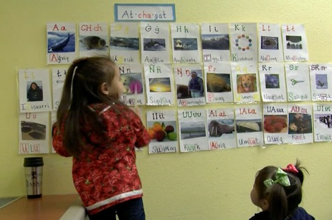
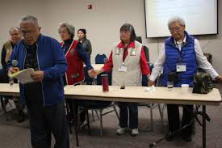
What do Native families want?
AK Native families want what every other family wants and expects, equal education opportunity in their communities so children are where they belong, with their families, communities, and cultures; so they may grow to be thriving, healthy, happy Native peoples of this land
Notes:
For more on these lawsuits: http://www.alaskool.org/native_ed/law/law_ane.html
http://www.alaskool.org/native_ed/law/tobeluk.html

Slide 24
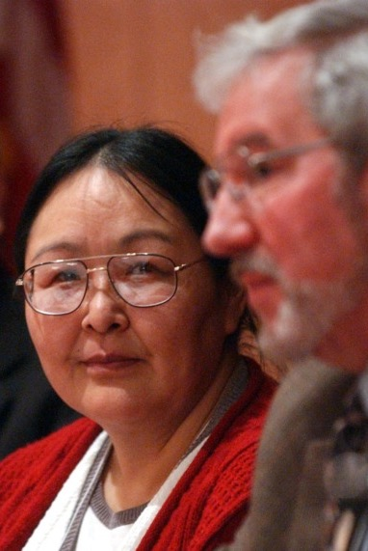
Lawsuits Filed to Protect this Right
1971: Five 9th grade Kivalina students sue the state to require a secondary school in their village
Outcome: Kivalina got a K-12 school and a new state regulation stating that every child has a right to education without leaving home
1972: “Molly Hootch” litigation (Tobeluk v. Lind): group of children sue the State for noncompliance with the new regulations
Outcome: Consent decree providing for the establishment of a high school program in every one of the 126 villages covered by the litigation, unless people in the village decided against a local program.

Slide 25
Lawsuits Cont’d
Kasayulie v. State (1999): Court finds AK has dual, arbitrary, unconstitutional, and racially discriminatory system for funding school facilities
Held education is a fundamental right
Rejected motion from state to reopen the decision, as the new info provided reinforced the court's findings
State then allocated significant funds for construction and renovation of rural schools but has not yet changed the unconstitutional, dual system of facilities financing
Moore v. State (2009): Court finds the state continued to deny students in rural schools the education guaranteed them by the AK Constitution by not meeting its constitutional responsibility to “maintain a system of public schools open to all children of the State”
Currently, schools with less than 10 students enrolled are not eligible for state school funding, forcing closure and communities to once again be lifeless without their children

Slide 26
Notes:
William Yardley’s 2009 New York Times article (Note 3) discusses the problems faced by rural schools when enrollment drops and makes note of the response from different legislators.

Slide 27
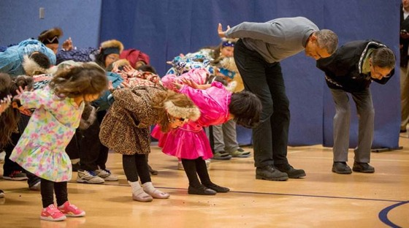
Potential Solutions Exist!
Utilize Self-Determination/Self-Governance over Education like the Alaska Native Health System has done, transforming health outcomes (over 10 year increase in life expectancy, over 90% of children immunized, higher than any other pop.)
Fed-State-Tribe Partnership
Children need an education to compete in the work force that includes Native ways of knowing and learning – it is an environment all children can thrive in
Notes:
Learn about this school by going to http://www.chickaloon.org/ and looking at “education” within the “Departments” tab.
Read more about this school at http://ekc.k12northstar.org/about
Learn about the school and other educational opportunities in Sitka at http://www.sitka.net/sitka/education.html

Slide 28
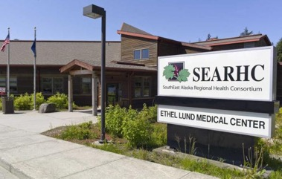
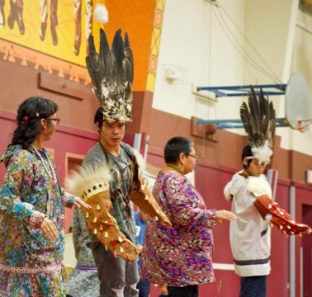
Health Organizations Today
Solutions to health and wellness issues are approached from many angles
Re-establishing cultural pride, increasing local control of health care and local staffing of health programs
Health care and treatment services are provided by tribal health consortiums and regional tribal non-profit entities, as well as individual tribes and State
Federal 638 contracting and self-governance compacting enables Native orgs to increase their level of control over health-care delivery and work towards healthier peoples
Notes:
You can review a 2007 description of Alaska’s Tribal Health Network on line at http://www.hss.state.ak.us/hspc/files/ATHS%20PP.pdf and learn about the Alaska Tribal Health System at https://www.alaskatribalhealth.org/

Slide 29
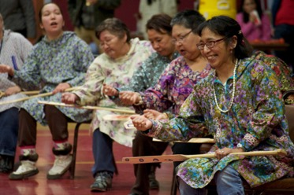
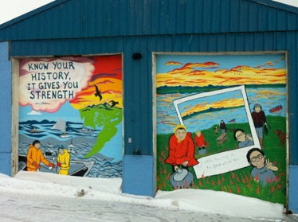
Tribal Governments
Term “tribe” used two ways:
Ethnologically: a social, political organization of a group of people who share race, customs, language, culture, etc.
Legally-politically (Montoya v. United States, 180 U.S. 261 (1901)): “a body of Indians of the same or a similar race, united in a community under one leadership or government, and inhabiting a particular though sometimes ill-defined territory”
Notes:
Pursuant to federal law, the Bureau of Indian Affairs publishes a list of federally recognized American Indian/Alaska Native tribes every two years in the Federal Register
The list is located at this website:
http://www.bia.gov/WhoWeAre/BIA/OIS/TribalGovernmentServices/TribalDirectory/

Slide 30
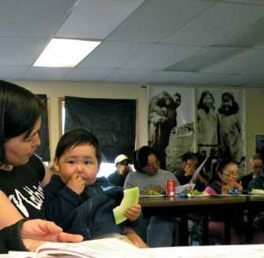
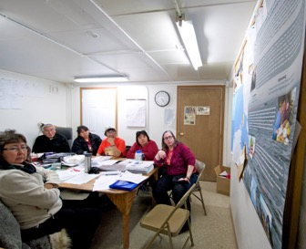
Tribal Governments
567 federally recognized Tribes (231 are in Alaska)
Each tribe possesses inherent rights of self-government (i.e. tribal sovereignty) and are entitled to receive certain federal benefits, services, and protections because of their special relationship with the U.S.
Under federal law, Tribes are subject to the plenary power of Congress
The power to deal with and regulate the tribes is wholly federal; the states are excluded unless Congress delegates power to them (e.g. PL 280)
The federal government has a responsibility for the protection of Tribes from encroachments by the states and their citizens

Slide 32
ANCSA Highlights
12 regional corporations (13th no land)
18 million acres + subsurface estate of village-selected lands, fee simple 195 village corporations (originally 224, some merge)
22 million acres of surface estate, fee simple
$962 million paid for 335 million acres of , land (~$3/acre) for business’ incorporated under state law, to benefit shareholders
ANCSA lands are privately owned, not held in trust; not Indian Country
Important provisions
7(i) and 7(j)– 70% of natural resource revenue must be shared among all ANC corps, distributed to Village Corps and shareholders
Only 6 regional and some village corporations opened rolls to those born after December 18th 1971
ANCSA stocks cannot be bought or sold on the open market
Corporations responsible for maintenance and protection of historical places and cemetery sites
ANCSA extinguished aboriginal hunting and fishing rights
Many of the ANCs (regional corps) are top contributors to the economy in revenue and employment; Top 49
Jobs often held by non-Natives and non-shareholders
SBA 8(a) Contracting- Tribes and ANCs have unique rights in Federal procurement to jump-start Native economies

Slide 33
Village Corporations
One for every village, but some merged
Success of the village corporations is varied
Some corporations merged and pooled resources
Some no longer exist
Some heavily depend on 7(i) distributions
NANA and AHTNA regions: all but one village merged with the Regional Corporation
Kikiktagruk Inupiat Corporation (KIC) in Kotzebue
Native Village of Chitina
Calista Region: 56 communities organized into 45 Village Corporations

Slide 34
GOVERNORS TRIBAL ADVISORY COMMITTEE
Consists of 11 members representing expertise in 11 areas:
1. Education
2. Healthcare
3. Subsistence
4. Energy
5. Public safety and justice
6. Wildlife and fisheries
7. Economic development
8. Housing
9. Transportation
10. Language
11. Culture

