Slide 1
Purpose & Need
Training
Webinar for Alaska
October 29, 2015
Notes:
Speaking:
Hello and welcome to our webinar. [Rob & Rod introduce themselves].
A well defined Purpose and Need can minimize conflict, serve as a foundation for alternative to focus design efforts and subsequently improve project delivery times. In this session we will highlight the importance that these be carefully developed in the planning AND project development processes and provide examples of well crafted Purposes and Needs.
Before we begin, we ask that you ensure that your phones are on mute until we get to question and answer session. If you have to leave for a few minutes – please do not place your phone on hold! Just hang up and call back!
Please use the chat pod to let us know how many participants are in your location. You can either type in the names or send us a list of those in your location later.
Please type any questions in the chat pod and we will ask you to unmute if needed.
So let’s begin…

Slide 2
What is NEPA Assumption?
23 USC 327:
“…the [USDOT] Secretary may assign, and the State may assume, the responsibilities of the Secretary with respect to one or more highway projects within the State under the National Environmental Policy Act of 1969”
Notes:
So what is NEPA Assumption (or Assignment)?
Alaska has decided to assume FHWA NEPA responsibilities. This means you won’t be sending environmental documents over to FHWA for approval. The buck stops with you as you’re now ultimately responsible.
You also get the opportunity to get sued without FHWA and the US Department of Justice as defendants. You’re on your own. Good luck.

Slide 3

Why am I here today?
Notes:
[Have Melissa or Tim or someone else from Alaska explain why we’re having this training]

Slide 4
What are my learning outcomes?
Identify P&N basics
Identify some transportation needs and purposes
Identify a framework for crafting a quality P&N statement
Notes:
By the end of this webinar, you will be able to identify some basic aspects of purpose and need; identify some of the more common transportation-related needs and purposes that drive your projects; and finally, be able to identify a framework for crafting a quality P&N statement.

Slide 5

What resources are available to me?
“Supplemental Information for FHWA Resource Center Delivery of Purpose & Need Training (Version 2, June 2014)”
Notes:
Let’s briefly cover some resources that may be useful to you in crafting your purpose and need. These are all available in the download pod.
This is a supplemental document that goes along with our 1-day class on purpose and need.

Slide 6
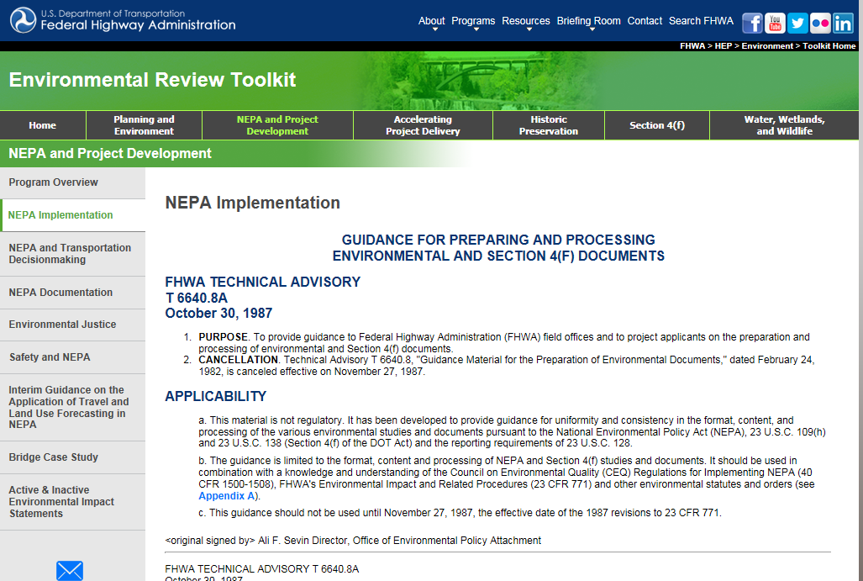
What resources are available to me?
FHWA Technical Advisory TA T 6640.8A (1987)”
www.environment.fhwa.dot.gov/projdev/impta6640.asp
Notes:
The FHWA Technical Advisory also contains information on crafting a purpose and need.

Slide 7
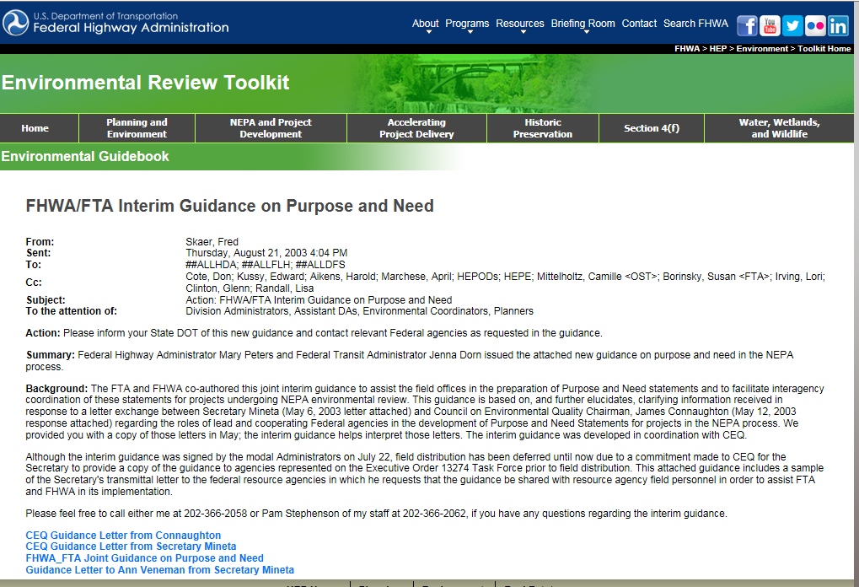
What resources are available to me?
“FHWA/FTA Interim Guidance on Purpose and Need (2003)”
www.environment.fhwa.dot.gov/guidebook/Ginterim.asp
Notes:
We also have Interim Guidance on Purpose and Need.

Slide 8
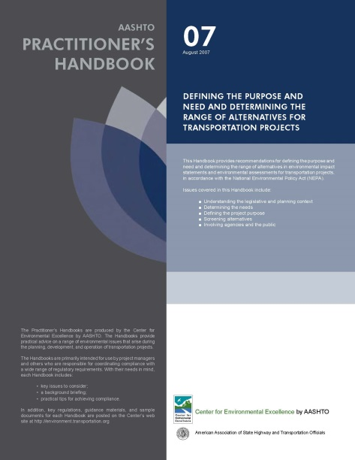
What resources are available to me?
AASHTO Practitioner’s Handbook #7 “Defining the Purpose and Need and Determining the Range of Alternatives for Transportation Projects” (August 2007)
environment.transportation.org/center/products_programs/practitioners_handbooks.aspx
Notes:
AASHTO has a practitioner’s handbook on purpose and need.

Slide 9
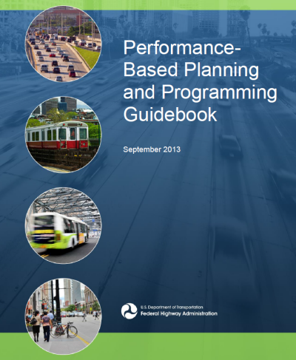
What resources are available to me?
FHWA “Performance-Based Planning and Programming Guidebook” (September 2013)
fhwa.dot.gov/planning/performance_based_planning/pbpp_guidebook/
Notes:
FHWA’s performance-based planning and programming guidebook is useful for the planning folks who originate a lot of the projects that get into NEPA.

Slide 10

What resources are available to me?
AASHTO “Improving the Quality of Environmental Documents” (May 2006)
environment.transportation.org/pdf/hot_documents/IQED-1%20for%20CEE.pdf
Notes:
This document from 2006 is still relevant for information on crafting quality environmental documents, which purpose and need is an important part of.

Slide 11

What resources are available to me?
“Federal Plain Language Guidelines” (March 2011)
plainlanguage.gov/howto/guidelines/FederalPLGuidelines/index.cfm
Notes:
The plain language guidelines can be a useful tool as you write purpose and need statements as well as other parts of an environmental document.

Slide 12
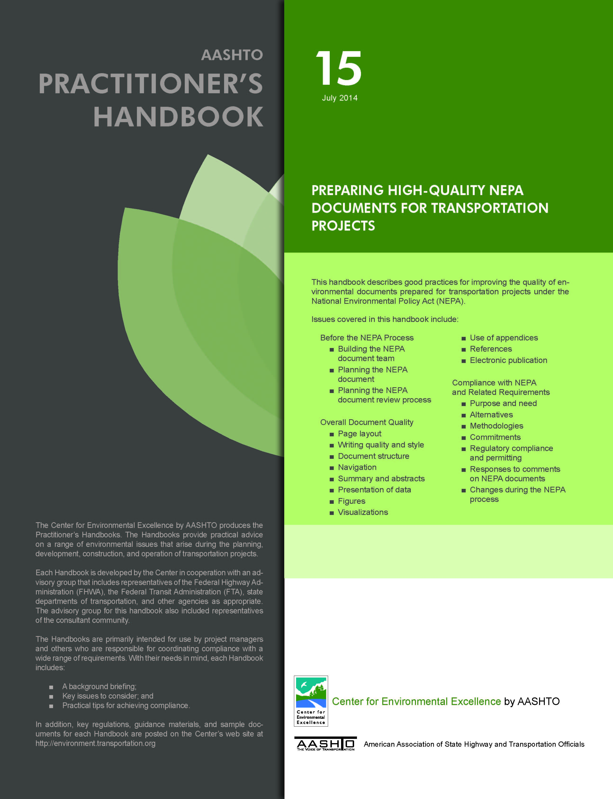
What resources are available to me?
AASHTO Practitioner’s Handbook #15 “Preparing High Quality NEPA Document for Transportation Projects” (July 2014)
environment.transportation.org/center/products_programs/practitioners_handbooks.aspx
Notes:
This is a recent publication on preparing high quality NEPA documents.

Slide 13

What resources are available to me?
AASHTO “Examples of Effective Techniques for Improving the Quality of Environmental Documents” (2014)
environment.transportation.org/center/products_programs/reports/quality_enviro_docs.aspx
Notes:
And here’s a companion document containing many examples of quality documents.

Slide 14
Where do I fit in?
Planning
NEPA
Design
ROW
CST
Ops. & Maint.
Public
&
Agencies
Notes:
All of you are somehow involved in the development and operation of your transportation system.
Planners (and asset managers) monitor the condition of your transportation system and identify underperforming facilities.
The NEPA folks then get involved to complete the environmental process.
Design can get engaged during NEPA but ultimately come up with design plans.
Right of way acquisition may be necessary for your projects.
Construction occurs.
Followed by our operating and maintaining the transportation system.
It then starts all over again.
The public and agencies may be interested in some or all of these parts.

Slide 15
Why Should I Care About This Stuff?
Planning
Project Development
Design
PrefAlt
P &/or N
P&N
Alts
Planners
Project Development
Designer
Public/Agencies
/FHWA
Key:
= my P&N responsibility
= my P&N interest
Notes:
Various parties have an interest in P&N, either directly (being involved in crafting or reviewing), or indirectly (P&N affecting later decisions during project development & design). Each of you today fits in somewhere on this chart.
Through the planning process, Planners initially identify the community’s transportation needs. Planners also are involved in identifying what type of performance is desired for their transportation system. This can be articulated as a P&N statement or it can be information that is later used by the Project Development folks to define or refine a P&N. Planners maintain an interest when a P&N is developed, alternatives are considered and a preferred alternative is selected, since they want to ensure that whatever solution is implemented is consistent with the initial problem they identified.
Project Development (NEPA) is directly responsible for crafting the P&N pursuant to NEPA. Project Development has an indirect interest in outputs from the Planning process, since these outputs form the foundation of P&N. After Project Development crafts P&N, P&N affects the rest of the project development responsibilities since the rest of project development is about identifying a solution that meets the purpose.
Design has an indirect interest in P&N, alternatives and preferred alternative. Since the design is based on the preceding (and sometimes concurrent) project development process, the design must still meet the purpose of the project.
Although The Public/Agencies/FHWA may or may not be directly involved in crafting a P&N, all have an indirect interest in P&N and the rest of project development through their various roles of providing input and (in the case of other federal permits and decisions) later approvals.

Slide 16
What’s my Opportunity?
Avoid or Minimize Conflict
More focused, meaningful projects
Notes:
So, WHY are we talking about how to identify and define Purposes and Needs better? A well defined problem – or Need and Purpose reduces and sometimes can avoid public or agency conflict about a project by clearly expressing what the point of a transportation proposed project is. While eliminating conflict is unlikely – we want to seek to reduce conflict… and reducing conflict can reduce the time it takes to resolve conflict thereby allowing an expedited delivery of a transportation project. A well defined Purpose and Need also provides opportunity to focus the number and extent of project development alternatives – again reducing project delivery time.

Slide 17
What are the P&N Basics?
Why
What
Who
When
How
Notes:
Before we get into specific P&N issues, let’s go over some of the basics of P&N. We’ll learn why you have to do this thing called “purpose & need”, talk about what these terms really mean, identify who’s involved in determining the purpose & need for a project, look at when purpose & need is developed, and then talk about how purpose & need is used.

Slide 18
Is P&N required for an EIS?
CEQ regulations (40 CFR 1502.13): “The statement shall briefly specify the underlying purpose and need to which the agency is responding in proposing the alternatives including the proposed action.”
FHWA Technical Advisory T 6640.8A : “Identify and describe the proposed action and the transportation problem(s) or other needs which it is intended to address...”
Notes:
So where do the terms “purpose and need” come from? As you see on the screen “purpose and need” is found in the CEQ (Council on Environmental Quality) regulations that implement NEPA. Specifically, “purpose and need” appears as a requirement for Environmental Impact Statements.
The Technical Advisory also mentions describing the problems or needs.

Slide 19
Is P&N required for an EA?
CEQ regulations (40 CFR 1508.9(b)): “Shall include brief discussions of the need for the proposal…”
FHWA Technical Advisory T 6640.8A : “Identify and describe the transportation or other needs which the proposed action is intended to satisfy”
So what about a CE?
Notes:
CEQ addresses EAs-Environmental Assessments by requiring a “brief discussion of the need for the proposal”. CEQ doesn’t really say anything about CEs—Categorical Exclusions, but Federal Highway’s Technical Advisory directs us to at least identify the needs.
So does this mean for EAs and CEs you don’t need to craft a purpose? I guess technically that’s correct, but there can be good reasons for still articulating the purpose of a project even for a CE.
We’ll talk about desired performance in a few minutes, but if you don’t know what success—the purpose—looks like for your project, then how will you know if you’re project is even needed? Furthermore, there are other laws and regulations that use purpose and need in the evaluation—think the Section 404 Least Environmentally Damaging Practicable Alternative—so if you don’t articulate the purpose of your project, it may be problematic later on during your analysis.

Slide 20
What is a “need”?
Some part of the transportation system is not performing as well as we’d like
Notes:
So what is a “need”? A need represents a problem. Some aspect of your transportation systems that’s not performing as well as you’d like. It might be a bridge that’s got a poor bridge deck condition. It might be a roadway that’s heavily congested or pavement that’s cracking.
Should you be able to tangibly describe the need? Sure. The better you can provide facts (and data) about the substandard performance, the easier it is to explain why you believe you’ve got a problem. Does the problem need to exist today? No. You’ve got long range planning efforts. You’ve got management systems for things like pavement and bridges and safety. Just because a problem doesn’t exist today doesn’t mean we have to wait for a problem before trying to solve it. So “no”, we can identify a future problem and address it today.
All of your projects require the expenditure of public funds. All of you projects have impacts to the environment. Doing a good job of identifying and documenting a problem helps us (and interested parties) to better understand the reason for proposing your project.

Slide 21
What is a “purpose”?
This is how we’d like the transportation facility to perform when we’re done with the project
Notes:
Let’s now talk about a “purpose”. We’ve already established that a “need” represents a problem or something that’s underperforming. The purpose then articulates the desired performance for whatever problem we want to address. So if you’ve got a poor bridge deck, the purpose will be something like “achieve a good condition for the bridge deck”. If you’ve got a safety problem, maybe the purpose could be something like “reduce fatal crashes” (but it depends on the actual safety problem). We’ll get into a lot more detail on examples but I just wanted to give a couple for now.
A purpose should be achievable. Think about one of your freeways. Folks want to go long distances in short times. In a perfect world, maybe what we really need is 5 lanes in each direction but is this something that can realistically be achieved? The point is, the purpose sets forth some level of improvement. Sometimes we can completely solve our problems but other times we can only hope for incremental progress.
A purpose should be unbiased. We should not craft the purpose in a way that results in only one way to solve a problem. Think about what we refer to as “bridge replacement projects”. We’re usually trying to remedy some aspect of the bridge that’s not working well (the problem). But what we sometimes do is say “the purpose of this project is to replace the bridge”. Well, when we write it this way, we’ve just precluded the rehabilitation option. A good purpose allows for a reasonable range of alternatives to solve the problem. Kind of like Goldilocks and the 3 bears—not too many alternatives, not too few, but just right.

Slide 22
Are all purposes equal?
To communicate the full range of factors considered in decision-making:
A primary purpose is a “driver” of the project (a fundamental reason for the project)
A secondary purpose (“other desirable outcome”) is desirable, but not a core purpose
Why might you want to differentiate?
Notes:
Sometimes you might have multiple purposes that you want to address, but some are more important than others. You have the ability to articulate which ones are critical, meaning the project won’t be considered successful if the purpose is not achieved. This would be a primary purpose.
There may be other purposes that are the “nice to have” kind. These are not critical to the success of the project but if you can make them happen, then that’s just icing on the cake. These are called secondary purposes or maybe called other desirable outcomes.

Slide 23
Who Develops P&N?
Responsibility = lead Federal agency
Pre-NEPA Assumption = FHWA
Post-NEPA Assumption = Alaska DOT
other?
Notes:
So who’s responsible for a P&N? It’s the lead federal agency. Now for the federal-aid highway program, FHWA has always been the lead federal agency. But with NEPA assumption, FHWA will be out of the picture and so Alaska DOT will be the lead agency for FHWA-funded projects.
So who’s the lead agency if FHWA funding is not involved? Depends on which federal agency has a decision. Maybe it’s the Corps of Engineers if you need a Clean Water Act permit but the project is state-funded.

Slide 24
When is P&N Crafted?
Planning
(Proposed Projects)
Collect P&N Data
Alternatives
Based on P&N
P&N In
NEPA Doc
Projects
Prioritized
Collect more P&N data
Finalize
P&N
Start of Environmental Review
Collect more P&N Data
Projects
Programmed
Planning
Project Development
Notes:
24
The development of a project Purpose and a project Need is an evolution. It begins early in the planning process when you start identifying performance problems in your transportation system. This data and analysis begins the formation of purpose and need.
As projects are identified, prioritized and eventually programmed on the transportation improvement program, chances are, additional information or data relative to needs and performance are being gathered by planners.
When project development starts, Project Development Engineers and Environmental staff should be reaching back into planning to understand what’s driving the project that’s now on our desk. Something led to a decision that a bridge needed to be fixed, a road needed widening, a sidewalk was needed somewhere. The project development and NEPA folks need to understand this. Otherwise, they’ll have to search for a problem that fits the project description—this is backwards.
So the project development and NEPA folks gather more data, or maybe (and hopefully) there’s enough data and analysis coming from the planning process that all the NEPA folks need to do is verify and/or update the information before finalizing the purpose and need.

Slide 25
Can I change my P&N?
Yes, but you’ll need to revisit subsequent analysis:
alternatives previously dismissed as not meeting the purpose may now meet
alternatives previously meeting the purpose may now not meet
additional coordination with the public & agencies may be necessary
Notes:
25
So can you change your P&N? Of course you can. But, if the P&N changes, you’ll have to make sure to review other decisions based on the old P&N to determine if anything changes.
Maybe you had dismissed an alternative as not meeting the purpose but now, with a revised purpose, that alternative now meets the new purpose of the project.
Conversely, alternatives that previously met the purpose may now not.
You may need to coordinate more with the public and agencies.
So there can be good reasons for you to change your purpose and need, you just might have to do some rework.

Slide 26
How is P&N used?
Avoid an ill-conceived project
Share understanding of the problems
Define a project’s scope
Guide development & evaluation of alternatives
Allow decisions to be legally defensible
Justify impacts and spending of funds
Influence compliance with other laws
Notes:
Let’s talk about a couple of uses for purpose and need. We’ve touched on a couple already.
[pick a few and ad-lib]

Slide 27
Questions?
“Always get married early in the morning. That way, if it doesn't work out, you haven't wasted a whole day”
--Mickey Rooney
“Always get P&N early in the process. That way, if it doesn't work out, you haven't wasted a couple of years”
--unknown
Notes:
We’ll stop for a moment and ask if any of you have questions before we move into the discussion on specific purpose and need issues.
Please type your questions into the chat pod. If we need further clarification from you, we’ll ask you to unmute your phone line.

Slide 28
Possible Needs/Purposes
Congestion
Safety
Facility Deficiencies
Access/ Mobility
System Linkage/ Connectivity
Land Use/ Economic Development/Vitality
Legislative Intent
Security
Environment/ Energy/ Quality of Life
Notes:
The list you see on the screen represents most of the purpose and need topics you may encounter with transportation projects. This list is not all-inclusive. There may be other issue that you’ll have to deal with that are out of the ordinary. That’s fine.
We’ll touch on the ones highlighted in yellow in this webinar.
Although we’ll talk about this later, it’s worth mentioning here that a proposed project can certainly address multiple problems and have multiple purposes.

Slide 29
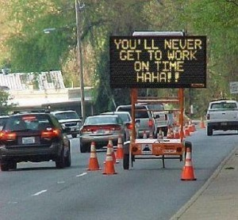
What about Congestion?
Notes:
Congestion is a common issue that you probably encounter.

Slide 30
What is Congestion?
TRB: “Travel time in excess of that normally incurred under light or free-flow conditions”
Wikipedia: “a state of excessive accumulation or overfilling or overcrowding”
Dictionary.com: “overcrowding, clogging”
Find a definition for your project! If you can’t define it, you won’t know if you’ve achieved it!
Notes:
There are many definitions for congestion. The important thing to remember is you need some way of measure congestion so that you’ll be able to document a problem and then evaluate whether or not proposed solutions would address the problem.

Slide 31
How do we measure Congestion?
Example Performance Measures:
Speed (peak hour/period)
Delay (peak hour/period)
LOS (peak hour/period)
V/C Ratio (peak hour/period)
VMT
Density/Headway
Signal Cycle Failure
Queue Length
Vehicle Hours of Travel
Notes:
On the screen, you’ll see a list of ways to measure the performance of transportation facilities. Some are better in certain circumstances than others, but if you’re involved in congestion issues, you’re probably using one or more of these already. Again, there’s no “right or wrong” on to use, per se. Often you use a performance measure that coincides with the analysis tool that’s available to you. Chances are, if you’re in a TMA and you have a Congestion Management plan, this stuff is already there.
It’s also OK for the planners to use one performance measure and the NEPA folks to use another. I guess it’s better if we’re all using the same performance measure but it’s not necessary. The important point is for you to choose some way to evaluate your level of congestion because if you don’t, how will you know if proposed solutions will really address your congestion problems?

Slide 32
Is there a Congestion need?
Example
“…traffic volumes increased - leading to poor levels of service (LOS) on major travel corridors in the County. The LOS for portions of…and side roads serving as access points currently operate at unacceptable levels today, and are anticipated to worsen through 2030. “
Notes:
Let’s look at an example from an unnamed state. In this case, we appear to have information that there is indeed a congestion problem. You see level of service used as a performance measure which is good. The text also states that the LOS is poor and we’ve got unacceptable levels today and in the future so obviously there’s a problem.

Slide 33
Is this better?
Example
“The CMP identifies a desired level of service D or better for all roads…traffic volumes increased - leading to poor levels of service (LOS E) on major travel corridors in the County. The LOS for portions of…and side roads serving as access points currently operate at unacceptable levels today (LOS E), and are anticipated to worsen through 2030 (to LOS F). “
Notes:
It’s not clear to me what the threshold is for determining when level of service goes from good to bad or from acceptable to unacceptable so let’s look at how this might have been clearer.
The first change at the beginning was to articulate the community’s desired performance. In this case, it’s LOS D or better. The rest of the changes simply clarify what we mean by “poor” and “unacceptable”. By making these simple changes, we know exactly what performance is desired, what performance is occurring (now and in the future) as well as identifying the obvious gap (or deficiency).

Slide 34
So what was the purpose?
Same Example
“…Improve Operational Efficiency of the existing transportation system;…“
Notes:
We’re still with the same project. In looking at the purpose, we want to “improve operational efficiency of the transportation system”.
As someone not familiar with the circumstances of the problem, it’s clear that we want some level of improvement so that’s good. I’d probably be curious to know if there a certain level of performance that we want—not just “any improvement”. When we use open-ended verbs like “improve” or “reduce” without specifying a target, it gets really difficult to eliminate alternatives that don’t meet this specific purpose. When you’re thinking about what performance you want, whether you’re in planning or in NEPA, consider whether there is a certain level of performance that would make your project a success.

Slide 35
Is this better?
Same Example
“…Improve Operational Efficiency of the existing transportation system;…Achieve LOS D or better on the intersection of Road X and Road Y“
Notes:
The proposed changes clarify a certain performance target (in this case LOS D or better) while also clarifying which transportation facility we want to address.
Now there’s no requirement to set a certain performance level. We could still have gone with simply “improving” rather than trying to achieve LOS D or better. The point is, during the Planning process, if decisions are being made based on achieving a certain level of performance, let’s make sure we understand that in NEPA so we’re correctly reflecting the desire of the community.
Regarding the other change, a bit more clarification would help understand exactly which part of the existing transportation system is the focus of this project.

Slide 36

What about Safety?
True or False?
Everything we do will make a facility safer.
Notes:
Safety is another issue that you most likely deal with. Read the statement and think for yourself what the correct answer should be.
The answer is “false”. Don’t assume that everything we might do will improve safety (beware of unintended consequences).
In some places we used “safety” too often and inappropriately. We used it to make the project seem more palatable, just like mom and apple pie. How could anyone argue with a project that was meant to improve safety? But over time, we’re trying to really focus safety problems on real safety needs and use “safety” in a more appropriate manner.

Slide 37

What’s the safety management process?
Network
Screening
Evaluation
Diagnosis
Prioritization
Select
Countermeasures
Economic
Appraisal
Notes:
The safety management process includes the six steps you see on the screen. We’ll talk briefly about the first two steps—network screening and diagnosis—as these help us with Purpose and Need, but there’s a lot more that you need to know about safety than we can cover in this class.
The Diagnosis step is highlighted because this critical step is most often not addressed. We’ll talk about this in a moment.

Slide 38
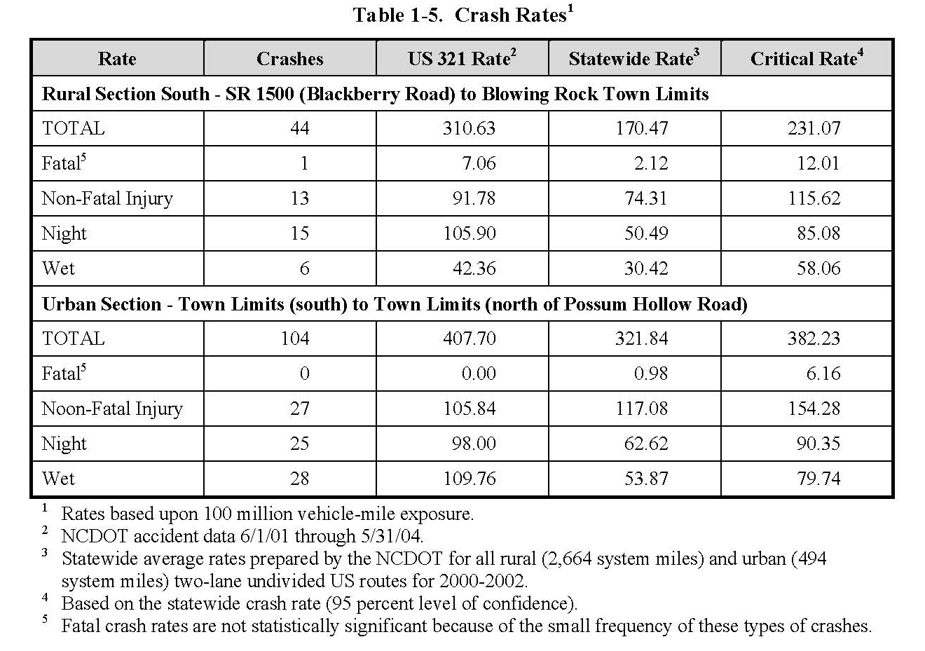
What is network screening?
Purpose is to identify sites which may respond to a countermeasure
Notes:
Network screening is the first step. The purpose of this is to identify sites which may respond to a countermeasure. I stress the word “may”, because this step is not certain enough to tell you whether you really have a problem or not. It’s just an indication.
Looking at the information on the screen, this is what we see a lot of in planning documents and even in environmental documents. You have the crash rate for the facility and a statewide rate for similar facilities. If the crash rate for the road is higher than the statewide average, we have a crash problem, right?

Slide 39
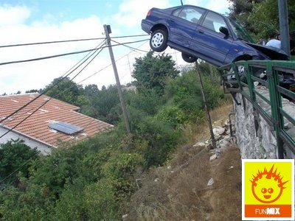
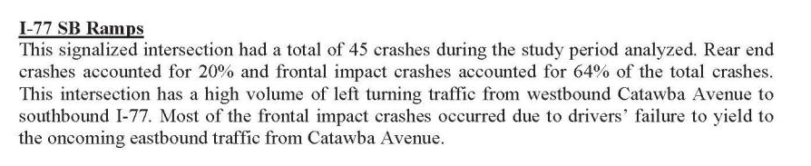
What is “diagnosis”?
Purpose is to identify causes of collisions, potential safety concerns/crash patterns
safety data review
assess supporting documentation
assess field conditions
Notes:
Wrong. The diagnosis step is where we confirm whether there is a crash problem or not.
This is the step where the safety engineers really figure out if there is a problem and exactly what it is.

Slide 40
How about an example?
Notes:
Here’s an example of the diagnosis step comparing crash rate to one of the diagnosis measurements called the critical crash rate. Look at the data in the green box. Just comparing the US 321 crash rate to the state rate suggests a problem. However, that’s just network screening. When proper analysis is performed and the US 321 rate is compared to the critical rate, the data shows there is not a problem.
This is the type of crash analysis you need to show there is a crash problem. If you don’t do this level of analysis, don’t use crash problems in your purpose and need.

Slide 41
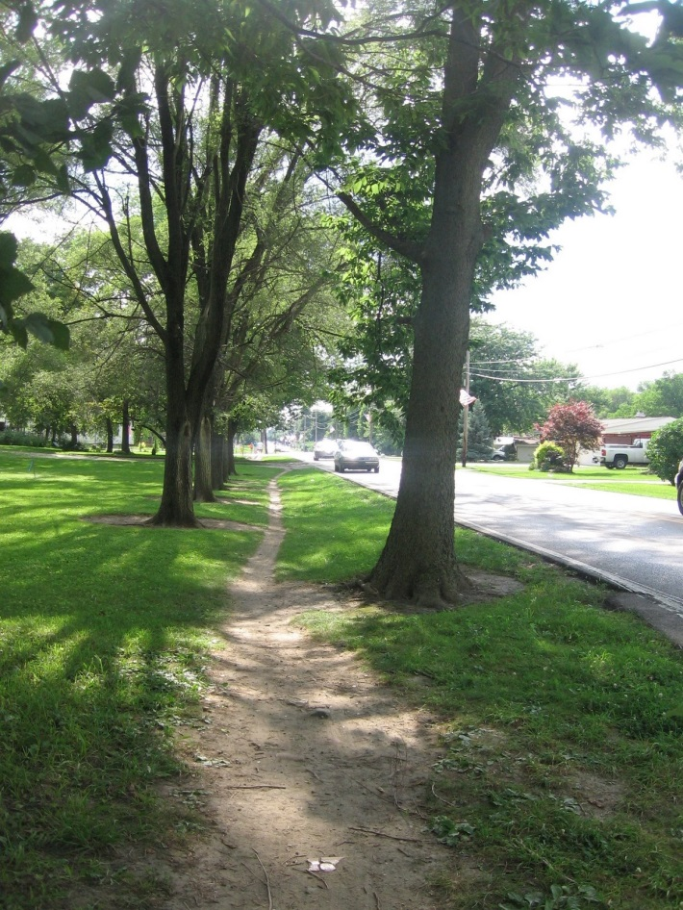
What if there isn’t a crash history?
Exposure is used to describe potential conflicts between users (e.g. trains v. vehicles, peds v. vehicles, vehicles v. vehicles)
For example, if pedestrians are walking along the side of the road (because there are no sidewalks), but there’s no evidence of pedestrians being hit, a community might want to reduce/eliminate the exposure of pedestrians to vehicles
Notes:
So what if there’s a perceived safety need but no crash history to support it? Exposure can be used to address potential safety problems.
It’s fine to acknowledge there’s not a history of crashes but that you want to make it safer. You can articulate this in terms of reducing the exposure of something (say a pedestrian) to another thing (say vehicles).

Slide 42
Is there a Safety need?
Example
“Currently there is a sight distance problem at the intersection with Fry Rd. “
Notes:
Here’s a safety example from a project. It’s apparent that we have a sight distance problem. Now, what I’d ask would be:
“OK we have a sight distance problem, but is it causing crashes?” I don’t know the answer. Maybe there’s data to support a crash problem somewhere, so the point is, if this is really a safety problem, perhaps if we articulate the problem in terms of crashes, we’d have a better rationale for doing something.
At first blush, I’d lean towards identifying the problem as “the road doesn’t meet current design standards due to inadequate sight distance”. So maybe this is really a facility deficiency rather than a safety problem. I don’t know, but the point is, maybe we’d be better off documenting a deficient facility that might increase the chance of crashes, rather than pitching this problem as a safety problem.

Slide 43
Is this better?
Example
“Currently there is a sight distance problem at the intersection with Fry Rd. A tight curve exists at MP. 21 and there have been numerous run-off-the-road crashes. Crash analysis shows a run-off-the-road crash rate of 87.2 and the critical crash rate is 50.1“
Notes:
At any rate, let’s assume it’s a safety problem.
I’ve added facts to better articulate the safety problem. We now focus on the type of crash while documenting a safety problem.

Slide 44
So what was the purpose?
Same Example
“This project will…alleviate accident problems associated with this intersection.”
Notes:
And now we find out the purpose: “alleviate accident problems associated with this intersection”. Let me now play devil’s advocate.
Are we really trying to alleviate all accident problems at this intersection or just those caused by a sight distance problem?
Are we really trying to alleviate (which means partially fix) any level of accident problems or are we trying to alleviate to a certain point, or even eliminate, accident problems.
Maybe I’m being too nitpicky on these, but I’m trying to make the point that the wording you choose to use has a bearing on what alternatives satisfy your purpose and need. If crafted without much though, a purpose and need statement could either result in no alternatives meeting your purpose or an inability to achieve the level of performance that you really wanted.

Slide 45
Is this better?
Same PennDOT Example
“This project will reduce run-off-the-road crashes…alleviate accident problems reduce associated with this intersection.”
Notes:
Now, we’ve better clarified what problem we’re trying to solve.

Slide 46
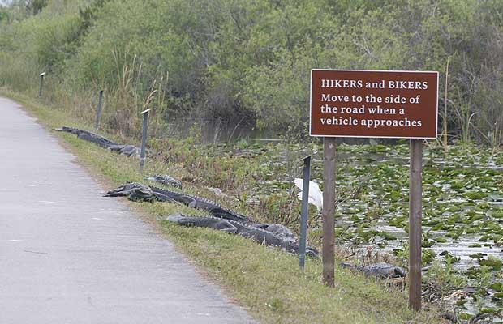
What about Facility Deficiencies?
Notes:
Facility Deficiencies is probably the most frequent issue that you encounter.
I really like this picture, I don’t recall where it is but when I lived in Florida, I often saw alligators on the side of the road.

Slide 47
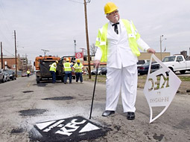
How do we define Facility Deficiencies?
Physical characteristics of a facility that are below the desired performance
Substandard geometrics
Load limits on structures
Inadequate cross-sections
High maintenance costs
Notes:
When you’re working with a project that’s addressing facility deficiencies, you really want to be able to define what makes the facility deficient.
This might include:
A one-lane road when your standards call for at least two lanes.
A “deficient bridge”; or maybe
The pipe under the road is undersized.

Slide 48
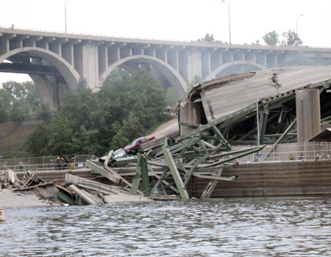
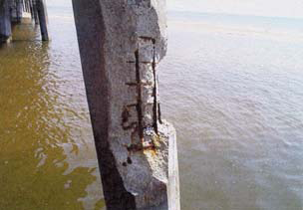
Where might we find performance information?
Pavement Management System
Bridge Management System
Maintenance Management System
Roadway Design Manuals and Guidelines
Structure Standards
Notes:
Assuming you think you do have some sort of facility deficiency, you’ll want to reference back to whatever adopted standards exist that support “here’s how we want our facility to perform”.
When you’re able to do this, you then have the information to articulate the desired performance. You then (hopefully) have documentation that the facility is underpeforming. From these two pieces of information, you can demonstrate that a gap in the performance exists and you’ve got your desired performance already articulated.
There are a number of sources within Pennsylvania that address desired performance levels for probably all of the transportation infrastructure. The point is, find an adopted performance standard and make sure you can document that a problem really exists.

Slide 49
Is there a Facility Deficiency need?
Example
“The bridge is Structurally Deficient, posted for a 3 Ton weight limit, and requires continual maintenance to remain open. The bridge was closed to all traffic for several months in 2006 due to the collapse of part of the masonry retaining wall and the severely deteriorated condition of the masonry arches. “
Notes:
So here we have a bridge issue. The data appears to show that it’s structurally deficient. The bridge folks certainly can provide data supporting the existing sufficiency rating and what the desired sufficiency rating is. This is a very good articulation of the problem.

Slide 50
So what was the purpose?
Same Example
“The purpose of this project is to provide a reliable crossing of the…Creek that provides for legal loads, is not structurally deficient or functionally obsolete…”
Notes:
And now we get to the purpose. “provide a reliable crossing that provides for legal loads and is not structurally deficient or functionally obsolete”. I really like this. Note the authors didn’t say “the purpose is to replace the bridge”. If they had, I would have had some heartburn because we don’t craft a purpose that specifies a particular solution. In this case, the performance has been articulated. It doesn’t preclude the rehabilitation option.

Slide 51
Questions?
“A goal without a plan is just a wish.”
--Antoine de Saint-Exupery
Notes:
We’ll stop for a moment and ask if any of you have questions before we move into the rest of the possible needs and possible purposes.
Please type your questions into the chat pod. If we need further clarification from you, we’ll ask you to unmute your phone line.

Slide 52

What about Legislative Intent?
Project-specific legislation does not necessarily determine the project purpose
Lead agency still must exercise judgment in NEPA when deciding if and how to incorporate legislative intent
Did the legislature exempt FHWA (now Alaska) from NEPA?
Notes:
Legislative Intent certainly can be something that you’ll have to deal with. We’re not getting as many Congressional earmarks these days as we did in the past, but I understand Alaska had a few in the past.
Just because Congress appropriated funds for a particular project description, it doesn’t necessarily mean the exact project description must be implemented. Remember, we still must go through the NEPA decision-making process. The only time a federal agency gets a “free pass” from NEPA is if Congress specifically exempts the federal agency from having to comply with NEPA.

Slide 53
What about Economic Development?
Notes:
Economic Development is an issue that you may need to address.

Slide 54
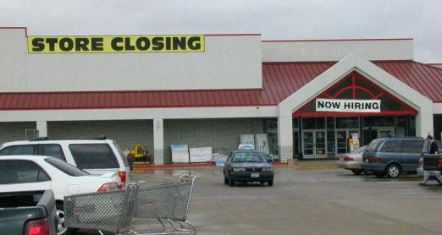
Is it just about transportation?
Public infrastructure (e.g. water, sewer, schools & transportation) and other considerations (e.g. tax rates, available workforce, available land and/or buildings, real estate values) collectively help determine how and where a community will grow and prosper economically
Notes:
Economic Development certainly is important to many communities. These communities compete for jobs and so having a good transportation system hopefully makes your communities more attractive for jobs. I want to caution you, however, when economic development is a driver of one of your projects.
There are lots of factors that influence economic success. Transportation is certainly one, but there are others that collectively influence economic success. Other infrastructure like water and sewer, taxes and school—all of these combine to influence economic competitiveness.

Slide 55
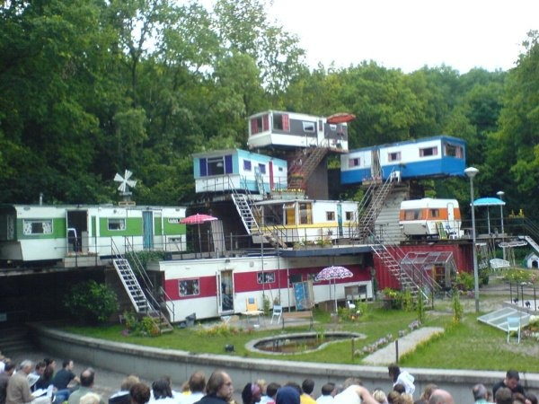
What’s the transportation connection?
P&N should focus on the underlying reasons based on meeting a transportation need
A desired outcome of a transportation project can be the facilitation of growth
Notes:
The thing you need to remember, as a transportation agency, is that you, and your projects, are only able to contribute to a piece of the economic competitiveness pie. Therefore, if economic development is an issue for your projects, you should identify economic needs from a transportation perspective and then frame any possible purpose from a transportation perspective. I’ll show you an example on the next slide.

Slide 56
Is there a transportation need?
Example
“By providing better access to the industrial park, the project will also discourage industrial traffic (including heavy truck traffic) from utilizing a section of …that traverses through an existing residential area. “
Notes:
Here we have an apparent access problem for vehicles trying to get to an industrial park but they’re going through a residential area. There’s more underlying data to support this need but this is OK as a problem.

Slide 57
Was it just about transportation?
Same example
“The purpose of the project is to promote growth and job creation in the…Business Park.”
Notes:
Look how the purpose was framed. Let me ask: if the purpose is to promote growth and job creation, what might our range of reasonable alternatives be? What if we lower taxes? What if we provide financial incentives to prospective businesses? What if we extend water and sewer to the business park? What if we improve the school system? Might not all of these promote growth and job creation in the business park? The point is, this purpose was probably crafted a bit too broad for what the DOT is able to do.
The next slide offers a suggestion for focusing on the underlying transportation problem.

Slide 58
Is this better?
Same example
“The purpose of the project is to promote growth and job creation in the…Business Park. By provideing better access to the industrial park the project will also and discourage industrial traffic (including heavy truck traffic) from utilizing a section of…that traverses through an existing residential area.”
Notes:
To frame the purpose from a transportation perspective, what if we modify it the way you see on the screen. Rather than focusing on job creation which has solutions far beyond just transportation, we’ve framed the purpose to relate to better access to the industrial park as well as getting through trucks out of a residential area. This way, we’re trying to achieve better performance from a transportation perspective.
Remember, the P&N can evolve through planning efforts and into NEPA. We don’t just articulate it once and never revisit it. As conditions change and new information becomes available, we must reassess our problems to make sure they still exist and determine if conditions have gotten better or worse. We also must reassess our purpose, making sure it’s still valid and specifying the correct level of performance.

Slide 59
So Which One(s) Do I Pick?
Understand project needs
Determine if there is a well-defined and well-supported need
Decide (for each potential purpose):
  include as a primary purpose;
  include as a secondary purpose; or
  do not include
Remember: there needs to be at least one primary purpose and all it takes to justify a project is one primary purpose
Notes:
To help you sift through possibly multiple needs and purposes, there’s a decision-making flow that you might find useful. First, you have to identify problems. Second, if you’ve got well-defined and well-documented problems, you then have a choice:
do you have to solve that problem in order for the project to be successful? If so, it would be a primary purpose.
Would you like to solve the problem, but if you can’t, that’s OK? If so, then articulate it as a secondary purpose.
Do you not want solve the problem with your project? If so, then leave it out. There’s nothing that requires you to solve all of your problems all at the same time. In fact, you only need one purpose in order to justify a project. You can have as many as you want, but you need at least one.

Slide 60
Questions?
“I am the Lorax, and I'll yell and I'll shout for the fine things on earth that are on their way out!”
--Dr. Seuss
Notes:
We’ll pause for questions now before we go into the last part of the webinar.
Please type your questions into the chat pod. If we need further clarification from you, we’ll ask you to unmute your phone line.

Slide 61
How do I craft a quality P&N?
Data &
Analysis
Presentation
Documentation
Coordination
Notes:
For our final part of the webinar, we’ll explore a framework for crafting a quality purpose and need.

Slide 62
What is “system performance?
Vision & Goals
(system performance)
Need
Identify
Gaps
I.D. Problems
To be fixed
Purpose
Desired
Facility Performance
Notes:
For the rest of the conversation on need and purpose, we’ll use a flowchart to show how your decision-making occurs.
The first step is understanding how your system is intended to perform. What we mean here is the Vision, Goals, Objectives, Performance Measures and/or Measures of Effectiveness (hereinafter referred to as “system performance”) that are typically developed early in the Planning Process. Whichever of these terms your plan uses, this is where you first look to establish how a community wants their transportation system to perform (for example “Maintain Level of Service “D” or better on all urban arterials”).
This is important because when you’re proposing a project, it’s always preferable to have your desired performance for that particular project founded in a Planning or Asset Management process that has been deemed acceptable. Otherwise, you might be placed in a position where you’re wanting to achieve some level of performance for a specific project that cannot be substantiated very well (or at all)—this could pose some problems when you get into the NEPA process.

Slide 63
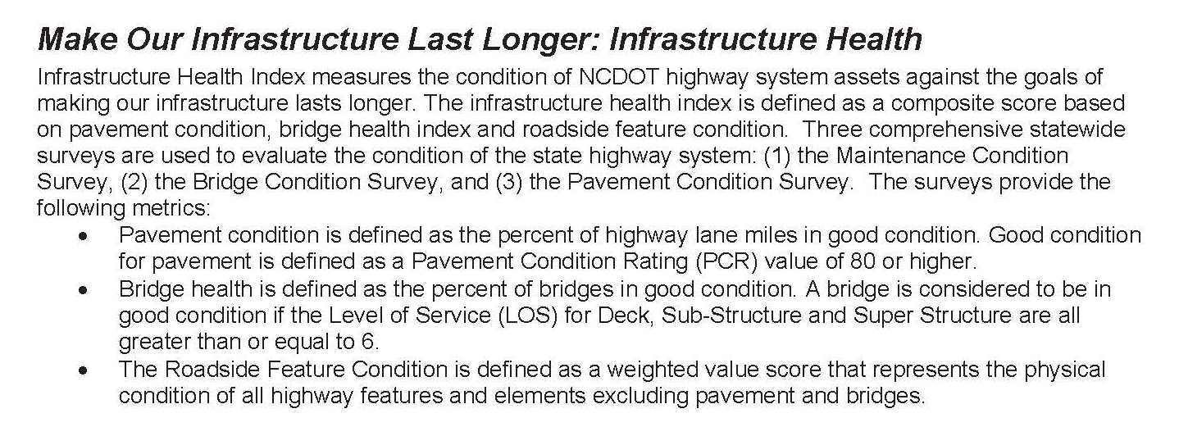
How do I do this?
A bridge is considered to be in good condition if the Level of Service (LOS) for Deck, Sub-Structure and Super Structure are all greater than or equal to 6.
Notes:
Here’s another example for identifying your system performance. Let’s use a bridge as an example. The condition rating is used to assess the bridge health. In the example on the screen, this particular state DOT has a standard indicating a desire to have bridges with “good” condition ratings, meaning a score of 6 or higher (out of 9).

Slide 64
What is Identify Gaps?
Vision & Goals
(system performance)
Need
Identify
Gaps
I.D. Problems
To be fixed
Purpose
Desired
Facility Performance
Notes:
Once you understand the desired system performance, then you determine how the system is actually performing. Portions of your system that are underperforming are identified by a gap analysis.

Slide 65
How do I do this (bridge example)?
Desired
System performance
“condition 6 or greater” (from DOT dashboard)
Actual
System performance
“Bridge #1234 has a condition rating of 3 for the Deck” (from bridge inspection report)
Gap?
Yes, since the deck condition is less than 6
Notes:
Continuing with the bridge example, we know the desired performance is a 6 or greater. From a bridge inspection report, we find out the deck has a rating of 3. Since 3 is less than 6, we have evidence of an underperforming facility. Pretty easy, right?

Slide 66
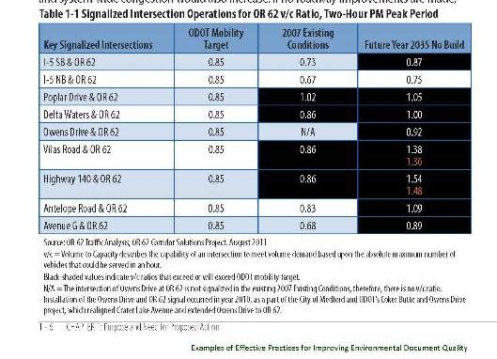
How do I do this?
Notes:
Here’s another example of a gap analysis. The system performance is represented by the ODOT Mobility Target column. Existing and future conditions were evaluated and the cells shaded in black were the portions that were underperforming.
Note the use of color to highlight the problem areas. It’s easier to read with the colors, as opposed to all cell values the same color and then the reader has to compare values to determine where the gaps occur.
66

Slide 67
What is Identify Problems to be fixed?
Vision & Goals
(system performance)
Need
Identify
Gaps
I.D. Problems
To be fixed
Purpose
Desired
Facility Performance
Notes:
After you’ve done your gap analysis, you may be faced with multiple deficiencies. Now you have to decide which problems you want to solve with your project.

Slide 68
How do I do this?
Range of problems
Problem(s) decided to address
Needs pedestrian facility (public)
Deck condition
(primary)
Needs lighting (safety unit)
Choose any (not necessarily all) for a particular proposed project
Pedestrian
(secondary)
Deck condition below standard
Notes:
In this example, let’s assume your transportation facility is a bridge and you’ve identified a lack of a pedestrian facility on the bridge, a need for lighting on the bridge for safety reasons and a poor bridge deck condition.
You can address one, two or three problems with a proposed project—there’s nothing that forces you to address all problems. So in this case, although there are three problems associated with this facility, we chose to address the deck condition as a primary purpose, the pedestrian issue as a secondary, and we’re deferring the safety problem for some reason.
So this is your opportunity to explain to the reader how you decided to solve various problems.

Slide 69
What is Desired Facility Performance?
Vision & Goals
(system performance)
Need
Identify
Gaps
I.D. Problems
To be fixed
Purpose
Desired
Facility Performance
Notes:
So by this point, you know what the desired system performance is, you know what the problems are, and you’ve decided which problem you want to address. The final part is to decide what performance you want for this project. This becomes the basis for your project purpose.

Slide 70
How do I do this (bridge example)?
Problem to address:
Overall system performance suggests 6 or greater, but for this particular facility:
Deck condition = 3
“Achieve a deck condition of 6 or greater”
Or
“Achieve a deck condition of 7 (or 8 or 9)”
Or
“Maintain the current deck condition”
Or ?
Notes:
We’re still with our bridge example. Although we know the desired system performance is 6 or greater, we have the ability to define successful performance for this particular bridge. Maybe a 6 is fine. Maybe we want something higher. Maybe we just want to preserve the current condition.
The point is, you need to decide what level of performance is desired for your project, given whatever constraints (such as funding or public opinion) exist for your project.

Slide 71
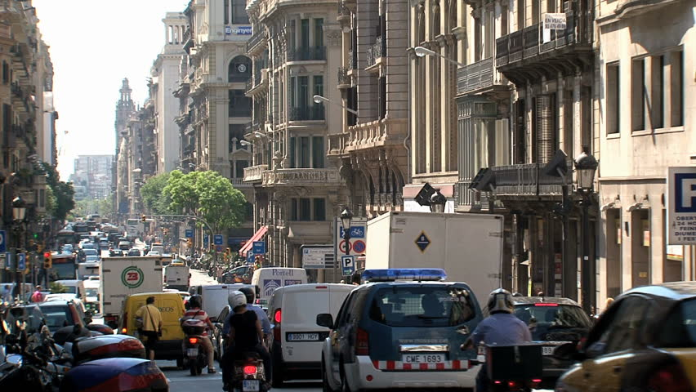
How do I do this (congestion example)?
What if the community desires LOS A for all roads?
Notes:
Here’s another example.
If the desired systemperformance was LOS A for all roads but the two-lane downtown main street was LOS F and they could only achieve LOS A by adding six lanes, would the really desire LOS A for this particular stretch of road or might they want something in-between?

Slide 72
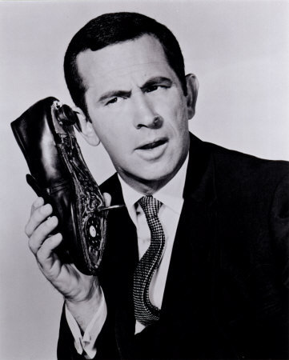
Should my purpose be SMART?
Specific
Measurable
Agreed
Realistic
Time-bound
Notes:
An effective tool for crafting your purpose is using the SMART template. A Specific, Measurable, Agreed-upon, Realistic and Timebound purpose facilitates your ability to determine whether an alternative meets your purpose.
A specific purpose is straightforward and clearly articulates what performance you want to achieve.
A measurable purpose allows you to better determine if/when an alternative is considered a success.
You are more likely to reach a decision on your project if stakeholders are comfortable with your P&N.
You are more likely to achieve success if you have a purpose that is realistic.
If you know when you want to achieve success, include a date.

Slide 73
Want a SMART template?
“Achieve a sufficiency rating >80 on Bridge #1234 by 2018”
[verb] + [measure of effectiveness] + [performance target] + [transportation facility] by [time]
“Achieve a LOS “C” on SR 1234 from A to B by 2040”
Notes:
Here are two examples incorporating SMART:
The “verb” describes the desired direction (up or down) of the measure of effectiveness. Examples of verbs are: increase, decrease, achieve, reduce.
The “measure of effectiveness” describes what metric will be used to track progress towards the performance target. Example measures of effectiveness are: fatalities, speed, injury rate, level of service, pavement condition.
The “performance target” describes what level of performance (based on the measure of effectiveness) is desired. If the measure of effectiveness is vehicle speed, then the performance target would be the desired speed. The performance target also must be achievable.
The “transportation facility” describes what type(s) of modal facility is the objective about. Examples are: sidewalks, greenways, roads, urban arterials, rural bridges.
The “time” describes when the objective is intended to be accomplished. It is usually the plan’s horizon year, although an objective could have an earlier desired time for accomplishing the objective.
When crafting your purpose, the order of these parts is flexible. What’s more important is that each part is contained in your purpose. For example, a purpose might be crafted as: “Achieve a Level of Service “C” on rural arterials in the County by 2040”. From the formula, the verb is “achieve”, the performance target is “C”, the measure of effectiveness is “Level of Service”, the transportation facility is “rural arterials in the County” and the time is “2040”.

Slide 74
What makes a Quality P&N?
Explain your decision-making
Use plain language to describe purposes and needs
Use bullets or numbering to itemize and prioritize purposes and needs
Provide specific supporting data for each need
Use graphics to illustrate needs
Describe agency and public involvement in developing the purpose and need
Notes:
Your Purpose and Need statement should clearly describe each of the needs and purposes as well as provide specific factual information that supports the existence of those needs and how you decided on your purposes. For practitioners, the challenge lies in translating this advice into practice. The following approaches can help:
• You should use plain language to describe needs and purposes. You should use words that most readers can easily understand. Jargon should be replaced with plain language. So rather than saying the “road is deficient”, consider saying “By today’s standards, the bridge is too narrow.” When jargon is used, it should be explained in the Need & Purpose chapter itself. A sidebar or text‐box is an effective way to introduce technical terms.
• You should use bullets or numbering to itemize needs and purposes. Some of your transportation projects could serve multiple purposes ‐ for example, to reduce congestion and improve safety. Attempting to capture all of the elements of the purpose in a single lengthy sentence may create confusion. If your project serves several distinct purposes, they can usually be expressed most clearly in a series of bullets, each corresponding to a different element of the purpose.
• Each of your project needs should be supported with data or other relevant information. In deciding what data to include, it is useful to consider each element of the need separately, and ask “Do we have the data to support this need?” For example, if safety is identified as a need, the Purpose and Need statement should include data demonstrating the existence of the safety problem.
• Figures, maps, renderings, and other visual elements should be used to illustrate important aspects of the Purpose and Need. For example, if the need is to address road congestion, a map could be included showing the locations where congestion will occur and, ideally, the severity of the congestion in those locations. If the need is to replace a structure at risk of catastrophic failure, a figure could be included showing the problems with the existing structure.
• You should describe agency and public involvement in developing the need and purpose. Under 23 USC 139, FHWA is required to give participating agencies and the public an “opportunity for involvement” in developing the purpose and need for an EIS. It is helpful to describe that outreach in the Purpose and Need chapter, including any major issues raised and how they were addressed.
Including this information not only helps you document compliance with a legal requirement, but also gives the public a better sense of the reasoning that led to adoption of your Purpose & Need.

Slide 75
Any Final Questions/Discussion?
“Creative minds have always been known to survive any kind of bad training”
--Anna Freud
Notes:
Rob Speaking:
We’re at the end of the webinar content so now’s your last chance to ask questions.

Slide 76
Later Questions/Feedback?
Rob Ayers, AICP
FHWA-Resource Center
Phone: 708.283.3509
E-mail: rob.ayers@dot.gov
Rod Vaughn
FHWA-Resource Center
Phone: 720.963.3238
E-mail: rodney.vaughn@dot.gov
Notes:
If you have any feedback on this webinar and want to reach us, our contact information is on the screen.
Thanks for your participation today.

