Slide 1
Alaska Department of
Transportation & Public Facilities
D&ES Statewide Materials
5800 E. Tudor Road
Anchorage, AK 99508-1286
March 17th, 2022
Mike San Angelo, P.E.
State Materials Engineer

Slide 2

What Do Materials Engineers Do?

Slide 3




  Federal Regulations
  Quality Assurance
  Program
  Statistical Methods
  Sampling & Testing
  Teamwork

Slide 4

The KEY to CONSTRUCTION
Construction
Materials
Notes:
A pavement is only as good as its weakest link.

Slide 5
STATEWIDE MATERIALS
Bridge Foundation Engineering
1
2
3
4
5
6
7
Pavement Engineering & Analysis
Construction Quality Assurance Program
Construction Specifications (Materials)
Alaska Test Method Manual
Materials Testing Training Program
Consultant Contract Inspection & Testing

Slide 6
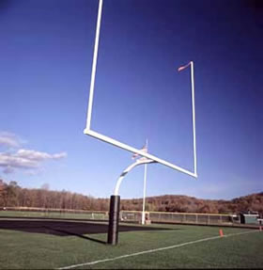
Two Goals
Quality
Durability
Performance
Specs
Testing
Inspection

Slide 7
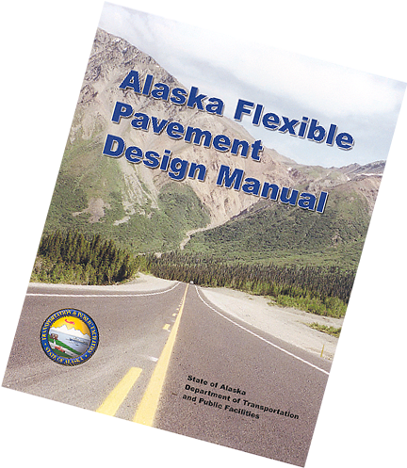
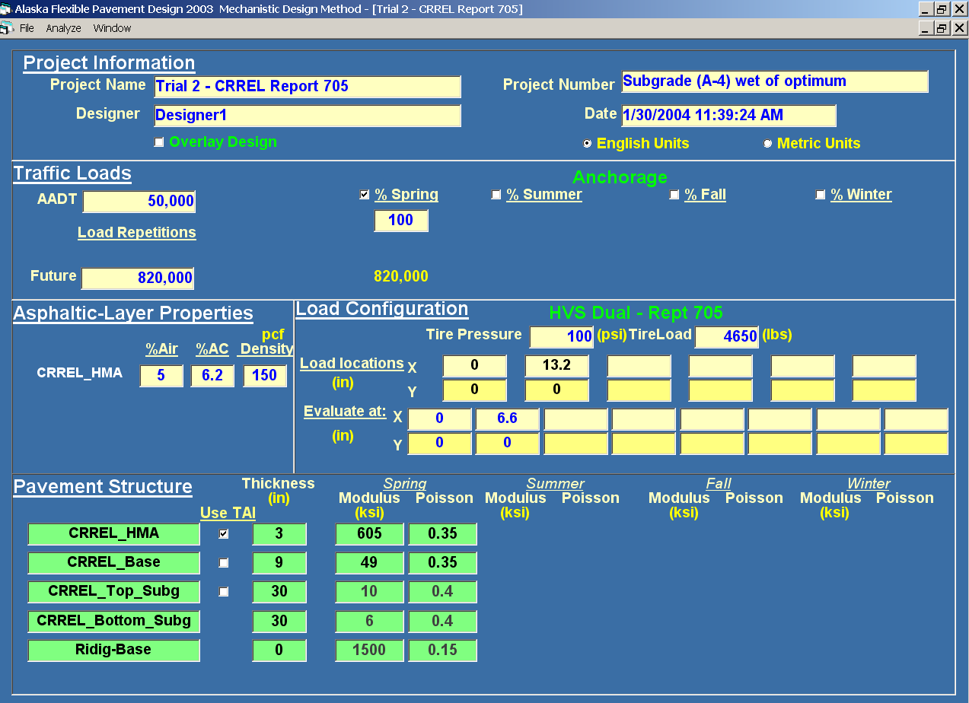
State Pavement Engineer
Integrity ∙ Excellence ∙ Respect

Slide 8
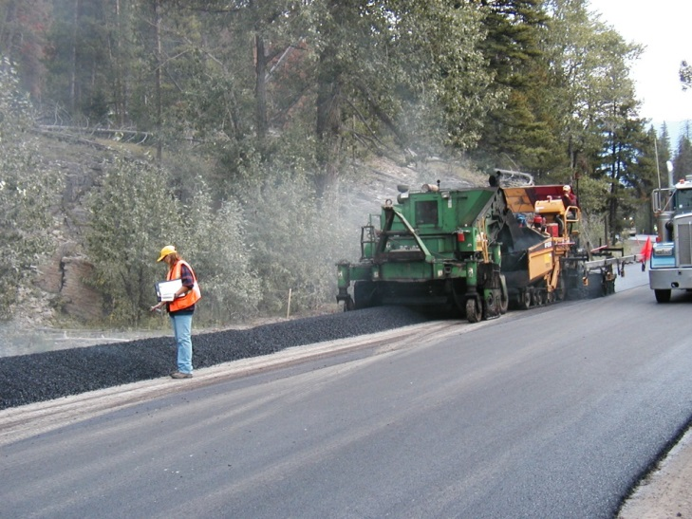
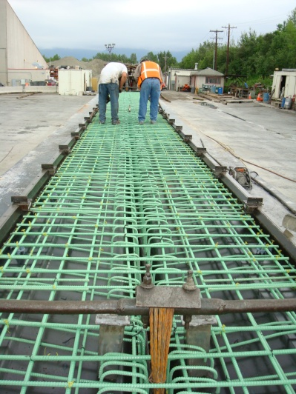
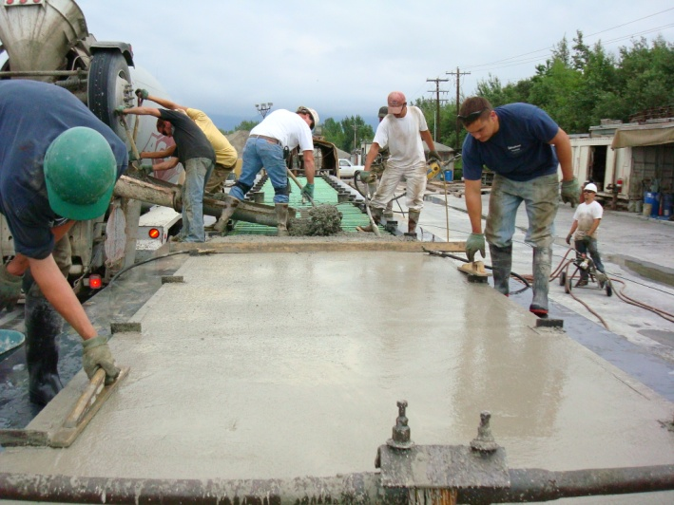
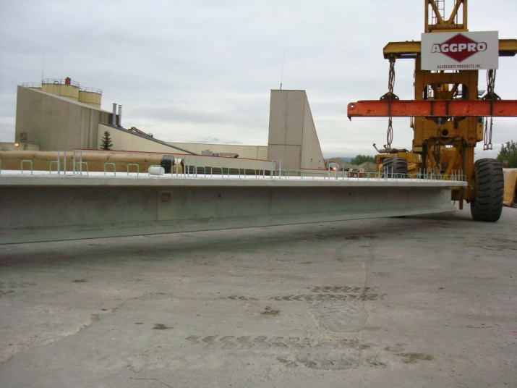
Special Inspection Term Agreements
Integrity ∙ Excellence ∙ Respect

Slide 9
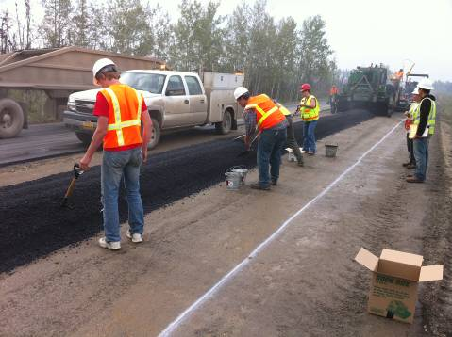
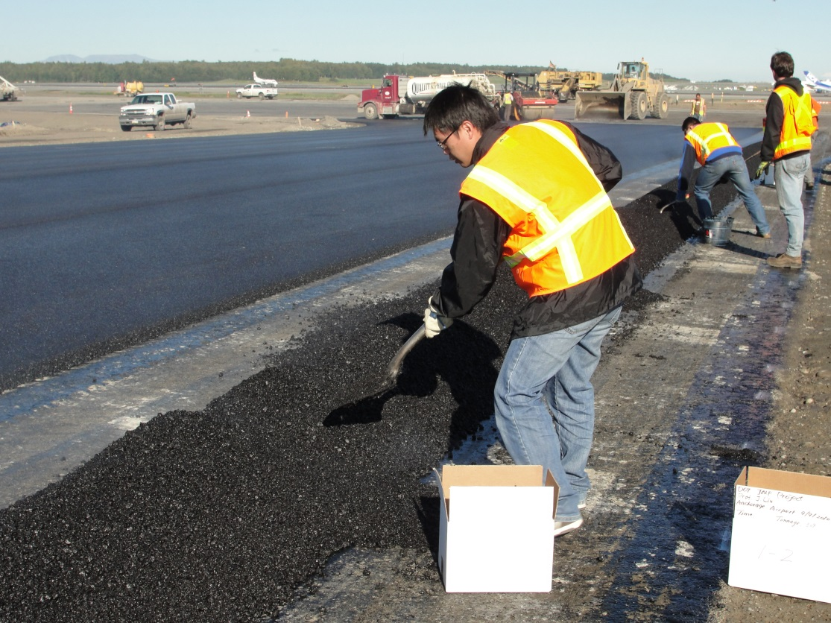
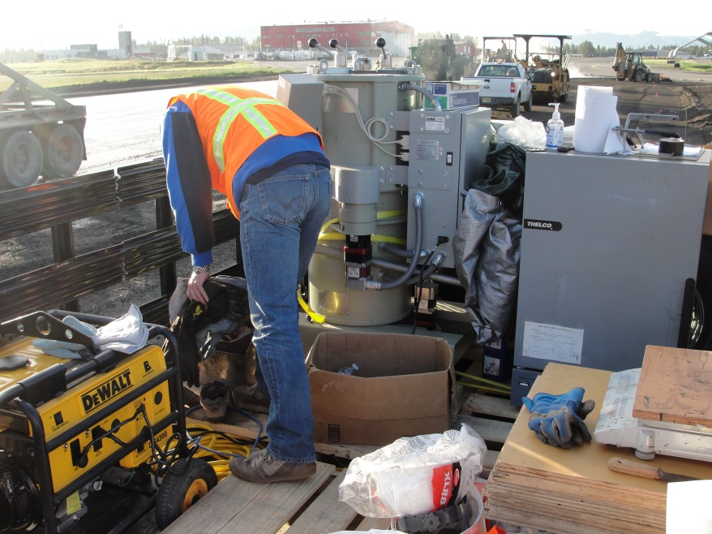
Anchorage International Airport
Nenana

Slide 10

Special Inspection Term Agreements
Welding and Coating Review & Inspections
Integrity ∙ Excellence ∙ Respect

Slide 11
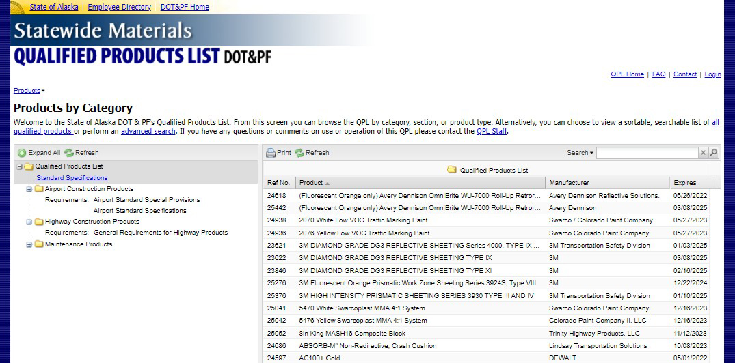
Qualified Products List
Integrity ∙ Excellence ∙ Respect

Slide 12
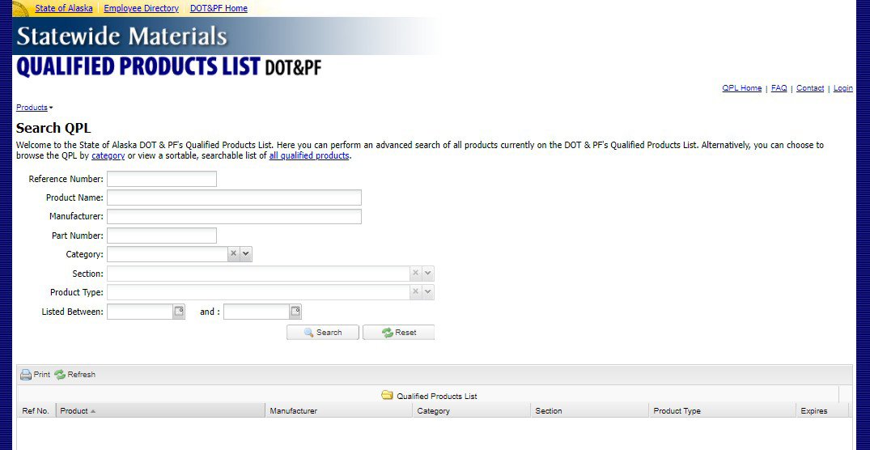
Qualified Products List
Integrity ∙ Excellence ∙ Respect

Slide 13
Questions?
Mike San Angelo, P.E.
State Materials Engineer
Desk 907-269-6234
michael.sanangelo@alaska.gov
Integrity ∙ Excellence ∙ Respect

