Slide 1
John Linnell, P.E. Central Region Deputy Director
March 15, 2022

Slide 2
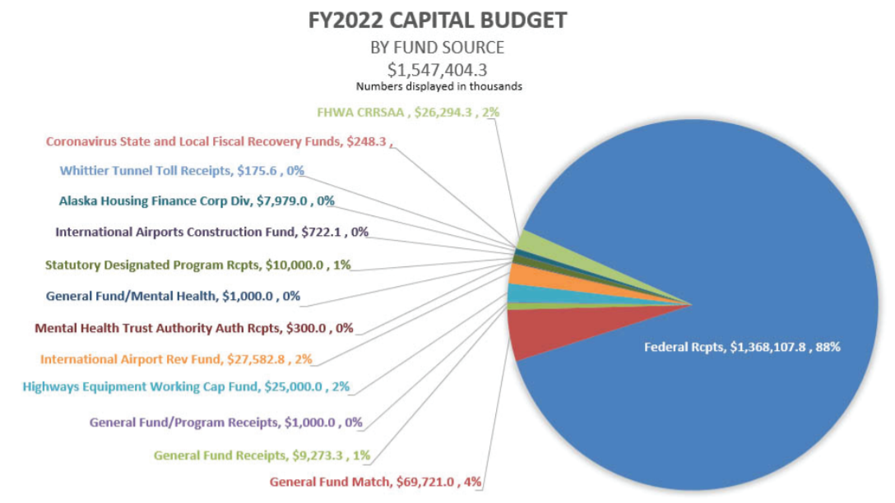
Statewide Capital Program

Slide 3
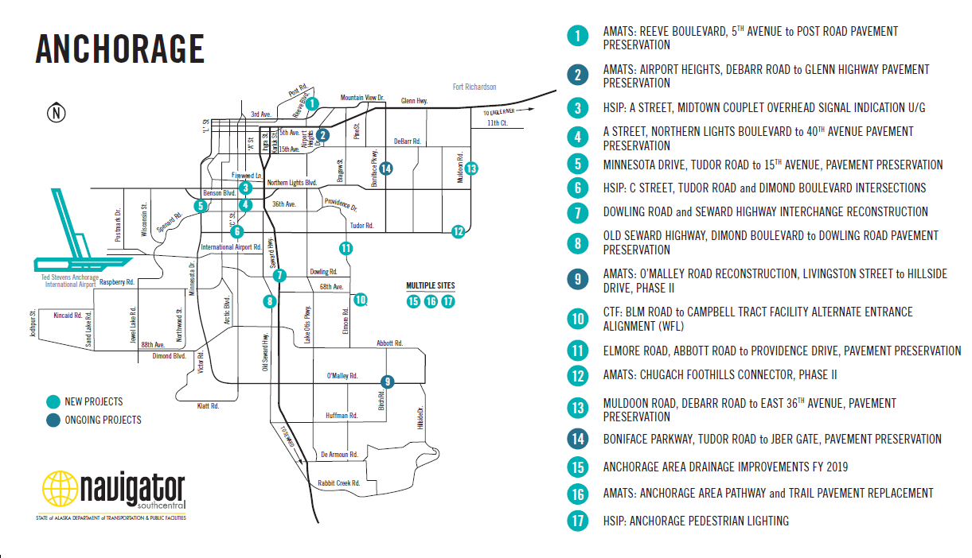
Central Region Construction Anchorage

Slide 4
Central Region Construction Kenai Peninsula

Slide 5
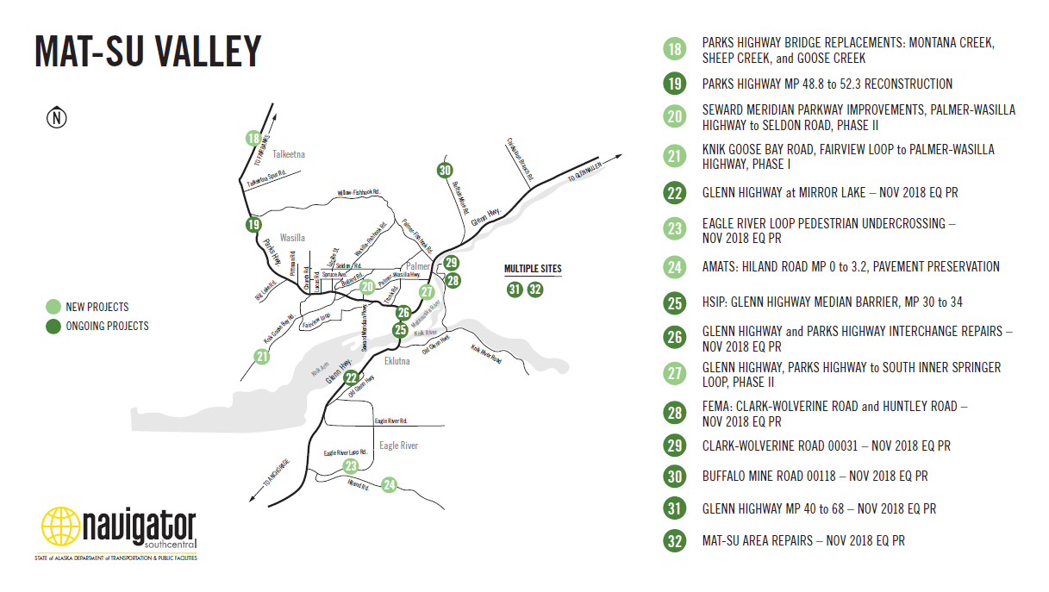
Central Region Construction Mat-Su Valley

