Slide 1

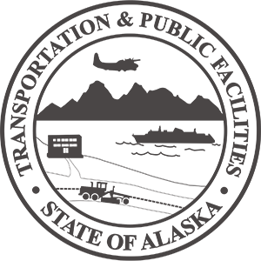
19TH ANNUAL DBE & SUBCONTRACTORS CONFERENCE
Presentation by
Carolyn Morehouse, PE Chief Engineer
March 15, 2022
Our mission is to Keep Alaska Moving through service and infrastructure.
2022

Slide 2

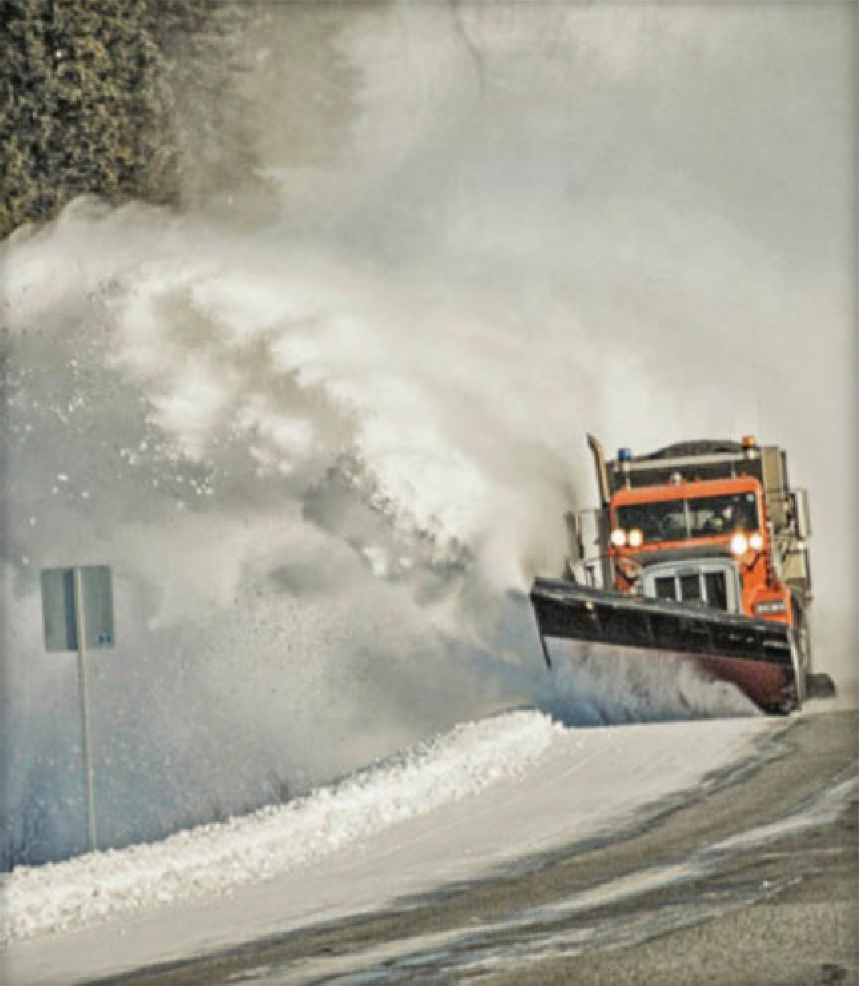
Alaska DOT&PF Infrastructure
5,638 center line miles / 11,756 lane miles of roads / highways
74 DOT&PF staffed Maintenance Stations 237 State Airports
2 International Airports
9 Active Ferries, 1 in long-term layup
33 Ports of Call
16 Harbors
839 DOT&PF owned bridges
3 DOT&PF owned tunnels
839 Public Facilities maintained, inclusive of 731 DOT&PF Owned Facilities
9 Weigh Stations
2.5-mile Anton Anderson Memorial Tunnel
Approx. $12.6B in transportation asset infrastructure
2

Slide 3
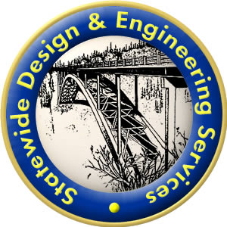
Chief Engineer’s office
Bridge Design & Standards - Rich Pratt PE
State Environmental Office - Douglas Kolwaite
Engineering Services - Michael San Angelo, PE
Administration & Information - Erik McCormick
Civil Rights Office - Rashad Joseph effective Jan 1, 2022
Consultation, Compliance & Statewide Policy/Guidance
2

Slide 4
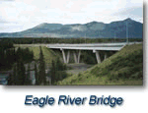
Bridge Design & Standards
Bridge Asset Management Team
Bridge Design Teams support inspections
Hydraulics Design & Policy Team
Standards Team – all manuals, guidance, standard specifications and standard plans
2

Slide 5
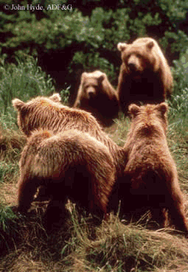
Statewide Environmental Office
National Environmental Policy Act NEPA FHWA
Historic & Culturally Significant Properties
“Section 106”
Stormwater Specialists
M&O support
2

Slide 6
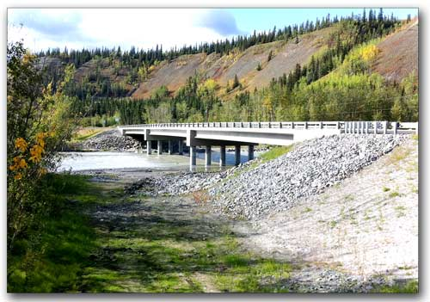
Engineering Services aka SW Materials
Construction QA – material inspections
Asset Management Pavement, Geotechnical and other assets
Research & Technology Transfer
Tribal Liaison
2

Slide 7

Administration & Information Services
Administration
Geospatial Engineering Services GIS/ITS
AASHTOWare Project
2

Slide 8
Civil Rights Office
Committed to equality in transportation service
Disadvantaged Business Enterprise (DBE) Program
Equal Employment Opportunity (EEO)
Limited English Proficiency
On the Job Training
Title VI and Environmental Justice
Tribal Liaison
Americans with Disabilities Act (ADA)
2

