Slide 1
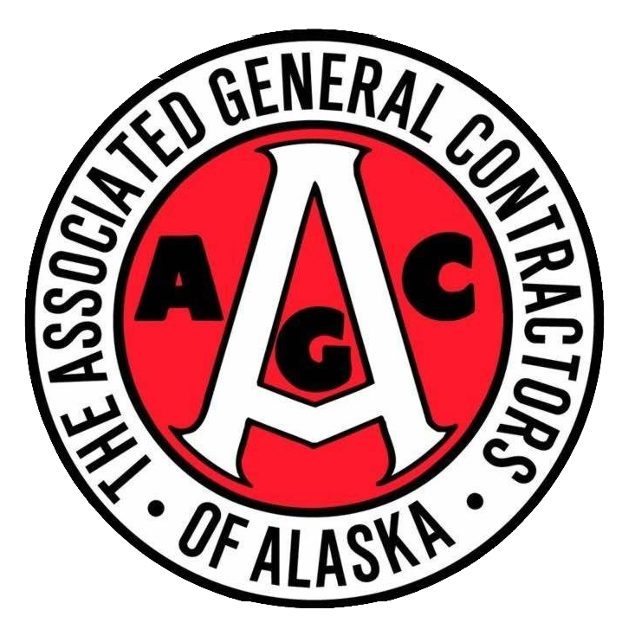
agc of Alaska member benefits

Slide 2
Organizational Structure
What We Do
Connect members w/ members
Connect members w/ jobs & resources
Advocate for constructive regulation, legislation and standards that promote a healthy business environment
Provide a voice for the industry
Workforce Development
Who We Are
Local branch of national organization
Over 600 members throughout Alaska: General + Specialty + Associates
Board of Directors + Executive Board AGC Staff
Notes:
We’ll do a quick refresher of our organizational structure here: AGC is the largest construction trade association in Alaska with more than 600 members throughout the state. Our membership is made up of general contractors, specialty contractors and associate members that represent the supply and service side of the industry. We have a 40-person, member comprised board of directors, headed by a 7-person executive board of directors. And The will of our board is carried out by our 6-person staff, five of which are here in the Anchorage office, and we have 1 located up in Fairbanks.
What we do? Everything we do is tethered to our mission of advocating, educating and promoting our members and Alaska’s construction industry.
→We host a variety of networking events and try to ensure there’s something that appeals to everyone. And really the underlying goal of all of our events is connecting our members and creating the opportunity members to start developing industry relationships to grow their business.
→We connect members with jobs through our Online Plans system, and being able to offer that as a free benefit of membership is a wildly attractive recruiting tool.
→On a direct level AGC promotes constructive regulation, legislation and standards that reflect the realities of our members that are out there doing the work. On a regular basis we are a meeting point for contractors/owner agencies/government agencies and everyone in-between. We act as a mediator, sometimes just as an information conduit, but we do our best to advocate for our members across the industry and for responsible dealings with the public. We try to keep our finger on the pulse of industry needs and ways we can encourage the industry to advance—and that’s where we really rely on you all our board to have open communication with us and keep us in the know of issues you’re facing, because it’s likely you’re not the only one experiencing that.
We like to think of ourselves as Problem Solvers→ And throughout the years, AGC has developed partnerships with just about every acronym based organization in Alaska. We’re talking, DOT, USACE, Alaska State Chamber, RDC. Partnering with these organizations have allowed us to collaborate on the issues facing our members and our combined advocacy efforts end up being a powerful force that provide us with the means to help our collective groups that we represent.
We understand that many of our members and our industry in general are facing a shortage of qualified workforce throughout the state, and AGC is very focused on workforce development and figuring out the best way for our organization to address that issue. Alicia covered the efforts from the Build Alaska social media campaign which is one way of promoting careers in our industry—and make sure to visit build907.com to start sharing those resources as well. We can move to the next slide

Slide 3
Did You Know?
All employees of member companies are considered members of AGC
Membership with AGC of Alaska includes free membership with AGC of America
Members of AGC receive free access to our Online Plans system
“AGC only supports union contractors”– FALSE!!
AGC of Alaska is celebrating our 73rd year as a chapter
DBE’s can have their AGC membership dues reimbursed by DBE/CRO team—limited availability, first-come first served. Getting you 50% off your membership with AGC!!
Notes:
→Not just the Owner or President or whoever signed up the membership initially—your entire team can take advantage of AGC’s myriad benefits platform, including access to your Online Plans account, member discount programs, networking events, committee participation—all things AGC related.
AGC of America, is largely considered the voice and choice of advocacy groups for the construction industry nationwide. Engagement opportunities through AGC of America range from business development seminars, national councils and forums, virtual and in-class trainings, a variety of national conference opportunities—all of which are offered at discounted rates to AGC members. To elaborate, we’re going to roll a quick video on AGC of America benefits.
All companies who join at the Associate Full, Specialty or General membership level receive free access to our Online Plans. AGC’s Online Plans offers our members up-to-date access to all of the RFPs/jobs that are out for bid throughout the state of Alaska, along with access to historical bid results. Our members are among first to know about new projects through daily email updates highlighting new jobs, project addenda and bid results. Membership with AGC covers the cost for unlimited users on a company’s online plans account, and AGC also offers on-demand user training for this service. We can also facilitate in-house or virtual trainings for individual companies on an as-needed basis, and once things are back to normal we’ll go back to hosting monthly trainings here at our AGC Anchorage office.
Many people think that AGC only supports union contractors, and that is one of the biggest myths that gets kicked around the industry, and it’s one you can easily help us dispel by promoting the fact that we support both union and Non-union contractors.
More than half of our member base have been members of AGC for more than 10 years consecutively, the longevity of which speaks to the power of our organization and what we’re able to accomplish as a collective voice for the industry.
Established in 1949, AGC is currently celebrating our 72nd year as a chapter here in Alaska.

Slide 4
AGC Member Benefits
Free access to AGC’s Online Plans system
Advocacy Efforts
Discounts on Education & Training
Networking Opportunities
AGC of America Membership
Access to Industry Updates/Information
Construction Spending Forecast
Room Rentals
Promotion in AGC’s Member Directory & Alaska Contractor Magazine
Free access to AGC’s Safety Database
401(k) Retirement Program
Use & Share our logo
Labor Relations Participation
Notes:
We’ll do a quick refresher of our organizational structure here: AGC is the largest construction trade association in Alaska with more than 600 members throughout the state. Our membership is made up of general contractors, specialty contractors and associate members that represent the supply and service side of the industry. We have a 40-person, member comprised board of directors, headed by a 7-person executive board of directors. And The will of our board is carried out by our 6-person staff, five of which are here in the Anchorage office, and we have 1 located up in Fairbanks.
What we do? Everything we do is tethered to our mission of advocating, educating and promoting our members and Alaska’s construction industry.
→We host a variety of networking events and try to ensure there’s something that appeals to everyone. And really the underlying goal of all of our events is connecting our members and creating the opportunity members to start developing industry relationships to grow their business.
→We connect members with jobs through our Online Plans system, and being able to offer that as a free benefit of membership is a wildly attractive recruiting tool.
→On a direct level AGC promotes constructive regulation, legislation and standards that reflect the realities of our members that are out there doing the work. On a regular basis we are a meeting point for contractors/owner agencies/government agencies and everyone in-between. We act as a mediator, sometimes just as an information conduit, but we do our best to advocate for our members across the industry and for responsible dealings with the public. We try to keep our finger on the pulse of industry needs and ways we can encourage the industry to advance—and that’s where we really rely on you all our board to have open communication with us and keep us in the know of issues you’re facing, because it’s likely you’re not the only one experiencing that.
We like to think of ourselves as Problem Solvers→ And throughout the years, AGC has developed partnerships with just about every acronym based organization in Alaska. We’re talking, DOT, USACE, Alaska State Chamber, RDC. Partnering with these organizations have allowed us to collaborate on the issues facing our members and our combined advocacy efforts end up being a powerful force that provide us with the means to help our collective groups that we represent.
We understand that many of our members and our industry in general are facing a shortage of qualified workforce throughout the state, and AGC is very focused on workforce development and figuring out the best way for our organization to address that issue. Alicia covered the efforts from the Build Alaska social media campaign which is one way of promoting careers in our industry—and make sure to visit build907.com to start sharing those resources as well. We can move to the next slide

Slide 5
Upcoming AGC Member Events
Rank Choice Voting Overview (Zoom- April 7) Spring Agency Day & Kick Off Party (April 14 & 15) AGC Member Mixer (April/May TBD) Anchorage Golf Tournament (June 17) Fairbanks Golf Tournament (July 15) Safety Fair (July 27) AGC Annual Conference (November 9-12)
Questions?
Clare Kreilkamp- clare@agcak.org, (907) 865-0544
Notes:
We’ll do a quick refresher of our organizational structure here: AGC is the largest construction trade association in Alaska with more than 600 members throughout the state. Our membership is made up of general contractors, specialty contractors and associate members that represent the supply and service side of the industry. We have a 40-person, member comprised board of directors, headed by a 7-person executive board of directors. And The will of our board is carried out by our 6-person staff, five of which are here in the Anchorage office, and we have 1 located up in Fairbanks.
What we do? Everything we do is tethered to our mission of advocating, educating and promoting our members and Alaska’s construction industry.
→We host a variety of networking events and try to ensure there’s something that appeals to everyone. And really the underlying goal of all of our events is connecting our members and creating the opportunity members to start developing industry relationships to grow their business.
→We connect members with jobs through our Online Plans system, and being able to offer that as a free benefit of membership is a wildly attractive recruiting tool.
→On a direct level AGC promotes constructive regulation, legislation and standards that reflect the realities of our members that are out there doing the work. On a regular basis we are a meeting point for contractors/owner agencies/government agencies and everyone in-between. We act as a mediator, sometimes just as an information conduit, but we do our best to advocate for our members across the industry and for responsible dealings with the public. We try to keep our finger on the pulse of industry needs and ways we can encourage the industry to advance—and that’s where we really rely on you all our board to have open communication with us and keep us in the know of issues you’re facing, because it’s likely you’re not the only one experiencing that.
We like to think of ourselves as Problem Solvers→ And throughout the years, AGC has developed partnerships with just about every acronym based organization in Alaska. We’re talking, DOT, USACE, Alaska State Chamber, RDC. Partnering with these organizations have allowed us to collaborate on the issues facing our members and our combined advocacy efforts end up being a powerful force that provide us with the means to help our collective groups that we represent.
We understand that many of our members and our industry in general are facing a shortage of qualified workforce throughout the state, and AGC is very focused on workforce development and figuring out the best way for our organization to address that issue. Alicia covered the efforts from the Build Alaska social media campaign which is one way of promoting careers in our industry—and make sure to visit build907.com to start sharing those resources as well. We can move to the next slide

