Slide 1
Lake Hood User’s Group Meeting
October 30, 2014

Slide 2
Welcome
Local Associations
FAA
ANC
&
Lake Hood Family
Special thanks to the Alaska Aviation Museum

Slide 3
Agenda
Welcome
Lake Hood Updates
Summer Recap
Construction Update/Forecast
Winter Prep
Agency Updates
Comments/Questions
________________________________________________

Slide 4
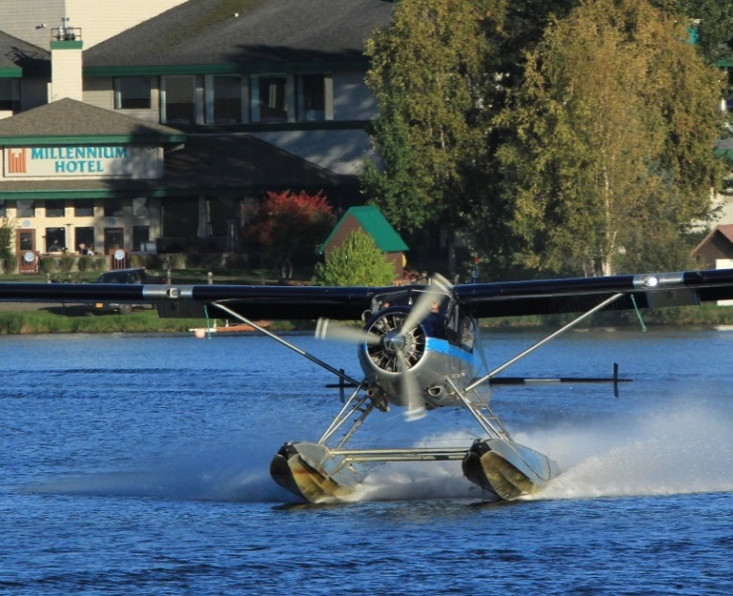
Lake Hood Summer Recap Total Lake & Strip Aircraft “Operations” (i.e. Take-offs/Landings)
FY 2014 | LHD Operations
October | 3,857
November | 1,534
December | 901
January | 1,184
February | 2,246
March | 4,888
April | 4,378
May | 7,920
June | 11,376
July | 12,329
August | 12,693
September | 8,705
TOTAL | 72,011
FY 2013 | 64,875

Slide 5
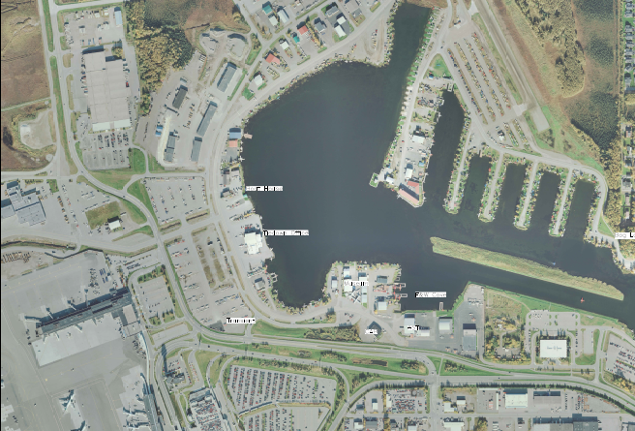
Bravo
Summer 2015 Alpha/Bravo Rehab
Repave
Add Electrical
Update Lighting
Update Layout (Alpha)
Temp
Alpha

Slide 6
Bravo
Ramp
Taxiway “Victor”
Temporary GA Ramp
Alpha
Ramp

Slide 7
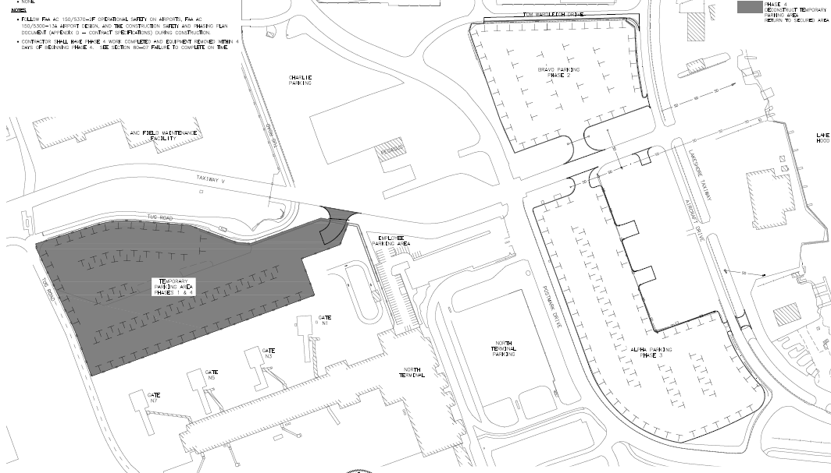
Alpha & Bravo Rehab
Bravo
Parking
TWY “Lakeshore”
TWY “V”
Temp
Parking
Alpha
Parking

Slide 8
Winter Prep
Winter Parking
Slips / Tiedown Ramp Areas
Ski Parking
Tiedown Anchor Checks
Snow Plan

Slide 9
Lake Hood Update
Airport Agencies/Departments
Field Mx
Environmental
Operations
Security Manager
Wildlife Control
Airport Fire & Police

Slide 10
Comments/Questions?

Slide 13
Contact Us
Lake Hood Manager - Tim Coons
(907) 266-2741
tim.coons@alaska.gov
Tie Down Specialist – Cheryl McDowell
(907) 266-2410
cheryl.mcdowell@alaska.gov
Office E-mail: DOT.AIA.LHD.Office@alaska.gov
Website: http://www.dot.state.ak.us/anc/business/generalAviation/

